Slide 1
A Review of Machine Learning Algorithms for Text-Documents Classification
Aurangzeb Khan, Baharum Baharudin, Lam Hong Lee*, Khairullah khanFEBRUARY 2010
Moran Abitbul
Tair Farangi

Slide 2
Outline
Machine Learning
Definitions
Text Mining
Learning Algorithm
Text mining for market prediction
Conclusions

Slide 3
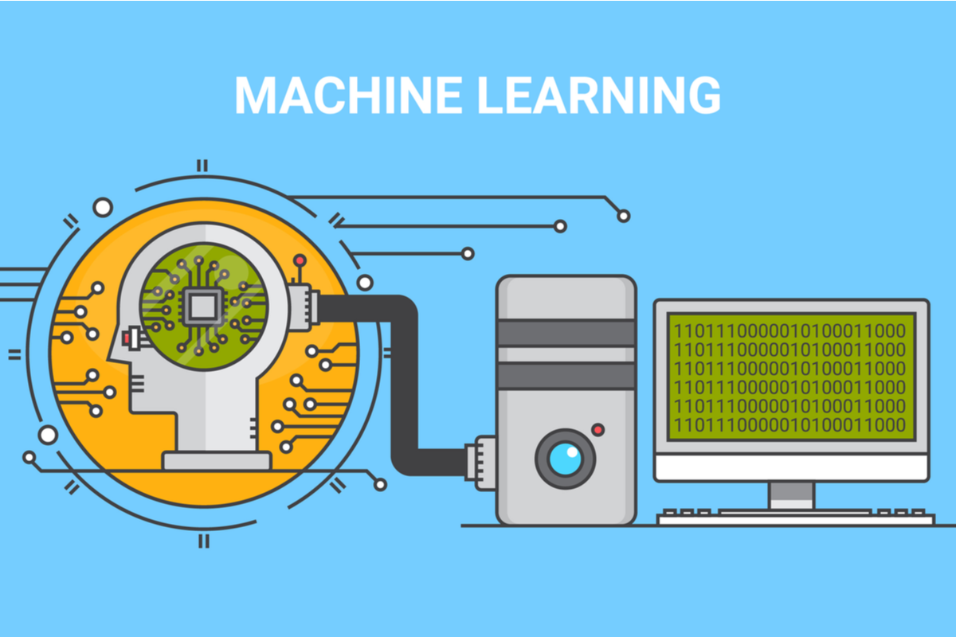
Definitions
•Machine Learning:
◦Allow the computer to learn from examples. ◦ Runs on a variety of computational tasks where classic programming is not possible.
•Supervised Learning. • Unsupervised Learning. • Reinforcement Learning.

Slide 4
Definitions
•Data Set: ◦ Data For Learning, Examples - with or without “results”.
•Occam’s Razor: ◦ prefer a simple model if possible.

Slide 5
Outline
Machine Learning
Text Mining
Learning Algorithm
Text mining for market prediction
Conclusions

Slide 6
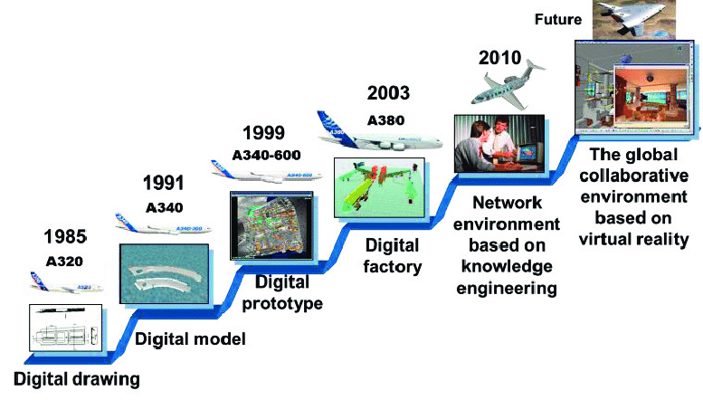
Text Mining
•Technology development.
•Documents go digital: ◦ Need to search for information digitally.
•Strong field, a lot of money, very popular.

Slide 7
Definitions
•Generalize to new examples: ◦ The ability of the model to properly adapt to previously unseen data.
•Dimensionality Reduction: ◦ Data from a high-dimensional space into a low-dimensional.
•NLP – Natural Language Processing.

