Slide 1

text
Solve the problem
text2
Text3
What is the fuking difffffffff
Now 2 new line
tab
Try to new line new line
Copy shape:
Try to new line new line

Slide 2
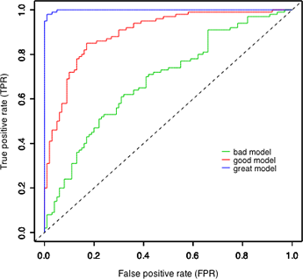

Machine Learning Lesson 9b - Error Analysis
Dr. Ami Hauptman
amih@mail.sapir.ac.il

Slide 3
Learning Systems
Last time…
How to “debug” learning systems
Two major steps:
Diagnose the algorithm
Solve the problem
Today:
Part 1: Control Classifier Output
Part 2: unsupervised learning
Notes:
תשתית, פלטפורמה,

Slide 4
Learning Systems
Last time…
How to “debug” learning systems
Two major steps:
Diagnose the algorithm
Solve the problem
Today:
Part 1: Control Classifier Output
Part 2: unsupervised learning
Notes:
תשתית, פלטפורמה,

Slide 5
Learning Systems
Last time…
How to “debug” learning systems
Two major steps:
Diagnose the algorithm
Solve the problem
Today:
Part 1: Control Classifier Output
Part 2: unsupervised learning
try:
Diagnose the algorithm
Solve the problem
e.g. high bias
e.g. get
More features
especially for
“skewed” classes
Notes:
תשתית, פלטפורמה,

Slide 6
Example
Say we want to identify cyber attacks
We train logistic regression
Got 1% error on test set
Reality:
Only 0.5% of internet traffic is attacks
Here’s a better algorithm with 1 line of code:
Always predict 0 !!
Many
cyber “experts”
Very few
are real
“impressive”
Better results
Notes:
תשתית, פלטפורמה,

Slide 7
What happened here?
This is called the Skewed classes problem:
Negative to Positive ratio is large
Usually, one class has very few examples
This occurs when
We try to predict something rare
Usually Accuracy is reported
This is not always enough!
We need a different evaluation mertic
e.g. 1 to 1000
class probabilities
are very important
% corect
Notes:
תשתית, פלטפורמה,

Slide 8
4 Types of outcomes
This table
is very important!
Positive \ Negative– what we said
True \ False – were we right or wrong?
analyzing
row\column
has its benefits…
Confusion Matrix:
 | Actual Class
Prediction | Real Attack | Real non-attack
“cyber attack” | True Positive | False Positive
“no attack” | False Negative | True Negative
False Alarm
Type I error
4 quantities
Missed (attack)
Type II error
Notes:
תשתית, פלטפורמה,

Slide 9
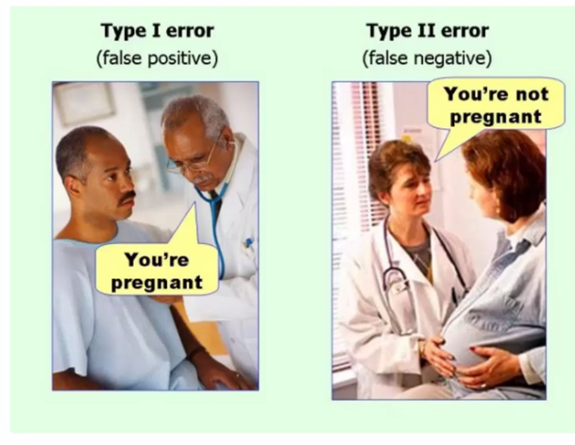
2 Types of error
False Positive
Missed
False Alarm
False Negative
Notes:
תשתית, פלטפורמה,

Slide 10
Question
Say we are trying to predict spam email.
For 2 specific emails, of which the first was really spam and the second was not, we predicted “spam”. Select the correct terminology for the 2 predictions:
False Alarm, True Positive
True Positive, False Positive
True Positive, True Negative
True Positive, False Negative
Also: false alarm
Notes:
תשתית, פלטפורמה,

Slide 11

New Metrics: Precision
How to get
close to
100% precision?
Precision:
How many were predicted correctly
… Out of all predicted attacks ($h_{θ}=1$)?
Precision calculation:
True Positives / Predicted Positives =
TP/(TP+FP)
Also called:
“TP Predictive value”
Only very
few “yes”
How to compute?
e.g. very
difficult
test
Top row
 | Actual Class
Prediction | Real Attack | Real non-attack
“cyber attack” | True Positive | False Positive
“no attack” | False Negative | True Negative
Notes:
תשתית, פלטפורמה,

Slide 12

New Metrics[2]: Recall
Precision & Recall
complete each other:
Both are important
Recall:
Out of all real attacks ($y=1$)…
…how many were detected correctly?
Recall calculation:
True Positives / False Negative=
TP/(TP+FN)
Also called:
Sensitivity
True Positive Rate
Or: how many
of good applicants
did we not miss?
How to get
close to
100% recall?
Left Column
Always “yes”
 | Actual Class
Prediction | Real Attack | Real non-attack
“cyber attack” | True Positive | False Positive
“no attack” | False Negative | True Negative
Notes:
תשתית, פלטפורמה,

Slide 13
Question
 | Actual Class
Prediction | 1 | 0
“1” | 80 | 20
“0” | 80 | 820
Precision: TP/(TP+FP)
Recall: TP/(TP+FN)
What is the precision in this case?
0.8
0.5
0.08
0.1
Minimum for precision
If we always say “yes”?
Work acceptance
Test…
Skewed: even 0%
Non-skewed:
50%
80% of accepted
are good candidates
Actual minimum:
0% if we answer
opposite to corrects
Notes:
תשתית, פלטפורמה,

Slide 14
Question [2]
 | Actual Class
Prediction | 1 | 0
“1” | 80 | 20
“0” | 80 | 820
Precision: TP/(TP+FP)
Recall: TP/(TP+FN)
What is the recall in this case?
0.8
0.5
0.08
0.1
Work acceptance
Test…
50% of
“good” candidates
were accepted
Notes:
תשתית, פלטפורמה,

Slide 15
Question [3]
 | Actual Class
Prediction | 1 | 0
“1” | 80 | 20
“0” | 80 | 820
Precision: TP/(TP+FP)
Recall: TP/(TP+FN)
What is the probability for class 1?
0.1
0.16
0.19
0.2
Work acceptance
Test…
160/(160+840)
16% of all applicants
(in population)
are “good”
Notes:
תשתית, פלטפורמה,

Slide 16
Constant prediction
Algorithm always predicting 0:
Reminder:
Precision: TP/(TP+FP)
Recall: TP/(TP+FN)
Precision:
0/0 = undefined…
Recall:
0/160 = 0
 | Actual Class
Prediction | 1 | 0
“1” | 80 (TP) | 20 (FP)
“0” | 80 (FN) | 820 (TN)
Can get 100%
or 0% easily
with only 1
in numer\denom
Fluctuating…
 | Actual Class
Prediction | 1 | 0
“1” | 0 | 0
“0” | 160 | 840
Notes:
תשתית, פלטפורמה,

Slide 17
A third measure: Accuracy
Accuracy: percent correct
(All True) / (All Cases)
(TP+TN)/(TP+TN+FP+FN)
Algorithm always predicting 0:
840/1000 = 0.84
Looks pretty good…
But algorithm is bad !!
 | Actual Class
Prediction | 1 | 0
“1” | 0 | 0
“0” | 160 | 840
Can this happen
for non-skewed?
No : max would
be 50%
Notes:
תשתית, פלטפורמה,

Slide 18
Constant Prediction [2]
Algorithm always predicting 1:
Reminder:
Precision: TP/(TP+FP)
Recall: TP/(TP+FN)
Recall:
160/(160+0) = 1
Precision:
160/1000 = 0.16
 | Actual Class
Prediction | 1 | 0
“1” | 80 (TP) | 20 (FP)
“0” | 80 (FN) | 820 (TN)
Didn’t miss
anyone
 | Actual Class
Prediction | 1 | 0
“1” | 160 | 840
“0” | 0 | 0
Only 16% were
really positive
Notes:
תשתית, פלטפורמה,

Slide 19
More general case
Now algorithm cannot “cheat” easily
As we saw at the beginning
Always “0” ➔ bad recall
Always “1” ➔ bad precision
both are important!
Precision & Recall
are more important
Than Accuracy
Notes:
תשתית, פלטפורמה,

Slide 20

Comments:
 | Actual Class
Prediction | 1 | 0
“1” | 80 (TP) | 20 (FP)
“0” | 80 (FN) | 820 (TN)
Convention:
Define precision\recall:
Where y=1 is the rare class
Algorithms cannot “cheat”
even when we have rare classes
Only accuracy can easily be high
E.g. always say “no”
”Newbies”
sometimes
only measure
accuracy
Even I did
☺
Notes:
תשתית, פלטפורמה,

Slide 21
Controlling Precision & Recall
2 types of errors:
“1” && 0
“0” && 1
Sometimes errors have different costs
Which is worse?
False diagnosis or missing a diagnosis?
false “Cyber attack” or missed real cyber attack?
If we know the costs – we can adjust the classifier
False Positive
False Negative
This is strongly
dependent of
the problem!
what is the cost
for each decision?
Notes:
תשתית, פלטפורמה,

Slide 22
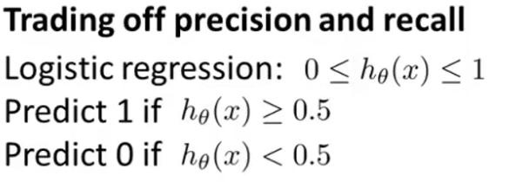
Controlling Logistic Regression
Suppose: cyber alarm is very expensive
only predict if very sure
How do we change predictions?
Change the threshold ➔ Change probabilities…
0.7, 0.9, …
Notes:
תשתית, פלטפורמה,

Slide 23
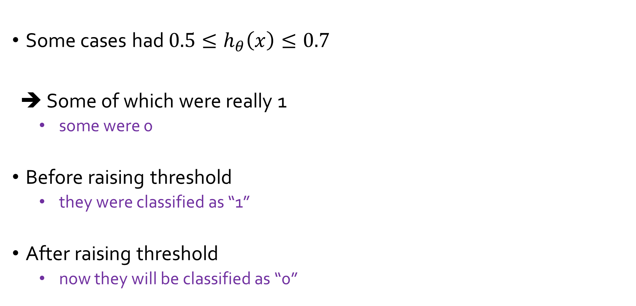
What will happen when raising the threshold?
Some cases had $0.5≤h_{θ}\left(x\right)≤0.7$
➔ Some of which were really 1
some were 0
Before raising threshold
they were classified as “1”
After raising threshold
now they will be classified as “0”
Cyber attacks
non-attacks
Notes:
תשתית, פלטפורמה,

Slide 24
Higher Threshold and Precision\Recall?
Assume the new threshold effected 20 cases
Precision:
80/100 ➔ 70/80
0.8 ➔ 0.875
Recall:
80/160 ➔ 70/160
0.5 ➔ 0.43
 | Actual Class
Prediction | 1 | 0
“1” | 80 (TP) | 20 (FP)
“0” | 80 (FN) | 820 (TN)
10 of each
class
20 moved
to bottom row
higher
precision
but not
always!
 | Actual Class
Prediction | 1 | 0
“1” | 70 (TP) | 10 (FP)
“0” | 90(FN) | 830 (TN)
lower
recall
Notes:
תשתית, פלטפורמה,

Slide 25

Different Case
Cost of missing a cyber attack is very bad
Cyber “false alarm” is not so bad
Lower the threshold…
“1” if $h_{θ}\left(x\right)≥0.3$
“0” if $h_{θ}\left(x\right)<0.3$
What will be the effect?
What to do?
Notes:
תשתית, פלטפורמה,

Slide 26
Lower threshold & Precision\Recall?
Assume the new threshold effected 20 cases
Precision:
80/100 vs. 90/120
0.8 vs. 0.75
Recall:
80/160 vs. 90/160
0.5 vs. 0.562
 | Actual Class
Prediction | 1 | 0
“1” | 80 (TP) | 20 (FP)
“0” | 80 (FN) | 820 (TN)
20 moved
to upper row
lower
precision
 | Actual Class
Prediction | 1 | 0
“1” | 90(TP) | 30 (FP)
“0” | 70 (FN) | 810 (TN)
higher
recall
Notes:
תשתית, פלטפורמה,

Slide 27
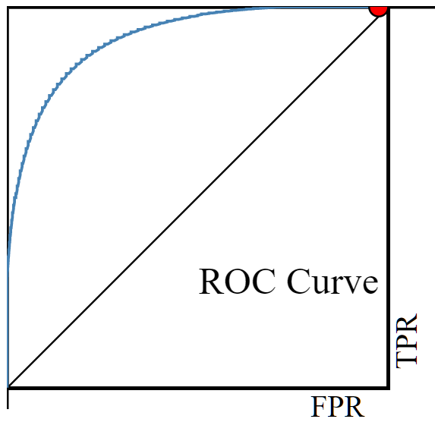
ROC Curve: how good is a classifier?
True Positive Rate (TPR): ☺
True Positives / (all Positive class)
Recall
False Positive Rate (FPR): ☹
False Positives / (all Negative class)
Depends on Threshold…
Low threshold ➔ Both are High
High Threshold ➔ Both are Low
 | Actual Class
Prediction | Positive Class | Negative class
“cyber attack” | True Positive | False Positive
“no attack” | False Negative | True Negative
1,1
0,0
Notes:
תשתית, פלטפורמה,

Slide 28
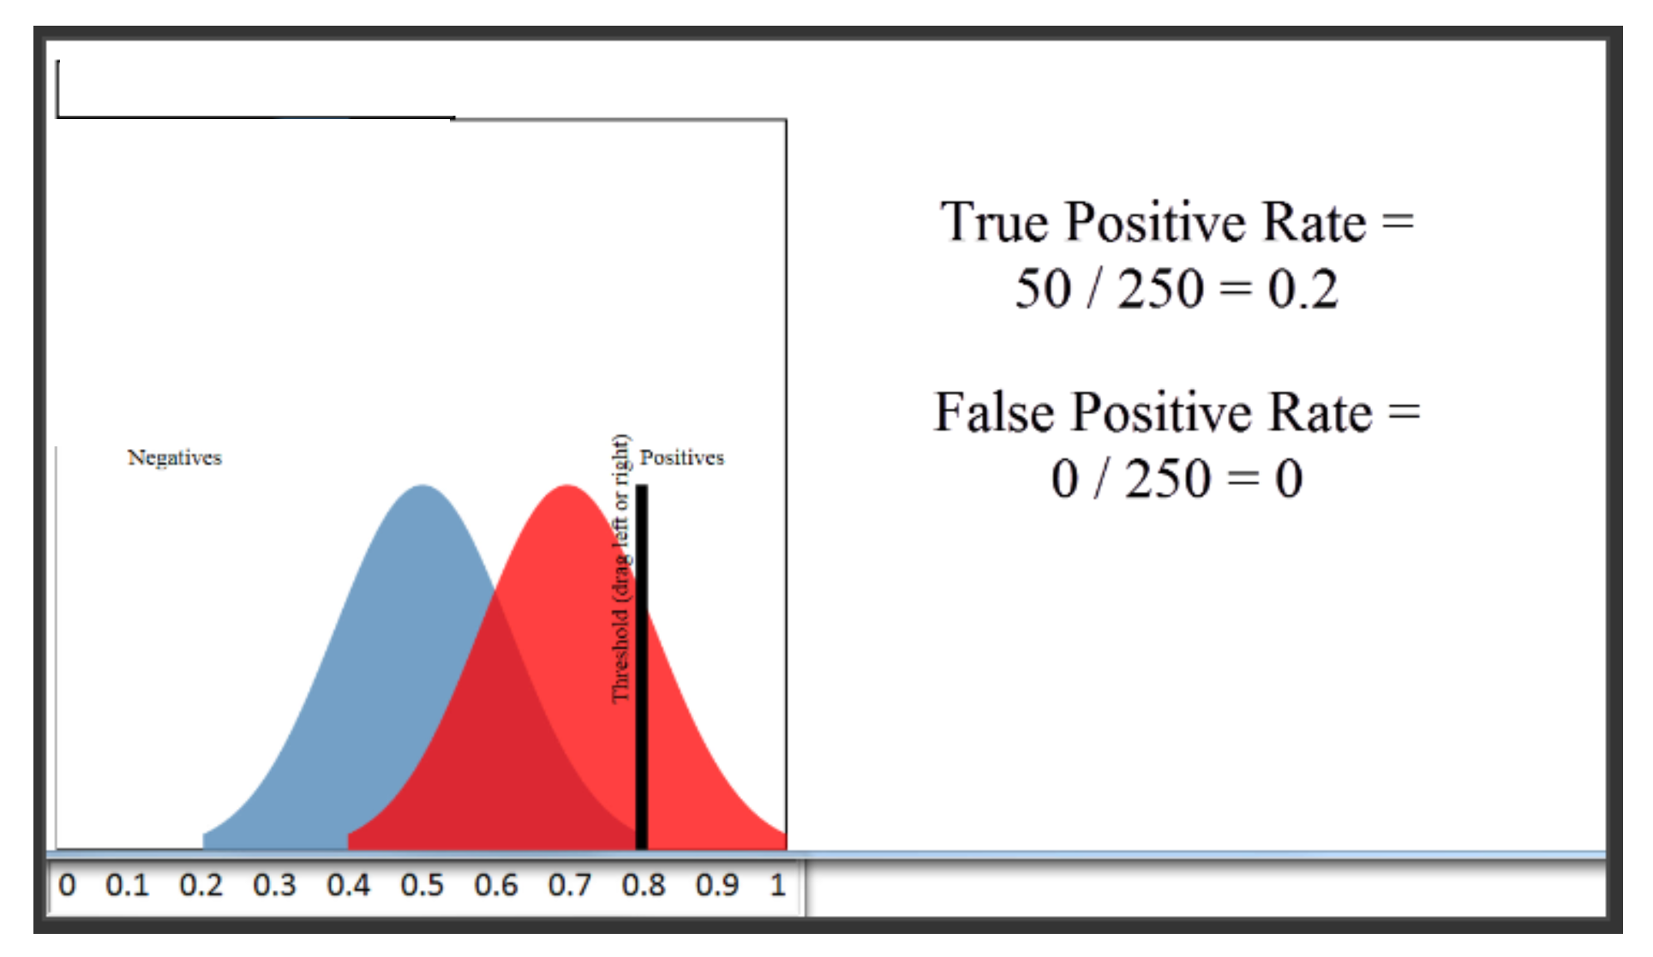
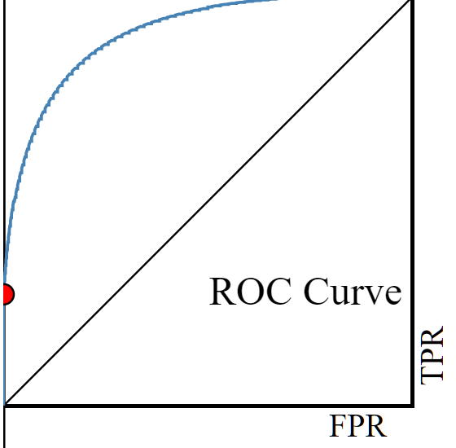

FPR and TPR – an example
Red = “positive class” (250)
Blue – “negative class” (250)
Threshold = 0.8
“yes” for 50
all of them are Red
TPR
FPR
Notes:
תשתית, פלטפורמה,

Slide 29
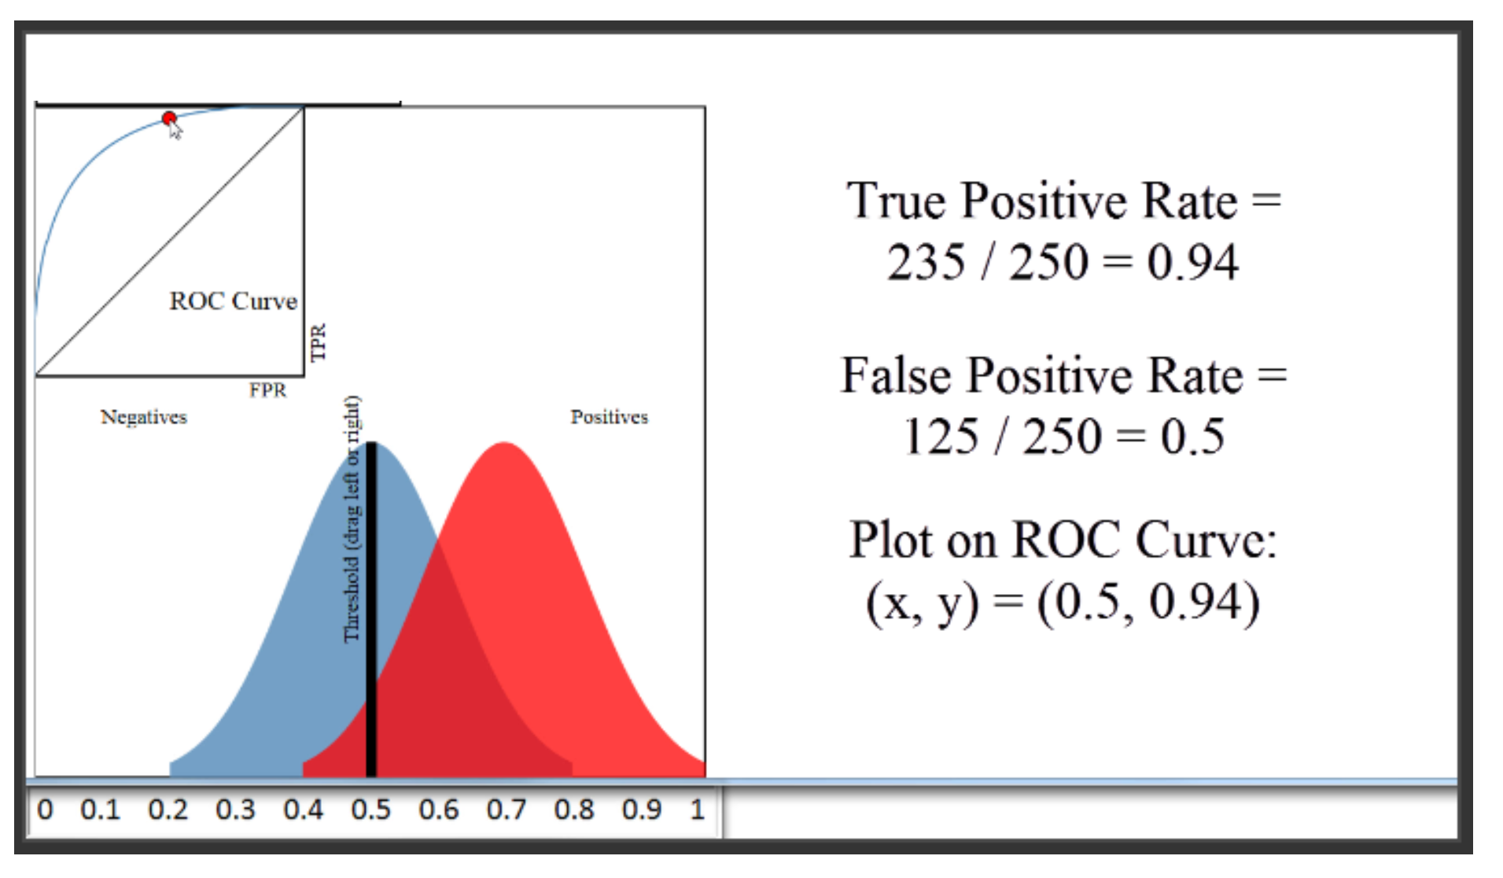
FPR and TPR – Med Threshold
Threshold = 0.5
TPR: Hi
FPR: Med
Notes:
תשתית, פלטפורמה,

Slide 30
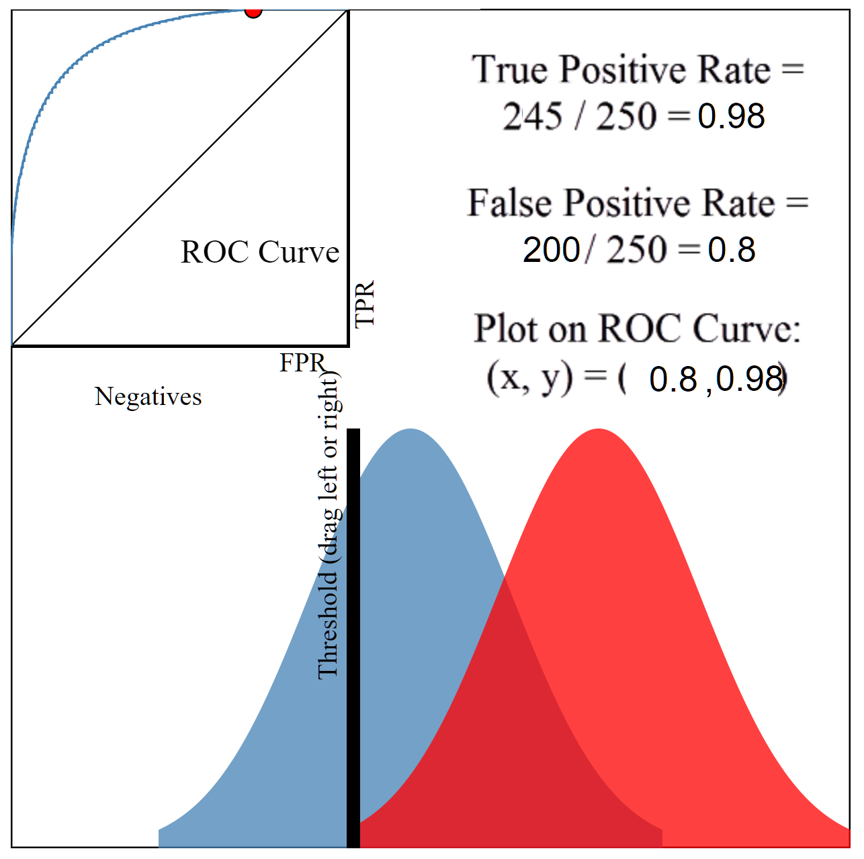
FPR and TPR – Med-low threshold
Threshold = 0.4
TPR: Hi
FPR: Med-Hi
Notes:
תשתית, פלטפורמה,

Slide 31
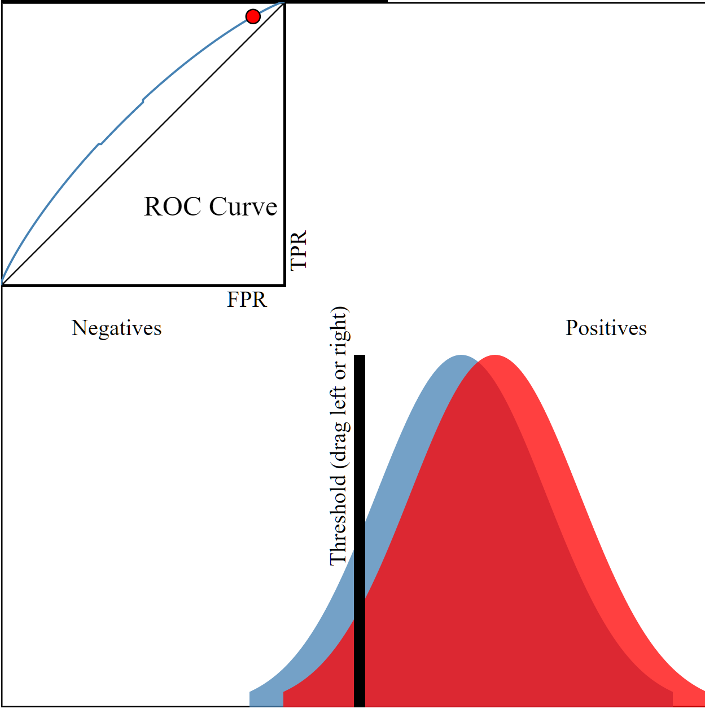
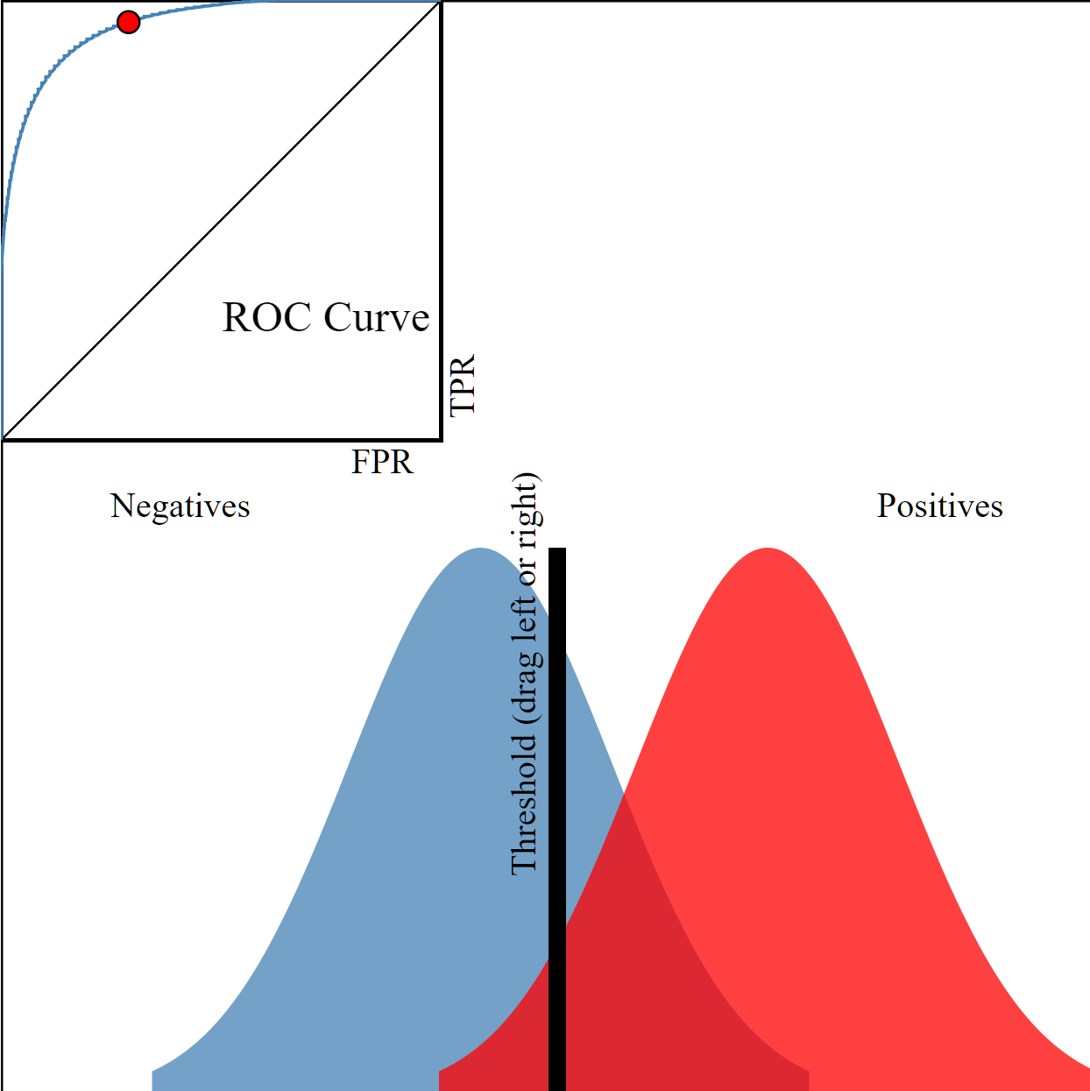
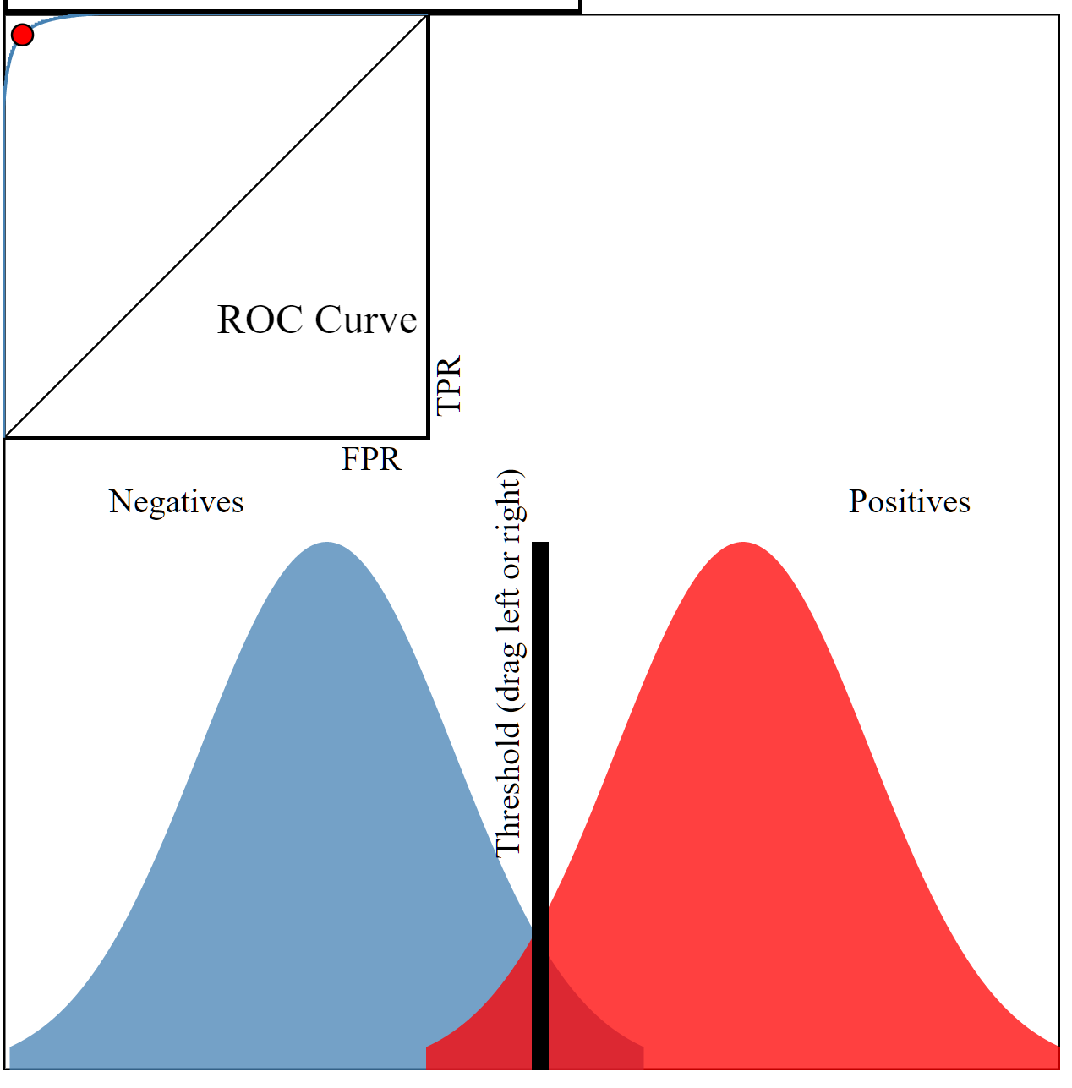
More generally: ROC for different classifiers
Applet: navan.name/roc
Shape of ROC is important; also Area Under Curve (AUC)
Bad Ok Very Good
AUC -> 0.5
AUC -> 1
Notes:
תשתית, פלטפורמה,

Slide 32
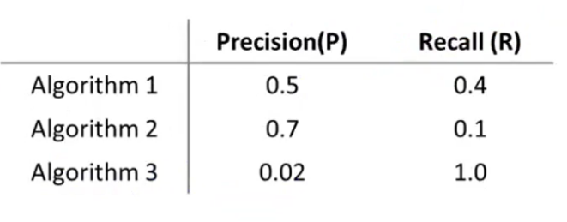
Simpler way to compare classifiers?
Now we have 2 scores
how to compare classifiers?
E.g.:
which is the best?
Not very clear…
We need a single score
(a single real-number metric)
Notes:
תשתית, פלטפורמה,

Slide 33
Option 1:
Maybe take (0.4+0.5)/2 ?
Not very good:
Using this option:
Algorithm 3 : avg = 0.51
Algorithm 1: avg = 0.45
But 3 is not really better than Algorithm1 !
Average is not good
always guesses 1
Notes:
תשתית, פלטפורמה,

Slide 34
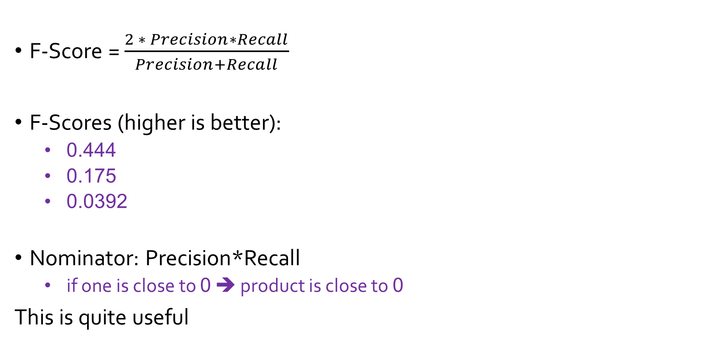
Option 2: F-Scores (F1-Scores)
F-Score = $\frac{2 ∗ Precision∗Recall}{Precision+Recall}$
F-Scores (higher is better):
0.444
0.175
0.0392
Nominator: Precision*Recall
if one is close to 0 ➔ product is close to 0
This is quite useful
Notes:
תשתית, פלטפורמה,

Slide 35
Selecting A classifier
Why not
Training?
Want to test
generalization
Test with cross-validation set
Select between different classifiers
Select for same classifier, different thresholds:
Try different thresholds ➔ get different F scores
Take threshold with highest F score
Threshold contains tradeoff between precision and recall
Note:
F-Score used
to select
threshold for
same classifier
Notes:
תשתית, פלטפורמה,

Slide 36
The End

