Slide 1
A Review of Machine Learning Algorithms for Text-Documents Classification
Aurangzeb Khan, Baharum Baharudin, Lam Hong Lee*, Khairullah khanFEBRUARY 2010
Moran Abitbul
Tair Farangi

Slide 2
Outline
Machine Learning
Definitions
Text Mining
Learning Algorithm
Text mining for market prediction
Conclusions

Slide 3
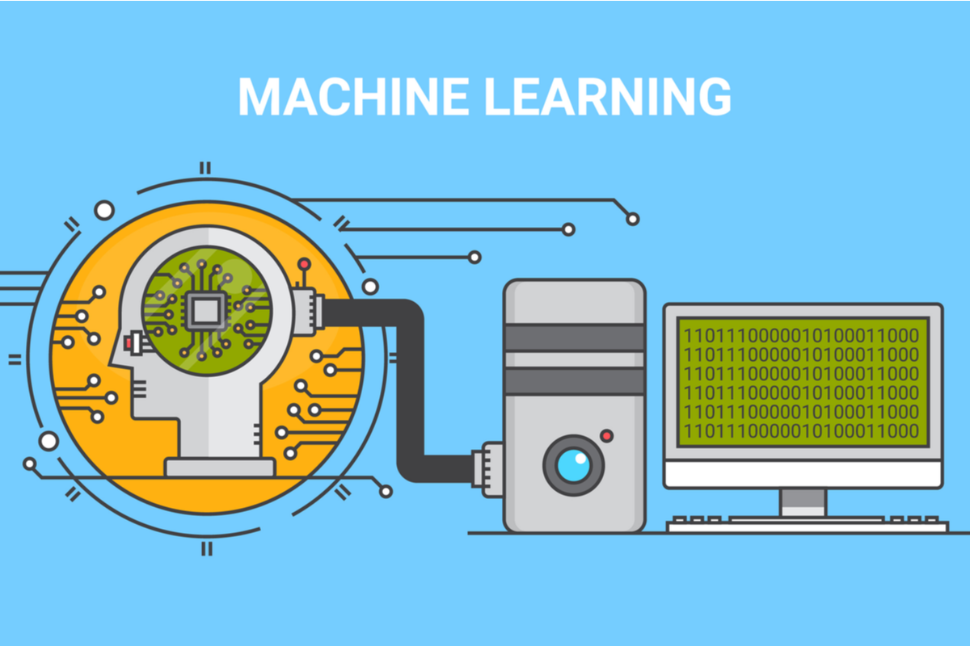
Definitions
•Machine Learning:
◦Allow the computer to learn from examples. ◦ Runs on a variety of computational tasks where classic programming is not possible.
•Supervised Learning. • Unsupervised Learning. • Reinforcement Learning.

Slide 4
Definitions
Data Set: Data For Learning, Examples - with or without “results”.
Occam’s Razor: prefer a simple model if possible.

Slide 5
Outline
Machine Learning
Text Mining
Learning Algorithm
Text mining for market prediction
Conclusions

Slide 6
Text Mining
Technology development.
Documents go digital: Need to search for information digitally.
Strong field, a lot of money, very popular.

Slide 7
Definitions
Generalize to new examples: The ability of the model to properly adapt to previously unseen data.
Dimensionality Reduction: Data from a high-dimensional space into a low-dimensional.
NLP – Natural Language Processing.

