Slide 1
A Review of Machine Learning Algorithms for Text-Documents Classification
Aurangzeb Khan, Baharum Baharudin, Lam Hong Lee*, Khairullah khanFEBRUARY 2010
Moran Abitbul
Tair Farangi

Slide 2
Outline.
Machine Learning.
Definitions.
Text Mining.
Learning Algorithm.
Text mining for market prediction.
Conclusions.

Slide 3

Definitions [1]
• Machine Learning:
• Allow the computer to learn from examples, Runs on a variety of computational tasks where classic programming is not possible
• Supervised Learning. • Unsupervised Learning. • Reinforcement Learning

Slide 4
Definitions [1]
• Machine Learning: Allow the computer to learn from examples, variety of computational tasks where classic programming is not possible
• Supervised Learning. • Unsupervised Learning. • Reinforcement Learning

Slide 5
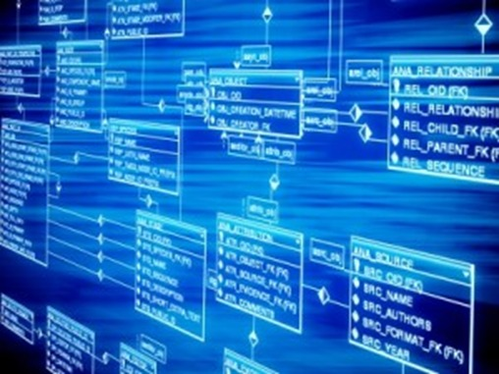
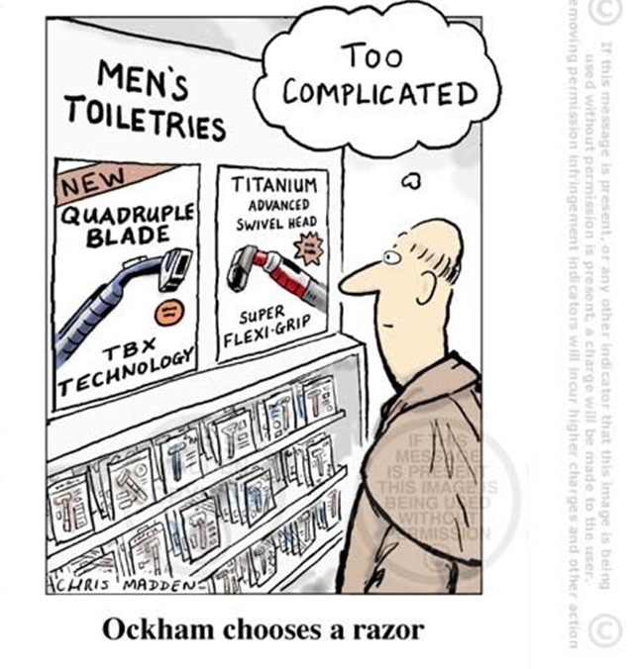
Definitions [2]
• Data Set: Data For Learning, Examples – with or without “results”. •
• Occam’s Razor: prefer a simple model if possible. •

Slide 6
Outline.
Machine Learning.
Text Mining.
Learning Algorithm.
Text mining for market prediction.
Conclusions.

Slide 7
Text Mining
• Technology development
• Documents go digital: Need to search for information digitally. •
• Strong field, a lot of money, very popular

Slide 8
Definitions
Generalize to new examples: The ability of the model to properly adapt to previously unseen data
Dimensionality Reduction: Data from a high-dimensional space into a low-dimensional
NLP – Natural Language Processing

Slide 9
PreFix
From a textual presentation
to an interactive presentation
An online platform that provides an innovative learning experience by changing and upgrading a textual presentation to an interactive presentation.

Slide 10
PreFix
From a textual presentation
to an interactive presentation
An online platform that provides an innovative learning experience by changing and upgrading a textual presentation to an interactive presentation.
Array of shapes
Array of color sentences
“0070C0”
“00B0F0“
“00B0F0“
“002060”
“002060”
0 0 1 0 1
0 1 2

Slide 11
​An online platform that provides an innovative learning experience by changing and upgrading a textual presentation to an interactive presentation. The system analyzes and adapts the visual characteristics to the human eye, offers a variety of additions that contribute to conveying messages in a clear and fascinating way, such as videos, pictures and builds question games that make the lesson interactive, fun and thus increase learner involvement.

Slide 12
['an', 'online', 'platform', 'that', 'provides', 'an', 'innovative', 'learning', 'experience', 'by', 'changing', 'and', 'upgrading', 'a', 'textual', 'presentation', 'to', 'an', 'interactive', 'presentation', 'the', 'system', 'analyzes', 'and', 'adapts', 'the', 'visual', 'characteristics', 'to', 'the', 'human', 'eye', 'offers', 'a', 'variety', 'of', 'additions', 'that', 'contribute', 'to', 'conveying', 'messages', 'in', 'a', 'clear', 'and', 'fascinating', 'way', 'such', 'as', 'videos', 'pictures', 'and', 'builds', 'question', 'games', 'that', 'make', 'the', 'lesson', 'interactive', 'fun', 'and', 'thus', 'increase', 'learner', 'involvement']

Slide 13
['online', 'platform', 'provides', 'innovative', 'learning', 'experience', 'changing', 'upgrading', 'textual', 'presentation', 'interactive', 'presentation', 'system', 'analyzes', 'adapts', 'visual', 'characteristics', 'human', 'eye', 'offers', 'variety', 'additions', 'contribute', 'conveying', 'messages', 'clear', 'fascinating', 'way', 'videos', 'pictures', 'builds', 'question', 'games', 'make', 'lesson', 'interactive', 'fun', 'thus', 'increase', 'learner', 'involvement']

Slide 14
['onlin', 'platform', 'provid', 'innov', 'learn', 'experi', 'chang', 'upgrad', 'textual', 'present', 'interact', 'present', 'system', 'analyz', 'adapt', 'visual', 'characterist', 'human', 'eye', 'offer', 'varieti', 'addit', 'contribut', 'convey', 'messag', 'clear', 'fascin', 'way', 'video', 'pictur', 'build', 'question', 'game', 'make', 'lesson', 'interact', 'fun', 'thu', 'increas', 'learner', 'involv']

Slide 15


