Slide 1
MSDAP
Anmol Gautam – AXG190014
Soumyadeep Choudhury – SXC180056

Slide 2
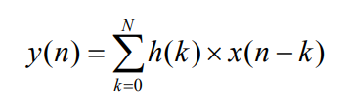


Algorithm Description
MSDAP uses the implementation of linear convolution for audio processors.
Where y(n)→ output sample, x(n) → input sample, h(k) → filter coefficients, N → order of the filter
The convolution of the FIR filter proposed by the MSDAP paper is as follow:
This reduces the normal computation of the convolution using standard formula.
where x_{j} (l) є {± x(n-k)}, 1 ≤ l ≤ r_{j}, and r_{j} is the total number of the power of two (POT) digits ±2^{-j} occurred among all filter POT coefficients.

Slide 3
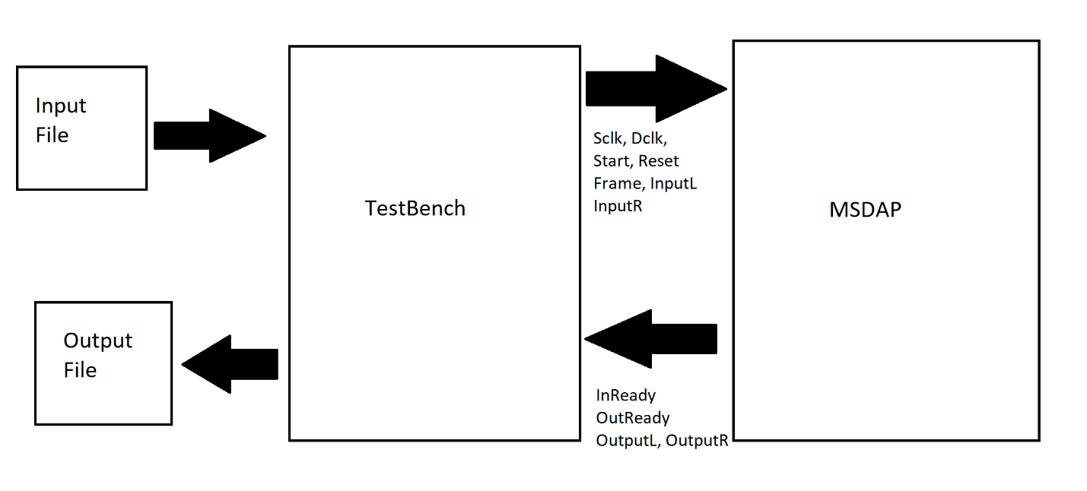
Block Diagram

Slide 4
Pin Settings – Input Pins
Dclk → This is the data clock of the system and the frequency is 768kHz.
Start → This is used to initialize the chip. In the beginning when start is high then all the registers are initialized.
Reset → When reset is high (because our specification said reset = 1), the system goes to state 7.
InputL → This is a 16bit wire which transmits left data from testbench parallely.
InputR →This is a 16bit wire which transmits right data from testbench parallely.
Frame →This pin is high when the first of 16dclk comes. Because the data is sent parallely, this is when both the left and right inputs are sent.
State → This state send the next state value to filter and the filter handles all the changes that needs to be done for that state.
Sl → Sends a signal along with the state to filter to enable sleep.

Slide 5
Pin Settings – Output Pins
InReady →This pin is high when the system is ready to take inputs. It is made high first time when the system enters state 1.
OutReady → This pin is high when the ALU starts computing the system is ready for output.
OutputL → This pin carries left output to testbench serially.
OutputR →This pin carries right output to testbench serially
wsenL & wsenR → This is output from filter to testbench to synchronize the write to the file task.

Slide 6
Input Formats
Rj
Coefficient
Input Data
Output Data

Slide 7
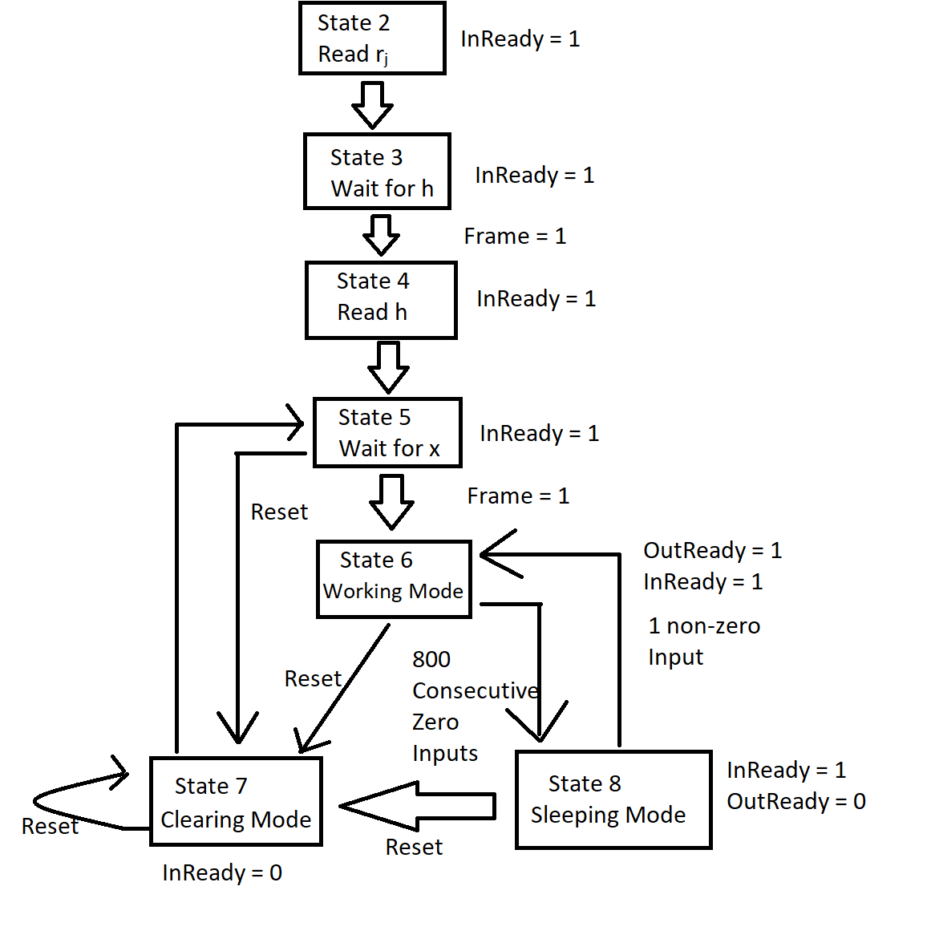
Operation Modes

Slide 8
Operation Modes / States
State 0 → During this state the registers and memories are all cleared. Then chip enters State 1.
State 1 → This state sets InReady to high and the system waits for frame to enter State 2 and start reading rj values.
State 2 → In this state, the system starts reading rj values. Once all the rj values are read, the system enters state 3.
State 3→ In this state, the system waits for the coefficient values to be read. When the frame is read as high, the system enters State 4.
State 4 → In this state, the system reads the coefficient values. Once all the coefficients are read then the system enters State 5.
State 5 → In this state, the system waits for the input values to be read. If the frame is high then the system enters State 6.
State 6 → In this state, the system starts reading input values. The convolution process also starts along as the input values are being read. If reset is detected high then the system enters State 7. If 800 consecutive zeros are read then the system enters State 8.
State 7 → In this state, Inputs are no longer read and the InReady is set to low. Memory containing input values are cleared. Then system goes back to State 5.
State 8 → In this state, OutReady is set to low and the InReady remains high. Once a non-zero input is read either in left or right channel then the OutReady is set back to high and the system enters State 6.

Slide 9
Our Implementation
For storing last 256 values of input values, we use a cyclic array to do that.
We maintain the actual index value of the input in a separate array which is used to find the required value in the input array.
This is done because once the 255 array is filled, to store the new values the oldest value in the array is replaced with the newest and their location is maintained in the other array.

Slide 10
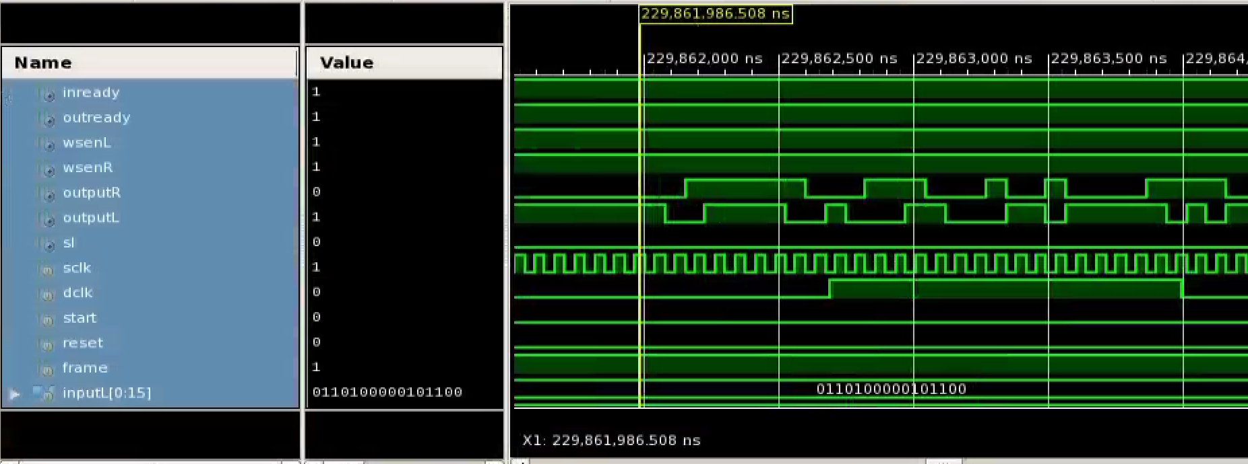
Inputs
Dclk = 768 kHz
Sclk = 26.88 MHz

Slide 11
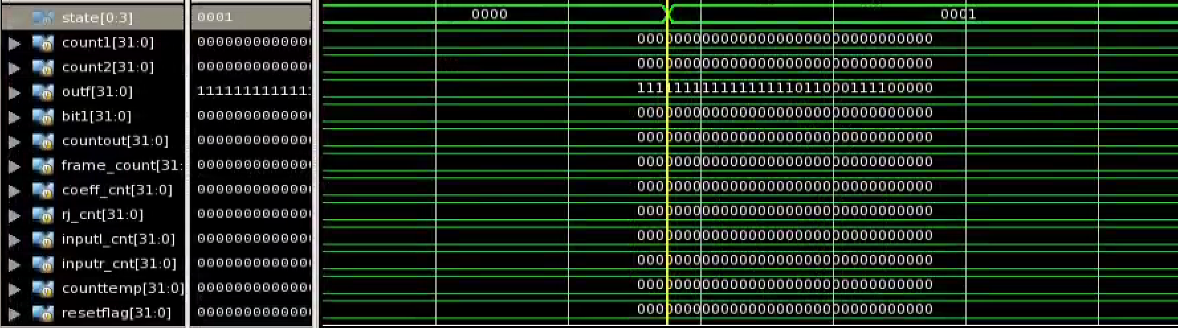
Waveforms – State 0 - 1

Slide 12
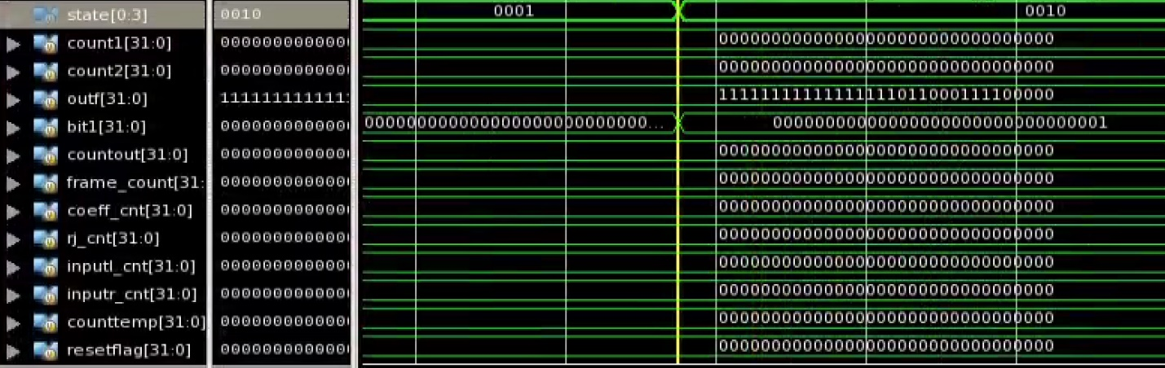
Waveforms – State 1 - 2

Slide 13
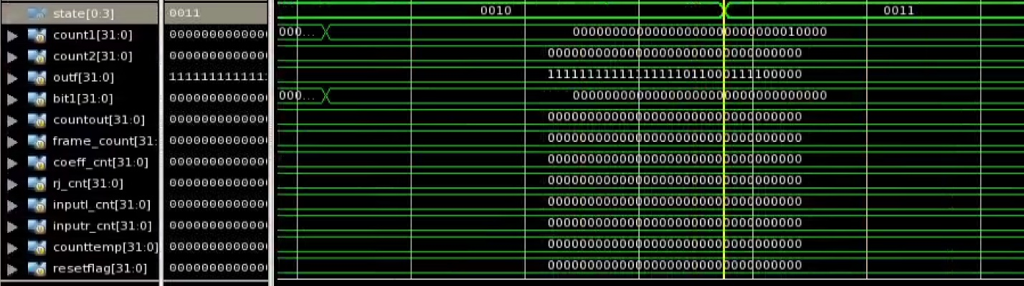
Waveforms – State 2 - 3

Slide 14
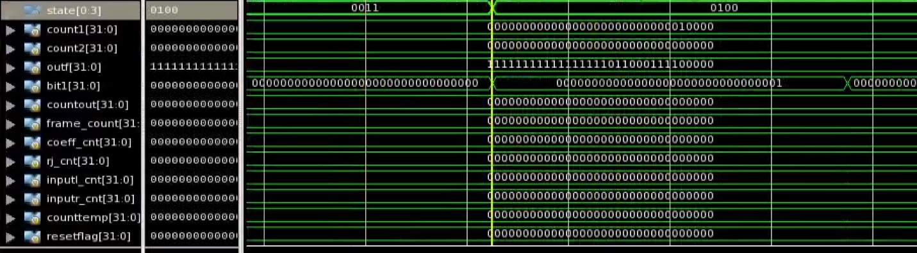
Waveforms – State 3 - 4

Slide 15
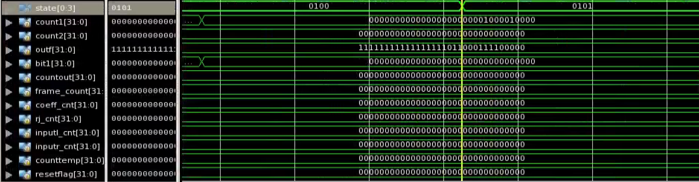
Waveforms – State 4 - 5

Slide 16
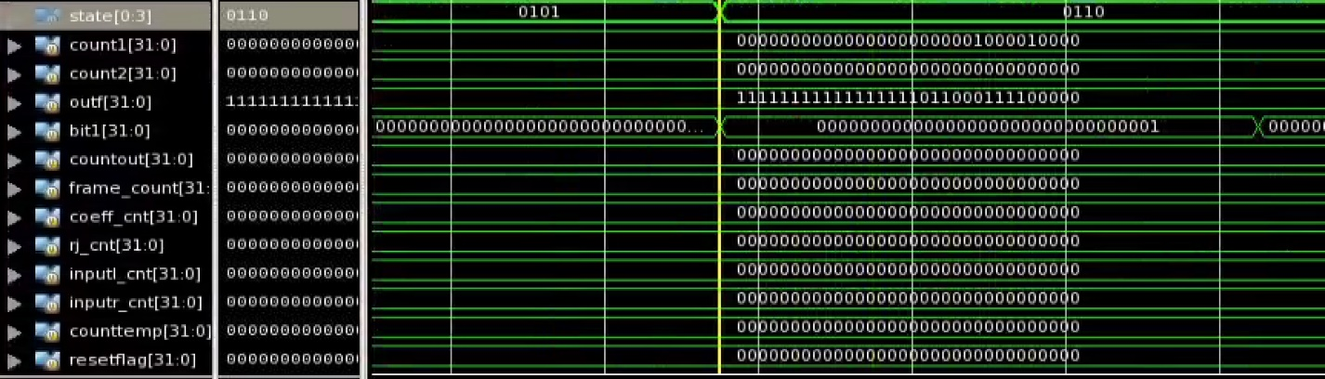
Waveforms – State 5 - 6

Slide 17
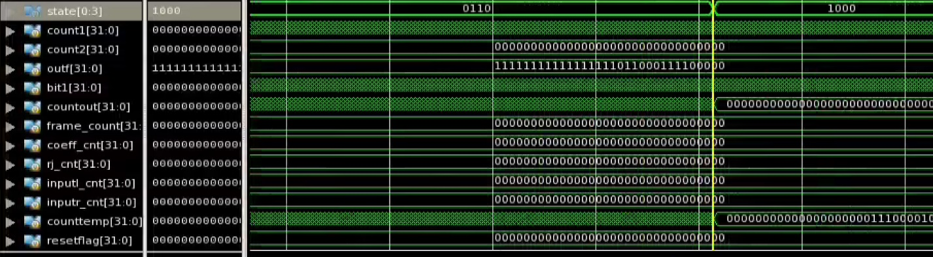
Waveforms – State 6 - 8

Slide 18
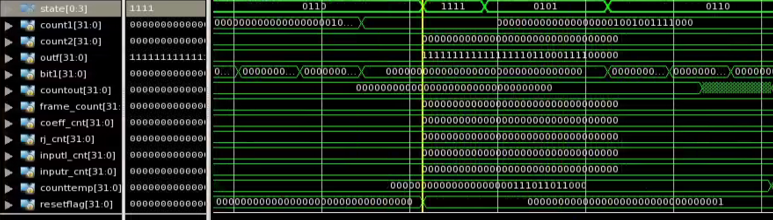
Waveforms – State 6 – 7 – 5 – 6

Slide 19
THANK YOU

