Slide 1
November 4, 2020
Digital Engineering
Ethnikis Antistasis 205
45500 Katsikas
Ioannina, Hellas
Tel.: +30 26510 85230
Fax.: +30 26510 85233
niki-mepe.gr

Slide 2
Alexandros Filios
Computer Science & Engineering (CSE)

Slide 3
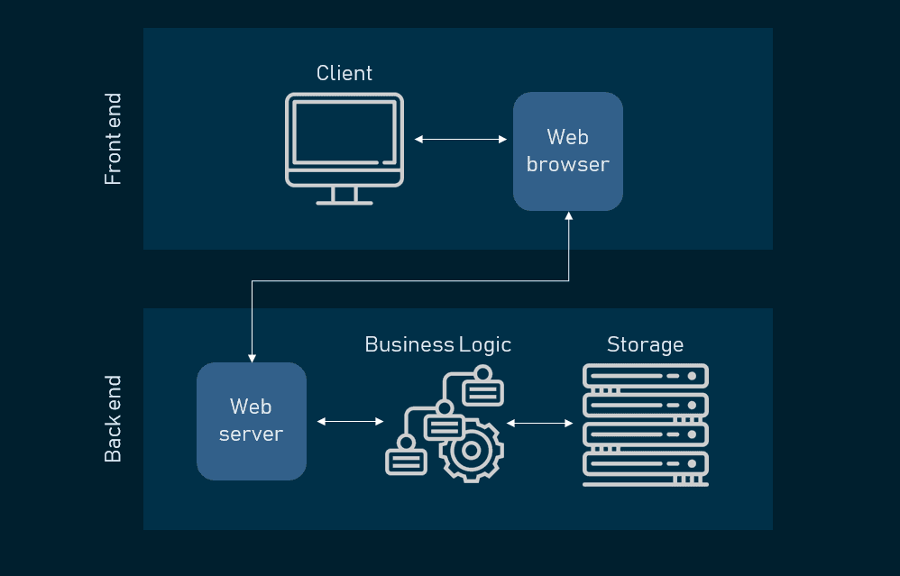

ProPer– Technical Overview
Web application that uses:
Angular 11 on client side (frontend)
JS on server side (backend)
MongoDB & Mongoose (NoSQL DB)

Slide 4
ProPer – Logic Overview
Imports Excel files
via client
Applies the four
CRUD basic functions.
(create, read, update, and delete)
tables in html
Produces a variety of reports
Uses http requests via client
tables in excel files

Slide 5
ProPer– Development workflow
Supervisor NIKI
Does the communication with clients
Writes the tasks
Developer - NIKI
Develops new features
Suggests testing scenarios
Deploys application
Does the testing
Arranges meetings for extra specifications/ requirements
Resolves bugfixes

Slide 6
ProPer– Development workflow
PROPER
User-Info
Excel Import
Excel Export

Slide 7
ProPer– Development workflow
PROPER
User-Info
User
Info

Slide 8
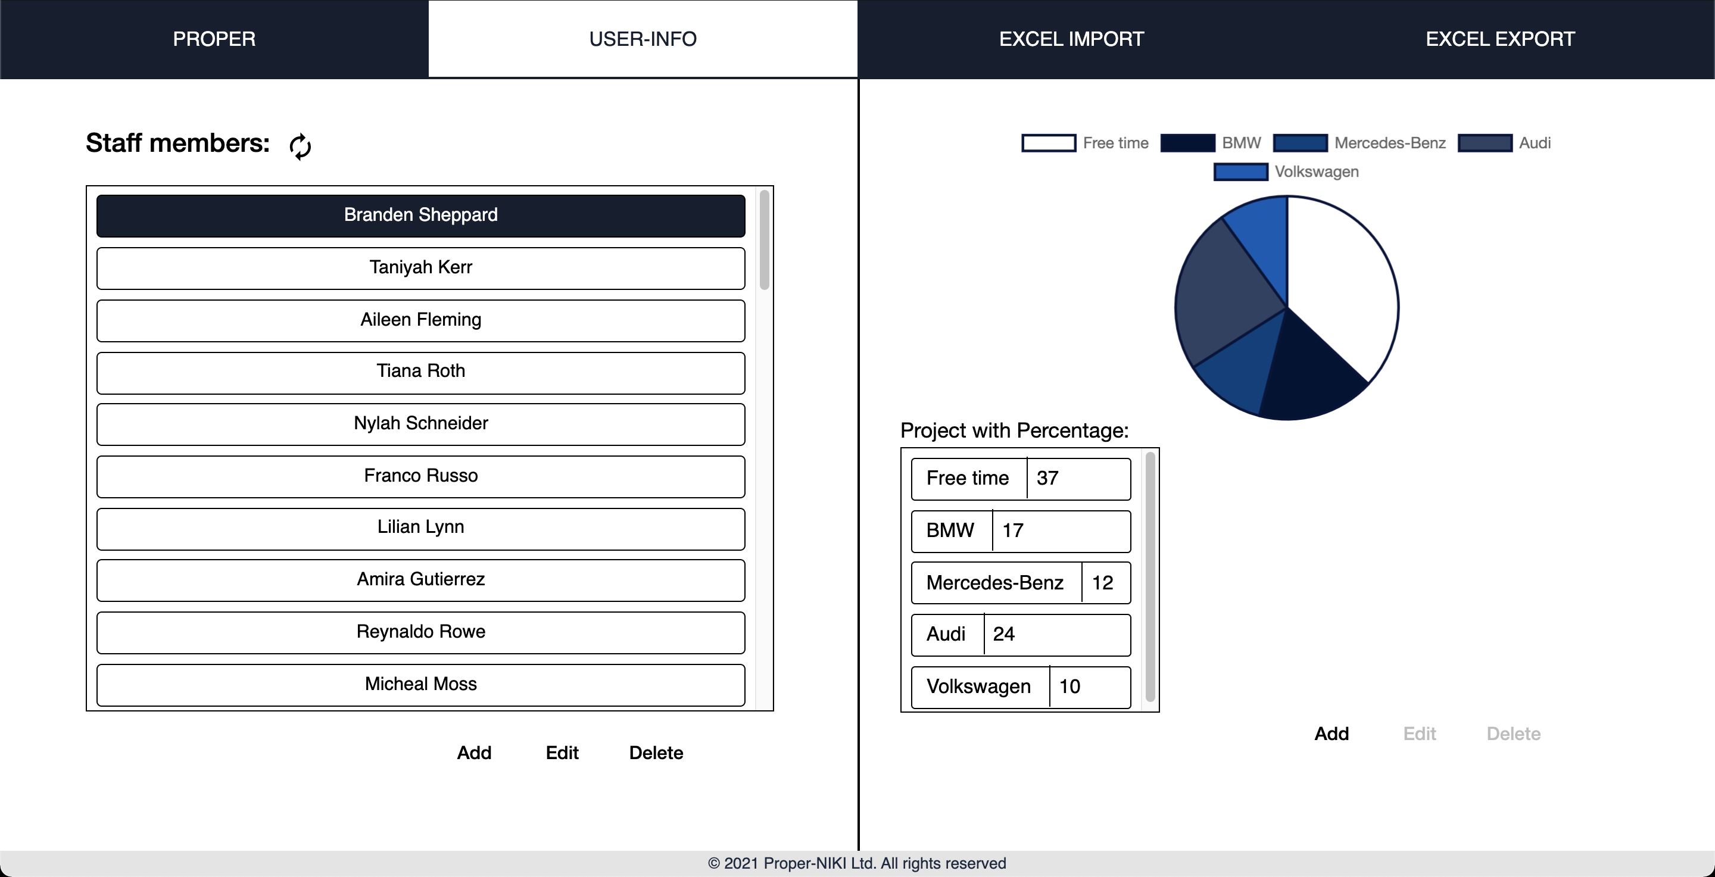
ProPer– Development workflow
User-Info
User
Info

Slide 9
ProPer– Development workflow
User-Info
User
Info

Slide 10
ProPer– Development workflow
User-Info
User
Info

Slide 11
ProPer– Development workflow
DATA
User-Info
User
Info

Slide 12

ProPer– Development workflow
DATA
User-Info
User
Info

Slide 13
ProPer– Development workflow
DATA
User-Info
Fetching DATA
Add
Delete
Edit
User
Info

Slide 14

ProPer– Development workflow
DATA
User-Info
User
Info
Next..

Slide 15
ProPer– Development workflow
PROPER
User-Info
Excel Import
Excel Export

Slide 16
ProPer– Development workflow
Excel Import

Slide 17
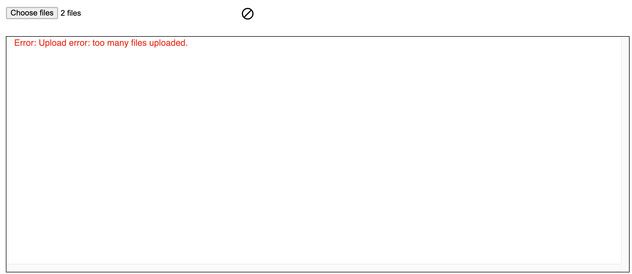
ProPer– Development workflow
Excel Import

Slide 18
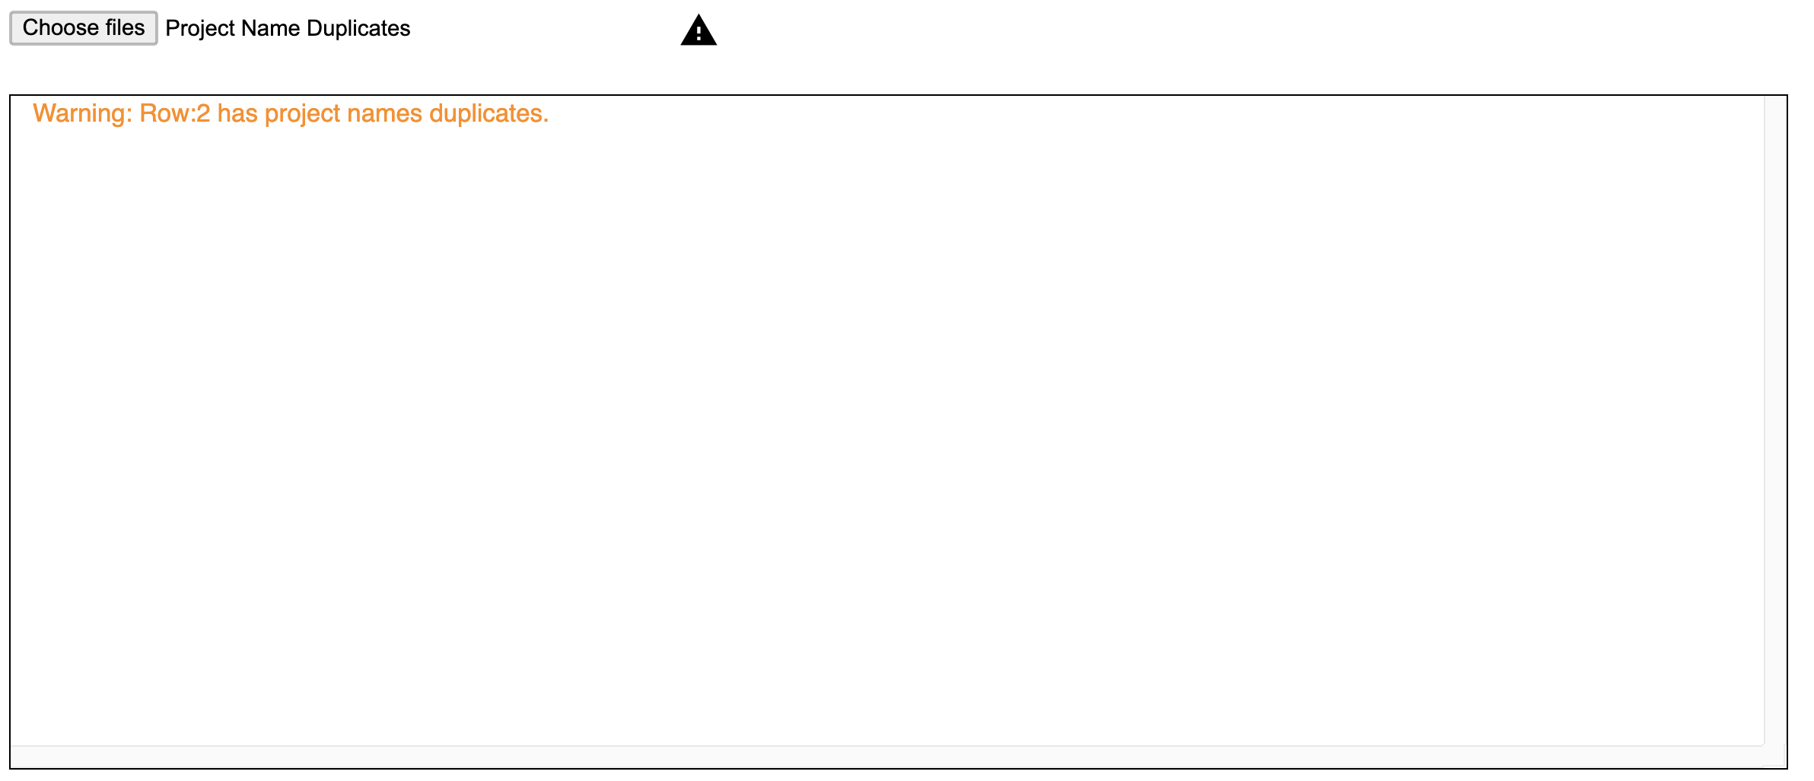
ProPer– Development workflow
Excel Import

Slide 19
ProPer– Development workflow
Excel Import

Slide 20

ProPer– Development workflow
Import
Excel Import

Slide 21
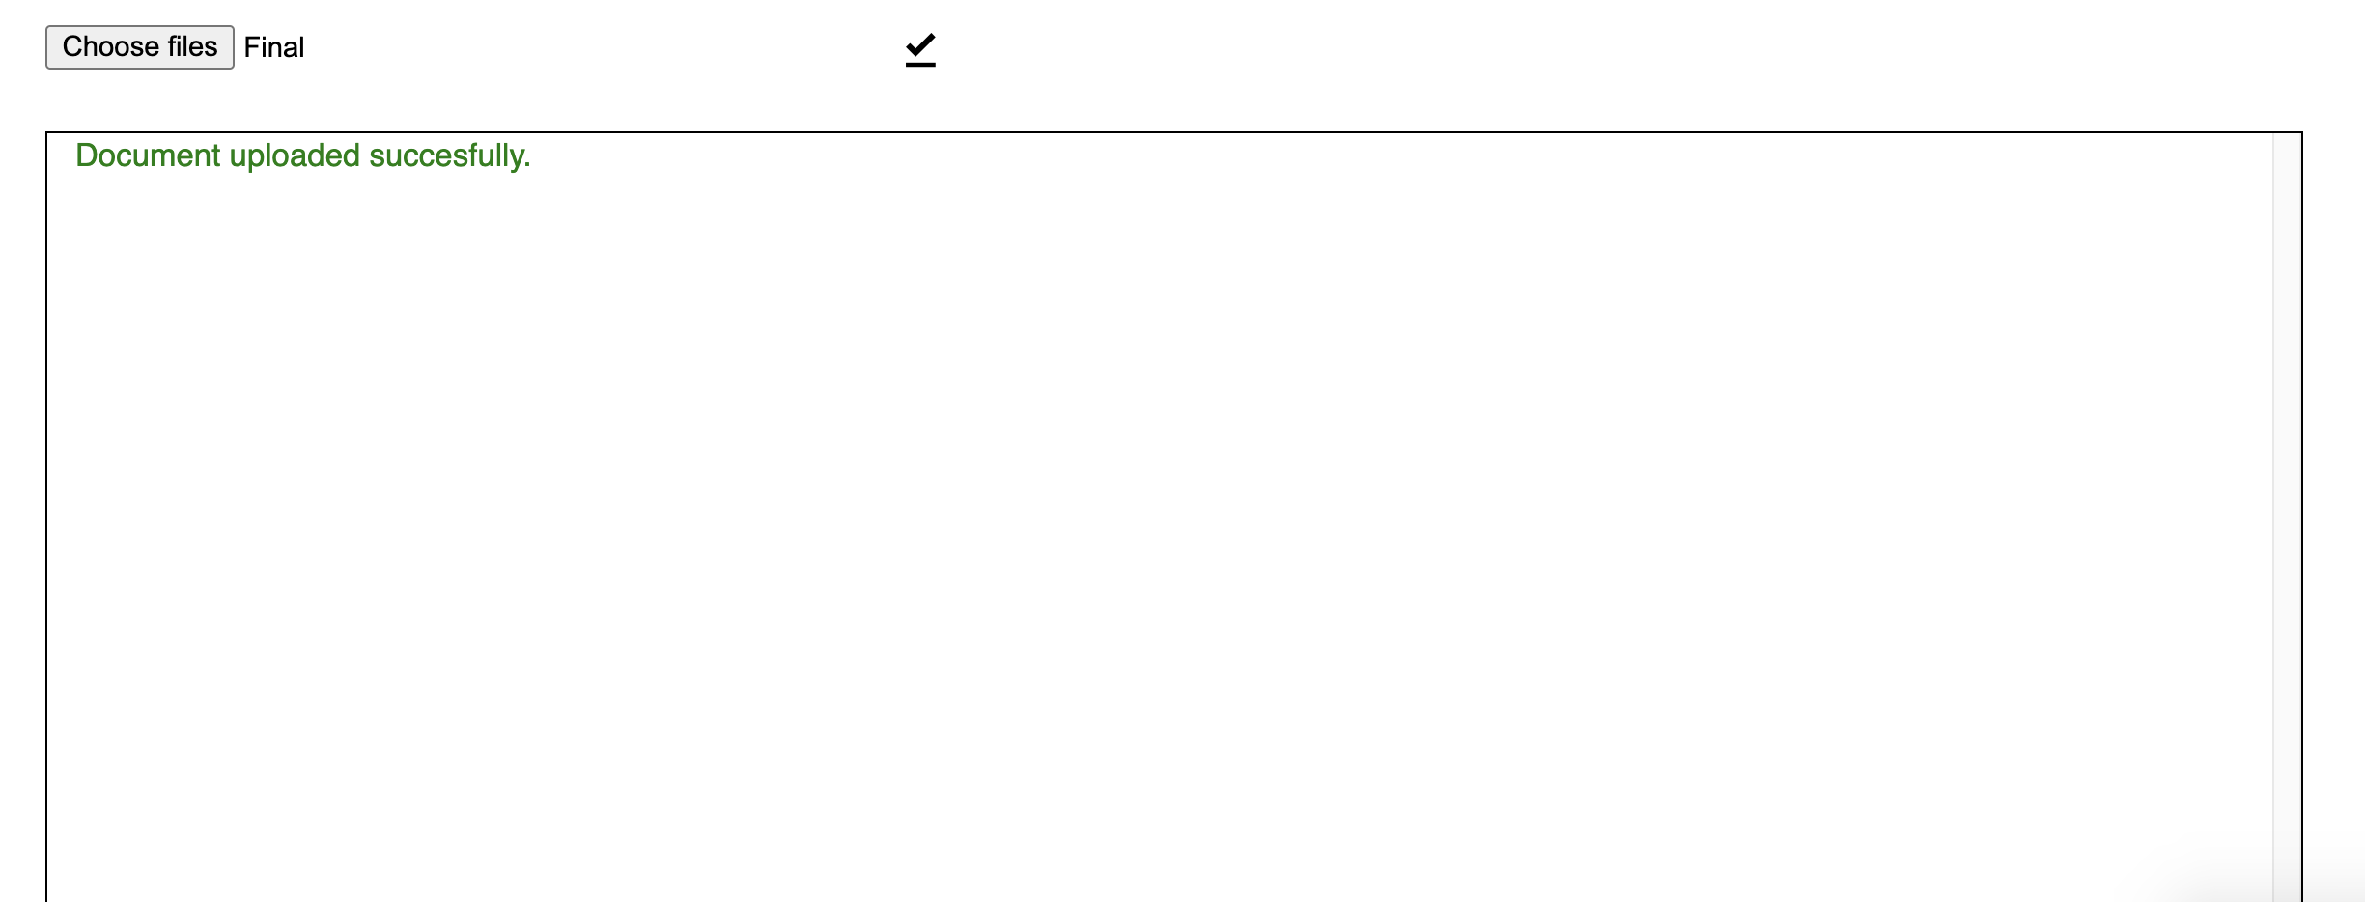
ProPer– Development workflow
Import
Upload
Excel Import

Slide 22
ProPer– Development workflow
PROPER
User-Info
Excel Import
Excel Export

Slide 23
ProPer– Development workflow
PROPER
Export
User-Info
Excel Import
Excel Export

Slide 24
Ερωτήσεις?

