Slide 1
CS5590 GitHub Introduction Lab Submission Guidelines
Summer 2019
UMKC

Slide 2
Topics to cover
Installations
GitHub
Lab Submission Guidelines
Wiki
Video Submission

Slide 3
Git Basic Tasks
1. Create Git remote repository using Git account
2. Clone Git repository to your local
3. Use Git to add file into local
4. Modify files and use Git to commit change
5. Use Git to push the commit to remote
6. Use Git to pull (sync) content with remote

Slide 4
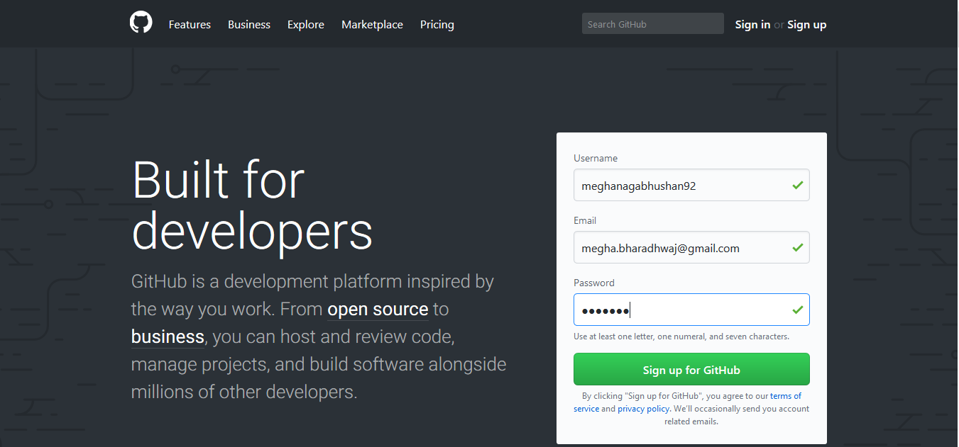
Git 1. Create Git Account

Slide 5
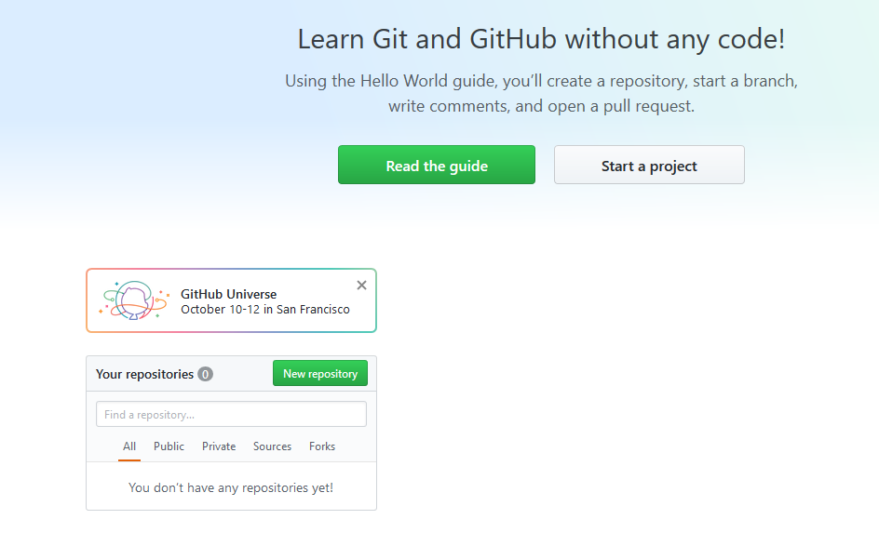
Git 2. Create Repository

Slide 6
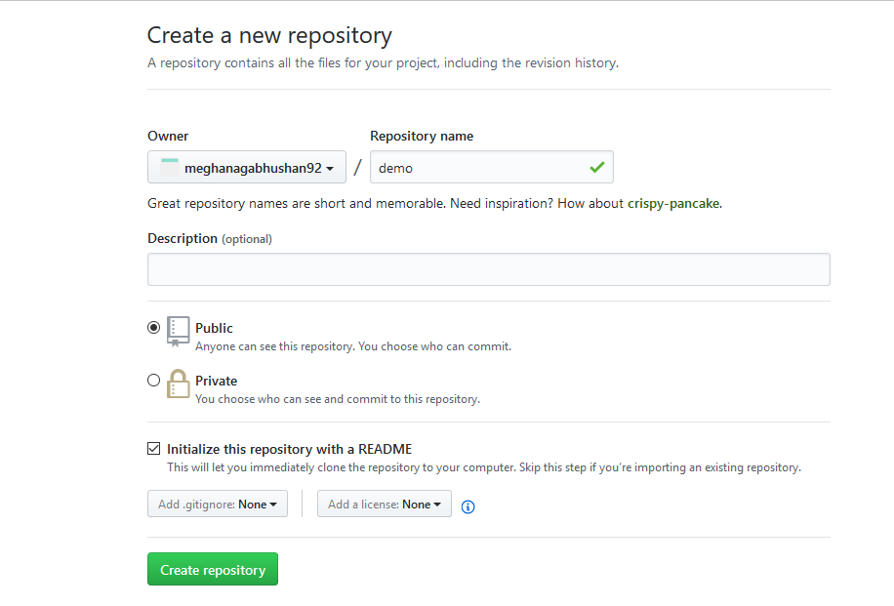
Git 2. Create Repository
create a sample repository.

Slide 7
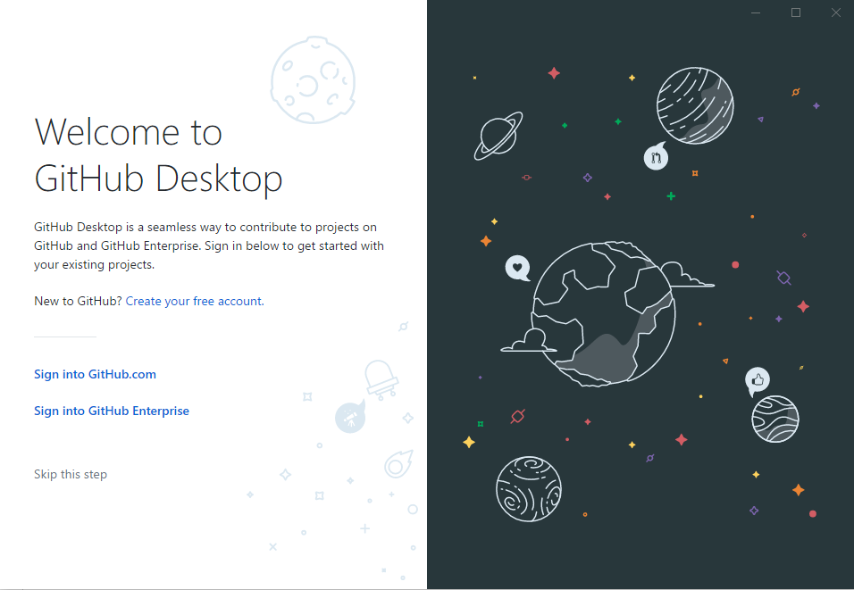
Git Desktop
Download git using this link - https://git-scm.com/downloads
Download Github Desktop using this link - https://desktop.github.com/

Slide 8

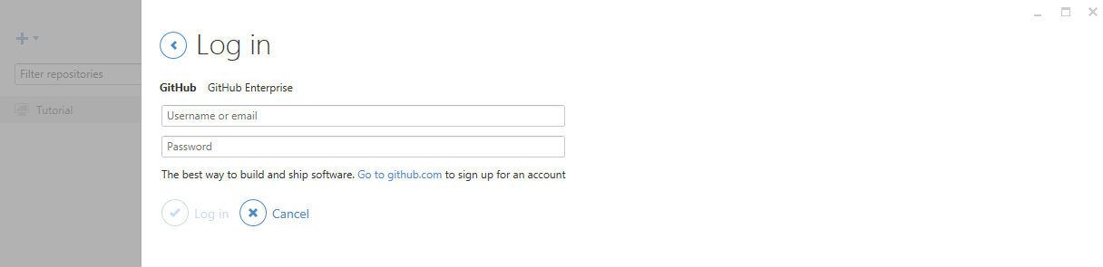
Git
For Windows user, please open GitHub desktop by double clicking icon
login to your GitHub desktop with your GitHub account (It is very important to login before you do the rest of steps. Because after you login, you secure connection has been made)

Slide 9
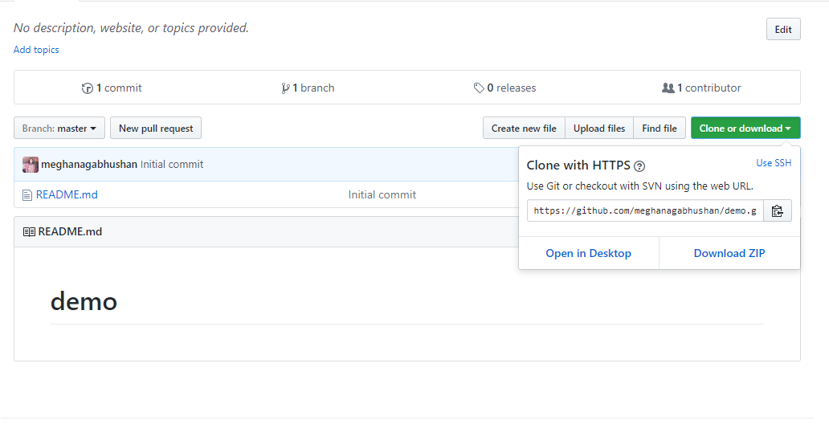
Git 3. Clone repository to your local
Click on "Clone or Download" -> "Open in Desktop".

Slide 10
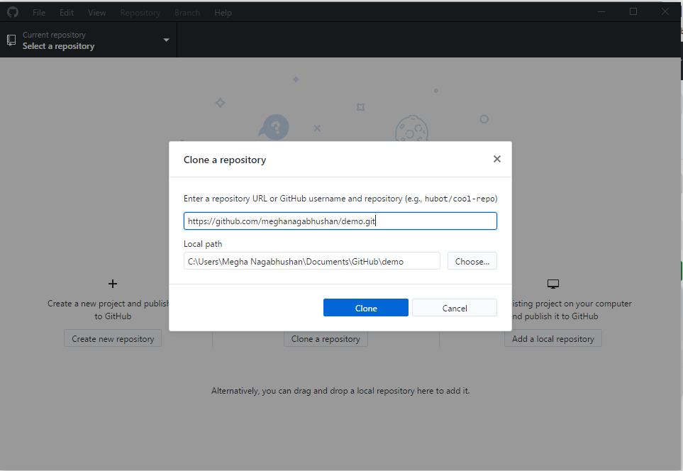
Git 3. Clone repository to your local
Choose the path to save your repository.

Slide 11
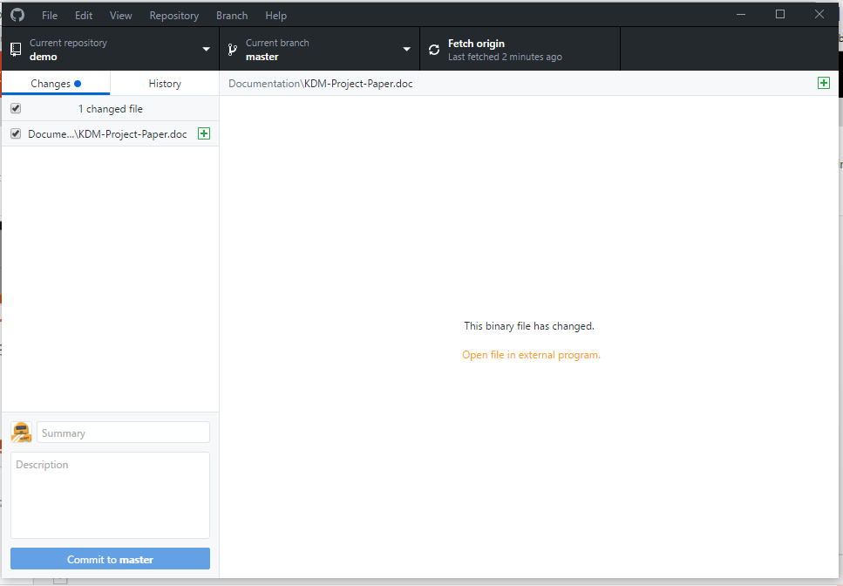
Git 4. Add file to local Repository
Go to the location of your repository.
Create a Source and Documentation folder.
Add a sample file in the Documentation folder.

Slide 12
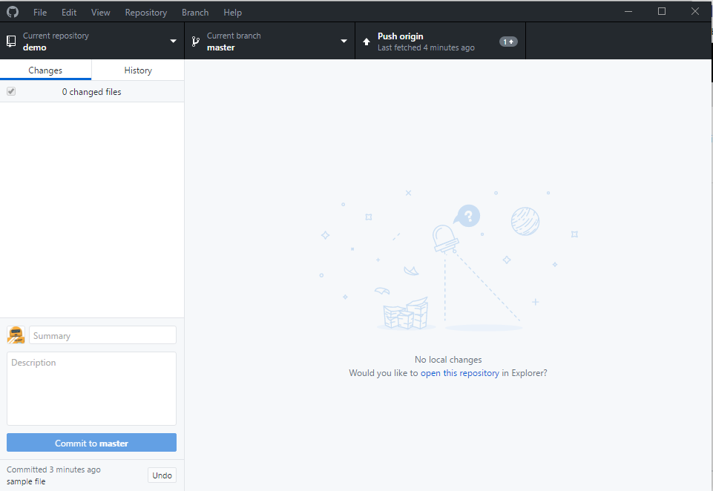
Git 5. Commit this change
Fill summary and description boxes and click on Commit to master.

Slide 13
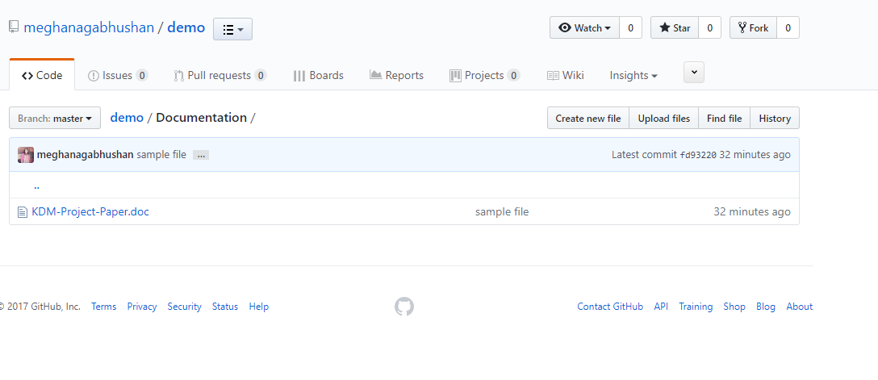
Git 6. Push the change to remote
Click on "Push origin" at the top of the git desktop screen.
Open the repository on your Github. The file will now be visible in your repository.

Slide 14
For now, Windows users have done all basic steps.
But for Linux and Mac users, there are some more steps

Slide 15
(Non-Windows User)
• For Linux or Mac user, we have more work to do before pushing change to remote
Here are the steps
Generating new SSH Key and adding SSH Key to the ssh-agent
Adding a new SSH key to your GitHub account

Slide 16
1. Generating new SSH Key and adding SSH Key to the ssh-agent
•1. Generate a SSH key with your GitHub email address
ssh-keygen -t rsa -b 4096 -C “your_email@example.com”
•2. It will ask you the file name
Enter a file in which to save the key (/Users/you/.ssh/id_rsa): [Press enter]
•3. Save this key and passphrase. Give the key name and make passphrase as empty.
Enter passphrase (empty for no passphrase): [Type a passphrase]
Enter same passphrase again: [Type passphrase again]
•For example:
we give key name as id_rsa, key pair would be: id_rsa and id_rsa.pub

Slide 17
Contd…
4. Adding SSH key to the ssh-agent
eval "$(ssh-agent -s)”
5. If you're using macOS Sierra 10.12.2 or later, you will need to modify your ~/.ssh/config file to automatically load keys into the ssh-agent and store passphrases in your keychain.
Host * s
AddKeysToAgent yes
UseKeychain yes
IdentityFile ~/.ssh/id_rsa
6. Adding ssh key to ssh-agent
ssh-add -K ~/.ssh/id_rsa

Slide 18
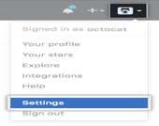


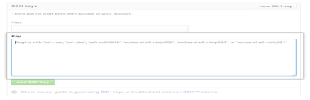

2. Adding SSH key to Github account
Copy key to your GitHub account
In the user bar in the top-right corner of page,
click setting button
Click SSH Keys in the left sidebar
Click Add SSH key
In the Title field, add a descriptive label for key
Paste your key into the "Key" field
Click Add key.

Slide 19
Testing
SSH to GitHub for testing ssh -T git@github.com
Switching remote URLs from HTTPs to SSH
git remote set-url origin git@gxxxxxx.gits

Slide 20
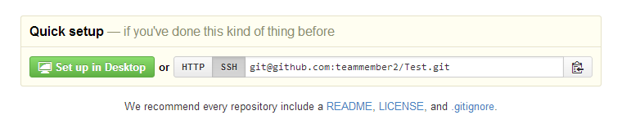
Contd…
Now you can push using
git push –all
If something change in remote, for sync purpose, you can type
git pull

Slide 21
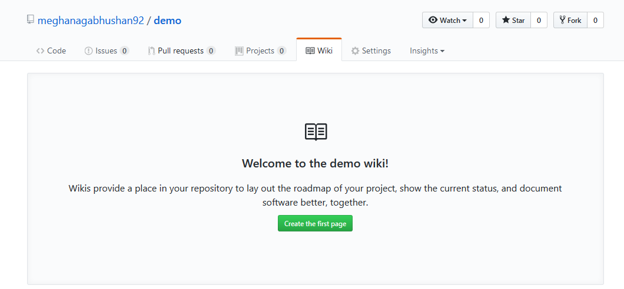
Wiki
Every GitHub repository comes equipped with a section for hosting documentation, called a wiki.

Slide 22
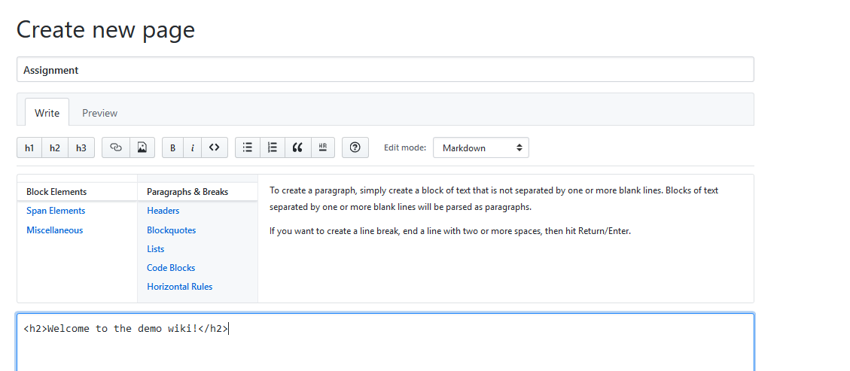
Wiki

Slide 23
Build Burndown Chart
A burn down chart is a graphical representation of work left to do versus time.

Slide 24
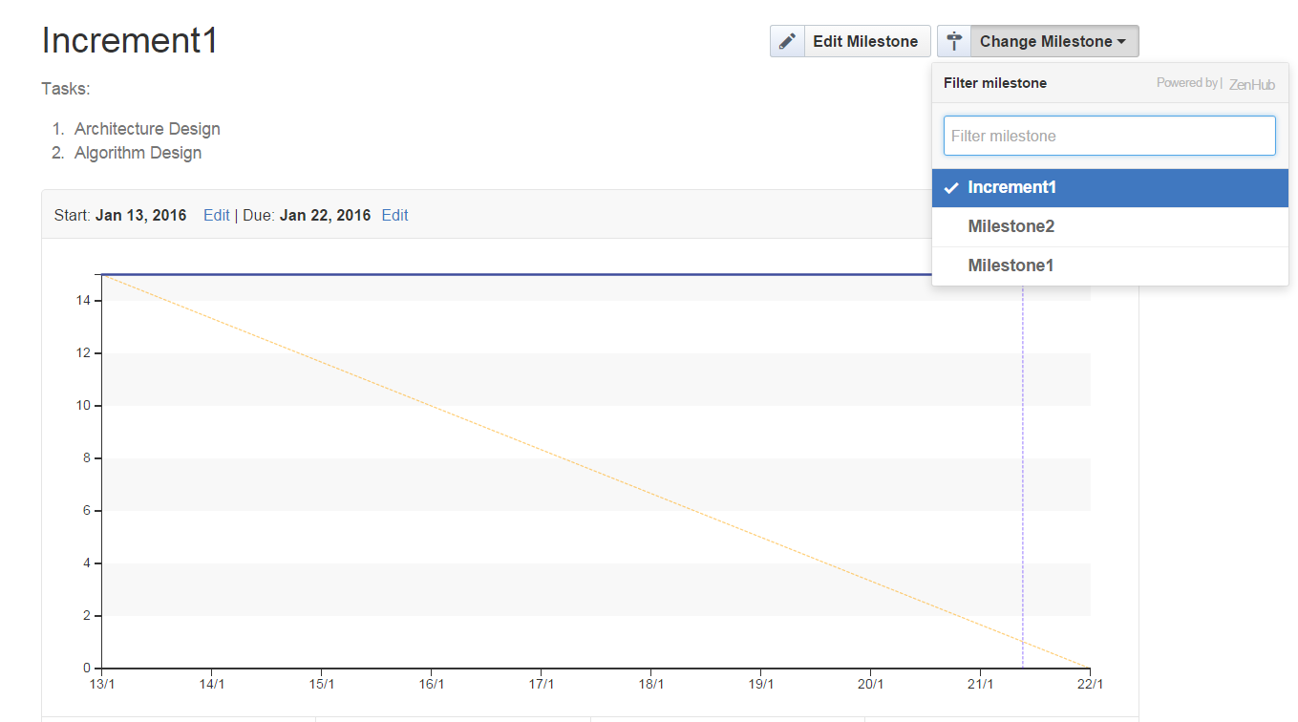
Build Burndown Chart
Go to burndown option, select a specific milestone, to see the burndown chart

Slide 25
Code Contribution
The Code Contribution on the Github Project will be used to evaluate your individual score on the contribution towards the project.

Slide 26
Wiki: Lab Submission
Create a repository for all Lab assignment submissions
Create a folder for each lab assignment and place all code inside source code folder
Use Github wiki pages to submit reports for each lab
Include all wiki links in README.md file

Slide 27
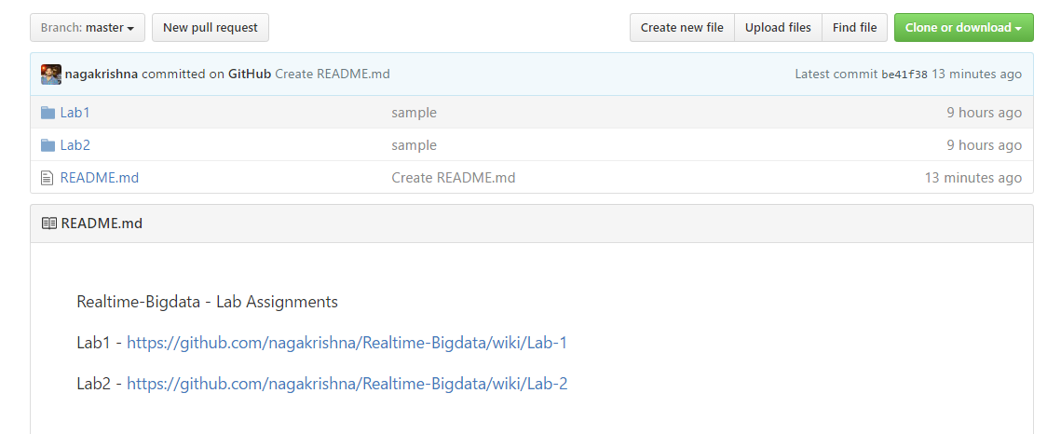
Wiki: Lab Submission

Slide 28
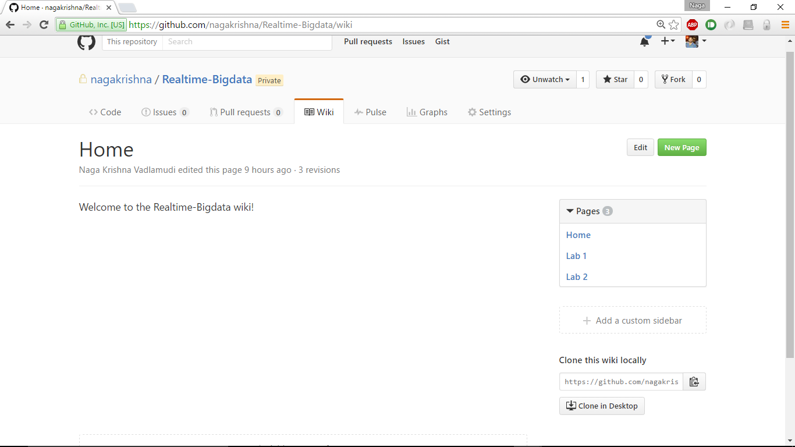
Wiki: Lab Submission

Slide 29
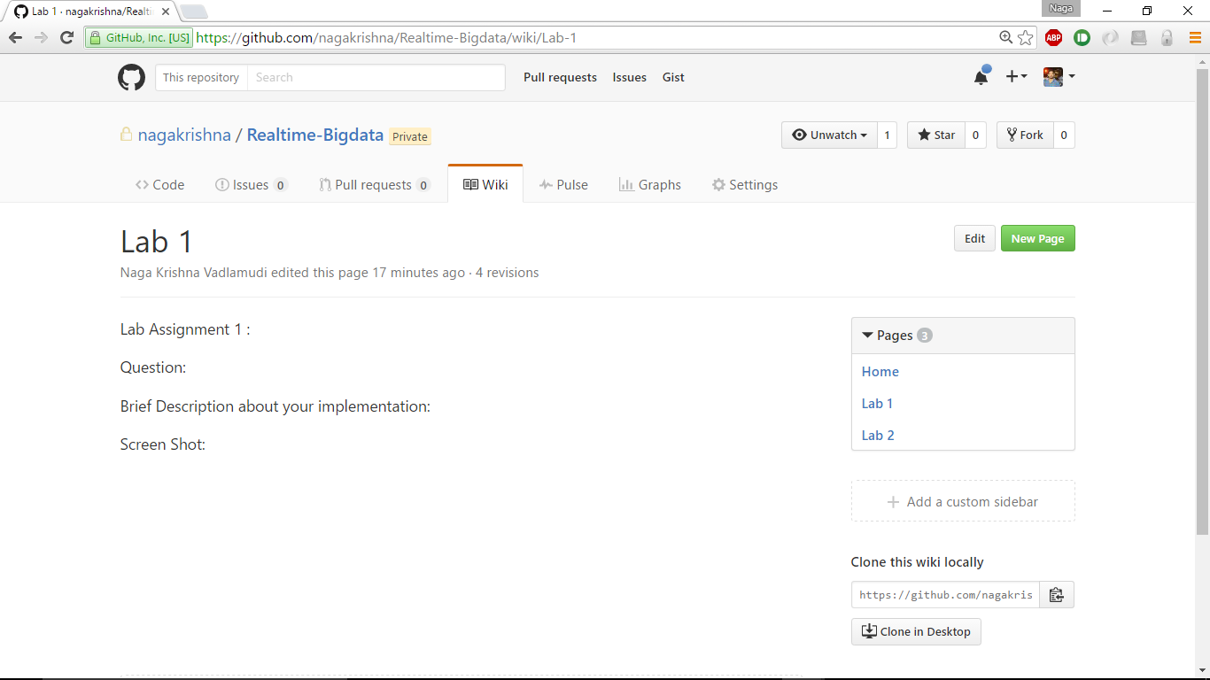
Wiki: Lab Submission

Slide 30
Video Recording
Video Submission is mandatory
ICP Submission for Online Students
Lab Submission for all the students
2 – 3 min video showing the demo of the ICP/Lab, with brief voice over on the code explanation
Use any software for recording: (Ref: https://filmora.wondershare.com/screen-recorder/best-open-source-screen-recorders.html)
Include the link in wiki and in submission form.

Slide 31
END

