Slide 1
CS 3630 Project 6
Name: Matthew Yang
GT email: mattyang@gatech.edu
GT username: myang349
GTID: 903447357

Slide 2
1. What data was given to you to complete this project? How did you use it?
We were given 180 Lidar scans (.ply files) that were captured by Argo, a self-driving car company in Pittsburgh, PA.
The scans were capture over 18 seconds (meaning ~10 scans/seconds)
The data from these lidar scans comes in the form of point clouds. In this assignment, we first visualized the point clouds, and then we used this data for ICP and factor graphs in order to estimate the pose of our vehicle w/ GTSAM
Finally, we finished up SLAM with mapping.

Slide 3
2. If you used LIDAR information from just one frame to create a map, what would the map be missing that make it not-so-helpful?
Using only one frame to create a map would defeat the purpose, since the goal of using ICP and factor graphs is to get the pose of the car (and other objects) OVER TIME.
Furthermore, the map would only display the point clouds from one time step, which would not be an accurate representation of the surroundings given all the noise that could occur.

Slide 4
3. What is the Iterative Closest Point (ICP) algorithm? Explain briefly.
“Briefly”, the ICP algorithm estimates the transform between two dense sets of points.
How it does this, is it first starts with an initial transformation guess. Next, it uses one of many mapping methods (i.e. point to plane), in order to map points from the first set to the second set.
Then, ICP estimates the new transformation parameters, performs the transform, and repeats until the change in transformation parameters between iterations is very small (meaning we slowly approach the correct answer every iteration).

Slide 5
4. How did you use the ICP algorithm in this project?
In this project, we implemented ICP, and we used it to align two clouds of LIDAR data.
In the Factor Graph section, we used the transforms from the ICP algorithm to estimate the POSE of our vehicle between two frames (two clouds).
We then used ICP again to add skip connections to our Factor Graph.
Ultimately, the role of ICP was to provide transforms that could be used in our Factor Graph to estimate the poses of our vehicle over time.

Slide 6
5. What is a factor graph? How was it used in this project?
In general, a factor graph is a probabilistic graphical model. In the beginning of the course, we converted bayes nets to factor graphs, which allowed us to run inference algorithms in good time complexity.
In this project, we used factor graphs in order to estimate the pose of our vehicles using the transforms from our ICP algorithm, where the transforms become our “factors”, and the variables we are optimizing are the poses.

Slide 7
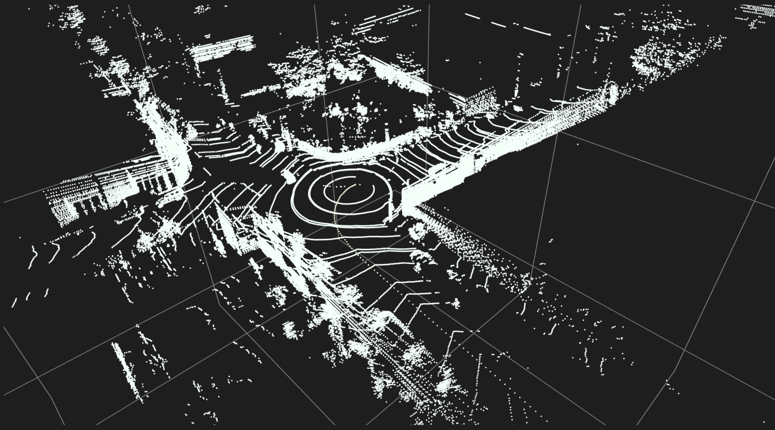
6. Paste a screenshot of the vehicle poses being given as output from the factor graph.
<Insert screenshot here.>

Slide 8
7. In the generated map, what happened to the people and other cars moving around the car collecting LIDAR data?
In contrast to the very thick / solid clouds formed by stationary objects such as the walls, the people and other cars appear “noise-like”, represented by the scattered points spread across the image.

Slide 9
8. What did you learn about mapping in autonomous driving in this project?
I learned that while autonomous driving sounds very cool, mapping is an extremely hard task and even having my hand held through this project, I found it very difficult.
Honestly, prior to this project, my understanding of mapping was very limited. I knew the theory behind using factor graphs and pose SLAM, but this project really helped me connect all the ideas.
Ultimately, I learned how we can turn LIDAR scans into full fledged maps, and that’s pretty cool!

Slide 10
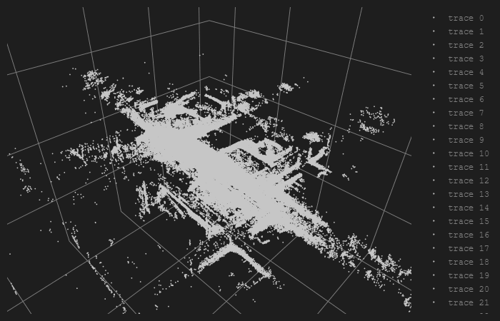
9. Insert the cloud map visible to you after at the end of the project.
<Answer here.>

Slide 11
10. What do you think you could add or change to make the map better?
Change it from single color to multi-color, like a heat map. This would make it much easier to visualize the difference between various densities of clouds, without having to zoom in on each area. It is also very laggy.
In terms of the actual quality of the map data, we could capture more LIDAR scans per second which would improve the accuracy of our optimizer’s world coordinate guesses.

Slide 12
11. Do you feel confident that you can take up a challenge related to self-driving at ArgoAI?
No, honestly this assignment has shattered my confidence.
I don’t know what I thought self-driving research was like, but spending many many hours pouring through documentation was not very fun.
I’m sure I could step up to the challenge, but I definitely do not feel ready right now and I would need to improve my computer science skills a lot.

