Slide 1
MIS 407
Week 2, Class 4
Aug. 29, 2016
Prof. Smith
timsmith@iastate.edu

Slide 2
Recap

Slide 3
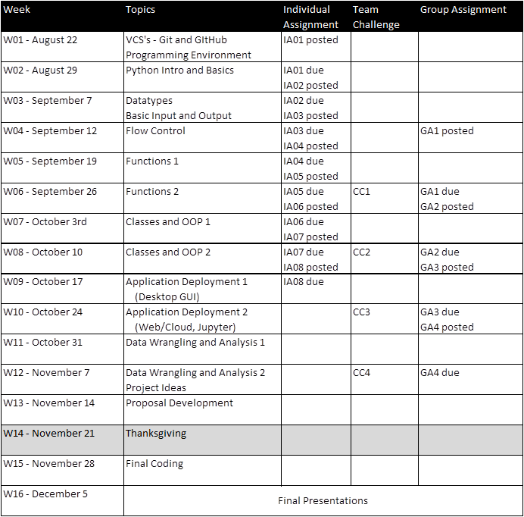
We are here

Slide 4
Individual Assignments
Unless otherwise stated, individual assignments are due by 7:55 AM on Friday’s.
IA01 is due this Friday morning at 7:55 AM!
IA02 will be available later Friday (Sept. 2nd) and will be due 7:55 AM on Friday Sept. 9th
Etc.

Slide 5
For Today…
Running Python Code
Organizing Python Code
pip and package management
Modules and Namespaces
"import" and "from"3.
Choose teams

Slide 6
But first…
Today’s TopHat questions
These ones count!

