Slide 1
W12c35
Introduction to Predictive Modelling
Tim Smith

Slide 2
Schedule of remaining items…
 | Class Content | Deliverables
9-Nov-16 | Intro to Predictive Analytics
11-Nov-16 | Modeling 1 (Clustering), Assisgment 7 posted
14-Nov-16 | Modeling 2 (Regression), Assignment 8 posted | Project Proposals (Due by Midnight)
16-Nov-16 | Class Time to work on project
18-Nov-16 | Class Time to work on project | Design Document, IA7 due (Both due by Midnight)
21-Nov-16 | break
23-Nov-16 | break
25-Nov-16 | break
28-Nov-16 | Class Time to work on project
30-Nov-16 | Project Presentation (5 minute), Closing lecture/remarks | Send slides prior to class presentation
2-Dec-16 | No/Class | Final Project Code Submitted, IA8 due

Slide 3
Remaining Deliverables
IA7 and IA8 will be on predictive analytics. In these assignments you will develop a Jupyter Notebook to develop a predictive model.
Final Project will consist of 4 deliverables.
Project Proposal (due by end of day Nov. 14)
Submit a brief introduction to your project idea (2-3 pages).
Design Document
Similar to GA2, submit a design document that elaborates on your project idea: It should define, Functionality, System Design (define details such as data required, module structure that will be developed, libraries that will be used), and project structure (who does what).
Project Presentation
5 Minute project prototype presention: What is the idea, how will you develop this (code/design), and demonstration of prototype.
Final Code/Product Delivery
Submit final working code and any associated documentation.

Slide 4
Choosing a Project
Choose a project that is “doable” within 3 weeks, yet challenging and interesting.
What is the business problem you’re solving?
Who are the users of the system?
How will they use the system?
What (if any) external data will you need to support this system, and where will you get it?

Slide 5
Choose how users will interact with your software…
Select one of the following interfaces for your program:
GUI based project using Tkinker
ChatBot based (“SlackBot”, or other)
Jupyter Notebook
Web based interface

Slide 6
Modeling algorithms, and algorithm
Introduction to Predictive Modelling
Tim Smith

Slide 7
A statistician and a data scientist watch someone flip a coin 5 times, and each time it comes up heads. The person flipping the coin then asked asks the statistician. “What will the result of the next coin flip” and the statistician says, these are independent events, and each coin toss have is 50/50 chance for heads or tails. This person then turns to the data scientist, and asks the same question. The data scientist says, “obviously you have a trick coin”.
BUT who is right?
This is an illustration of philosophical orientations we have about the world, and it's consistencies. The data scientist is illustrating a more empirically based perspective – showing an inclination to give what is observed precedence over what is supposed, thus drawing theory from evidence. The statistician, on the other hand, is showing a tendency to give precedence to the theoretical model, rather than what is seen.
At what point does the statistician doubt his/her model? At what point does the data scientist believe he/she has the correct one?

Slide 8
Decision Making and Problem Solving in Business
Before discussing effective decision making, we need to agree on what a decision is.
A rational decision is a choice that you make about what actions you will take (or not take) in a given situation after analysing the consequences of each option.
Often, rational decision making occurs as part of a larger problem-solving process.

Slide 9
Types of Decisions in Business
Structured
Algorithmic (A x B / C) where A, B & C are all known quantities = verifiable result
Transactional decisions - HST on a purchase
Unstructured
Open a new store? Launch a new product? Hire a new CIO?
Can only be accurately assessed after the fact
Semi-structured
Elements of both – Investment decision

Slide 10
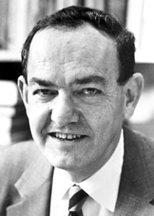
Can all business decisions be fully rational?
The rationality of individuals is bounded (limited) by cognitive limitations, limited time (budget), and limited access to information
Satisficing – Satisficing is a decision-making strategy that entails searching through the available alternatives until an acceptability threshold is met.
Herbert Simon
(1916-2001)
BUT - Easier access to more data and processing assistance can increase this “threshold”!

Slide 11
Agenda
Review the basics principles of and issues within predictive modeling
Data ‘lingo’
Model ‘Learning’
Model Performance measurement
The difficulty in predicting the future, and how we respond.

Slide 12

Predictive Modeling
Goal: build a representational model of a relationship between input and target values that predicts target measures that we have not yet seen.
Input
Hidden
Relationship
Target
Representational Model
Predicted
Target
The “hidden relationship” produces the target we are attempting to “hit”.
A representation model attempts to “hit” the target.

Slide 13
Application | Business Problem | Prediction Goal
Credit Scoring | How to assess and control risk within existing (or new) consumer portfolios? | Measure credit worthiness of new and existing set of customers
Market Basket Analysis | How to increase sales with cross-sell/up-sell, loyalty programs, promotions? | Which products are likely to purchased together?
Asset Maintenance | How to minimize operational disruptions and maintenance costs? | Identify real drivers of asset or equipment failure
Health & Condition Mgmt. | How can we reduce healthcare costs and satisfy patients? | Identify patients at risk of a chronic illness & offer treatment program
Fraud Mgmt. | How to decrease fraud losses and lower false positives? | Detect unknown fraud cases and future risks
Drug Discovery | How to bring drugs quickly and effectively to the marketplace? | Find compounds that have desirable effects & detect drug behavior during trials

Slide 14
Models are Not Perfect
Ideally, we identify a predictive model that accurately (without error) predicts future data
…. realistically, we never fully achieve this:
“The map is not the territory” (Eric Bell)
The world is noisy and stochastic
Even an ideal model will exhibit error when fitting to real world
“All models are wrong, but some are useful”(George E. P. Box)
Despite this lack of perfection, we can minimize expected error when predicting future data to such a degree that it significantly improves decision making.
Predictive analytics offers a set of practices, tools and approaches that can help us achieve “good” models that prove reasonably accurate.

Slide 15
Context Setting… let’s begin with a quick review of the fundamentals

Slide 16
Data Labeling
Data Set
In predictive modeling we identify and label variables as inputs and targets.
NOTE: You may also hear similar terms such as Independent and Dependent variables,
Explanatory and Response variables.
Though there are subtle differences between these terms, today we will see these as essentially “meaning” the same thing
inputs
target
Each row in our table is an observation, also known as cases.

Slide 17
Identify a Predictive Model
Data Set
inputs
target
Our goal is to identify a “Good” model that associates the observed inputs to observed targets

Slide 18
Predictive Models “Predict” Target values
Data Set
inputs
predictions
A predictive model, when given a set of input measurements, produces “predictions” of what the target value will be

Slide 19
The Predictive Modeling Process
Involves “training” a model to learn the best fit for the given data
Data Set
inputs
target
predictions
Guided by known values of our target variable, a number of candidate models are tested and “fine tuned”.

Slide 20
The Predictive Modeling Process
Involves “training” a model to learn the best fit for the given data
Data Set
inputs
target
predictions
errors
+
Model Selection &
Refinement
Better models have smaller error signals. The “best model” has the lowest error signal.
This error signal can get small, but rarely goes to zero.
The selection of models is bounded by skill, knowledge, capacity, and time
Prediction
Supervised Learning Process
Error Signal
Model Testing

Slide 21
Assessing model “fit”…
In general, we have two key approaches to assessing model fit:
Accuracy: Represent the error between the predicted values and the target values (i.e. sum of squared errors, r², misclassification rate, etc.) without assuming too much about the population
Confidence: Conduct a statistical test to identify how confident you are that the model fits the target population and is not the result of chance (based on assumptions about the population).
errors
The smaller the error the better the fit to the given data
NOTE: For the purposes of predictive modeling in data mining, it is quite common to focus on the 1st approach – representing how well the model predicts target values based on some measure or representation of error. Such a focus decreases the burden of assuming/guessing about characteristics of the population – but conversely, doesn’t provide you with “confidence” measures/indicators
Sampling approaches and model testing strategies can help us bridge these two approaches… we’ll cover this in a few slides ☺

Slide 22
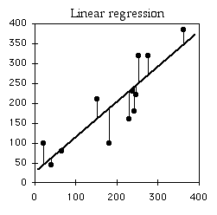
An Example…
One example that many of you will be familiar with is a (Least Squares) Regression Model
Given a set of data – with one continuous input variable, and one continuous output variable, we may then visually determine that the “best” model is the linear model – and we then attempt to fine tune the fit of this model by adjusting m and b (slope and intercept from y=mx+b ) to best fit (least error) the predicted values to the observed values
inputs
Take inputs and use
a linear model to predict target values…
Difference between
Predicted and Observed Target values are Errors
target
predictions
errors
The smaller the error the better the fit to the given data
Using Regression, we
develop a prediction
model …
Prediction=β₀+β₁(input)
(simply another form of y=mx+b)

Slide 23
Let’s test our understanding

Slide 24
Let’s test our understanding
Q1: When we fit a linear regression model to the data
We are attempting to select the best model.
We are attempting to identify the parameter values for a selected model that best fits the data.
Both a and b
None of the above

Slide 25
Let’s test our understanding
Q2: What’s our primarily objective when conducting predictive modeling?
Given a set of input variables, develop a model that accurately predicts target variables.
Develop a model that best fits your current data.
Accurately predict input variables
Describe the data in ways that generate new insights

Slide 26
Let’s test our understanding
The variables that we identify and use to predict values of target variables are called:
Big Data
Categorical Data
Continuous Variables
Input Variables

Slide 27
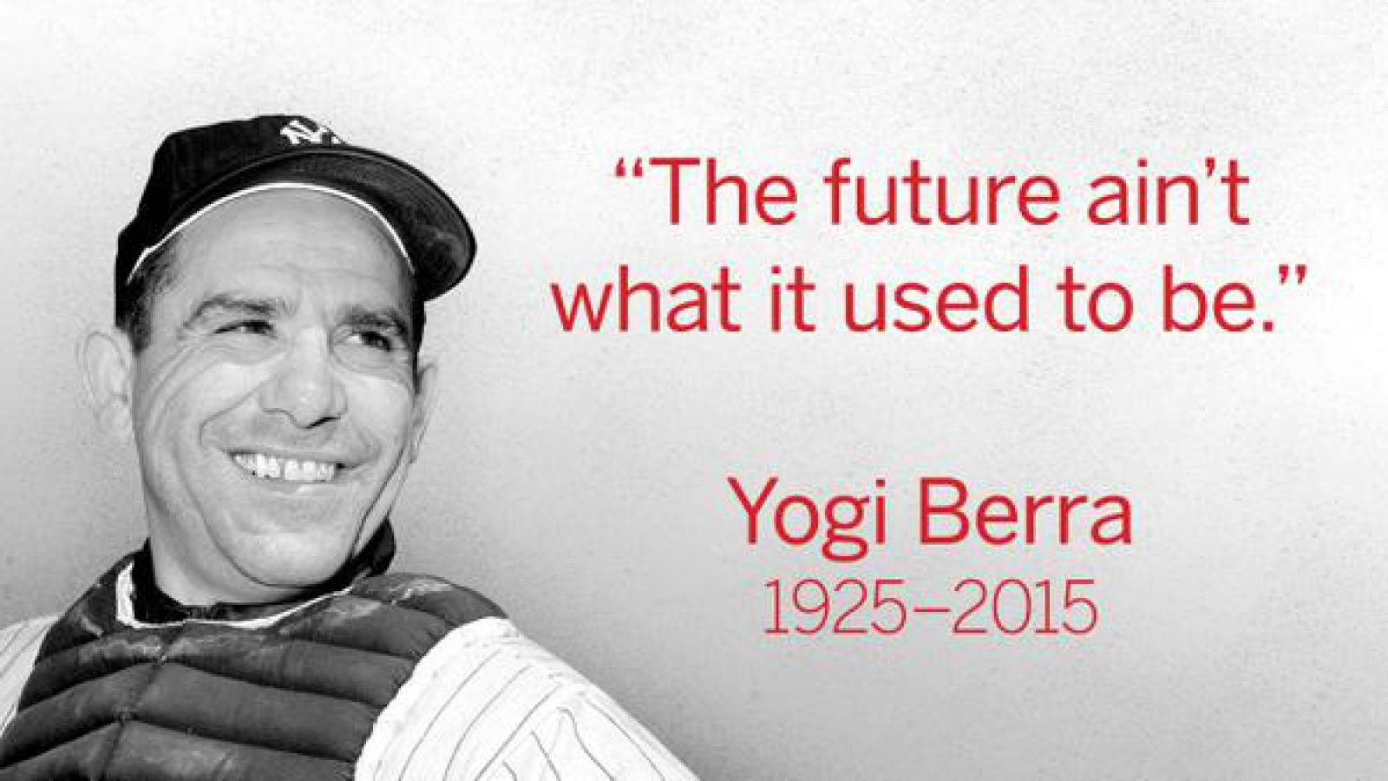
Now, let’s focus on two important issues in predictive analytics that set it apart from descriptive analytics…

Slide 28
Let’s ‘try’ to predict the future …
For demonstration purposes, I’ve created a data generating stochastic process that I will attempt to identify using regression analysis.

Slide 29
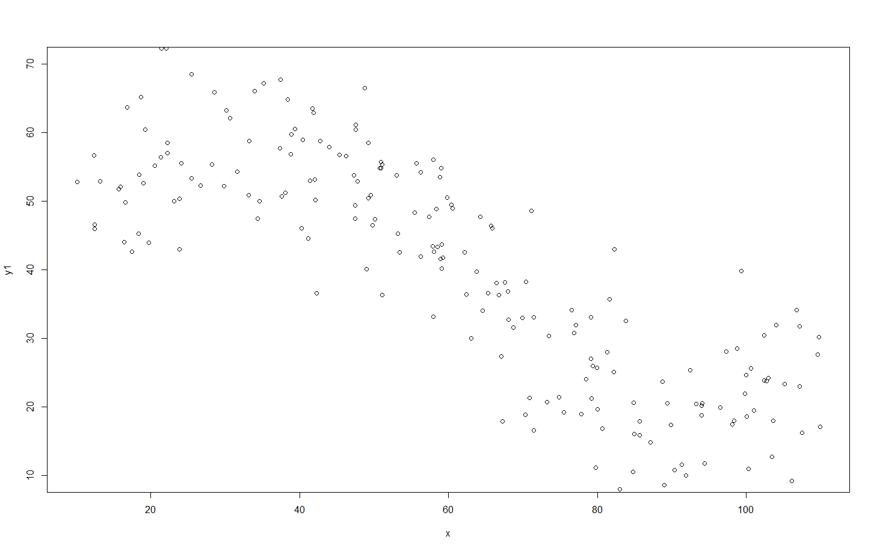
Using this process, I generate 200 observations…

Slide 30
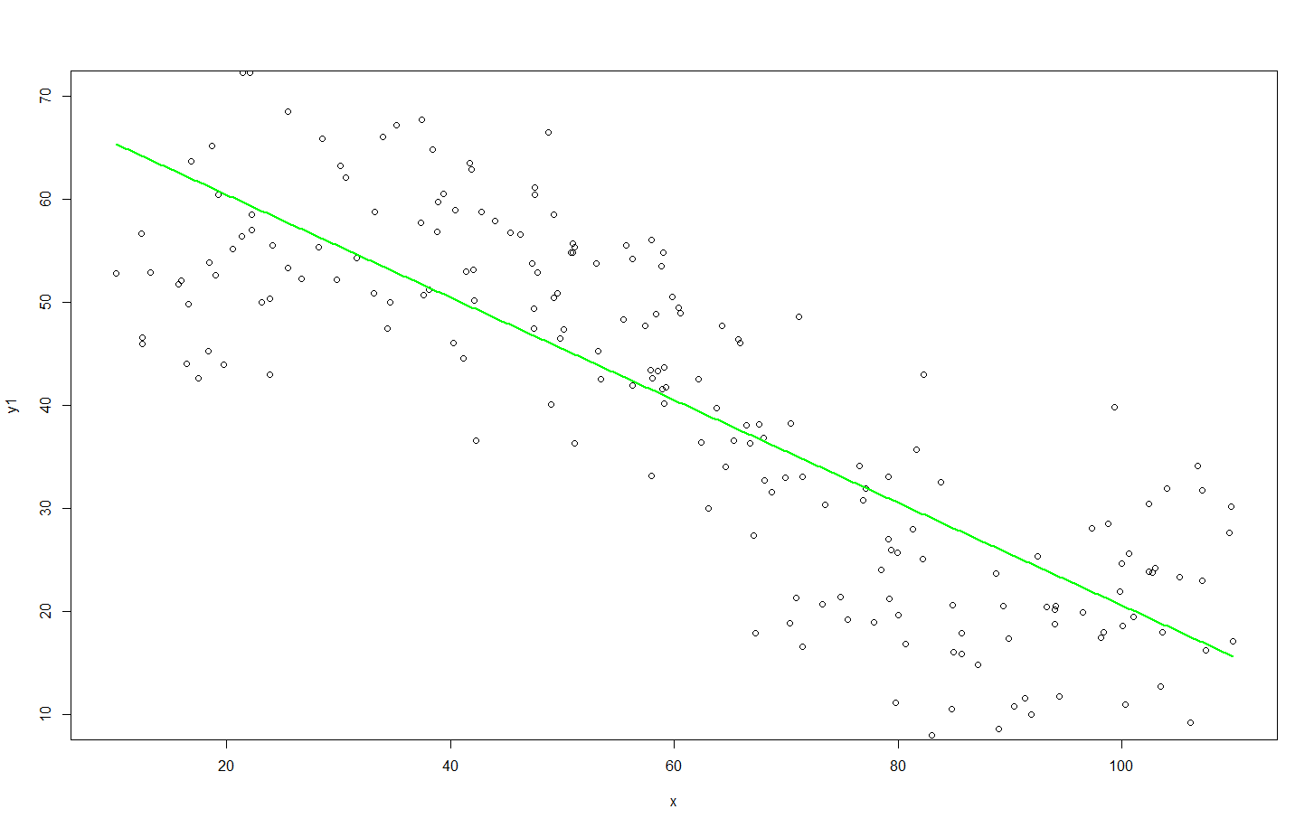
I fit my 1st Candidate Model to this “training” data:
Y=β₀+β₁x
Y=70.3-0.51x
Root Mean Squared Error = 10.71

Slide 31
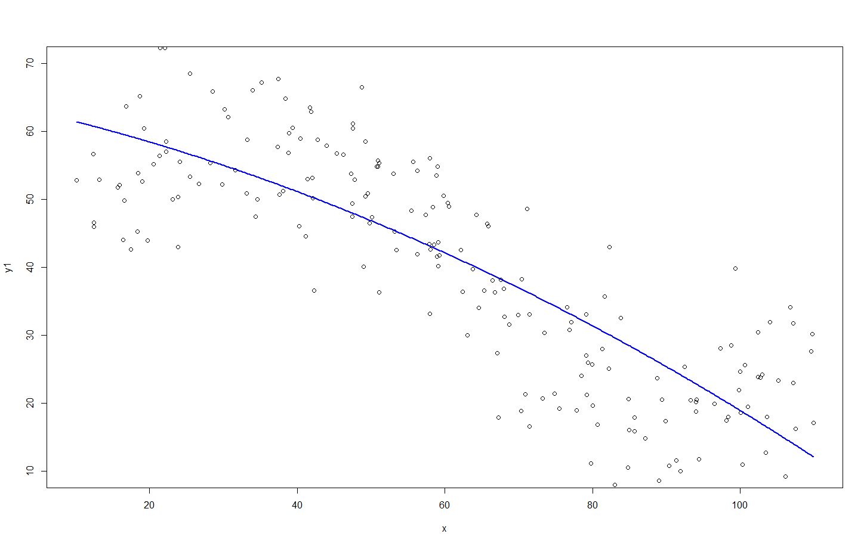
…Then, my 2nd Candidate Model:
Y=β₀+β₁x + β₂x²
Y=63.8-0.22x-0.002x²
Root Mean Squared Error = 9.94

Slide 32
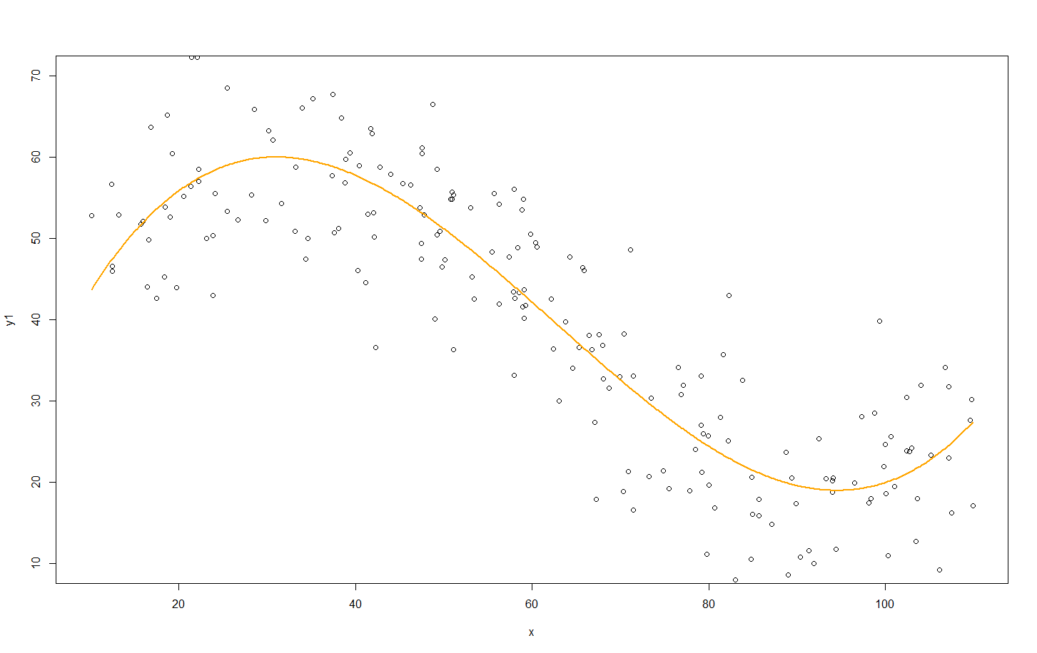
3rd Candidate Model:
Y=β₀+β₁x +β₂x²+β₃x³
Y=24.4+3.66x-0.058x²+0.0003x³
Root Mean Squared Error = 7.64

Slide 33
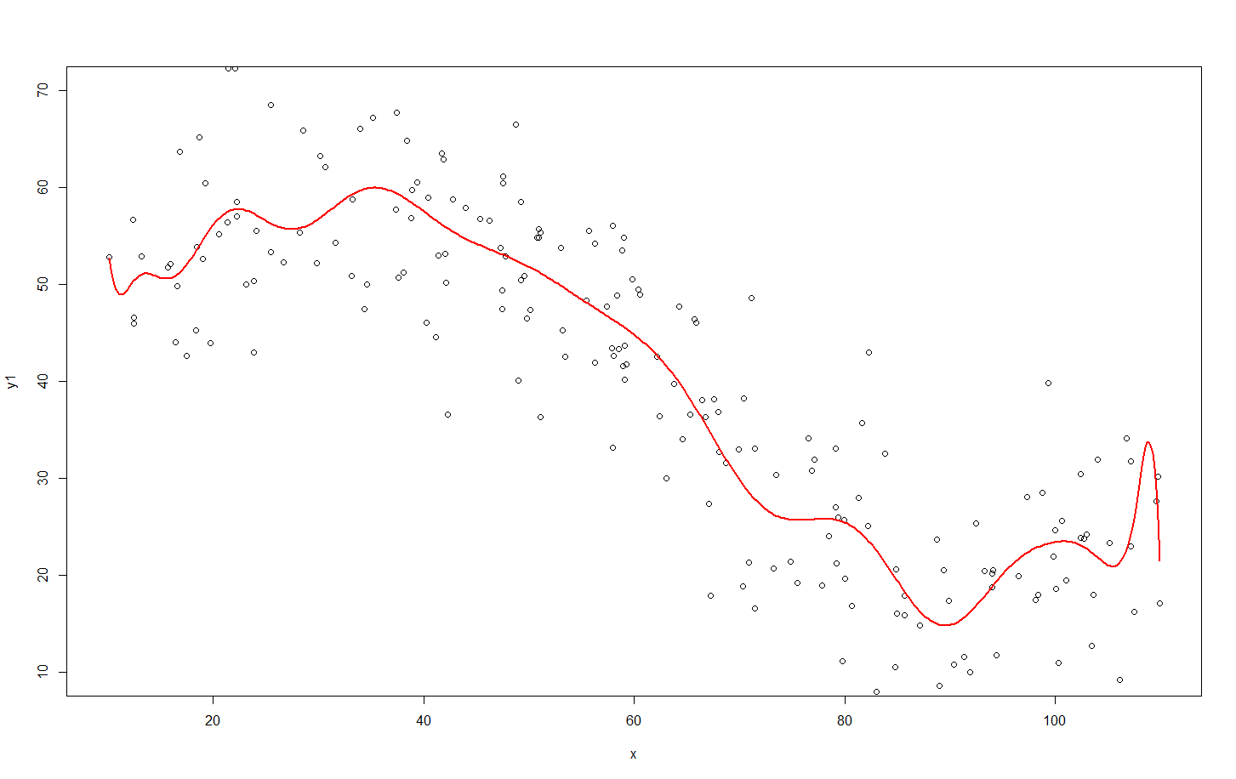
4th Candidate Model:
Y=β₀+β₁x +β₂x²+β₃x³+ β₄x⁴+β₅x⁵+ β₆x⁶+β₇x⁷+ β₈x⁸+β₉x⁹+ β₁₀x¹⁰+β₁₁x¹¹+ β₁₂x¹²+β₁₃x¹³+ β₁₄x¹⁴+β₁₅x¹⁵+ β₁₆x¹⁶+β₁₇x¹⁷+ β₁₈x¹⁸+β₁₉x¹⁹+ β₂₀x²⁰
Y=11490-4490.9x +777.3x²-78.1x³+ 5.1x⁴-0.29x⁵+ 0.007x⁶-0.00017x⁷+ 2.7*10⁻⁶x⁸-3.12*10⁻⁸x⁹+ … -1.97*10⁻²⁴x²⁰
Root Mean Squared Error = 7.38

Slide 34
The “Best” Performing Model…
Set of Predictive Models | Model Fit on Training Data (Root Mean Square Errors)
#1) Y=β₀+β₁x | 10.71
#2) Y=β₀+β₁x β₂x² | 9.94
#3) Y=β₀+β₁x +β₂x²+β₃x³ | 7.64
#4) Y=β₀+β₁x +β₂x²+β₃x³+ β₄x⁴+β₅x⁵+ β₆x⁶+β₇x⁷+ β₈x⁸+β₉x⁹+ β₁₀x¹⁰+β₁₁x¹¹+ β₁₂x¹²+β₁₃x¹³+ β₁₄x¹⁴+β₁₅x¹⁵+ β₁₆x¹⁶+β₁₇x¹⁷+ β₁₈x¹⁸+β₁₉x¹⁹+ β₂₀x²⁰ | 7.38

Slide 35
So, which is the better predictive model? To identify this, we need to understand how to systematically balance between complexity, and guarding against under/over fitting

Slide 36
Some approaches to this…
Big Data: With more and more data, law of large numbers tells us that is should become more and more representative of there “true” model (distribution).
Could you ever have “enough”? And if you did, would you have the resources to process this in a timely fashion?
What about drift? Maybe the real-world model in which you are attempting to identify is changing?
Penalize complexity: To combat overly-flexible models, apply some penalty for complexity (i.e. Put limits on number of parameters, levels, etc.)
This is a rather arbitrary call, but can work on certain data sets where visualization and intuition (like in our previous example) can be applied. But, the limits used can often be inappropriate… we are attempting to limit such “from the gut” evaluations.
Cross-validation: Divide data into two parts. Call one part the training set, and the other the validation set. Develop the model on the training set, and assess performance on the validation set.

Slide 37
…let’s elaborate on this last approach (which is arguably the best overall approach, and one that you’ll commonly use)

Slide 38
Data Splitting and “Right” Fitting Honest Testing of our Predictive Model
Validation
Training
Test

Slide 39
Addressing issues of fit and complexity
The training set is used to determine the best fitting parameters for each of our models.
The validation set allows us to test each model against new data, and determine the best performing model.
The test set allows us to conduct a honest assessment (or scoring) of how well the selected model performs.

Slide 40
Data Partitioning
Training Data
Original Data
inputs
target
inputs
target
Validation Data
inputs
target
Test Data
inputs
target
Three data sets (Training, Validation, and Test) are sampled from the original data sets.

Slide 41
Predictive Model Sequence
Training Data
Validation Data
inputs
target
inputs
target
1
2
Using the training data create a number of potential models – some of which more complex than others
3
4
5
Model
Complexity

Slide 42
Model Performance Assessment
Training Data
Validation Data
inputs
target
inputs
target
1
Rate model performance using validation data.
2
3
4
5
Model
Complexity
Validation
Assessment

Slide 43
Model Selection
Training Data
Validation Data
inputs
target
inputs
target
1
Select the simplest model with the highest validation assessment.
2
3
4
5
Model
Complexity
Validation
Assessment

Slide 44
“Honestly” Assessing Selected Model Performance
Training Data
Test Data
inputs
target
inputs
target
Rate the models performance on a test set of data… A set of data not used in the training of the model or to cross validate the model.
3

Slide 45
The “Best” Performing Model…
Using the four models that “I fitted” to the training data, I test the fit of each model on a new batch of data (produced by the same stochastic process that I used to generate the first batch)…
Set of Predictive Models | Model Fit on Training Data (Sum of Squared Errors) | Model Fit on Validation Data (Sum of Squared Errors)
#1) Y=β₀+β₁x | 10.71 | 10.31
#2) Y=β₀+β₁x β₂x² | 9.94 | 10.21
#3) Y=β₀+β₁x +β₂x²+β₃x³ | 7.64 | 8.99
#4) Y=β₀+β₁x +β₂x²+β₃x³+ β₄x⁴+β₅x⁵+ β₆x⁶+β₇x⁷+ β₈x⁸+β₉x⁹+ β₁₀x¹⁰+β₁₁x¹¹+ β₁₂x¹²+β₁₃x¹³+ β₁₄x¹⁴+β₁₅x¹⁵+ β₁₆x¹⁶+β₁₇x¹⁷+ β₁₈x¹⁸+β₁₉x¹⁹+ β₂₀x²⁰ | 7.38 | 9.19

Slide 46
The “Best” Performing Model…
Set of Predictive Models | Model Fit on Training Data (Sum of Squared Errors) | Model Fit on Validation Data (Sum of Squared Errors)
#1) Y=β₀+β₁x | 10.71 | 10.31
#2) Y=β₀+β₁x β₂x² | 9.94 | 10.21
#3) Y=β₀+β₁x +β₂x²+β₃x³ | 7.64 | 8.99
#4) Y=β₀+β₁x +β₂x²+β₃x³+ β₄x⁴+β₅x⁵+ β₆x⁶+β₇x⁷+ β₈x⁸+β₉x⁹+ β₁₀x¹⁰+β₁₁x¹¹+ β₁₂x¹²+β₁₃x¹³+ β₁₄x¹⁴+β₁₅x¹⁵+ β₁₆x¹⁶+β₁₇x¹⁷+ β₁₈x¹⁸+β₁₉x¹⁹+ β₂₀x²⁰ | 7.38 | 9.19
Increasing
Complexity
Better fit
Worse fit
What’s going on here is that most complicated model — in this case, the 20th order polynomial— is not fitting the generalizable features of the data. Instead, this model is fitting the sampling noise, or the accidents which don’t repeat.
In general complex models tend to over- fit the data. Conversely, models that are too simple may not describe the generalized features of the data with sufficient detail, and thus results in under-fitting.

Slide 47
Apply this algorithm to our previous example…
Set of Predictive Models | Model Fit on Training Data (Sum of Squared Errors) | Model Fit on Validation Data (Sum of Squared Errors)
#1) Y=β₀+β₁x | 10.71 | 10.31
#2) Y=β₀+β₁x β₂x² | 9.94 | 10.21
#3) Y=β₀+β₁x +β₂x²+β₃x³ | 7.64 | 8.99
#4) Y=β₀+β₁x +β₂x²+β₃x³+ β₄x⁴+β₅x⁵+ β₆x⁶+β₇x⁷+ β₈x⁸+β₉x⁹+ β₁₀x¹⁰+β₁₁x¹¹+ β₁₂x¹²+β₁₃x¹³+ β₁₄x¹⁴+β₁₅x¹⁵+ β₁₆x¹⁶+β₁₇x¹⁷+ β₁₈x¹⁸+β₁₉x¹⁹+ β₂₀x²⁰ | 7.38 | 9.19
✓
Using this mode performance assessment, through a systematic evaluation we identify the 3rd model as our best candidate “predictive” model.

Slide 48
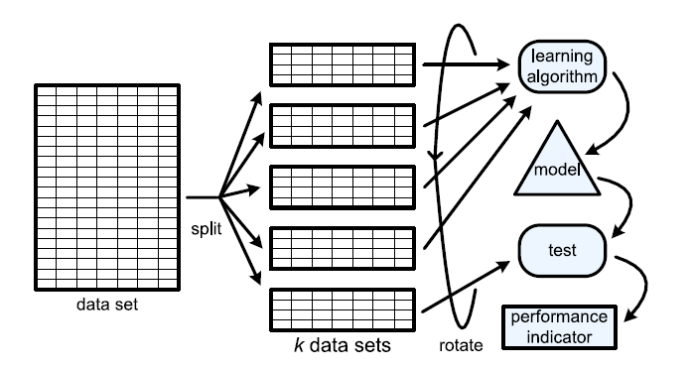
Advanced Predictive Modeling
Advanced Learning Algorithms take an approach of splitting the data multiple times, thus creating many different (yet from the same population) training and validation sets. The “cross validation” approach, in general, can result in identifying a more reliable (better performing when faced with new data) predictive model.
(source: Van der Aalst, W. (2011). Process mining: discovery, conformance and enhancement of business processes.)

Slide 49
Let’s test our understanding
The best model is the
simplest model with the best performance on the training data.
simplest model with the best performance on the validation data.
most complex model with the best performance on the training data.
most complex model with the best performance on the validation data.

Slide 50
Summary - Key Issues in Predictive Analytics
Two important issues that we need to consider for all modeling in predictive analytics…
Data “Fit”:
Over-Fitting: If our model is too specific in describing our existing/current data that we have used to fit our model, we may limit the models ability to predict data that we have not yet evaluated.
Under-Fitting: If our model is too general, we may limit the models ability to accurately predict data that has not yet been seen.
Model complexity:
Complex models introduce more assumptions than less complex models. Therefore, within reason, less complex models are preferred.
Complex models are more difficult to interpret, communicate and understand.
Complex models require more processing, and for time sensitive forecasts, this can be a big deterrent.
But, simple models may not capture the patterns exhibited by any underlying process or relationship being observed.

