Slide 1
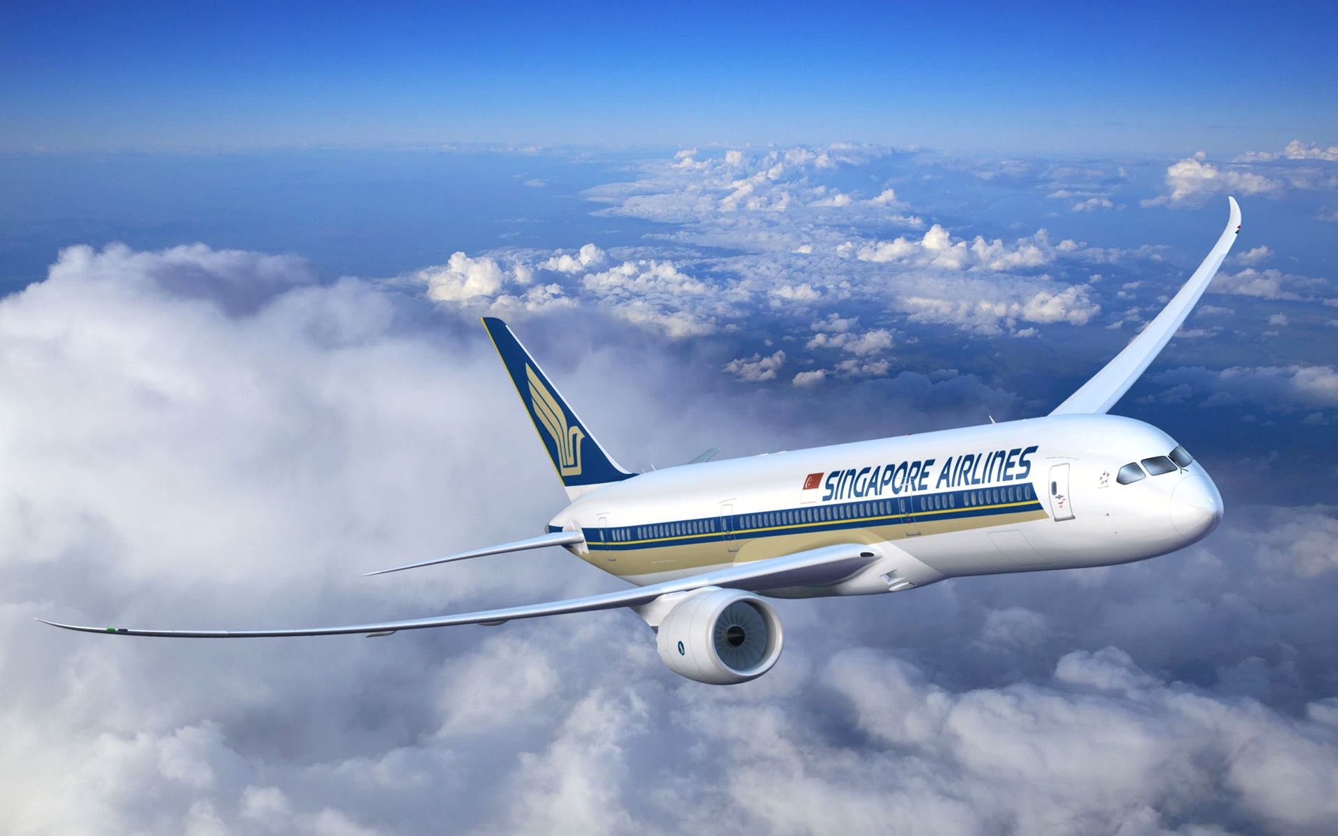

“Be Part of SIA’s Digital Transformation”
Team Bazingaa

Slide 2
Business Challenge
Business Challenge
Digital Singapore Stopover Holiday (SSH)
Problems
Pack has to be collected at SSH counter
Customers might not be able to find SSH counter
Paper-based; cumbersome and might lose it
QR codes generated and pasted manually; room for human errors
Have to brief customers manually on updates of attraction
Missing out on deals
Customers might lose the feedback forms
Driver collects feedback forms manually

Slide 3
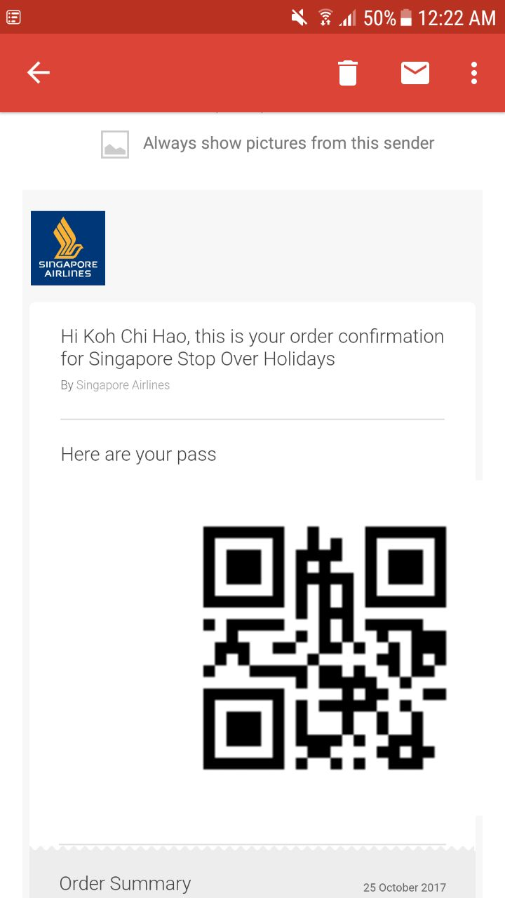
Solutions
Business Challenge
QR code that ties to customer’s particulars sent to their email using NodeMailer
Prompt user to download StopoverLah app in the email
Feedbacks to be done on iPad installed on shuttle service that brings customers back to airport for departure
StopoverLah
An app that includes everything in the SSH welcome pack
Interactive bus maps
QR Code for attractions
Exclusive deals

Slide 4
StopoverLah
Business Challenge
Customer scans QR code in email sent to get another QR code that acts as ticket to attractions
Interactive bus maps use GPS so app can still work while offline
Push notification to customers automatically about new exclusive deals
Staff will be able to login to admin site and edit content if necessary

Slide 5
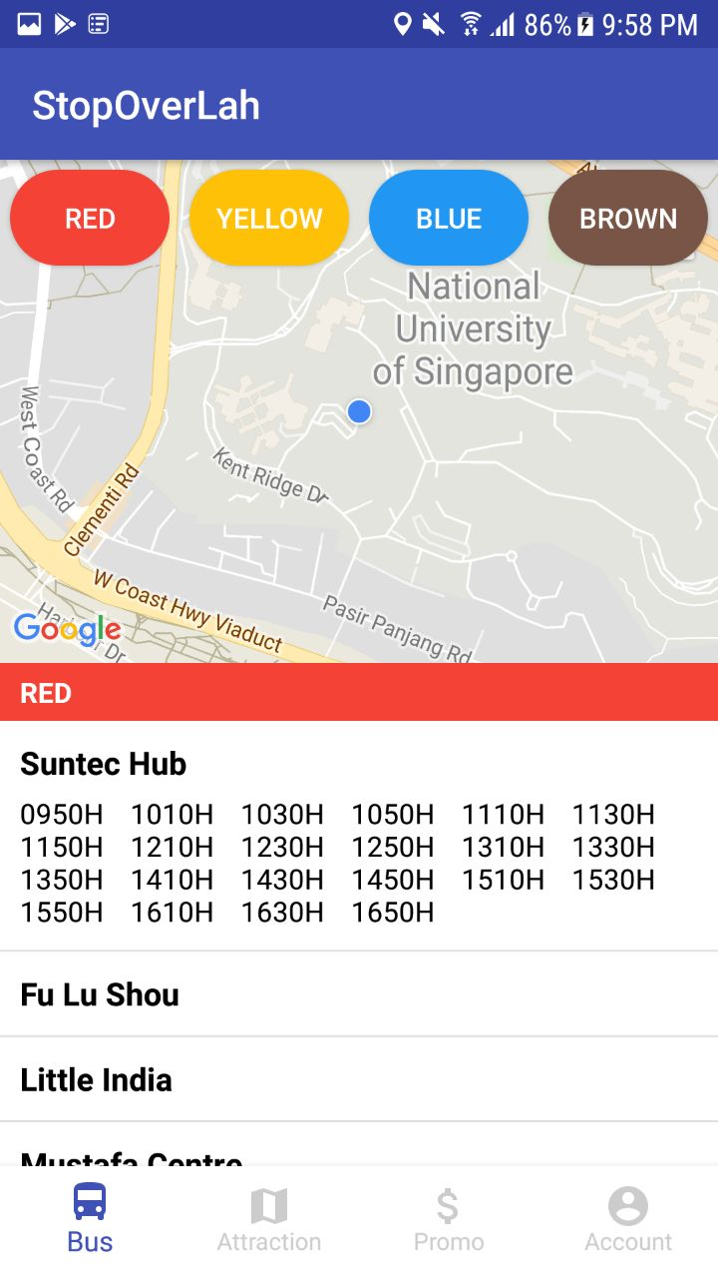
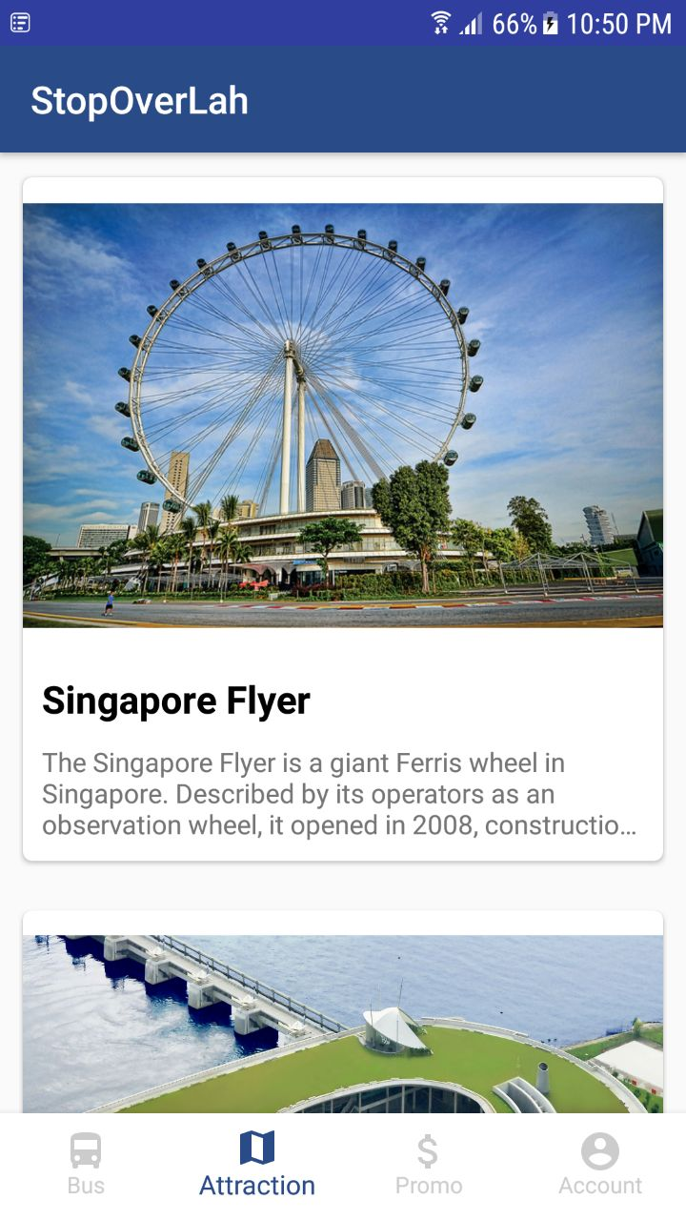
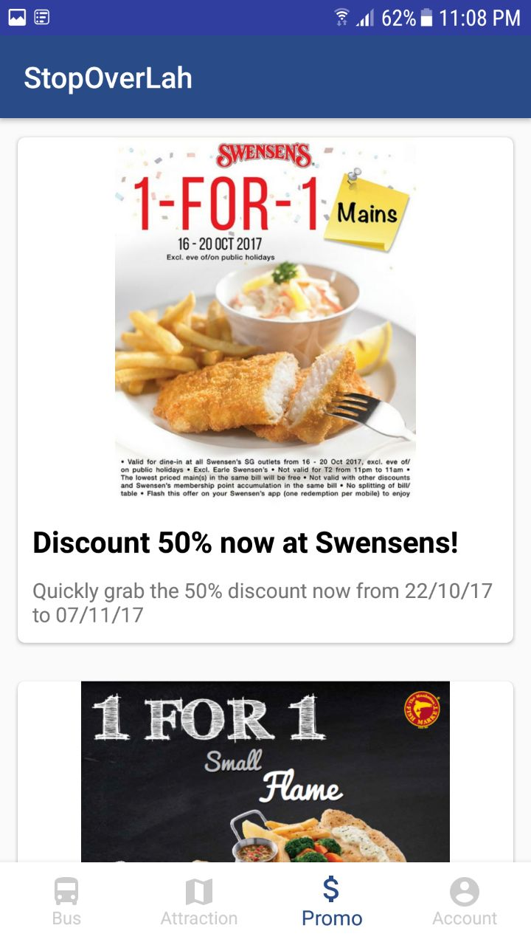
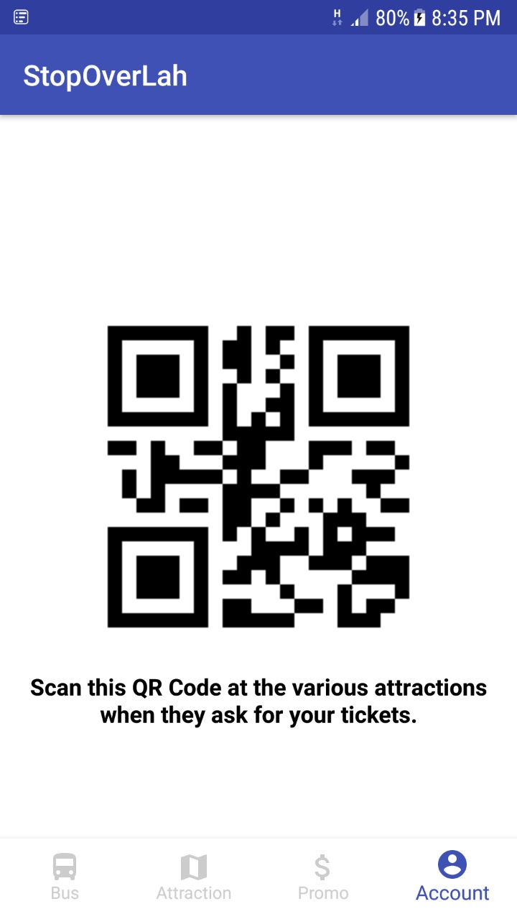
StopoverLah
Business Challenge
Interactive maps that use GPS
Information on attractions
Exclusive deals
QR code for attractions

Slide 6
Business Challenge
DEMONSTRATION

