Slide 1
SPARQA: Skeleton-based Semantic Parsing for Complex Questions over Knowledge Bases
Yawei Sun, Lingling Zhang, Gong Cheng, Yuzhong Qu
National Key Laboratory for Novel Software Technology, Nanjing University

Slide 2
Outline
Background
Our approach
Overview
Skeleton Parsing
Multi-Strategy Scoring
Experiment
Conclusion
Notes:
Background 3
Motivation
Our Approach
Overview
Skeleton Parsing
Multi-Strategy Scoring
Experiments
Conclusion

Slide 3
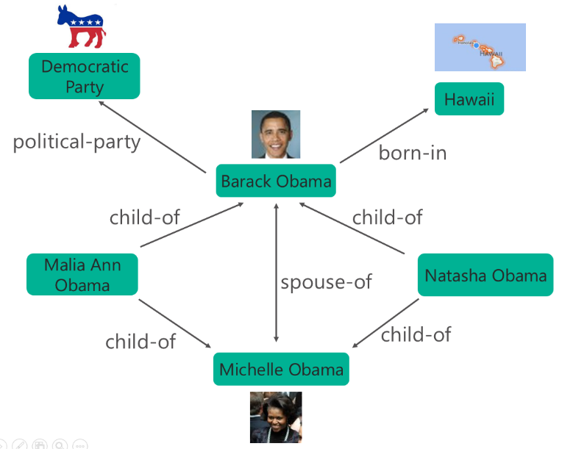
Question Answering over Knowledge Base (KBQA)
Question: Who is the wife of Barack Obama ?
Question Answering
Answer: Michelle Obama
Knowledge Base
Notes:
Freebase
DBpedia
Wikidata
YAGO

Slide 4
KBQA Classification
Simple KBQA
Single Predicate
Complex KBQA
Multiple Predicates or Aggregation
Example: What movie that Miley Cyrus acted in had a director named Tom Vaughan ?

Slide 5
Challenge 1
Syntactic Parsing Error
Incorrect relation between “in” and “had”
Miss long-distance dependency relation between “movie” and “had”
Notes:
Question parser error leads to their ill-formed representations.
of long complex questions
Complex KBQA
Existing works
Siva: transform dependency tree to logical form. (emnlp17)
Abu: recognize sub-questions from dependency tree. (www17)
Zou: construct query graph based on dependency tree. (tkde18)

Slide 6
Challenge 2
Structural Heterogeneity
what movie
?x
acted in
director named
film.performance.film
film.film.directed_by
Miley Cyrus
Tom Vaughan
?y
m.02z02cx
film.performance.actor
m.0bdxs5
Notes:
between question structure and knowledge base

Slide 7
Our approach
Challenges | Our solutions
Syntactic Parsing Error | Skeleton Parsing
Structural Heterogeneity | Multi-Strategy Scoring
Notes:
Challenge 1: parser error problem
Challenge 2: Structural Heterogeneity

Slide 8
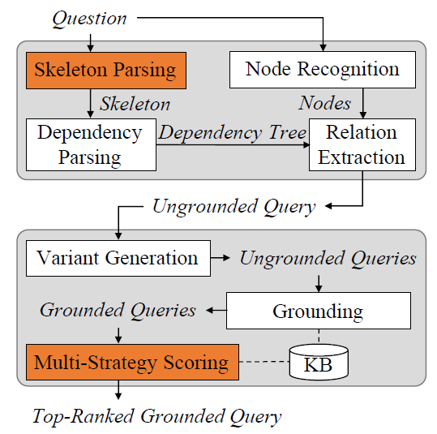
Our approach – Overview
Notes:
Question -> Skeleton Parsing -> dependency parsing -> relation extraction -> ungrounded query -> ungrounded queries -> grounded queries -> top-Rank Grounded Query -> answer
KB-independent Ungrounded Query Generation
parsing: coarse-to-fine
KB-dependent Grounded Query Generation

Slide 9
Example
What movie had a director ?
What movie
What movie that Miley Cyrus acted in had a director named Tom Vaughan ?
acl:relcl
acl
acted in
director named
that Miley Cyrus acted in
named Tom Vaughan
Miley Cyrus
Tom Vaughan
(1) Question
(2) Skeleton
(3) Ungrounded Query
?x
?x
film.performance.film
film.director.film
?y
m.02z02cx
?y
m.02z02cx
So Undercover
film.actor.film
m.0bdxs5
m.0bdxs5
(4) Variant
(5) Grounded Query
(6) Answer
Notes:
A -> B 通过skeleton parsing. B->C通过relation extraction. C->D通过一些变种操作. D->E通过顶点和边的grounding. E->F通过ranking和scoring打分, 最后返回第一个非空的答案.

Slide 10
Skeleton Parsing
Skeleton
Span: minimum semantic unit (S, NP, VP, PP)
Attachment relation: seven dependency relations (acl, acl:relcl, nmod, nmod:poss, conj, xcomp, advcl)
What movie had a director ? [S]
acl:relcl
acl
that Miley Cyrus acted in [S]
named Tom Vaughan [VP]
Notes:
s, np, vp, pp

Slide 11
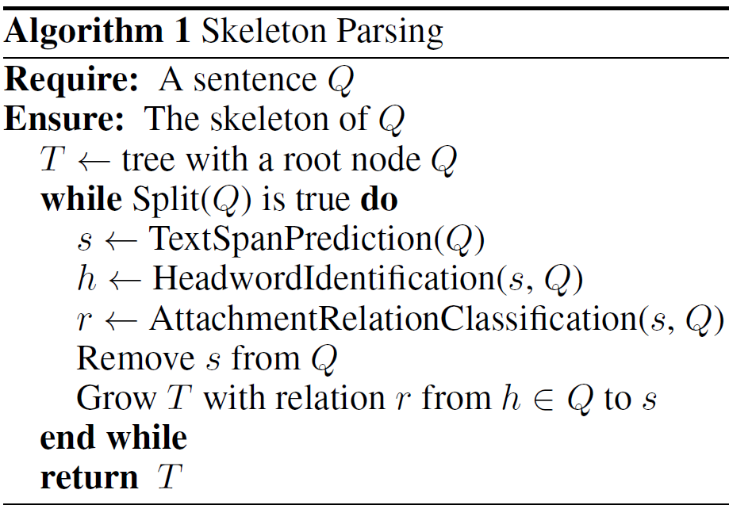
Skeleton Parsing
Notes:
4个零部件

Slide 12
Skeleton Parsing
Notes:
4个零部件

Slide 13
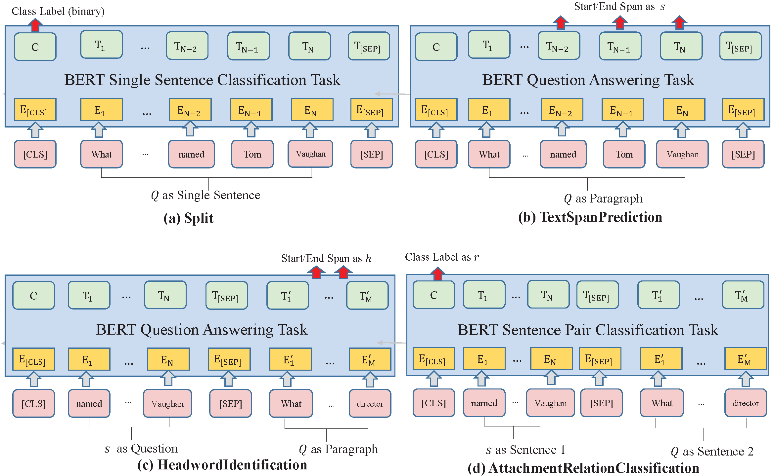
Skeleton Parsing – Procedures

Slide 14
Example – What movie that Miley Cyrus acted in had a director named Tom Vaughan ?
Step 1
What movie that Miley Cyrus acted in had a director ?
acl
named Tom Vaughan
Step 2
What movie had a director ?
acl:relcl
acl
that Miley Cyrus acted in
named Tom Vaughan

Slide 15
Multi-Strategy Scoring – Sentence-level Scorer
Question
Training data
Question Pattern
(Question pattern, Query pattern)
Topic Entity
Formal Query
Scoring
Candidate Grounded Queries
Notes:
Question Pattern

Slide 16
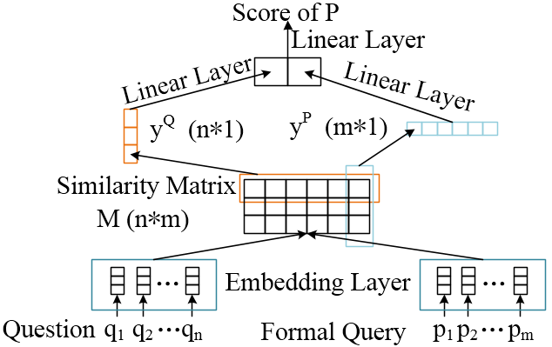
Multi-Strategy Scoring – Word-level Scorer

Slide 17
Experiment – Setup
Dataset | GraphQuestions | ComplexWebQuestions
Baseline | SEMPRE PARASEMPRE JACANA UDEPLAMBDA SCANNER PARA4QA | MHQA-GRN SIMPQA + PRETRAINED SPLITQA + PRETRAINED SPLITQA + data augmentation PullNet
Metric | F1 | P@1

Slide 18
Experiment – Result
GraphQuestions
ComplexWebQuestions
Method | F1
SEMPRE | 10.80
PARASEMPRE | 12.79
JACANA | 5.08
UDEPLAMBDA | 17.70
SCANNER | 17.02
PARA4QA | 20.40
SPARQA | 21.53
Method | P@1
MHQA-GRN | 30.10
SIMPQA + PRETRAINED | 19.90
SPLITQA + PRETRAINED | 25.90
SPLITQA + data augmentation | 34.20
PullNet | 45.90
SPARQA | 31.48
Notes:
ComplexWebQuestions

Slide 19
Experiment – Ablation Study
ComplexWebQuestions
Method | P@1
SPARQA | 31.48
SPARQA w/o skeleton parsing | 29.39
SPARQA w/o sentence-level scorer | 26.45
SPARQA w/o word-level scorer | 26.11

Slide 20
Conclusion
SPARQA
Skeleton Parsing
Multi-Strategy Scoring
Future Work
Node Recognition and Linking
Structural Heterogeneity
Notes:
Parsing
Challenge 1: parser error problem
Solution: Skeleton Parsing
Grounding
Challenge 2: structure mismatch problem
Solution: Multi-Strategy Scoring

Slide 21

Thanks for your listening
Code and Skeleton
https://github.com/nju-websoft/SPARQA
email: ywsun@smail.nju.edu.cn
Notes:
Skeleton Annotation data 10K. 后续代码也会放上去.
如果大家感兴趣的话, 可以使用, 也欢迎提问题, 与我联系.

