Slide 1
SPARQA: Skeleton-based Semantic Parsing for Complex Questions over Knowledge Bases
Yawei Sun, Lingling Zhang, Gong Cheng, Yuzhong Qu
National Key Laboratory for Novel Software Technology, Nanjing University
Notes:
各位老师, 各位专家, 下午好, 我叫孙亚伟, 来自南京大学计算机系
首先说明的是, 本人初学NLP技术, 如果有讲错的地方, 请批评和指正.

Slide 2
Outline
Background
Our approach
Overview
Skeleton Parsing
Multi-Strategy Scoring
Experiment
Conclusion
Notes:
Background 3
Motivation
Our Approach
Overview
Skeleton Parsing
Multi-Strategy Scoring
Experiments
Conclusion

Slide 3
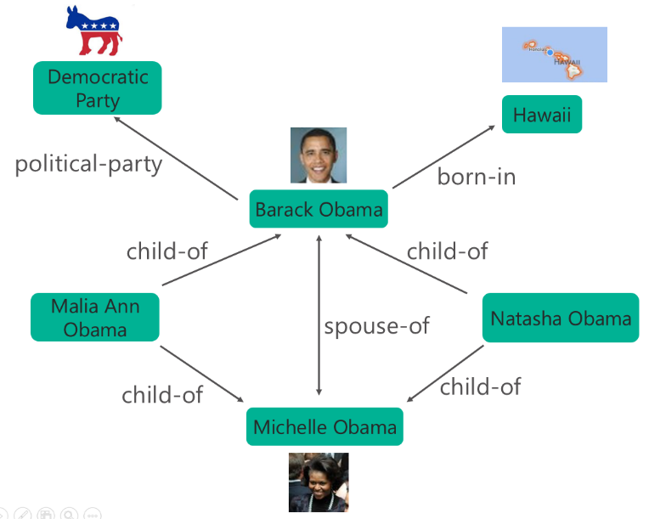
Question Answering over Knowledge Base (KBQA)
Question: Who is the wife of Barack Obama ?
Question Answering
Answer: Michelle Obama
Knowledge Base
Notes:
Freebase
DBpedia
Wikidata
YAGO

Slide 4
KBQA Classification
Simple KBQA
Single Predicate
Complex KBQA
Multiple Predicates or Aggregation
Example: What movie that Miley Cyrus acted in had a director named Tom Vaughan ?

Slide 5
Complex KBQA – Challenge 1
Syntactic Parsing Error
Incorrect relation between “in” and “had”
Miss long-distance dependency relation between “movie” and “had”
Notes:
Question parser error leads to their ill-formed representations.
of long complex questions
Complex KBQA
Existing works
Siva: transform dependency tree to logical form. (emnlp17)
Abu: recognize sub-questions from dependency tree. (www17)
Zou: construct query graph based on dependency tree. (tkde18)

Slide 6
Complex KBQA – Challenge 2
Structural Heterogeneity
what movie
?x
acted in
director named
film.performance.film
film.film.directed_by
Miley Cyrus
Tom Vaughan
?y
m.02z02cx
film.performance.actor
m.0bdxs5
Notes:
between question structure and knowledge base

Slide 7
Our approach
Challenges | Our solutions
Syntactic Parsing Error | Skeleton Parsing
Structural Heterogeneity | Multi-Strategy Scoring
Notes:
Challenge 1: parser error problem
Challenge 2: Structural Heterogeneity

Slide 8
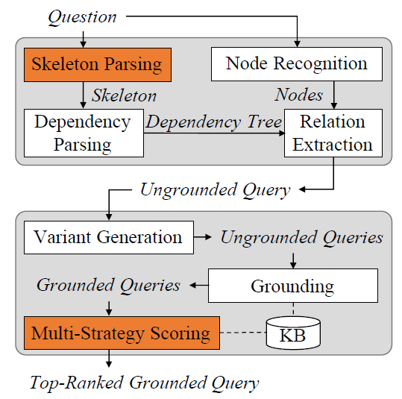
Overview
Notes:
Question -> Skeleton Parsing -> dependency parsing -> relation extraction -> ungrounded query -> ungrounded queries -> grounded queries -> top-Rank Grounded Query -> answer
KB-independent Ungrounded Query Generation
parsing: coarse-to-fine
KB-dependent Grounded Query Generation

Slide 9
Example
What movie had a director ?
What movie
What movie that Miley Cyrus acted in had a director named Tom Vaughan ?
acl:relcl
acl
acted in
director named
that Miley Cyrus acted in
named Tom Vaughan
Miley Cyrus
Tom Vaughan
(1) Question
(2) Skeleton
(3) Ungrounded Query
?x
?x
film.performance.film
film.director.film
?y
m.02z02cx
?y
m.02z02cx
So Undercover
film.actor.film
m.0bdxs5
m.0bdxs5
(4) Variant
(5) Grounded Query
(6) Answer
Notes:
A -> B 通过skeleton parsing. B->C通过relation extraction. C->D通过一些变种操作. D->E通过顶点和边的grouding. E->F通过ranking和scoring打分, 最后返回第一个非空的答案.

Slide 10
Skeleton Parsing
Skeleton
Span: minimum semantic unit (S, NP, VP, PP)
Attachment relation: seven dependency relations (acl, acl:relcl, nmod, nmod:poss, conj, xcomp, advcl)
What movie had a director ? [S]
acl:relcl
acl
that Miley Cyrus acted in [S]
named Tom Vaughan [VP]
Notes:
s, np, vp, pp

Slide 11
Parsing example – What movie that Miley Cyrus acted in had a director named Tom Vaughan ?
Step 1
What movie that Miley Cyrus acted in had a director ?
acl
named Tom Vaughan
Step 2
What movie had a director ?
acl:relcl
acl
that Miley Cyrus acted in
named Tom Vaughan

Slide 12
Multi-Strategy Scoring – Sentence-level Scorer
Test Question
Training data
2
1
3
Question Pattern
(Question pattern, Query pattern)
….
(Question pattern, Query pattern)
Topic Entity
4
Formal Query
5
Scoring
Candidate Grounded Queries
Notes:
Question Pattern

Slide 13
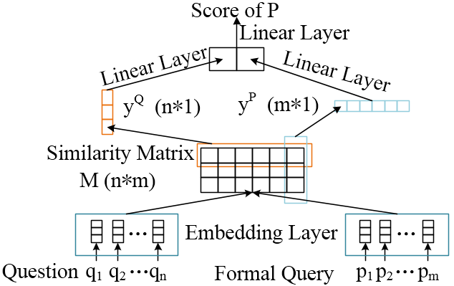
Multi-Strategy Scoring – Word-level Scorer
5
3
4
2
1

Slide 14
Experiment – Dataset, Baseline and Metric
Dataset | GraphQuestions | ComplexWebQuestions
Baseline | SEMPRE PARASEMPRE JACANA UDEPLAMBDA SCANNER PARA4QA | MHQA-GRN SIMPQA + PRETRAINED SPLITQA + PRETRAINED SPLITQA + data augment... PullNet
Metric | F1 | Precision@1(P@1)

Slide 15
Experiment – Result
GraphQuestions
Method | F1
SEMPRE | 10.80
PARASEMPRE | 12.79
JACANA | 5.08
UDEPLAMBDA | 17.70
SCANNER | 17.02
PARA4QA | 20.40
SPARQA | 21.53

Slide 16
Experiment – Result
ComplexWebQuestions
Method | P@1
MHQA-GRN | 30.10
SIMPQA + PRETRAINED | 19.90
SPLITQA + PRETRAINED | 25.90
SPLITQA + data augmentation | 34.20
PullNet | 45.90
SPARQA | 31.48

Slide 17
Experiment – Ablation Study
ComplexWebQuestions
Method | P@1
SPARQA | 31.48
SPARQA w/o skeleton parsing | 29.39
SPARQA w/o sentence-level scorer | 26.45
SPARQA w/o word-level scorer | 26.11

Slide 18
Experiment – Simple KBQA
1,172 simple questions
Method | F1
PARA4QA | 27.42
SPARQA | 27.68

Slide 19
Experiment – Skeleton Evaluation
1,000 complex questions
Overall Skeleton | 93.73(LAS)
Split | 99.42(ACC)
TextSpanPrediction | 97.17(ACC)
HeadwordIdentification | 97.22(ACC)
AttachmentRelationClassification | 99.14(ACC)

Slide 20
Experiment – Error Analysis
Node Recognition and Linking
Who have a concert tour named Rihanna: Live in Concert Tour ?
Skeleton Parsing
What country speaks Germanic languages with a capital called Brussels ?
Structural Heterogeneity
Who is the prime minister of the country that has national anthem March Forward, Dear Mother Ethiopia ?
Candidate Queries Scoring
Notes:
Node Recognition and Linking (37%)
Where was the artist had a concert tour named Rihanna: Live in Concert Tour raised ?
Skeleton Parsing (5%)
What country speaks Germanic languages with a capital called Brussels ?
Ungrounded Query (10%)
Structural Heterogeneity (22%)
Path-structured → star-structured, e.g., Who is the prime minister of the country that has national anthem March Forward, Dear Mother Ethiopia ?
Scoring (15%)
Other (11%)

Slide 21
Conclusion
SPARQA
Skeleton Parsing
Multi-Strategy Scoring
Future Work
Node Recognition and Linking
Structural Heterogeneity
Aggregation Question
Notes:
Parsing
Challenge 1: parser error problem
Solution: Span Tree
Grounding
Challenge 2: structure mismatch problem
Solution: Insert Node

Slide 22
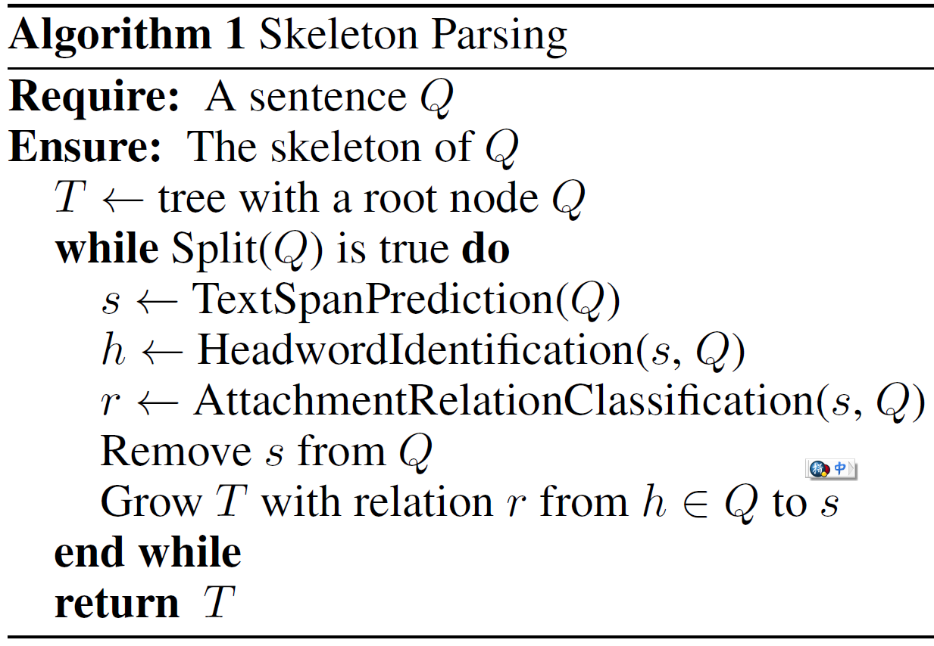
Appendix – Skeleton Parsing
Notes:
4个零部件

Slide 23












Appendix – Split
Class Label (binary)
C
$$T_{1}$$
…
$$T_{N−2}$$
$$T_{N−1}$$
$$T_{N}$$
$$T_{[SEP]}$$
BERT Single Sentence Classification Task
$$E_{[CLS]}$$
$$E_{1}$$
…
$$E_{N−2}$$
$$E_{N−1}$$
$$E_{N}$$
$$E_{[SEP]}$$
[CLS]
What
…
named
Tom
Vaughan
[SEP]
$Q$as Single Sentence
Notes:
单句分类任务

Slide 24








Appendix – TextSpanPrediction
Start/End Span as$s$
C
$$T_{1}$$
…
$$T_{N−2}$$
$$T_{N−1}$$
$$T_{N}$$
$$T_{[SEP]}$$
BERT Question Answering Task
$$E_{[CLS]}$$
$$E_{1}$$
…
$$E_{N−2}$$
$$E_{N−1}$$
$$E_{N}$$
$$E_{[SEP]}$$
[CLS]
What
…
named
Tom
Vaughan
[SEP]
$Q$as Paragraph
Notes:
QA任务, 但是question没有

Slide 25













Appendix – HeadwordIdentification
Start/End Span as $h$
C
$$T_{1}$$
…
$$T_{N}$$
$$T_{[SEP]}$$
$$T_{1}^{′}$$
…
$$T_{M}^{′}$$
BERT Question Answering Task
$$E_{[CLS]}$$
$$E_{1}$$
…
$$E_{N}$$
$$E_{[SEP]}$$
$$E_{1}^{′}$$
…
$$E_{M}^{′}$$
[CLS]
named
…
Vaughan
[SEP]
What
…
director
$s$ as Question
$Q$ as Paragraph
Notes:
QA 任务, s 作为Question, Q 作为Paragraph

Slide 26







Appendix – AttachmentRelationClassification
Class Label as $r$
C
$$T_{1}$$
…
$$T_{N}$$
$$T_{[SEP]}$$
$$T_{1}^{′}$$
…
$$T_{M}^{′}$$
BERT Sentence Pair Classification Task
$$E_{[CLS]}$$
$$E_{1}$$
…
$$E_{N}$$
$$E_{[SEP]}$$
$$E_{1}^{′}$$
…
$$E_{M}^{′}$$
[CLS]
named
…
Vaughan
[SEP]
What
…
director
$s$ as Sentence 1
$Q$ as Sentence 2
Notes:
句子对分类任务, s是句子1, Q是句子2, 输出它们之间的附属关系

Slide 27

Thanks for your listening
Skeleton
https://github.com/nju-websoft/SPARQA
email: ywsun@smail.nju.edu.cn
Notes:
Skeleton Annotation data 10K. 后续代码也会放上去.
如果大家感兴趣的话, 可以使用, 也欢迎提问题, 与我联系.

