Slide 1

SPARQA: Skeleton-based Semantic Parsing for Complex Questions over Knowledge Bases
Skeleton (a coarse-grained directed tree)
Span: minimum semantic unit
Attachment relation: seven dependency relations
Skeleton
What movie had a director ?
acl:relcl
acl
that Miley Cyrus acted in
named Tom Vaughan
What movie that Miley Cyrus acted in had a director named Tom Vaughan ?
email: ywsun@smail.nju.edu.cn
code: https://github.com/nju-websoft/SPARQA
Notes:
Challenges: Syntactic parsing error of CQ

Slide 2
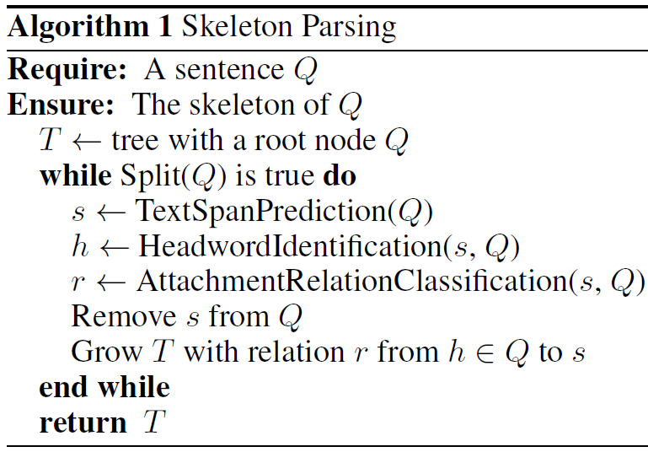
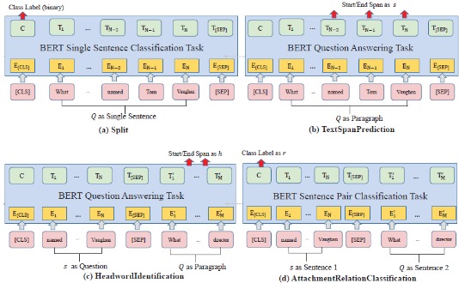
SPARQA: Skeleton-based Semantic Parsing for Complex Questions over Knowledge Bases
BERT-based Parsing
Step 1
What movie that Miley Cyrus acted in had a director ?
Step 2
What movie had a director ?
acl:relcl
acl
acl
named Tom Vaughan
that Miley Cyrus acted in
named …
email: ywsun@smail.nju.edu.cn
code: https://github.com/nju-websoft/SPARQA
Notes:
Challenges: Syntactic parsing error of CQ

