Slide 1
Docker Project Presentation
An introduction to Docker and Containers based on what I learned
Salvador Villalon
Software Development Intern
S&P Dow Jones Indices
July 20, 2018

Slide 2
What are Containers?
A container image is a lightweight, stand-alone, executable package of a piece of software that includes everything needed to run it: code, runtime, system tools, system libraries, settings.
Containers isolate software from its surroundings,
For example differences between development and staging environments and help reduce conflicts between teams running different software on the same infrastructure.
Main Idea:
A container contains all the necessary information you need to run the program
Source: https://www.docker.com/what-container

Slide 3
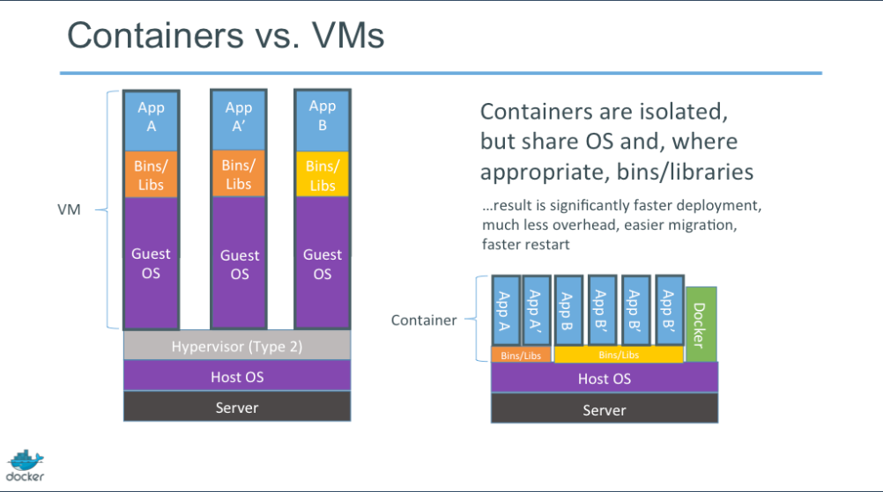
What are Containers?

Slide 4
What is Docker?
Docker let us implement the idea of Containers
Source: https://www.docker.com/what-docker

Slide 5
How Docker Works?
Linux containers can help mitigate many of these challenges with the microservices architecture.
Linux containers make use of kernel interfaces such as cnames and namespaces, which allow multiple containers to share the same kernel while running in complete isolation from one another.
The Docker execution environment uses a module called libcontainer, which standardizes these interfaces.
Docker and Microservices
The isolation between containers running on the same host that makes deploying microservice code developed using different languages and frameworks very easy.
Using Docker, we could create a DockerFile describing all the language, framework, and library dependencies for that service
Source: https://medium.com/aws-activate-startup-blog/using-containers-to-build-a-microservices-architecture-6e1b8bacb7d1

Slide 6
What is Kubernetes?
Kubernetes is an open source container orchestration platform, allowing large numbers of containers to work together in harmony, reducing operational burden. It helps with things like: Source: https://blog.containership.io/k8svsdocker
Running containers across many different machines
Scaling up or down by adding or removing containers when demand changes
Keeping storage consistent with multiple instances of an application
Distributing load between the containers
Launching new containers on different machines if something fails

Slide 7
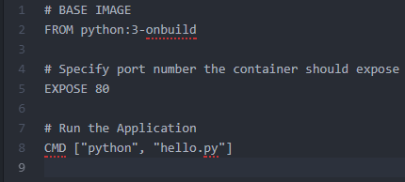
Creating a Docker Container
First, you need a Dockerfile
A Dockerfile defines what goes on in the environment inside your container
In this example, I am telling the Docker Client that I need a Python 3 Base Image. The next thing we need to the specify is the port number that needs to be exposed. This is so we can see our Web Application

Slide 8
Creating a Docker Container
Second, we build the image
With this command docker build -t [name of image] .
Do not forget the dot at the end
Below is a Sample Image

Slide 9

Creating a Docker Container
Third, we run the image
By running the image, we create the container
We run the image by this command
docker run -p [port number server will listen to:port number we will view our app] [name of image]
Below is an example

Slide 10
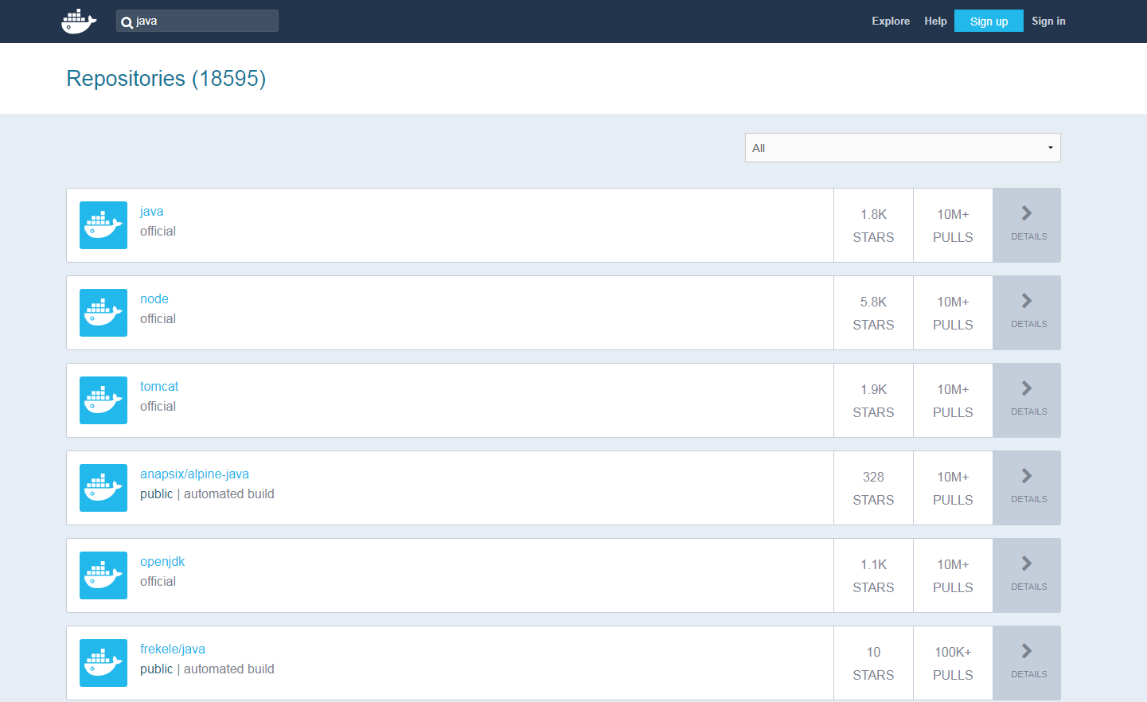
Docker Hub
Docker Hub is a cloud-based repository. https://hub.docker.com/
You can think of it like GitHub for Docker Images. You can use Docker Hub to store and distribute the container images you build.
You can search for all kinds of images, such as Python, Java, Kafka and many more

Slide 11
Docker Terms
Docker Image
Build component of a container
This template is needed to create a container
Registries
Used to store images
Registries can be local or remote (Remote Registry = Docker Hub)
Docker first looks at the image in the local registry, if not it will find it in the remote registry
Container
Running instance of an image
Docker uses containers to execute and run the software contained in the image
Dockerfile
Dockerfile can be tracked and distributed using a version control system
Dockerfile is the build file for an image

Slide 12
Docker Terms Continue
Docker Daemon
Responsible for managing images and running containers
Docker Client
Issues commands to the Daemon
Source: https://medium.com/aws-activate-startup-blog/a-better-dev-test-experience-docker-and-aws-291da5ab1238

Slide 13
Facts About Docker
Docker support in AWS Elastic Beanstalk
Docker containers are, by default, quite secure; especially if you run your processes as non-privileged users inside the container.
You can add an extra layer of safety by enabling AppArmor, SELinux, GRSEC, or another appropriate hardening system.
Source: https://docs.docker.com/engine/security/security/

Slide 14
Sources
https://medium.com/aws-activate-startup-blog/using-containers-to-build-a-microservices-architecture-6e1b8bacb7d1
https://medium.com/aws-activate-startup-blog/a-better-dev-test-experience-docker-and-aws-291da5ab1238
https://blog.containership.io/monolithisvsmicro
https://blog.containership.io/k8svsdocker
https://docs.docker.com/engine/security/security/
http://slides.com/atbaker/docker-101#/
https://www.slideshare.net/Docker/docker-101-introduction-to-docker

Slide 15

Thank You
Contact Info
LinkedIn: https://www.linkedin.com/in/salvadorvillalon/
Website: http://salvador-villalon.appspot.com/
Email: salvador.villalon@spglobal.com

