Slide 1
Group: B21RP01
1/13
Building E-voting system using blockchain
Ashutosh Chauhan | Vitthal Inani | K M Rajeev | Valluri Deepak
NEXT

Slide 2
Problem
Statement
2/13
The Current voting system involves paper ballet, or Electronic Voting machines which comes with their set of Pros and Cons.
We are proposing an Electronic-Voting solution as an alternative which can be used for small scale and possible large scale elections as well.
NEXT

Slide 3
Inherent Problems
There are a couple of inherent problems with election/voting.
Identity
Identity is one of the Major problems in voting. How can an individual prove his/her identity to a person or a system. Identity is required for eligibility.
Eligibility
The Second Problem that arises with Blockchain is eligibility. How can we verify the eligibility of a person without any bias. In a perfect world everyone is eligible but we rules and regulations for an individuals identity.
Privacy
The third Important Problem to solve is to protect the privacy of votes from another voter or from the election holding committee itself.
We also have some other problems to solve such as equality, transparency and verifiability.
11/13
NEXT

Slide 4
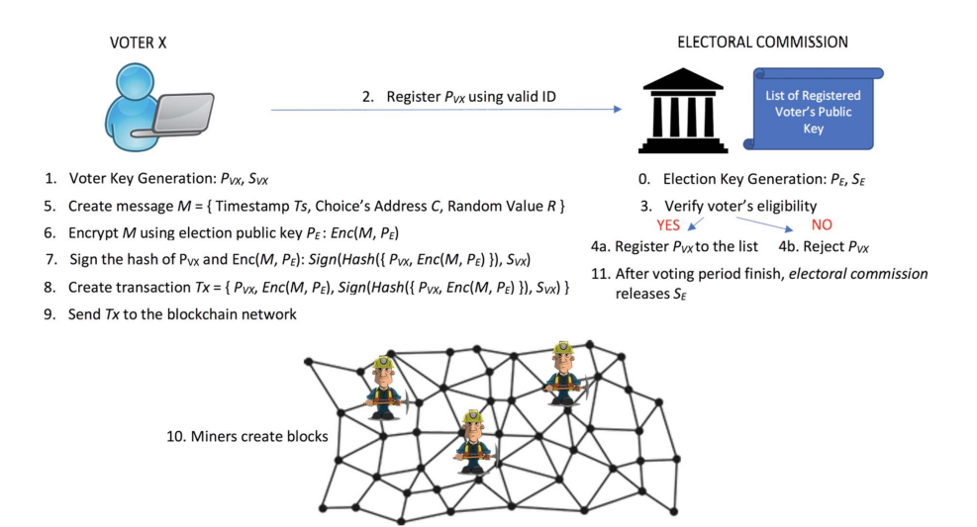
Reference Paper
We selected a Paper which provided a design for a Blockchain based e voting system
The paper we referenced proposed the following design.
The paper proposed a permissioned system where a user registers himself/herself for eligibility by sharing his public key to the election entity and votes in the election. His votes get added to the blockchain and at the end of the election and Secret key of election are released for everyone of verify and public keys of votes is erased for privacy.
11/13
NEXT

Slide 5
Our Improved Design
We are making improvements in the Privacy domain of electronic voting.
Election Setup
The election authority generates a Public-Private Key pair for a election.
Voters registers their generated Public-Private Key with the election authority by proving their identity.
Election authority checks eligibility of the candidate (depends on how identity is proven) and saves it to the list of eligible voters. In case of ineligibility or already registered, send a response back to the user.
The election authority initializes the blockchain network and the voters join.
The election authority broadcasts the list of voters and candidates to the network.
11/13
NEXT

Slide 6
Our Improved Design contd..
We are making improvements in the Privacy domain of electronic voting.
Voting Phase
The Voter chooses a candidate (from the list of candidates broadcasted by the election authority before).
The voter creates a message containing {Candidate ID, Timestamp, Random Pad}.
The voter encrypts the message with the Election Public Key.
The voter node creates a nonce (length 5-8) and compute PRvx = Hash(Pvx, nonce).
The voter signs the Transaction {Message, Pvx, PRvx} with user's Private key Svx.
The voter broadcasts the Signed Message to the blockchain network.
The other nodes mines the Transactions to add a block in the network.
11/13
NEXT

Slide 7
Our Improved Design contd..
We are making improvements in the Privacy domain of electronic voting.
Block Mining
The node will verify the signature of the transaction, later it will search for the Transaction's Pvx voter public key in its list of valid transactions.
The node will put the verified transactions in a queue.
Once a certain amount of transactions are gathered the node will combine them into a block storing only two information {M, PRvx} from a transaction along with a list of unordered voter's public keys {Pvxi | i ∈ Voters}
This will allow us to detach the actual public key while still providing verification.
When the block is mined the node will broadcast the block.
11/13
NEXT

Slide 8
Our Improved Design contd..
We are making improvements in the Privacy domain of electronic voting.
Receiving the Block
The node verifies the block and adds it to its ledger. It also removes the Public keys of the votes provided with the block as to prevent duplicate/multiple votes.
Counting Phase
Once the election time is complete. The Election authority releases the Private key of the election.
The nodes can then compute the result of the election by decoding the votes using the private key.
Once the result is computed it is declared and verified by everyone else.
11/13
NEXT

Slide 9
Our Improved Design contd..
How can Electoral commission keep the Private Key secure
Using Key Splitting
The electoral commission can split the keys using the key splitting algorithm.
Then there must be at least k compromised sections out of n in order to reconstruct the key.
We can setup the whom to send the keys when setting up the election.
11/13
NEXT

Slide 10
Plan Implementation
We will be continuing the implementation of our proposed solution
Ashutosh & Vitthal
We will start with learning how to use Ethereum blockchain platform to create a smart contract using Solidity.
Rajeev & Deepak
We will start with understanding how to setup development and testing environment for the Ethereum Blockchain.
Next Steps
We will start deployment of our network and test & simulate the network.
We will also look into some easier user interface for regular users.
11/13
NEXT

Slide 11
Technical Details
We will be using Ethereum Blockchain with a our voting smart contract.
For development and testing, we would use Ubuntu(Linux) machine.
We will use Ganache and/or Hardhat for simulating our network.
We will use Solidity Programming Language for developing our smart contracts.
11/13
NEXT

Slide 12
References
A Proposal of Blockchain-Based Electronic Voting System | IEEE Conference Publication | IEEE Xplore
http://hyperledger-fabric.readthedocs.io/en/latest/
13/13
NEXT

Slide 13
Thank You

