Slide 1

UNIVERSITATEA DIN BUCUREȘTI FACULTATEA DE MATEMATICĂ ȘI INFORMATICĂ
Sistem Online de Modelare Orientat pe Neuroni (S.O.M.O.N.)
Coordonator științific:
Conf. Dr. Traian ȘERBĂNUȚĂ
Absolvent:
Teodor Mircea POPESCU

Slide 2
Cuprins
Despre somon
Pași în rezolvarea unei probleme de AI:
1)Colectare/Procesare date
2)Vizualizare date
3)Folosirea unei funcții (ML/Vision/Text):
-Guess/Simplify function
-AI Functions

Slide 3
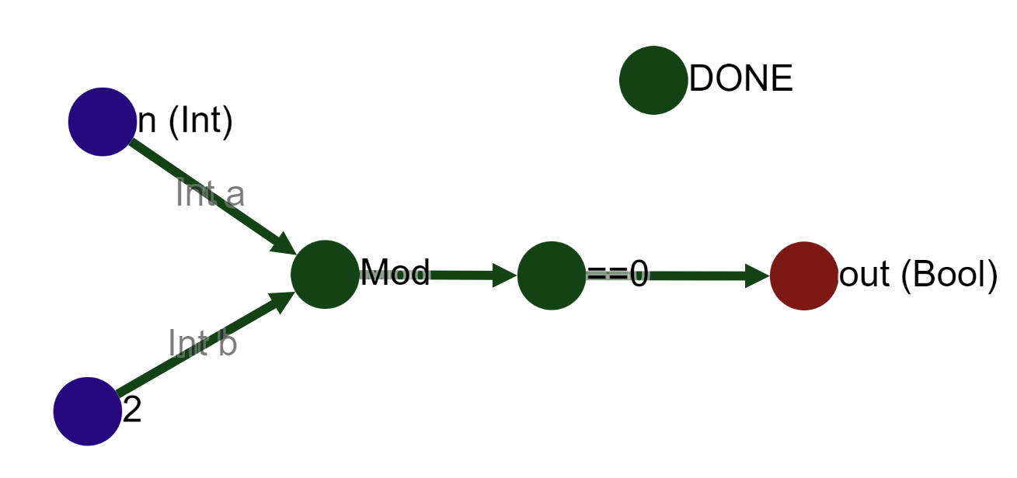
Despre somon
Notes:
Somon-o platforma pentru facut si executat functii. Prin executare (minat) se obtin sc care se pot folosi pentru a vota functii sau pentru a adauga instante cu prioritate

Slide 4
Tipuri de noduri
-Variable
-Constant
-IF
-Default
-Public
-Done
-Recursive
-Class
-ClassGetter
-Filter

Slide 5
Colectare/Procesare date

Slide 6
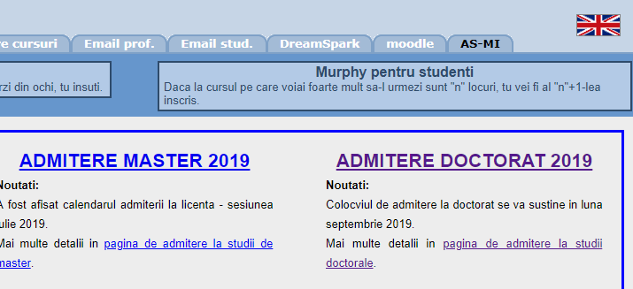
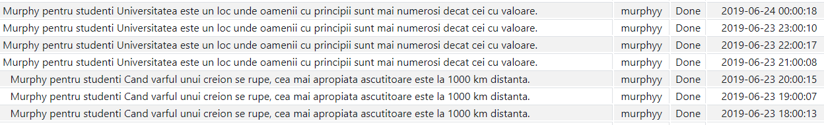
Generare / colectare date
(Dar nu este între 20 și 21 ci între 23 și 24, din motive de timezone +2 și ora de vara +1)

Slide 7
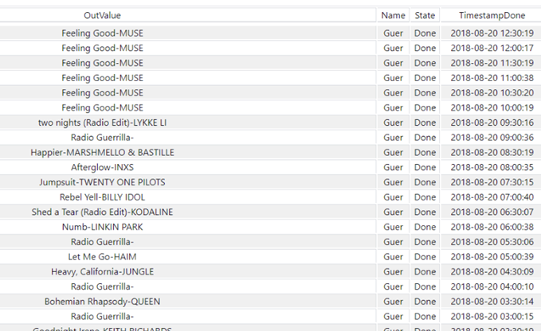
Generare / colectare date

Slide 8
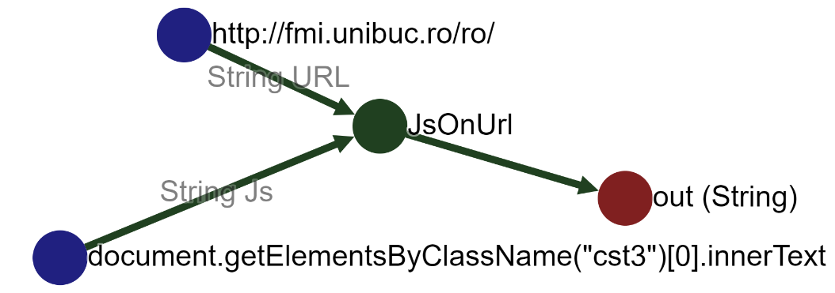
Histograme

Slide 9
Vizualizare date

Slide 10
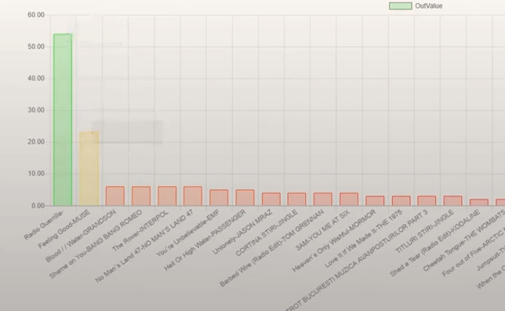
Vizualizare date

Slide 11
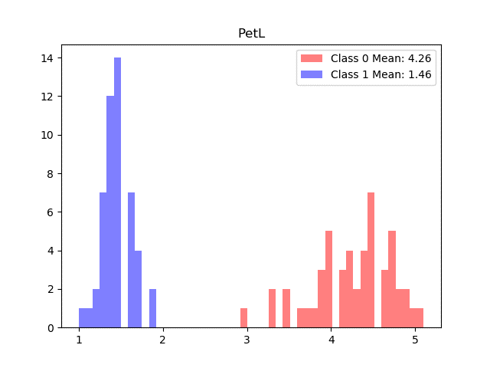
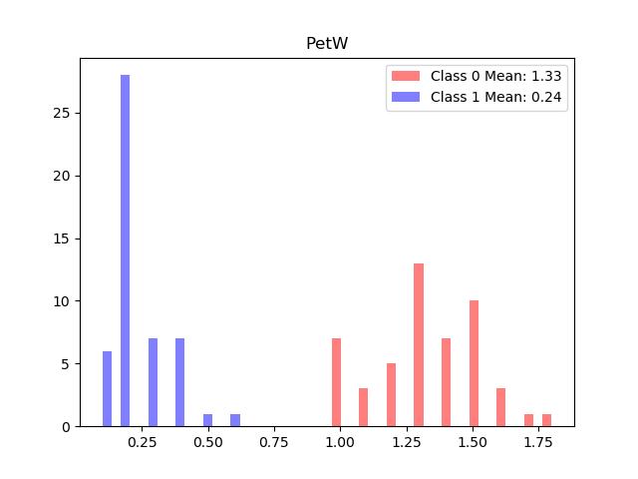
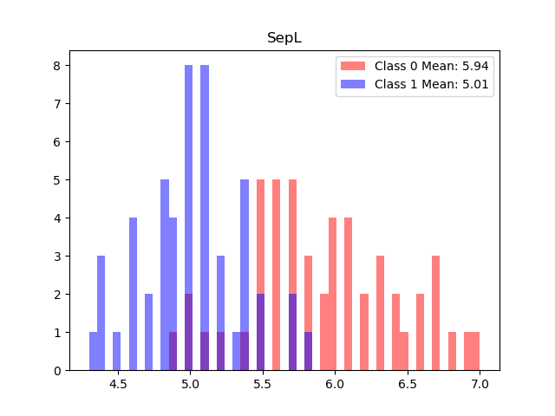
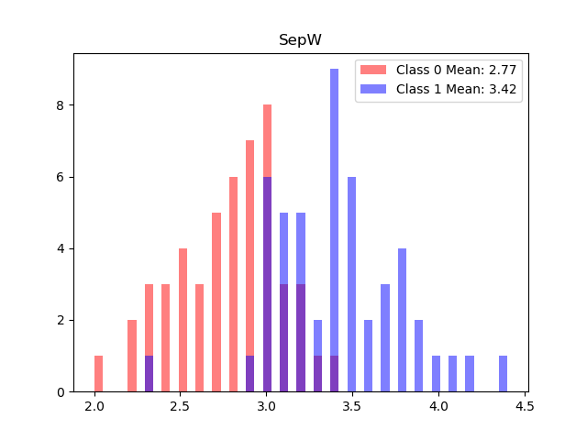
Histograme

Slide 12
Machine learning

Slide 13
Everything solver
SepL,SepW,PetL,PetW
Formulă găsită sub 5 secunde (din 100 secunde disponibile):
-(Abs(x2 - 1) - 1.0)*Abs(-x0 + x2 + Abs(x3 + 10))
=
-(Abs(PetL - 1) - 1.0)*Abs(-SepL + PetL + Abs(PetW + 10))
Exemplu din clasa 0) 7,3.2,4.7,1.4
-(Abs(4.7 - 1) - 1.0)*Abs(-7 + 4.7 + Abs(1.4 + 10)) = -24.57 <0
Exemplu din clasa 1) 5,3.3,1.4,0.2
-(abs(1.4 - 1) - 1.0)*abs(-5 + 1.4 + abs(0.2 + 10)) = 3.96 >0

Slide 14
Machine learning
None LR 1.0 time: 0.005047321319580078
None LDA 1.0 time: 0.010020732879638672
None KNNC1 1.0 time: 0.014037609100341797
None KNNC9D 1.0 time: 0.009027242660522461
None DTC 1.0 time: 0.004983425140380859
None RFC 1.0 time: 0.0898277759552002
None MLPC 1.0 time: 1.2221267223358154
None ABC 1.0 time: 0.013057708740234375
None GNB 1.0 time: 0.006525278091430664
None QDA 1.0 time: 0.0060367584228515625
None GBC 1.0 time: 0.21617555618286133
None ETC 0.99 time: 0.0040094852447509766
None BC 1.0 time: 0.09194278717041016
None SGDC 1.0 time: 0.00803375244140625
None RC 1.0 time: 0.013685226440429688
None PAC 1.0 time: 0.005012989044189453
None ETSC 1.0 time: 0.08673596382141113
None BNB 0.4 time: 0.009024620056152344
None GM 0.5 time: 0.02008199691772461

Slide 15
Machine learning
-LR =LogisticRegression
-LDA =LinearDiscriminantAnalysis
-KNNC1 =KNeighborsClassifier(1)
-KNNC9D =KNeighborsClassifier(9, weights='distance')
-DTC =DecisionTreeClassifier(max_depth=5)
-RFC =RandomForestClassifier(max_depth=5, n_estimators=10, max_features=1)
-MLPC =MLPClassifier(alpha=0.1)
-ABC =AdaBoostClassifier()
-GNB =GaussianNB()
-QDA =QuadraticDiscriminantAnalysis()
-GBC =GradientBoostingClassifier()
-ETC =ExtraTreeClassifier()
-BC =BaggingClassifier()
-SGDC =SGDClassifier()
-RC =RidgeClassifier()
-PAC =PassiveAggressiveClassifier()
-ETSC =ExtraTreesClassifier()
-BNB =BernoulliNB()
-GM =GaussianMixture()

Slide 16
Body mass index
x0*(x1 - x2) -> 0.5477941176470589
54% acc. cu EverythingSolver in 100 secunde (pe 544 linii)
65% acc. cu ML (pe 40 linii):
Gen,Inaltime,Greutate,Varsta
?,190,80,24
?,160,51,22
?,109,16,7
?,147,39,42
?,148,50,19
?,145,29,17
(1=barbat 0=femeie)
1.0 100.0 %
1.0 80.0 %
0.0 100.0 %
0.0 80.0 %
0.0 80.0 %
1.0 70.0 %

Slide 17
Vision

Slide 18
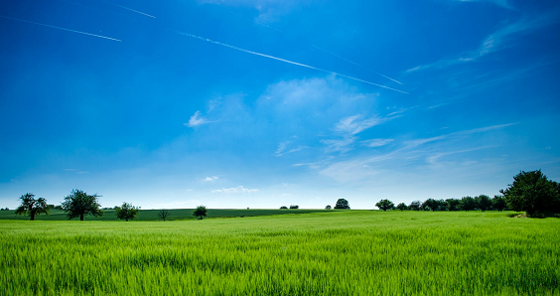

ImageFeatures
(0,0,0)
(128,128,128)
(0,128,128)
(128,255,255)
(128,128,128)
(255,255,255)
[0.134, 0.228, 0.161, 0.375, 0.000, 0.000, 0.022, 0.079]

Slide 19
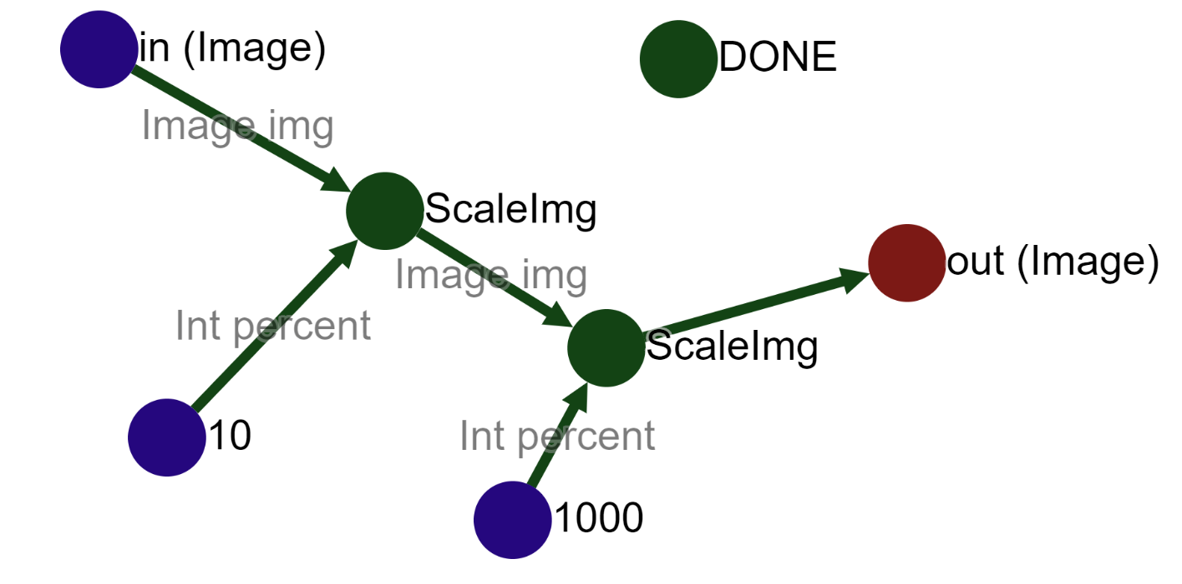
Blur

Slide 20

Blur

Slide 21
Text / NLP

Slide 22
Word-sense disambiguation (WSD)
String: the tank is full of nitrogen
Word: tank
Possible synsets
1 an enclosed armored military vehicle; has a cannon and moves on caterpillar treads
2 a large (usually metallic) vessel for holding gases or liquids
3 as much as a tank will hold
4 a freight car that transports liquids or gases in bulk
5 a cell for violent prisoners
Prediction:
2 with 53.48837209302326 % - a large (usually metallic) vessel for holding gases or liquids
1 with 35.65891472868217 % - an enclosed armored military vehicle; has a cannon and moves on caterpillar treads
3 with 6.2015503875969 % - as much as a tank will hold
4 with 4.651162790697675 % - a freight car that transports liquids or gases in bulk

Slide 23
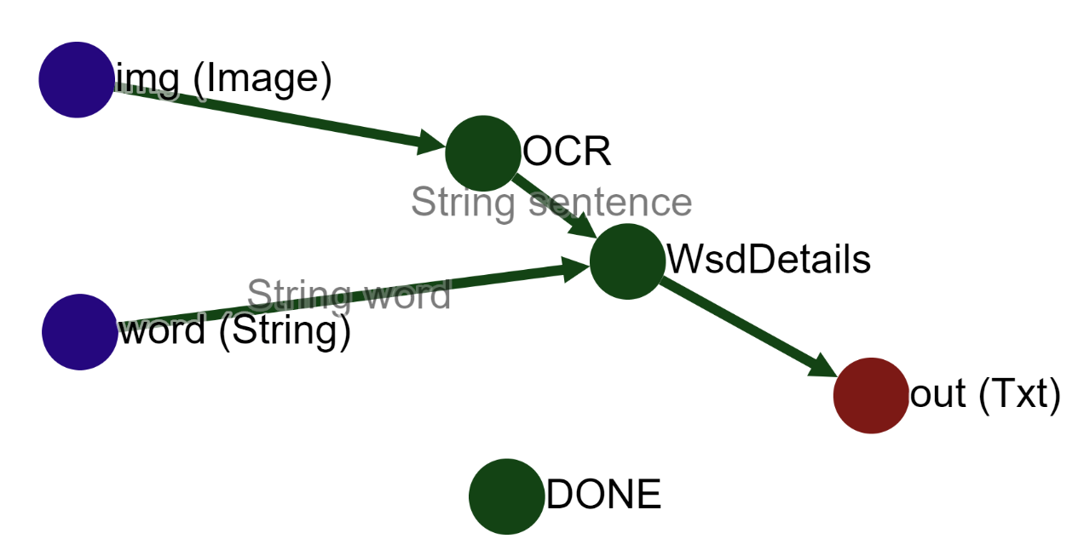
WSD pe imagini

Slide 24
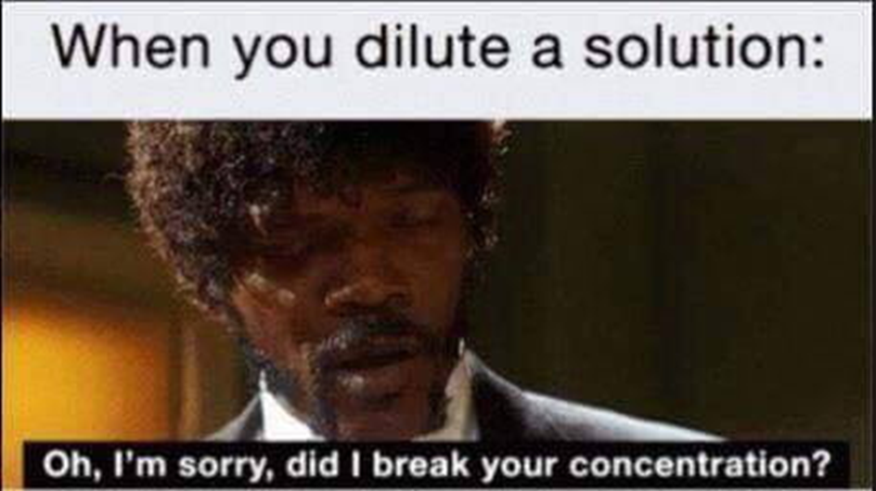
WSD pe imagini
Word: solution

Slide 25
WSD pe imagini
Possible synsets
1 a homogeneous mixture of two or more substances; frequently (but not necessarily) a liquid solution
2 a statement that solves a problem or explains how to solve the problem
3 a method for solving a problem
4 the set of values that give a true statement when substituted into an equation
5 the successful action of solving a problem
Prediction:
1 with 56.58914728682171 % - a homogeneous mixture of two or more substances; frequently (but not necessarily) a liquid solution
5 with 21.705426356589147 % - the successful action of solving a problem
3 with 21.705426356589147 % - a method for solving a problem

Slide 26
String Kernel
Max acc: 0.8130841121495327
Norm: False
m_pgram: 3
m_func: <function KernelFrom2ListsK3RN3L at 0x03AE5C00>
m_nu: 0.1
res/test/12_9.txt -> Pozitiveimdb 100.0 %
res/test/26_3.txt -> Negativeimdb 100.0 %
res/test/26_9.txt -> Pozitiveimdb 100.0 %
res/test/38_10.txt -> Pozitiveimdb 100.0 %
res/test/42_3.txt -> Negativeimdb 100.0 %
res/test/9_1.txt -> Negativeimdb 100.0 %
res/test/plato-gorgias-343.txt -> Plato 100.0 %
res/test/plato-seventh-358.txt -> Plato 100.0 %

Slide 27
Guess / simplify

Slide 28
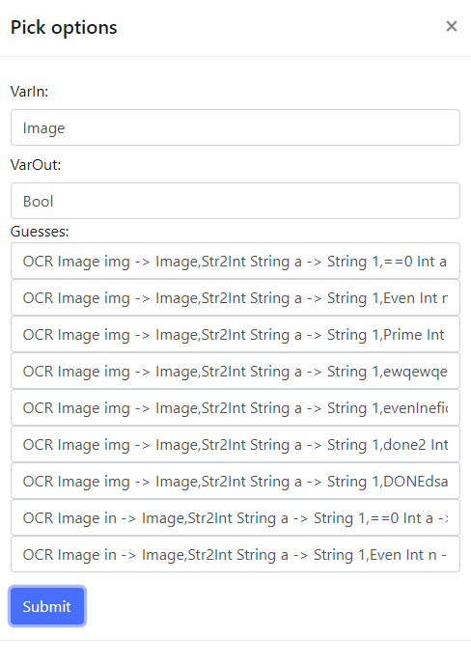
Guess function
Notes:
Sistemul e bazat pe cunostinte. Atat fctii de baza/publice cat si prin nr de apelari, modul in care sunt folosite 2 functii (dupa mod de multe ori se pune ==Int), nr de SC investiti etc

Slide 29
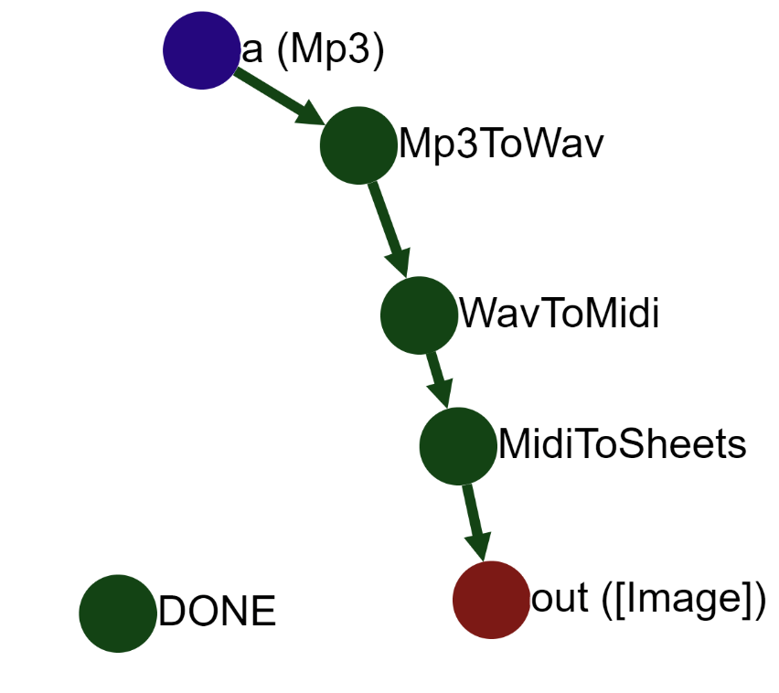
Mp3 to music sheet

Slide 30
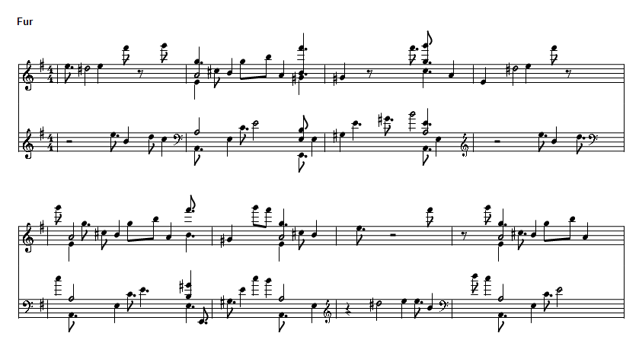
Mp3 to music sheet

Slide 31
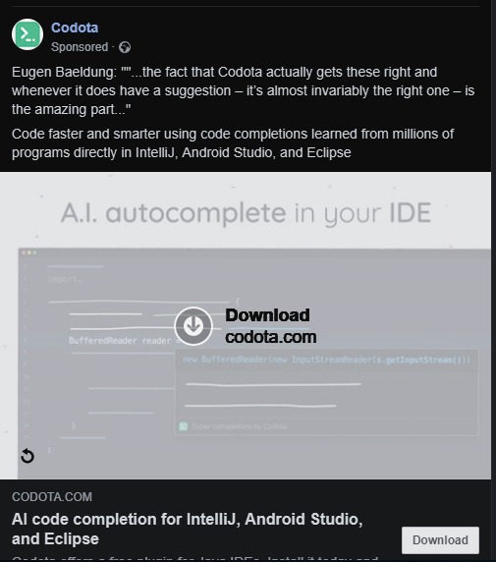
AI code completion

Slide 32
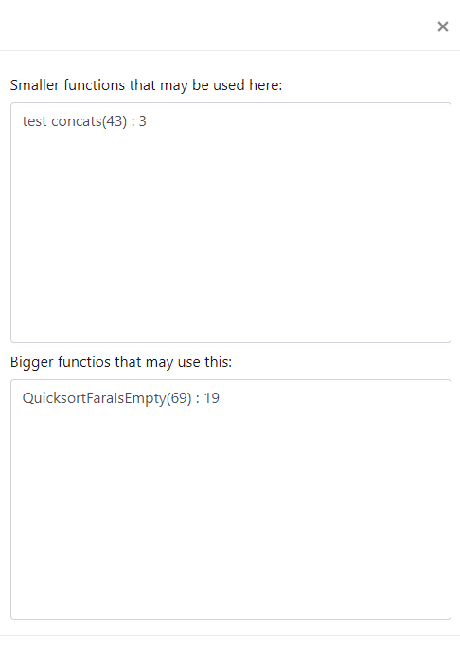
Simplify

Slide 33
Misc.

Slide 34
Filter
Int -> Bool (care verifică dacă un număr este prim sau nu)
Există doar un mod în care poate “evolua”:
[Int] -> [Int] (funcție care păstrează doar numerele prime)
Un exemplu mai complex:
String, Image -> Bool (dacă un string este într-o imagine)
Putem “evolua” această funcție la:
[String], Image -> [String] (ce stringuri apar într-o imagine)
SAU String,[Image] -> [Image] (ce imagini conțin cuvântul respectiv)

Slide 35
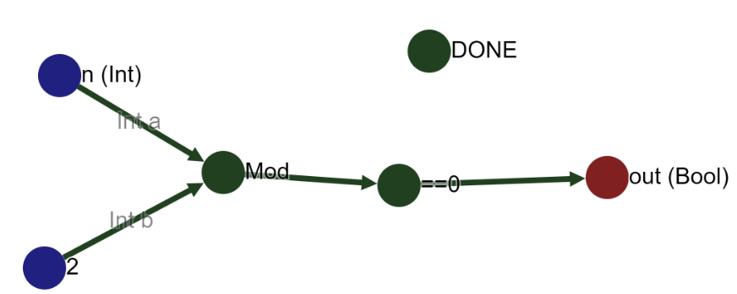
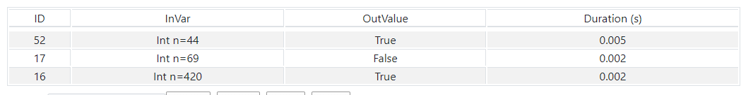
Exemple

Slide 36
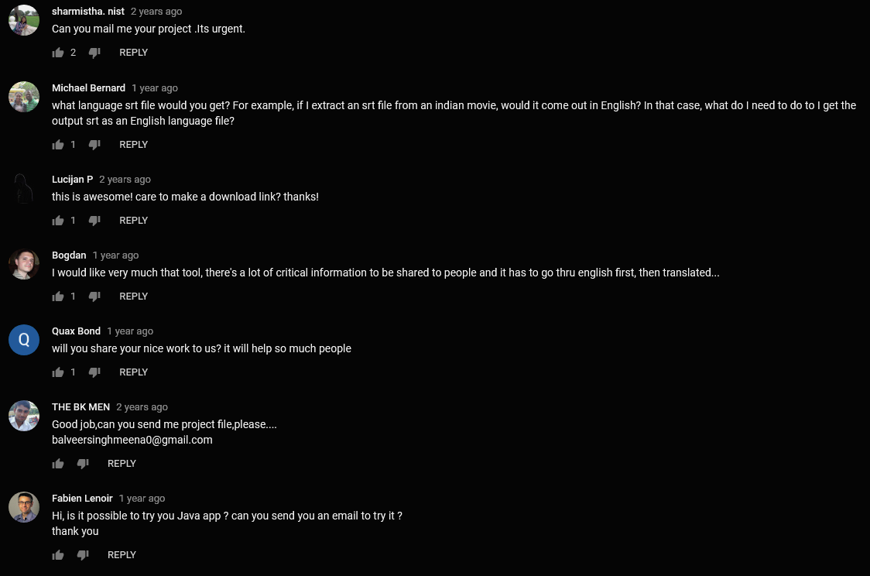
Dependințe

Slide 37
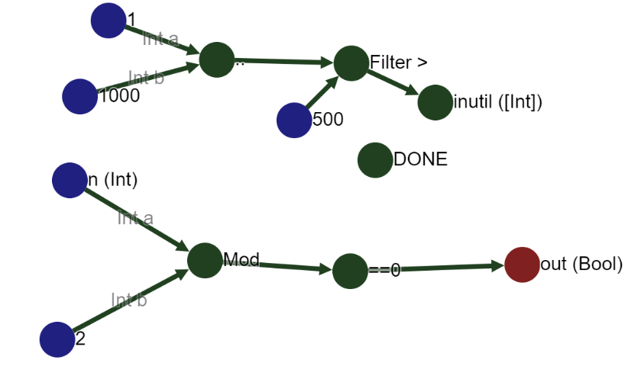
Paralelizare
+ Se poate rula de oricâte ori pe un calculator si pe oricâte calculatoare

Slide 38
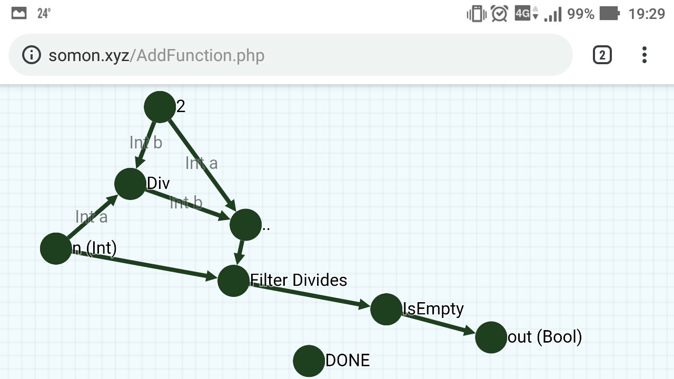
Portabilitate - prim pe telefon

Slide 39
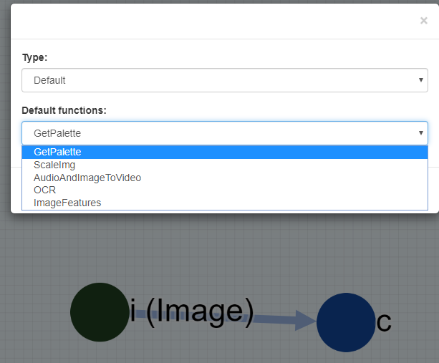
Utilizare simplă (1)

Slide 40
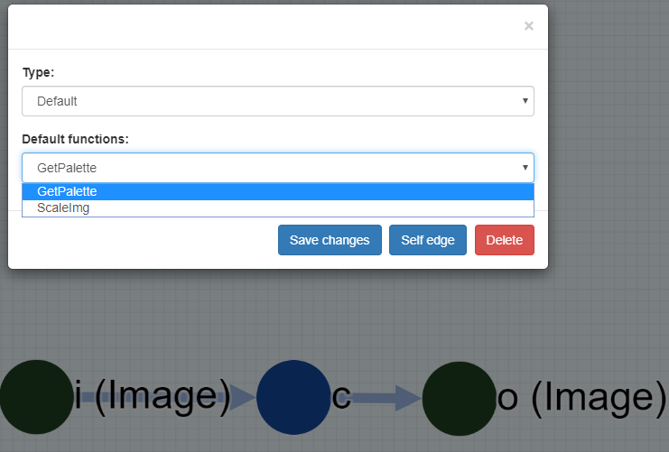
Utilizare simplă (2)

Slide 41
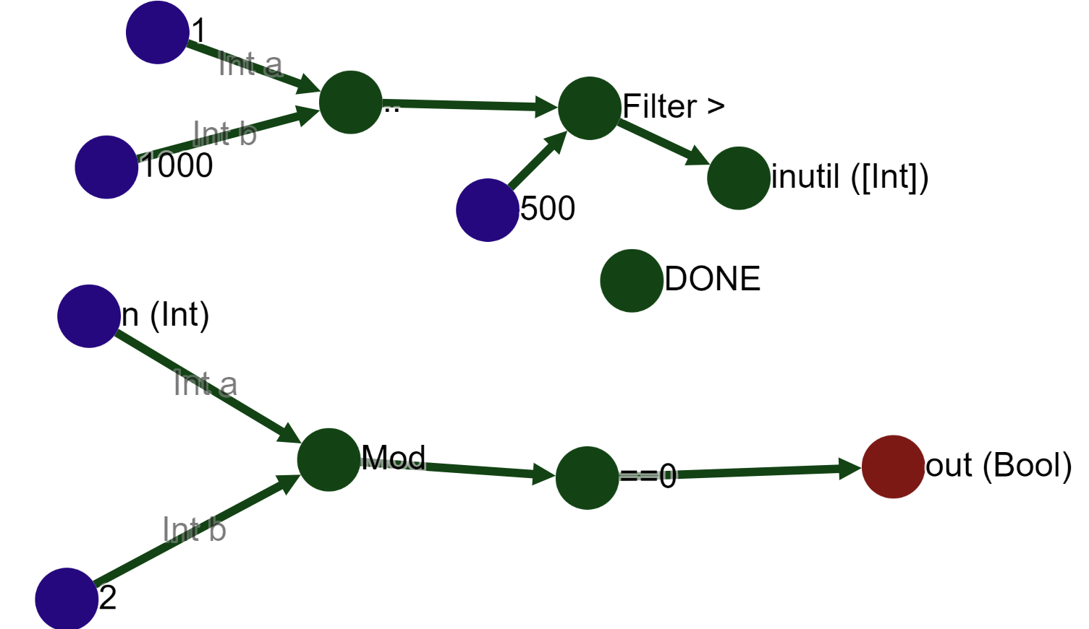
„Cod” mai clar (1)
Int f(int n)
{
vector<int> inutil;
for(i=1;1<1000;i++)
if(i>500)
inutil.push_back(i);
return n%2==0;
}

Slide 42
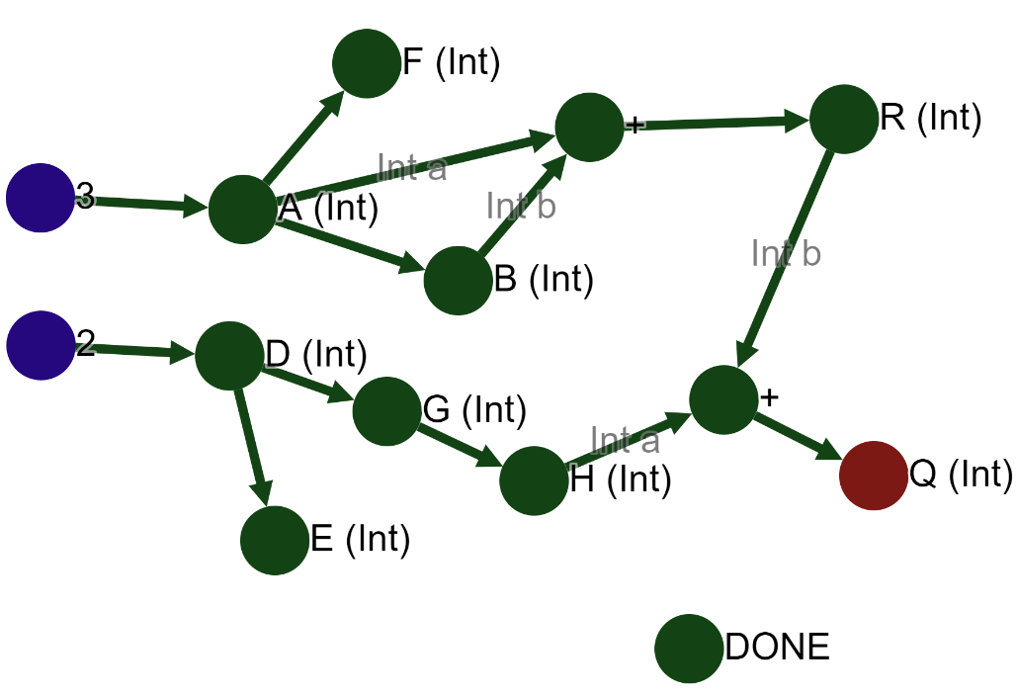
„Cod” mai clar (2)
Int f()
{
A=3
D=2
B=A
E=D
F=A
G=D
R=B+A
H=G
Q=R+H
return Q;
}

Slide 43
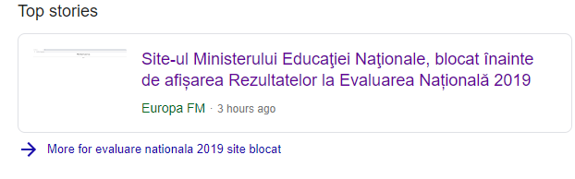
Stocarea puterii computaționale

Slide 44
Direcții de îmbunătățire
-Utilizarea SC
-Ordinea executării
-Translator (alte limbaje)
-Variantă locală
-Optimizări
-Securitate
-Paralelizabil
-Setări
-High order functions
-Mai multe statistici
-Simplificarea utilizării
-Erori
-Tipuri noi de date
-Guess function from example

Slide 45
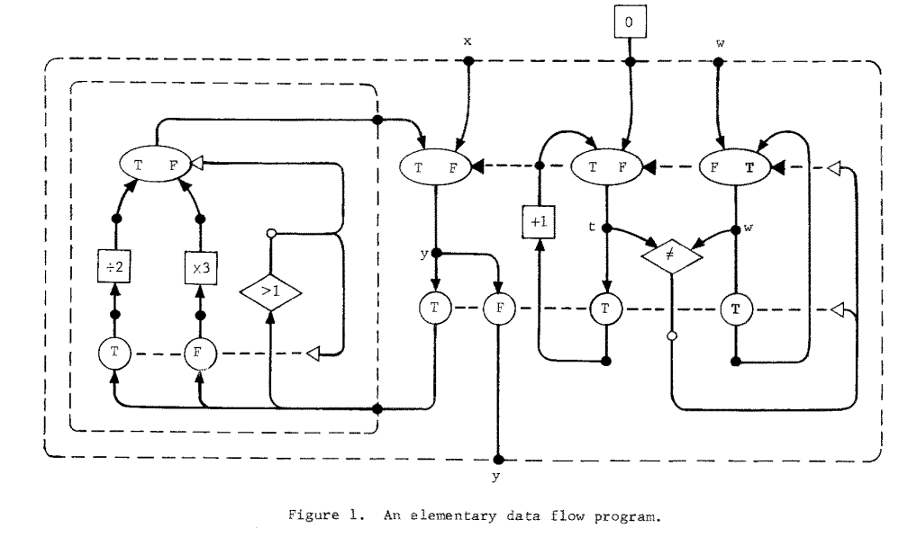
Programe similare - 1974

Slide 46
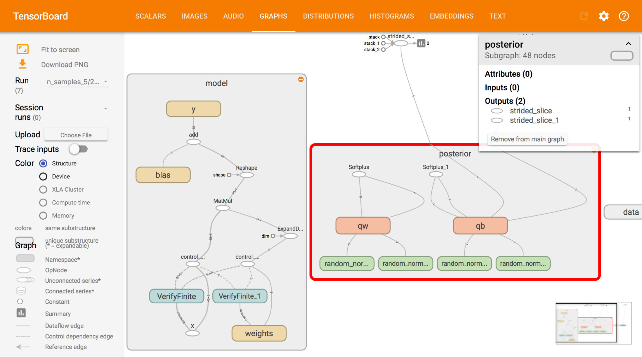
Programe similare - Tensorflow

Slide 47
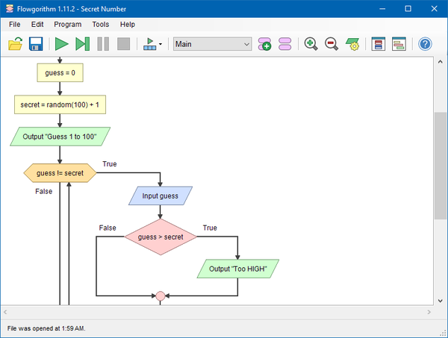
Programe similare - Flowgorithm

Slide 48
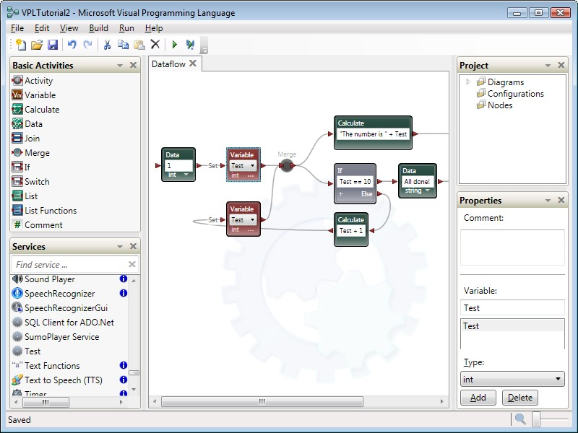
Programe similare - MVPL

Slide 49
8. Cod sursă și site
https://github.com/teo2mirce/Somon
http://somon.xyz

Slide 50
Surse folosite
Dennis J.B. (1974) First version of a data flow procedure language. In: Robinet B. (eds) Programming Symposium. Lecture Notes in Computer Science, vol 19. Springer, Berlin, Heidelberg
https://github.com/rmcelreath/rethinking/blob/master/data/Howell1.csv
http://www.textfiles.com/etext/AUTHORS/

