Slide 1
SQuAD2.0 Challenge
SQuAD2.0(Rakpurkar et al. 2018) or Stanford Question Answering Dataset is a reading comprehension dataset
It consists of Wikipedia articles and questions posed from each of the article in JSON format
Question and Answers are generated by crowd workers
SQuAD2.0 added 50,000 unanswerable questions combining with 100,000 questions from SQuAD1.1
The Challenge is to provide answer to the question if the answer can be found in the comprehension, associated with the question
If the Question is not answerable, then the output should be an empty string
Participants are evaluated with Exact Match(EM) value of answers and with an F1 score
Still an ongoing contest

Slide 2
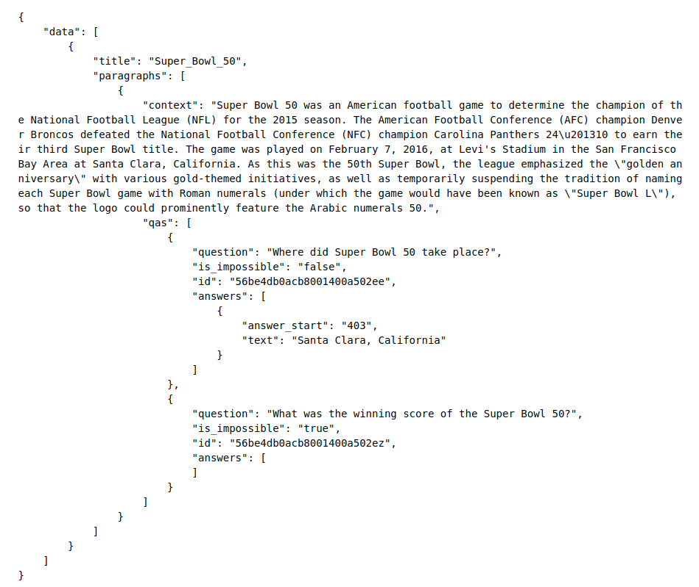
SQuAD 2.0 Dataset
The dataset is a Json file with each components consists of a context paragraph, questions and answers
Each question can have multiple answers
Also, with each question has another attribute called is_impossible which determines whether the question is answarable or not
The input into the model is the concatenation of two tokenized sequences: " [CLS] query [SEP] context [SEP]"

Slide 3
Model Architecture
BertForQuestionAnsweringSpanMask Model
Pre-TrainedBert
Model
SQuAD Dataset
Dataset is a JSON file with a paragraph, a Question with ground truth answer from the paragraph.
Using PreTrained BertForQuestionAnsweringSpanMask
Bert Tokenizer
Import Bert Tokenizer
Load SQuAD data & Generate Feature
FusedAdam
Optimizer
BERT Tokenizer
If 16-bit float and loss scaling used
FP16_Optimizer
Pre-Trained BERT
Optimizer
If 32-bit float is used
BertAdam
Start Train
Save Model
Calculate Accuracy

Slide 4
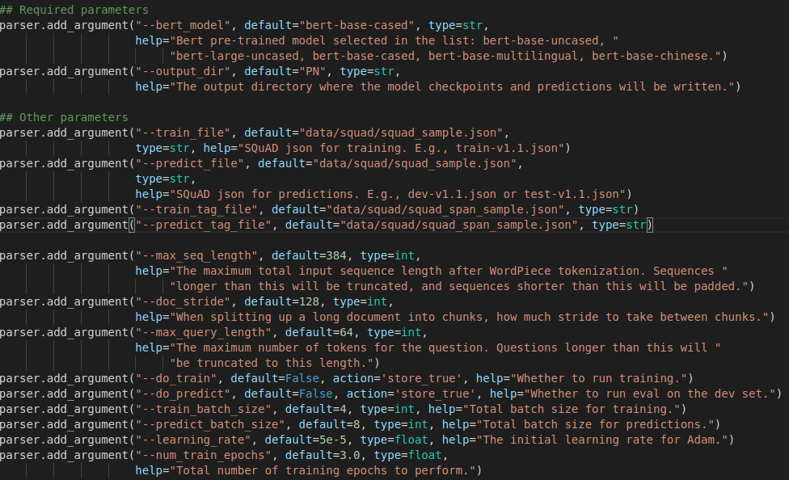
Argument Parsers
Inline argument are passed during compilation
Provides BERT model name, tokenizer etc.
Also includes hyperparameters, e.g., learning rate, batch size, epoch, sequence length etc.
Input file names like test and train tag file, input and output directory etc.
Also includes params to determine whether to use GPU or not and use of 16- or 32-bit float precession

Slide 5
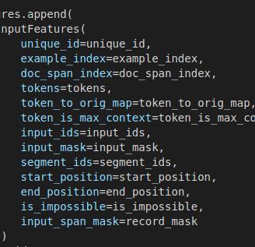
Feature Conversion
Generate Unique Id for each example
Generate token id using BERT tokenizer
Iterate over all the examples to generate features
Generate input mask and input span mask for each of the examples with 0's and 1's
Finally appending all the generated features into the InputFeatures object.

Slide 6
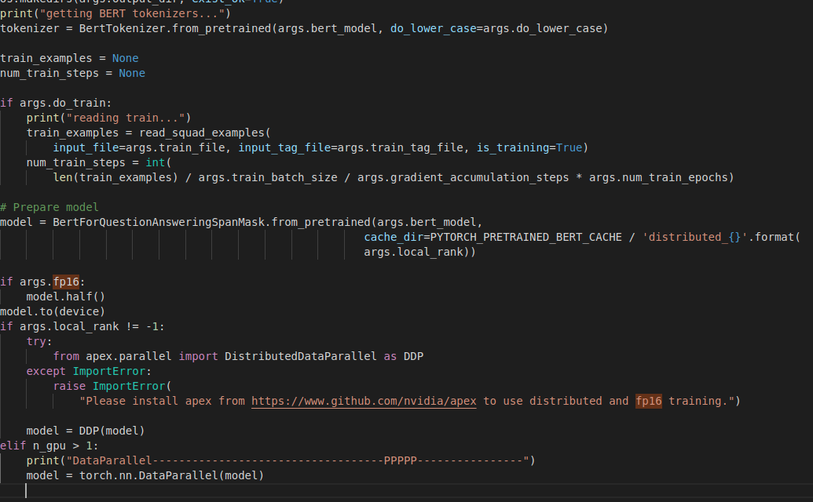
Tokenizer and Model
Tokenizer: Here they imported a pretrained tokenizer from BertTokenizer.
Does not differentiate between upper and lower case.
Read training file already downloaded locally.
Model name: bert-large-cased-whole-word-masking
FP16 is 16-bit floating point precession which improves accuracy.
Used DataParallel wrapper provided by pytorch to train on multiple GPU

Slide 7
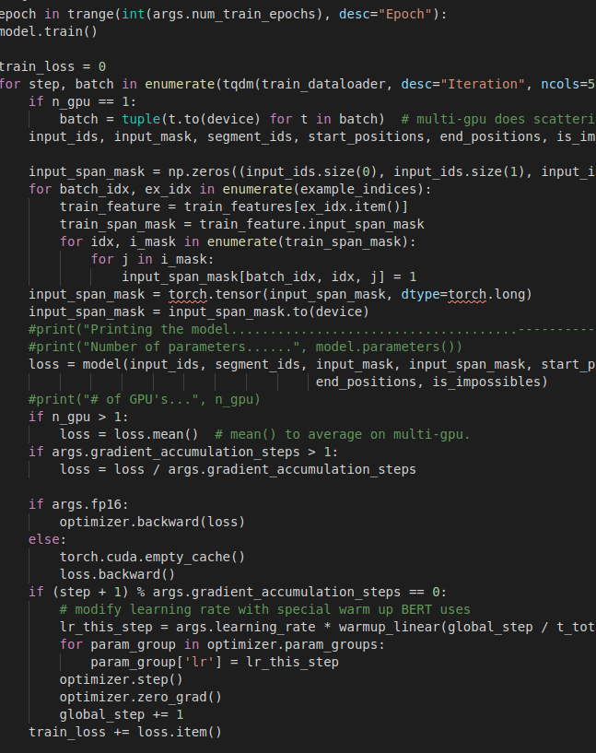
Training and Test
Iterate over the train_dataloader for the given number of epochs
Get the features for each training examples with the input mask
Run the model, calculate the loss
Calculate the gradient in backpropagation layer and update the gradient
Calculate training and validation loss to keep track of the efficiency of the model.

Slide 8
BertAdam Optimizer
Work in progress

Slide 9
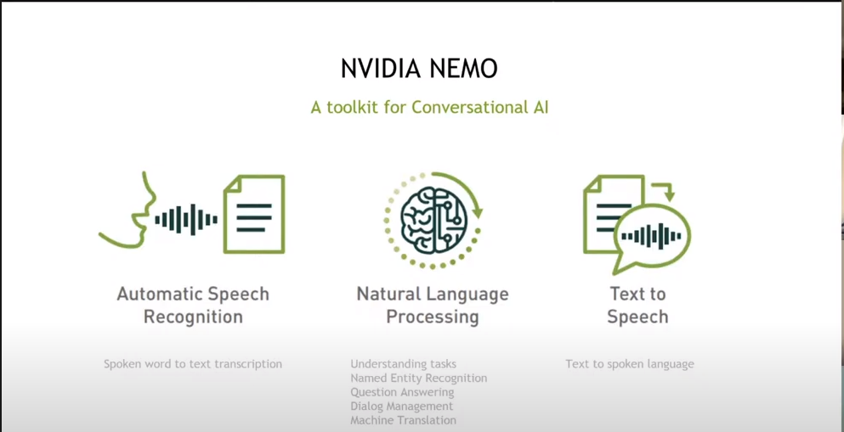

Slide 10
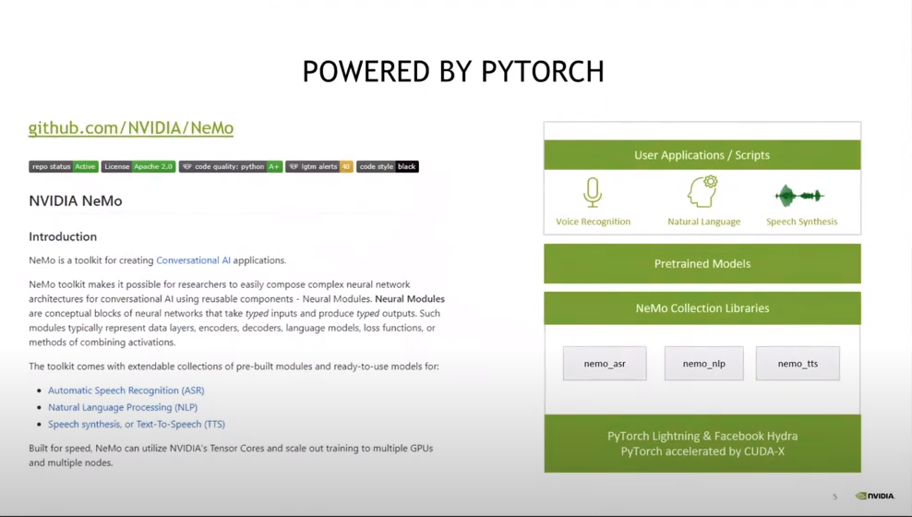

Slide 11
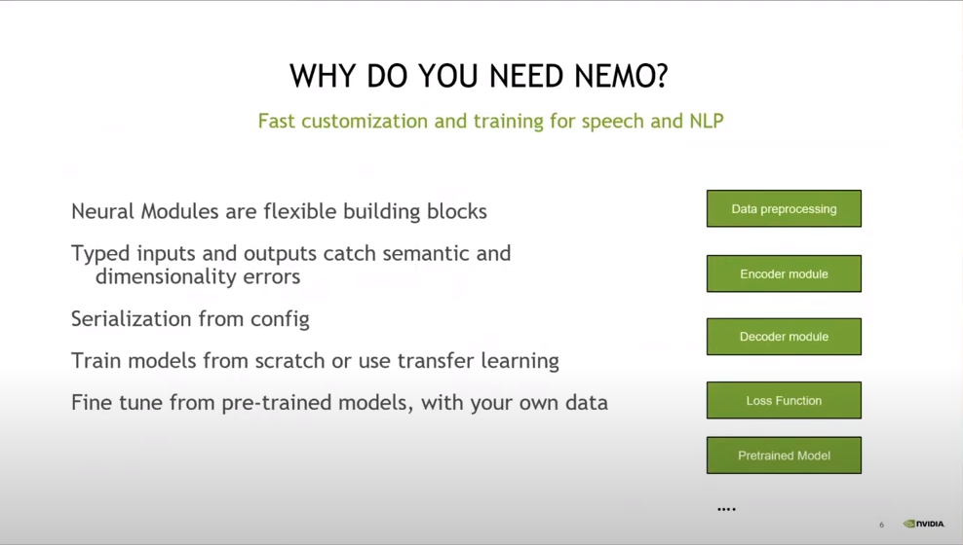

Slide 12
