Slide 1

Touch Fish
Capital
2021.05.08

Slide 2
WHO ARE WE ?

Slide 3
Team member
Member | Role | Responsibility
Zhou Yanan | Lead Quant | GUI and backtesting
Luo Feng | Quant Developer | Live trading and backtesting framework
He Zhaoyi | Quant Developer | Strategy and TCA
Ge Fangzhou | Quant Developer | GUI and backtesting
Zhao Qing | Quant Research | Strategy and presentation

Slide 4
CONTENTS
PART 1 Live Trading Framework
PART 2 Backtesting Data Import
PART 3 Strategy Introduction
PART 4 Strategy Backtesting
PART 5 Live Trading

Slide 5
Live Trading Framework
实盘交易框架

Slide 6
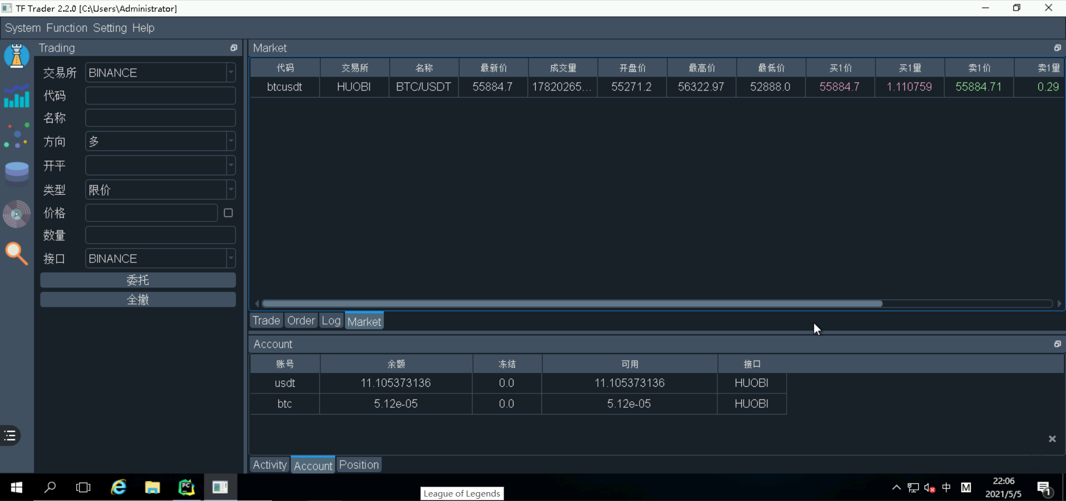
Live Trading Framework
GUI display

Slide 7
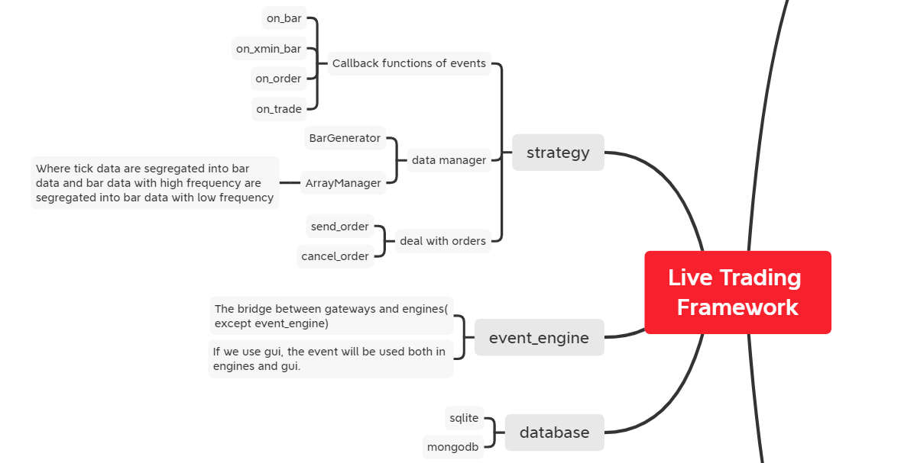
Live Trading Framework

Slide 8
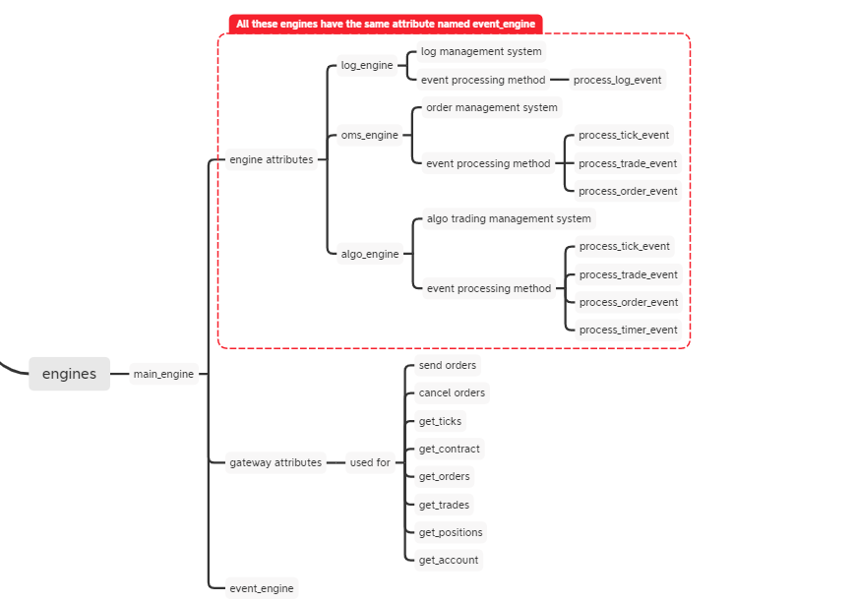
Live Trading Framework

Slide 9
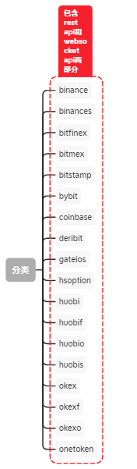
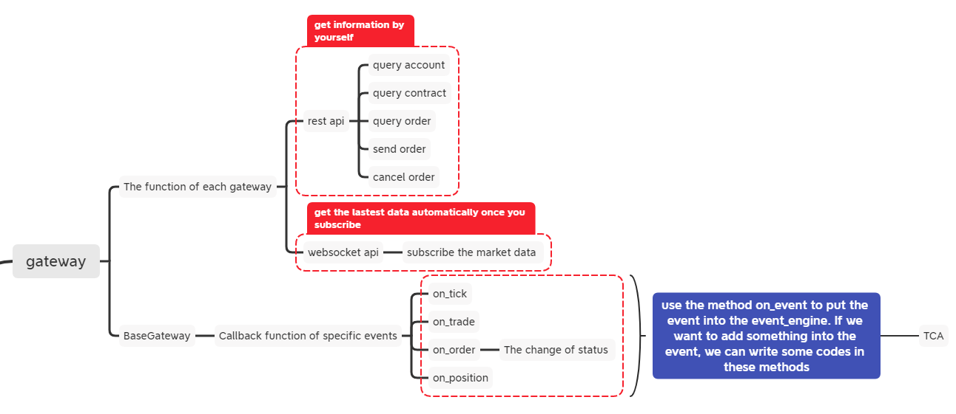
Live Trading Framework

Slide 10
Backtesting Data Import
回测数据导入

Slide 11
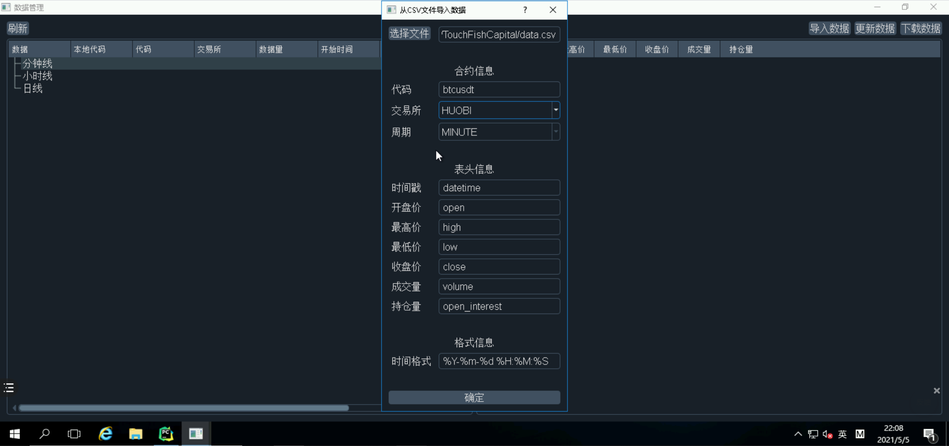
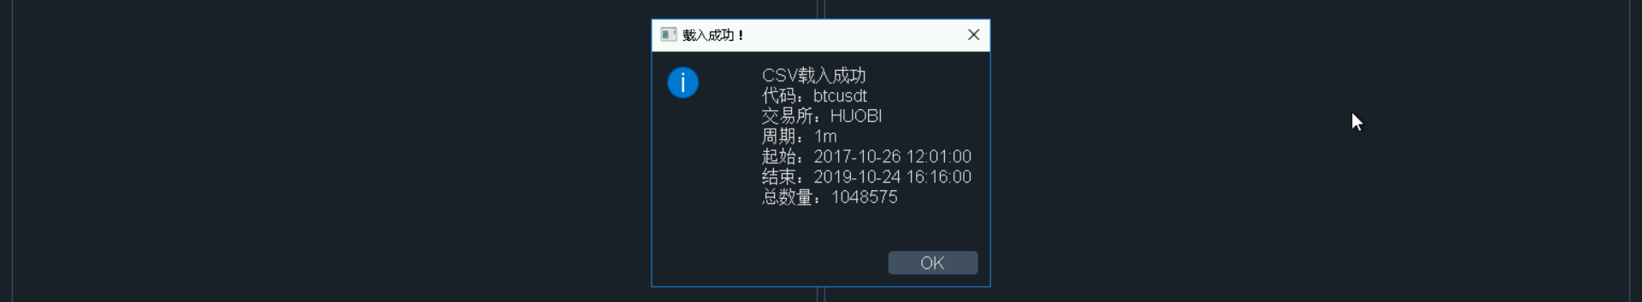
Backtesting Data Import

Slide 12
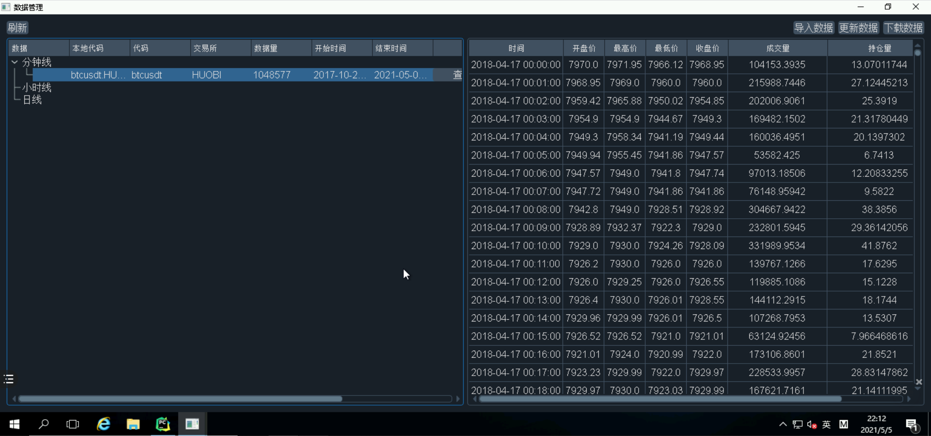
Backtesting Data Import
<import_data.py>
to import the data

Slide 13
Strategy Introduction
策略介绍

Slide 14
Strategy Introduction
Underlying：
BTCUSDT.HUOBI
Order：
As the price of Bitcoin changes rapidly, when opening a long order, use the current bar closing price plus 2; when closing a long order, use the current bar closing price minus 2.
Logic：
Every 30 minutes, calculate the average price fast_ma of the closing prices of the past 5 30-minute K-lines and the average price slow_ma of the closing prices of the past 20 30-minute K-lines.
If fast_ma> slow_ma, then ma_trend=1, otherwise, ma_trend=-1. At the same time, calculate the RSI value of the past 14 30-minute candlesticks and record it as rsi_value.
If there is no current position, and rsi_value>=80 and ma_trend=1, open a long position.
If the current long position is held and rsi_value<=50 or ma_trend=-1, then the long position will be closed.

Slide 15
Strategy Backtesting
策略的回测

Slide 16
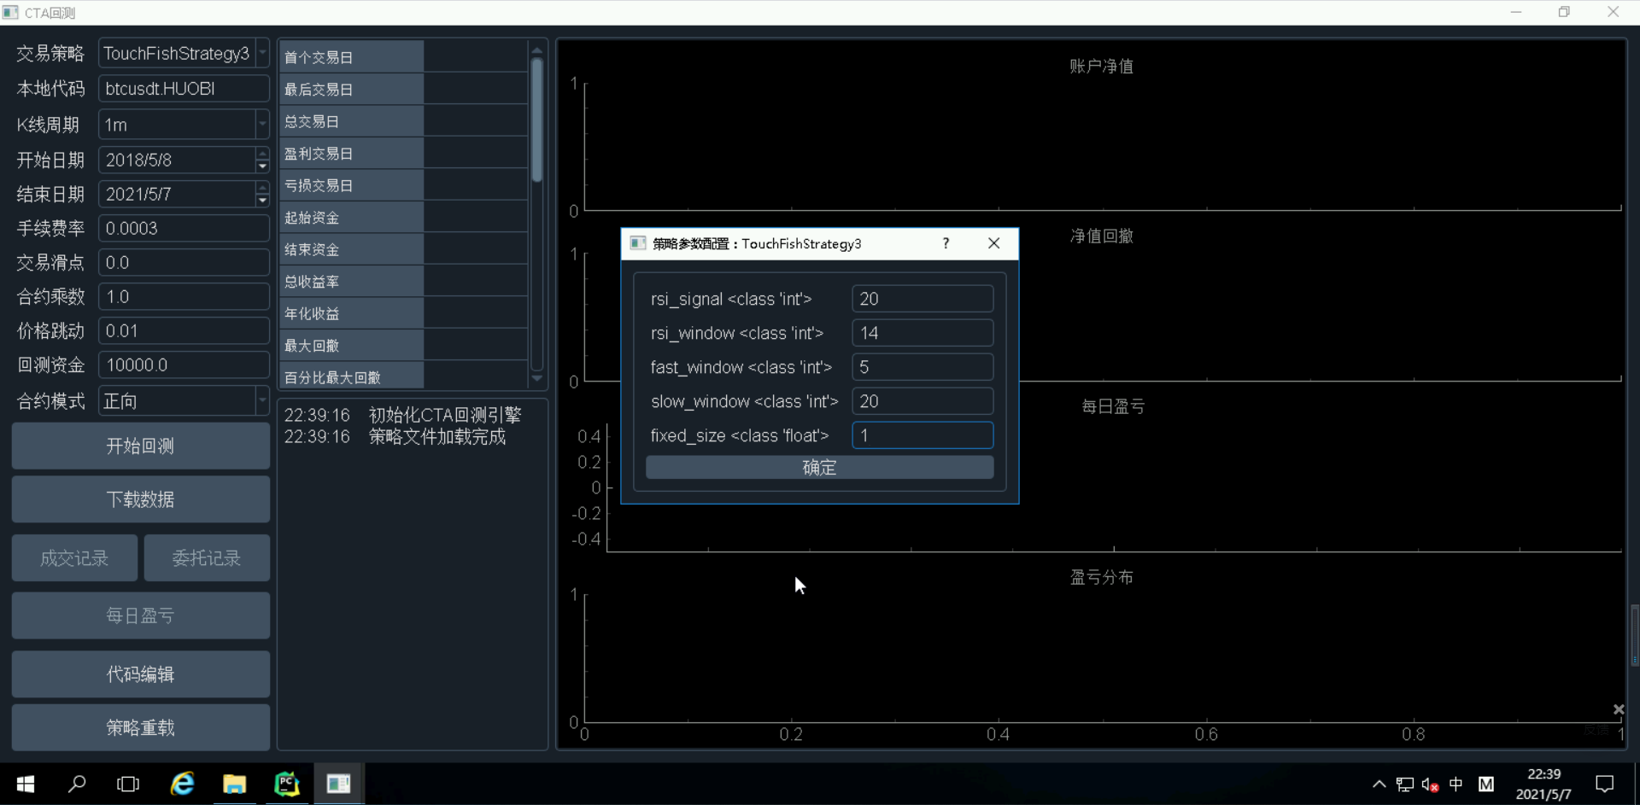
Strategy Backtesting
Configuration of transaction parameters

Slide 17
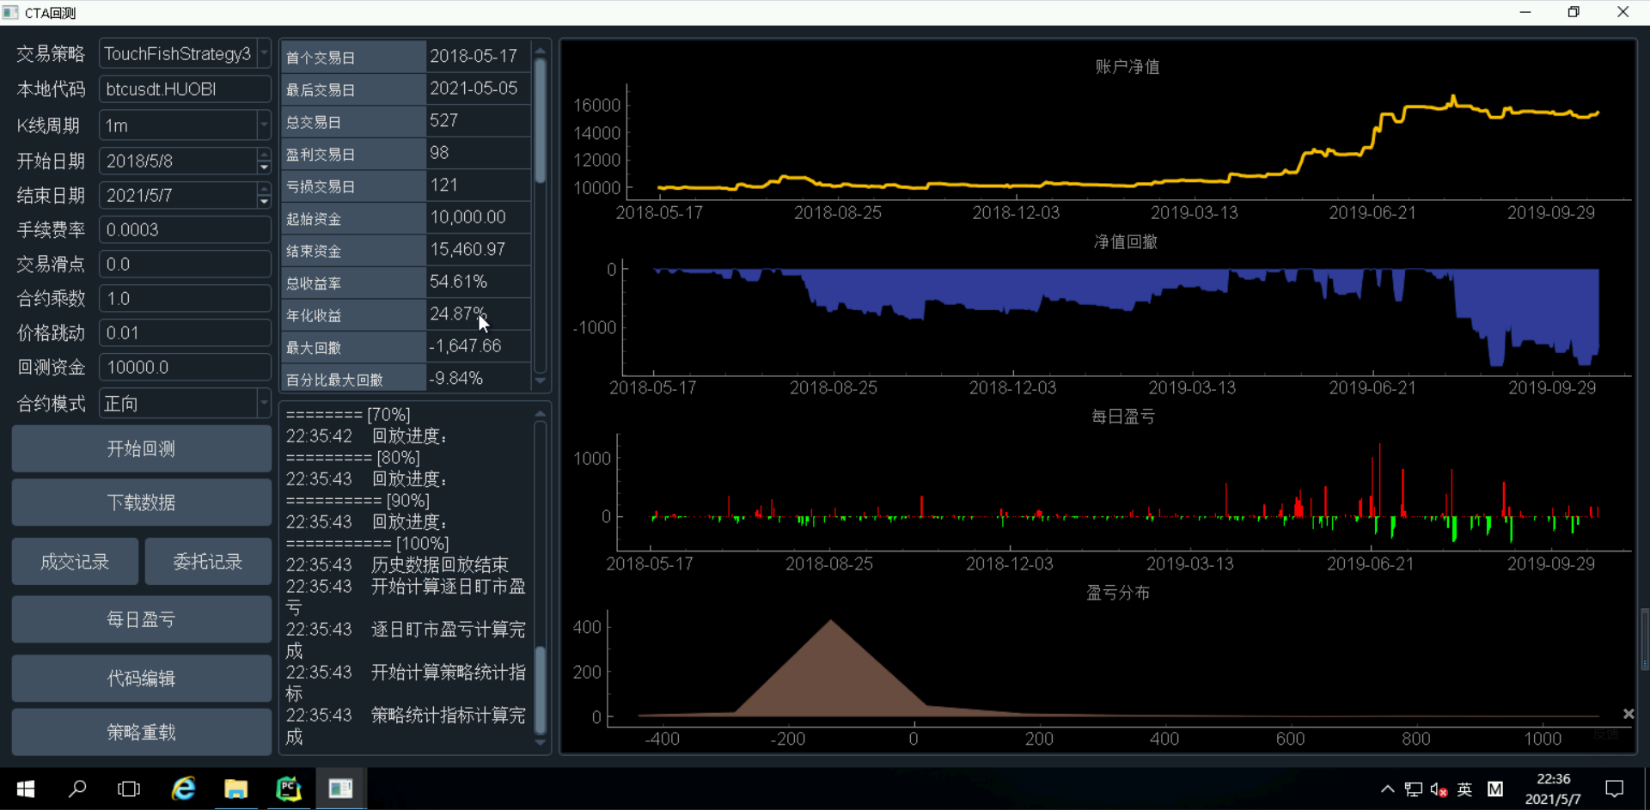
Strategy Backtesting
Process the order status and transaction records returned by the exchange, Calculate the slippage of each transaction and number of each order, and define the transaction cost as: slippage × volume

Slide 18
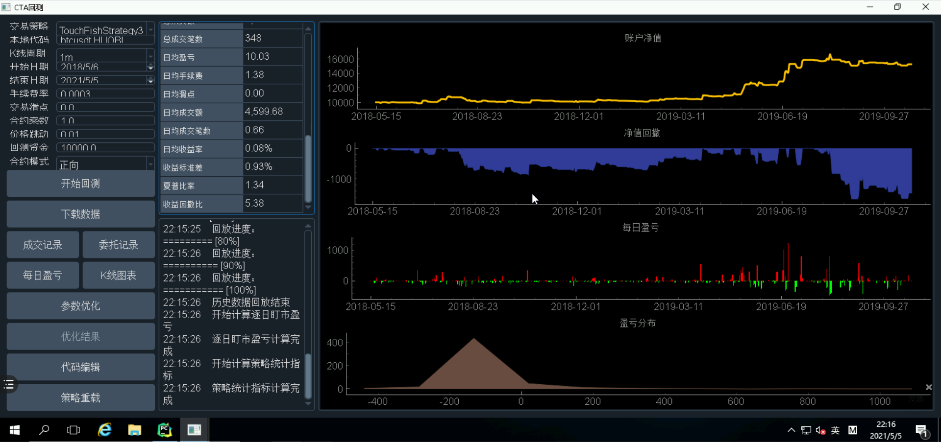
Strategy Backtesting
The outcome of backtesting

Slide 19
Live Trading
实盘交易

Slide 20
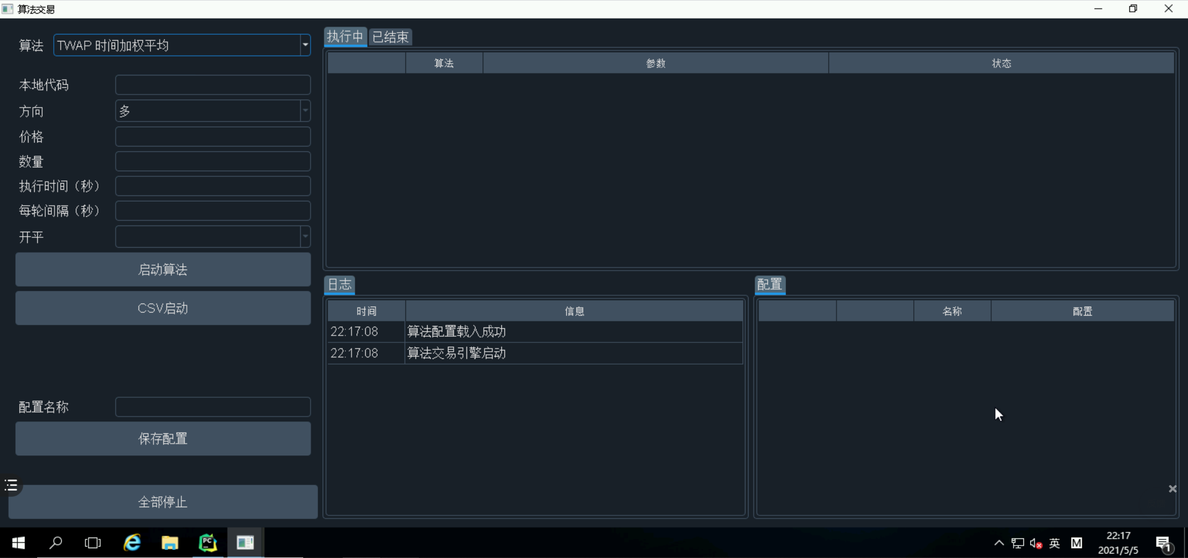
Live Trading

Slide 21
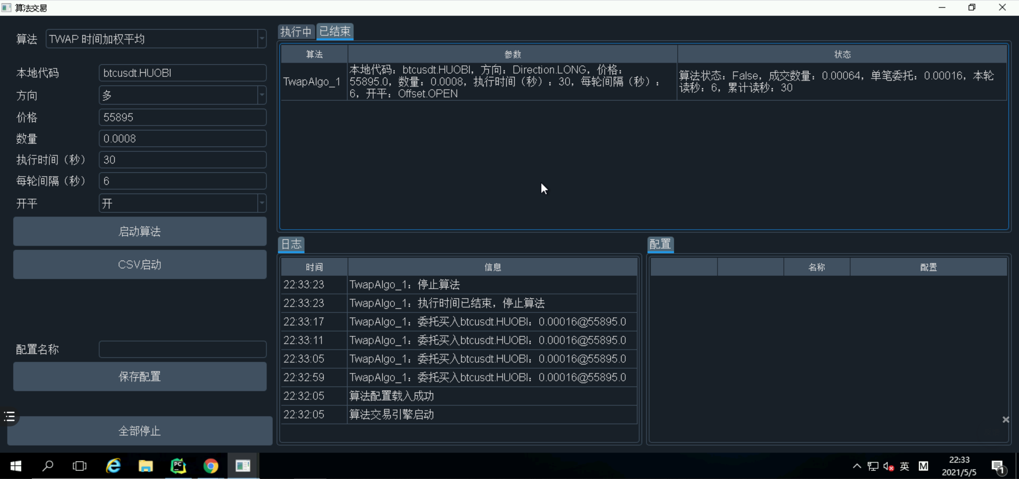
Live Trading

Slide 22
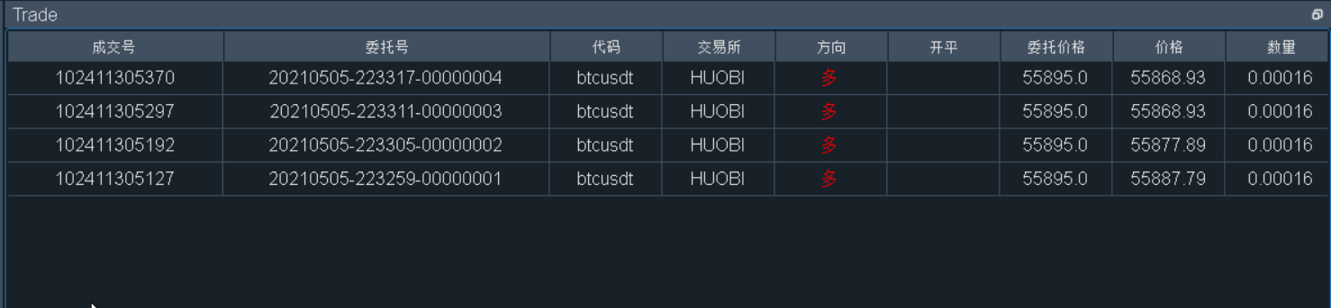
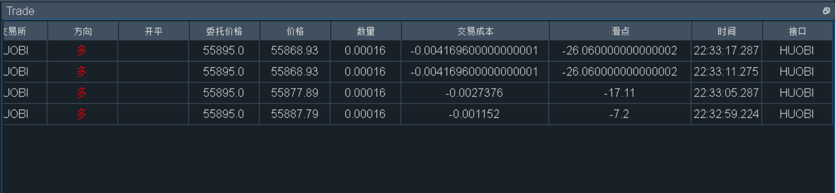
Live Trading

Slide 23
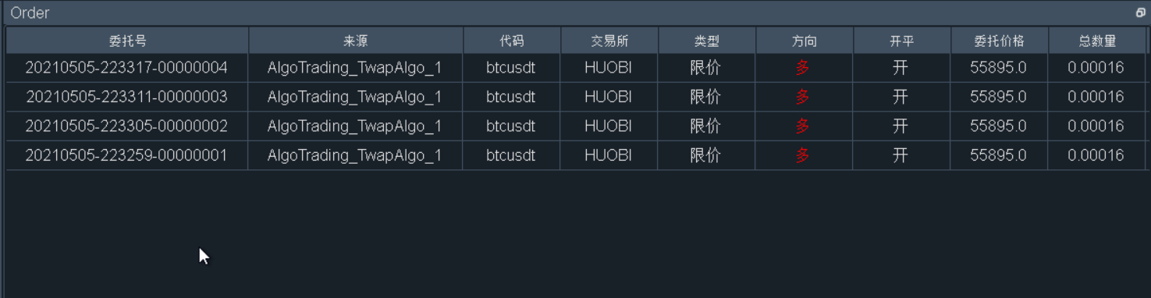
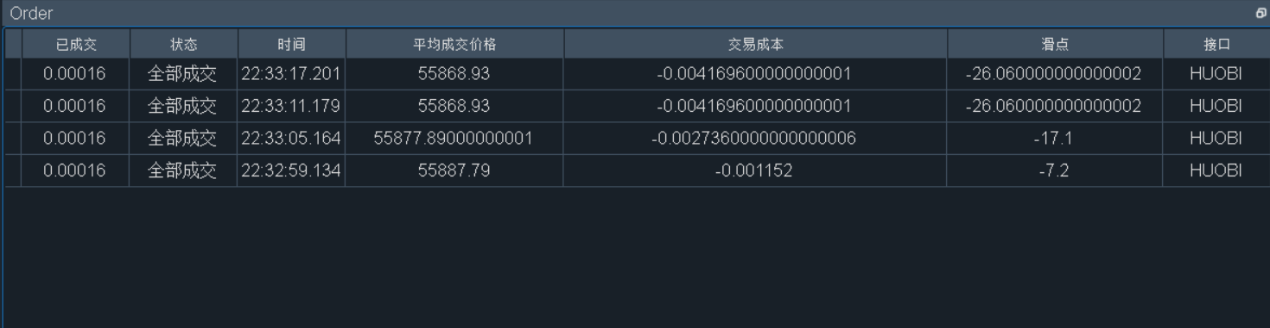
Live Trading

Slide 24
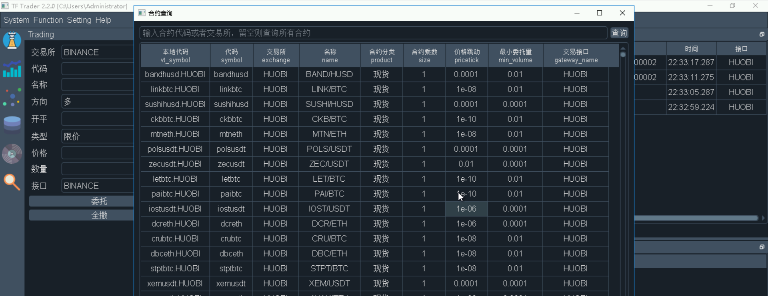
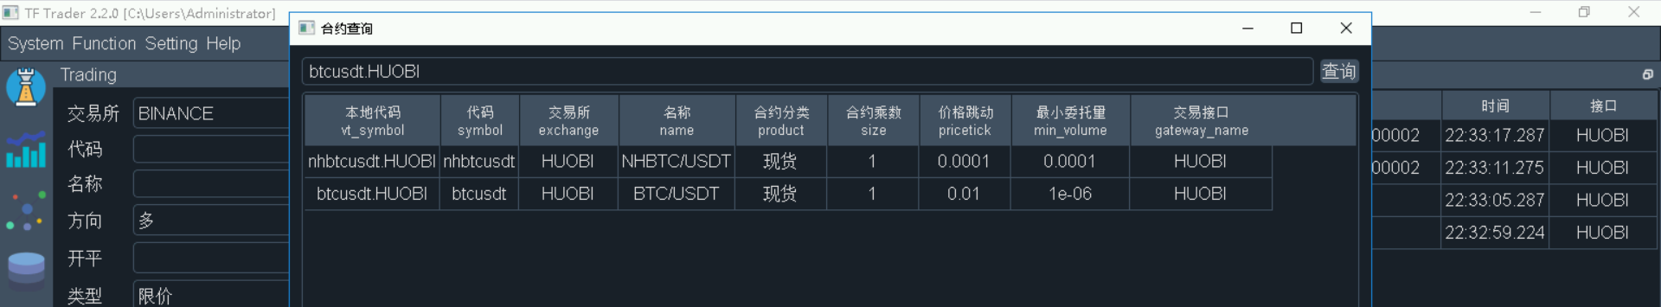
Live Trading

Slide 25

THANK YOU FOR ATTENTION

