Slide 1
2017 fall
CSC207 Project
Group number: 0436
Group members: Jiayi Zhang, Xindi Zhang, Ruijie Sun, Wenjie Hao

Slide 2
CSC207 PROJECT
1
A Quick Demo
Outline
2
UML
Design Patterns
3
4
Extra feature

Slide 3
01
Quick Demo
PART

Slide 4
02
UML
PART

Slide 5
CSC207 PROJECT
GUI
01
SCENES
02
MODEL
03
FILTER
04

Slide 6
03
Design Pattern
PART

Slide 7
CSC207 PROJECT
2.Design Patterns not used:
MVC
1
lterator
Observer
2
singleton
3
strategy
1.Design Patterns used:
4
Factory

Slide 8
04
Extra feature
PART

Slide 9
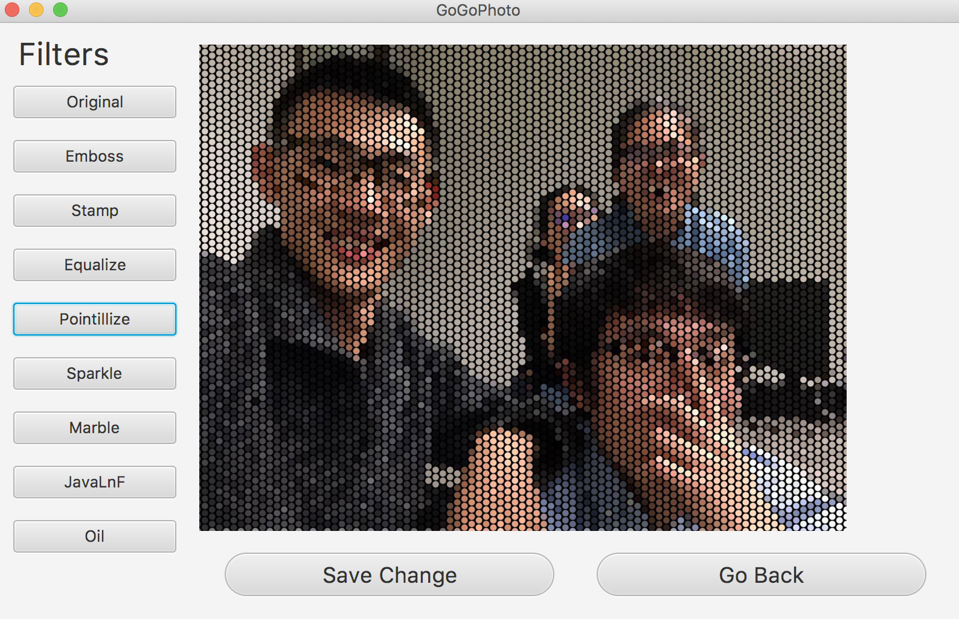
CSC207 PROJECT
Filters

Slide 10
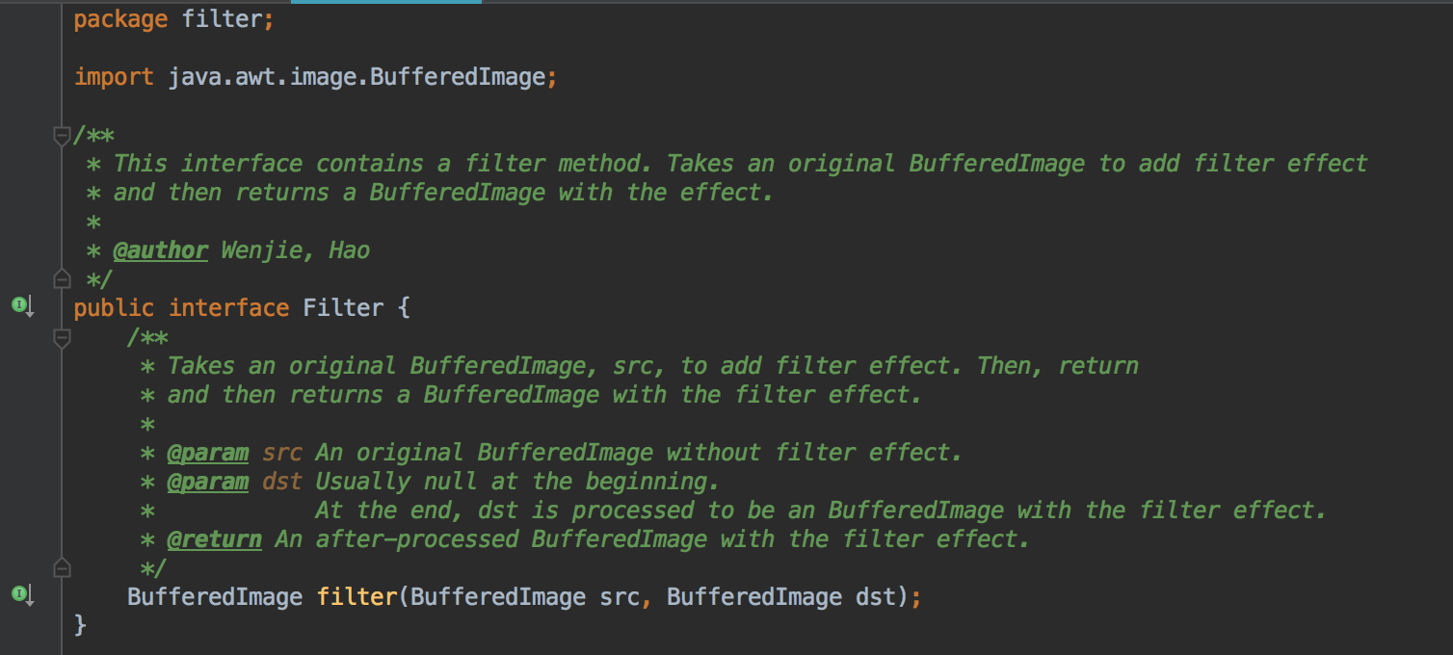
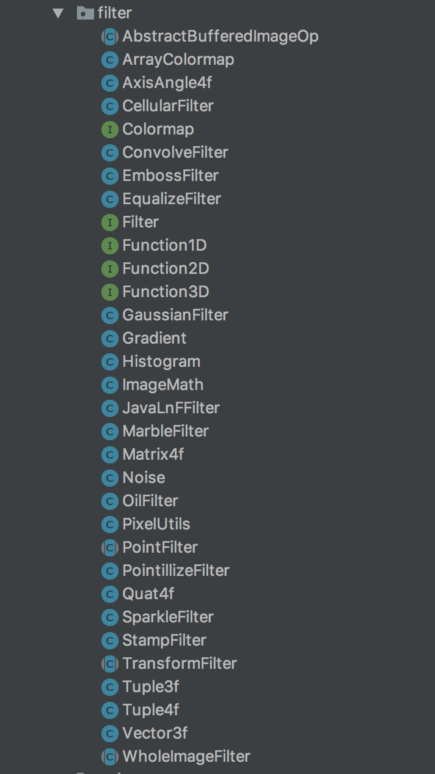
CSC207 PROJECT

Slide 11
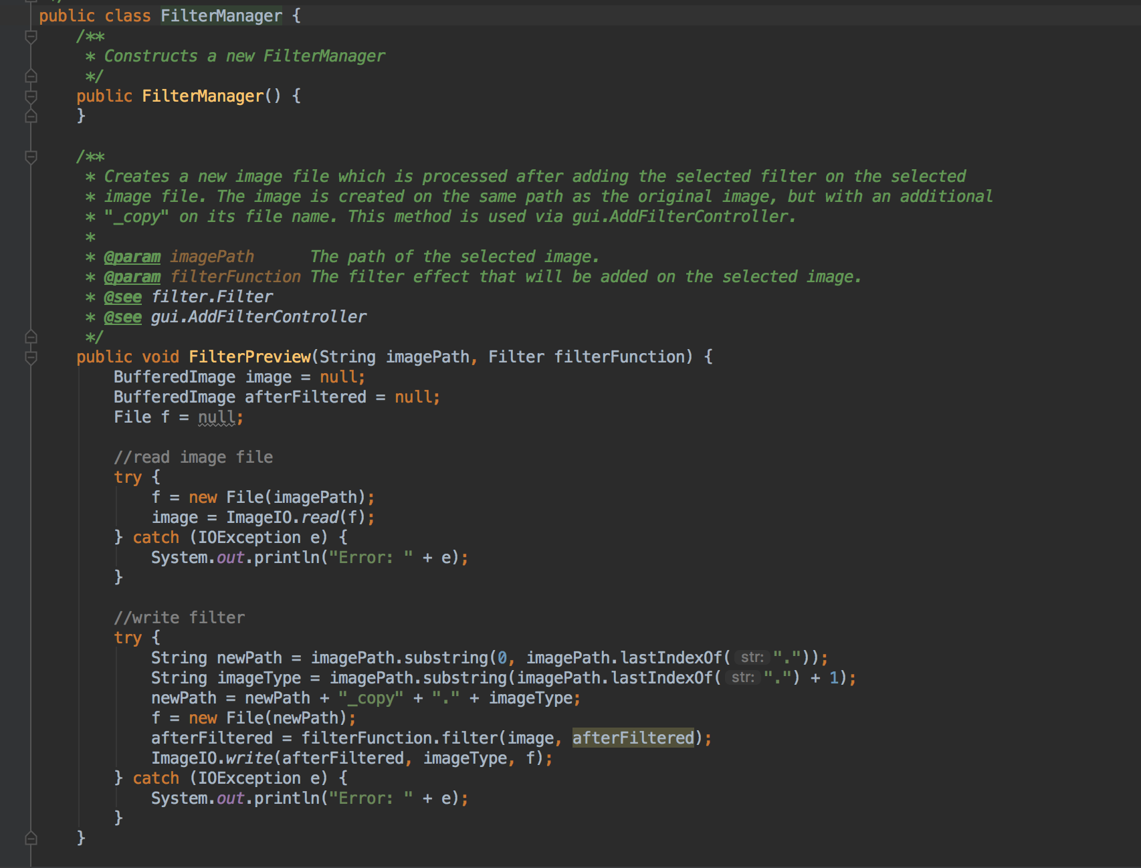
CSC207 PROJECT

Slide 12
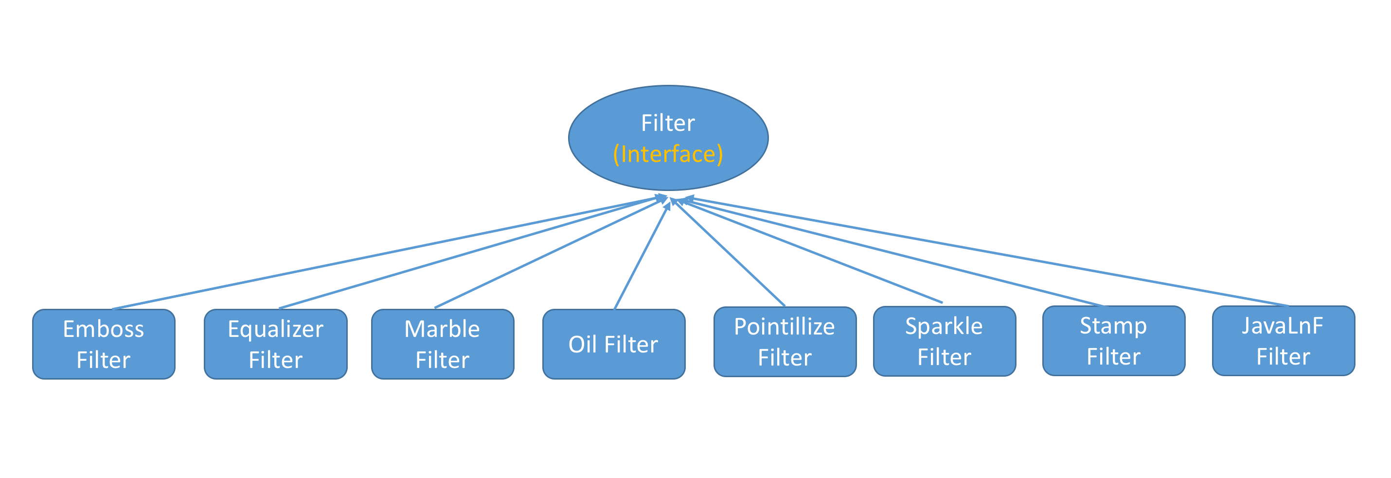
CSC207 PROJECT

Slide 13
2017 fall
Thank you for your time !

