Slide 1
CSC369 - Tutorial 2
ext2 as an example file system implementation
Exercise 2 – to be submitted online

Slide 2
Ext2 overview
Ext2 splits the HD into blocks of 1024 bytes.
1024
1024
1024
1024
1024
1024
1024
1024
1024
1024
1024
1024
1024
1024
1024
1024
1024
1024
1024
1024
1024
1024
1024
1024
…..
1024
1024
1024
1024
1024
1024
1024
1024
Use the macro:
EXT2_BLOCK_SIZE
From ext2.h

Slide 3
Ext2 overview
Ext2 splits the HD into blocks of 1024 bytes. Think of it as an array of blocks!
1024
1024
1024
1024
1024
1024
1024
1024
Metadata
1024
1024
1024
1024
1024
1024
1024
1024
Ext2 →
1024
1024
1024
1024
1024
1024
1024
1024
…..
Data
1024
1024
1024
1024
1024
1024
1024
1024

Slide 4
Ext2 overview
1024
1024
1024
1024
1024
1024
1024
1024
1024
1024
1024
Empty space
Superblock
Block bitmap
Inode bitmap
Block group descriptor table
Inode table
Don’t use this order as reference, this
is merely illustrative.
What do your exercise images look like?

Slide 5
Ext2 overview
Metadata
1024
1024
1024
1024
1024
1024
1024
1024
1024
1024
1024
1024
1024
1024
1024
1024
1024
1024
1024
1024
1024
1024
Data
…..
1024
1024
1024
1024
1024
1024
1024
1024
1024
1024
1024

Slide 6
Ext2 overview
Ext2 splits the HD into blocks of 1024 bytes. Think of it as an array of blocks!
And assigns different semantics to each of them.
1024
1024
1024
1024
1024
1024
1024
1024
1024
1024
1024
1024
1024
1024
1024
1024
Always empty!
Don’t use this order as reference, this
is merely illustrative.
Metadata
for the filesystem
Metadata
for the filesystem
Metadata
for directories
User file contents

Slide 7
Ext2 overview
Ext2 splits the HD into blocks of 1024 bytes. Think of it as an array of blocks!
And assigns different semantics to each of them.
Ext2 groups blocks into block groups
For the exercises you can assume only one block group.
1024
1024
1024
1024
1024
1024
1024
1024
Block group 1
1024
1024
1024
1024
1024
1024
1024
1024
Always empty!
Metadata
for the filesystem
Metadata
for the filesystem
Metadata
for directories
User file contents

Slide 8
Ext2 overview
What does your typical ext2 disk image look like?

Slide 9
Ext2 overview
What does your typical ext2 disk image look like?
1024
Empty space
The 0th block is reserved for other purposes
and is not used by the ext2 file system

Slide 10
Ext2 overview
What does your typical ext2 disk image look like?
The super block contains data about the overall
structure of the file system. It contains many fields
but we only care about a few of them:
1024
1024
Empty space
Superblock
struct ext2_super_block {
unsigned int s_inodes_count; /* Inodes count */
unsigned int s_blocks_count; /* Blocks count */
unsigned int s_free_blocks_count; /* Free blocks count */
unsigned int s_free_inodes_count; /* Free inodes count */
//continued in the header file ext2.h
…
}

Slide 11
Aside: How to read the data from disk
#include "ext2.h"
unsigned char *disk;
int main(int argc, char **argv) {
if(argc != 2) {
fprintf(stderr, "Usage: %s <image file name>\n", argv[0]);
exit(1);
}
int fd = open(argv[1], O_RDWR);
disk = mmap(NULL, 128 * 1024, PROT_READ | PROT_WRITE, MAP_SHARED, fd, 0);
struct ext2_super_block *sb = (struct ext2_super_block *)(disk + 1024);
printf("Inodes: %d\n", sb->s_inodes_count);
printf("Blocks: %d\n", sb->s_blocks_count);
return 0;
}
Notes:
Explain what mmap does
Make note that we are opening the file that contains the disk image
After mapping the file to a particular location in memory, we now know that the superblock is stored starting at byte 1024 in the file.
We can just cast this address to the superblock data type, and now we have access to the fields of the struct
Feel free to explain anything you want about this code. I removed the error checking so it would fit on the screen.
Mmap tutorials:
https://lwn.net/Articles/91829/
https://www.youtube.com/watch?v=m7E9piHcfr4
Mmap uses some part of process virtual memory (separate from heap and stack)
Faster than read() write() syscalls for random operations on files (you do not perform syscall for read, write, treat just as memory)
Beneficial for files that are used by a program for a long time before getting swapped out (because they can reside in the pagecache, but if you use read, the file can be swapped out of cache due to other operations)
https://www.quora.com/What-are-some-real-world-uses-of-mmap-Linux-system-call (real world use case mmap)

Slide 12
Ext2 overview
What does your typical ext2 disk image look like?
1024
1024
1024
Empty space
Superblock
Block group descriptor table

Slide 13
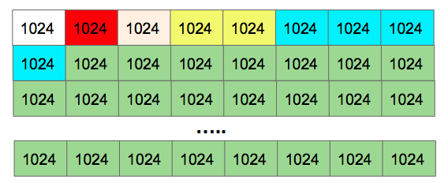
Block group descriptor
Block group 1
Disk
Block group 2
.
.
.
. . .
Block group n

Slide 14
Block group descriptor
Block group descriptor table
ext2_group_desc desc_table[N]
Block group 1
Block group 2
.
.
.
. . .
Block group n

Slide 15
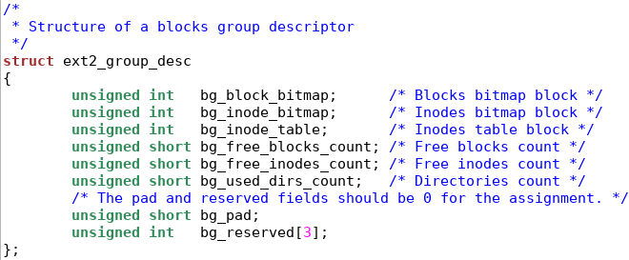
Block group descriptor
Block group descriptor table
ext2_group_desc desc_table[N]
Block group 1
Block group 2
.
.
.
. . .
Block group n

Slide 16
Block group descriptor
Only one “empty block”
(can be filled with MBR)
Block group 1
Block group 2
.
.
.
Block group n

Slide 17
Ext2 overview
Only 1 block group for exercises
So the block group descriptor table has only one element

Slide 18
Ext2 overview
What does your typical ext2 disk image look like?
1024
1024
1024
A large ext2 disk will have more than one block group.
We will learn about block groups later. For the exercises,
we only have one block group, and one block group
descriptor table which is an extension of the superblock
Empty space
Superblock
struct ext2_group_desc
{
unsigned int bg_block_bitmap; /* Blocks bitmap block */
unsigned int bg_inode_bitmap; /* Inodes bitmap block */
unsigned int bg_inode_table; /* Inodes table block */
unsigned short bg_free_blocks_count; /* Free blocks count */
unsigned short bg_free_inodes_count; /* Free inodes count */
Block group descriptor table

Slide 19
Ext2 overview
What does your typical ext2 disk image look like?
1024
1024
1024
1024
1024
Block bitmap contains a bit array that indicates
which blocks are in use.
Inode bitmap contains a bit array that indicates
which inodes are in use.
Empty space
Superblock
Block bitmap
Inode bitmap
Block group descriptor table

Slide 20
How to read the bitmaps

Slide 21
Ext2 overview
Suppose your inode bitmap is located at block 4.

Slide 22
Ext2 overview
Suppose your inode bitmap is located at block 5.
unsigned char *inode_bits = (unsigned char *)(disk + 1024 * 4);
1024
1024
1024
1024
1024

Slide 23
Ext2 overview
Suppose your inode bitmap is located at block 5.
unsigned char *inode_bits = (unsigned char *)(disk + 1024 * 4);
From the documentation:
The first inode of this block group is represented by bit 0 of byte 0, the second by bit 1 of byte 0. The 8th inode is represented by bit 7 (most significant bit) of byte 0 while the 9th inode is represented by bit 0 (least significant bit) of byte 1.
1024
1024
1024
1024
1024

Slide 24
Ext2 overview
Suppose your inode bitmap is located at block 4.
unsigned char *inode_bits = (unsigned char *)(disk + 1024 * 4);
From the documentation:
The first inode of this block group is represented by bit 0 of byte 0, the second by bit 1 of byte 0. The 8th inode is represented by bit 7 (most significant bit) of byte 0 while the 9th inode is represented by bit 0 (least significant bit) of byte 1.
If you have 32 inodes, you are looking at the first 32 bits, i.e., the first 4 bytes of the bitmap: for (byte = 0; byte < num_inodes / 8; byte++) for (bit = 0; bit < 8; bit++) in_use = inode_bits[byte] & (1 << bit);

Slide 25
Ext2 overview
What does your typical A4 disk image actually look like
1024
1024
1024
1024
1024
1024
1024
1024
1024
1024
1024
Empty space
Superblock
Block bitmap
Inode bitmap
Block group descriptor table
Inode table

Slide 26
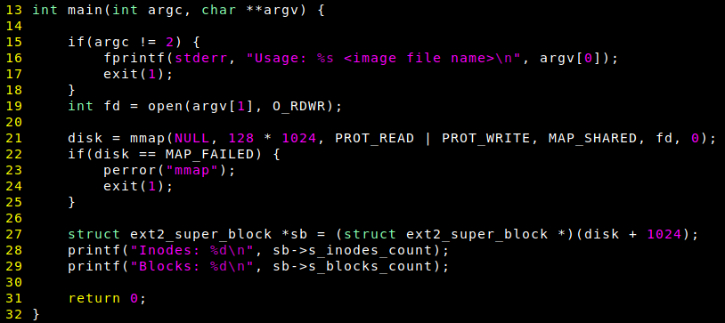
Starter code
char *disk;

Slide 27
Exercises 2 and 3
Print some attributes of the block group descriptor.
Exercise 2
Print some attributes of each inode that is being used.
Exercise 3
Some inodes are reserved and should be ignored.
Important: inodes are indexed starting from 1
i.e. inode 2 is really inodes[1]
Inode 2 is the root directory inode
Other inodes < 12 are reserved and we will ignore them
Notes:
Needs reformatting

Slide 28
Ext2 overview
Each file has an associated inode.
This does not contain the file itself!
A data structure with information about the file! Which information?

Slide 29
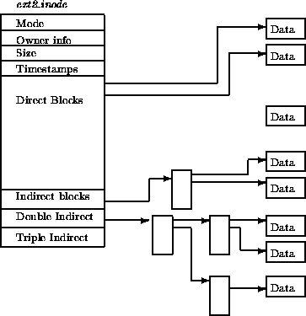
Ext2 overview: Inode
Each file has an associated inode.
This does not contain the file itself, but pointers to the data of the file!

Slide 30
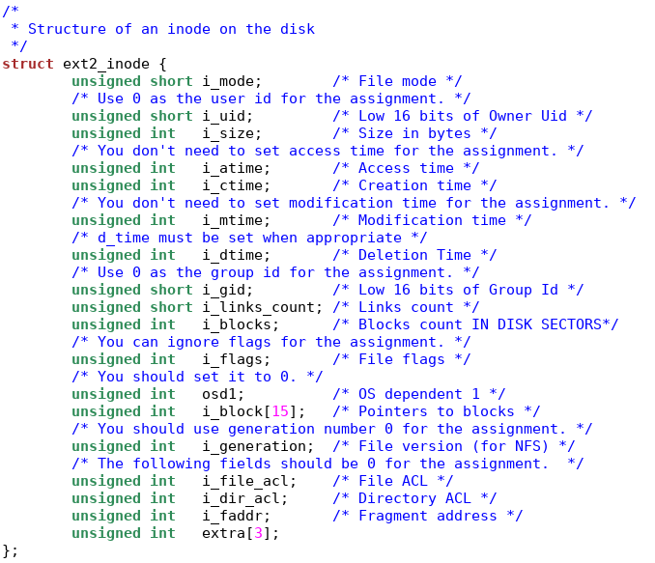

Slide 31
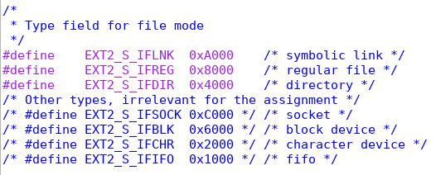

Slide 33
What is this? Check the documentation!!
http://www.nongnu.org/ext2-doc/ext2.html#I-LINKS-COUNT

Slide 34
Another pitfall here for ext2
Tip: block size for this field is different than the file system block size

Slide 35
The most important part of the inode!
An array of block numbers, telling you in which blocks the contents of the file are located!

Slide 36
If this is a text file with contents “Hello world”,
and i_block[0] = 10,
then the text is located in the 10th block,
byte number 10*1024 = 10240.

Slide 37
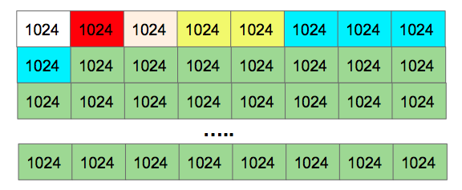
Ext2 overview: Inode Table
Ext2 allocates a constant number of consecutive blocks to serve as an array of inodes: the inode table.
(notice each inode has a fixed size, 128 bytes in our case)
You have a very limited number of inodes, and therefore a maximum number of files you can store!
Some inodes are reserved… documentation!
32*128 bytes per inode
___________________
1024 bytes per block

Slide 38
Ext2 overview: Reading the Inode table
Suppose you have a pointer to your disk:
char *disk; //Suppose, for now, that your disk is in memory.

Slide 39
Ext2 overview
Suppose you have a pointer to your disk:
char *disk; //Suppose, for now, that your disk is in memory.
Suppose your inode table is at block 6,
struct ext2_inode *inodes = (struct ext2_inode *)(disk + 1024 * 5);

Slide 40
Ext2 overview
Suppose you have a pointer to your disk:
char *disk; //Suppose, for now, that your disk is in memory.
Suppose your inode table is at block 6,
struct ext2_inode *inodes = (struct ext2_inode *)(disk + 1024 * 5);
and you want to print the contents of the 7th inode…
printf(“Size in bytes = %d”, inodes[6].i_size);
7th inode

Slide 41
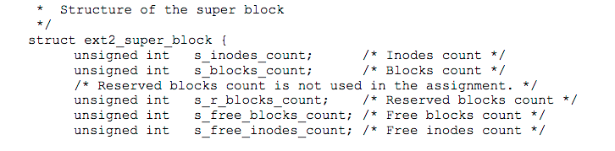
Demo: Locating superblock from an image

Slide 42
Looking at dumps: debugging your code
It will be useful to examine the images you create/modify using external tools.
Dump the files emptydisk.img and onefile.img
xxd -c 1 emptydisk.img emptydisk.dump
xxd -c 1 onefile.img onefile.dump
This dumps one byte per line. You can change this, but I find it useful to have line numbers matching the byte number you have.

Slide 43
Onto terminal

