Slide 1
CSC369 - Tutorial 3
Exercise 2, 3 – to be submitted online
Printing Inodes
Printing Directory Entries

Slide 2
Printing Inode information
Print some attributes of the block group descriptor.
Exercise 1
Print some attributes of each inode that is being used.
Exercise 2
Some inodes are reserved and should be ignored.
Important: inodes are indexed starting from 1
i.e. inode 2 is really inodes [1]
Inode 2 is the root directory inode
Other inodes < 12 are reserved and we will ignore them
Notes:
Needs reformatting

Slide 3
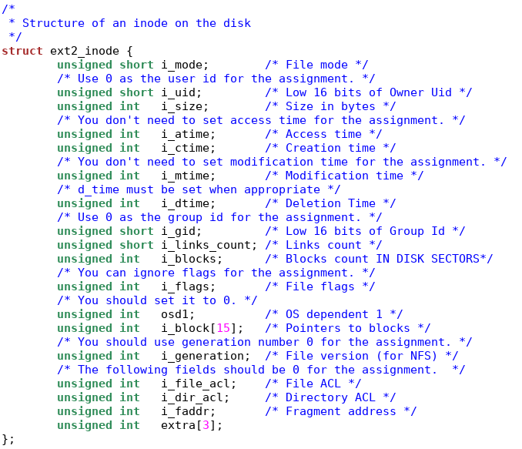
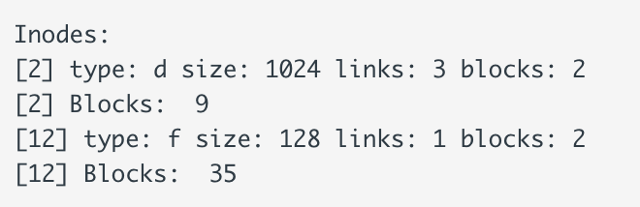
onefile.img

Slide 4
onefile.img

Slide 5
Ext2 overview
Suppose your inode bitmap is located at block 4.
unsigned char *inode_bits = (unsigned char *)(disk + 1024 * 4);
From the documentation:
The first inode of this block group is represented by bit 0 of byte 0, the second by bit 1 of byte 0. The 8th inode is represented by bit 7 (most significant bit) of byte 0 while the 9th inode is represented by bit 0 (least significant bit) of byte 1.

Slide 6
Ext2 overview
Suppose your inode bitmap is located at block 4.
unsigned char *inode_bits = (unsigned char *)(disk + 1024 * 4);
From the documentation:
The first inode of this block group is represented by bit 0 of byte 0, the second by bit 1 of byte 0. The 8th inode is represented by bit 7 (most significant bit) of byte 0 while the 9th inode is represented by bit 0 (least significant bit) of byte 1.
If you have 32 inodes, you are looking at the first 32 bits, i.e., the first 4 bytes of the bitmap: for (byte = 0; byte < 32 / 8; byte++) for (bit = 0; bit < 8; bit++) in_use = inode_bits[byte] & (1 << bit);

Slide 7
Coding

Slide 8
Directories
A directory is represented just like a file:
An inode + some data blocks.
While the data blocks for a file store its contents, a directory data block stores a list of directory entries.

Slide 9
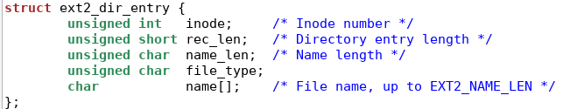
Directories
An entry must ALWAYS have a length that is a multiple of 4.
The last entry must always occupy the remaining space of the block.
This is why we have two “length” fields:

Slide 10
Sample directory: pay attention to the offsets
inode = 10
rec_len = 12
name_len = 1
file_type
name = “.”
padding
0
4
6
7
8
9
11
inode = 11
rec_len = 12
name_len = 2
file_type
name = “..”
padding
12
16
18
19
20
22
23
inode = 12
rec_len = 16
name_len = 6
file_type
name = 123456
padding
24
28
30
31
32
38
39
inode = 13
rec_len = 16
name_len = 8
file_type
name = 12345678
40
44
46
47
48
55
inode = 14
rec_len = 968
name_len = 8
file_type
name = 87654321
very long padding
56
60
62
63
64
72
1023

Slide 11
Deleting an entry:
inode = 10
rec_len = 12
name_len = 1
file_type
name = “.”
padding
0
4
6
7
8
9
11
inode = 11
rec_len = 12
name_len = 2
file_type
name = “..”
padding
12
16
18
19
20
22
23
inode = 12
rec_len = 16
name_len = 6
file_type
name = 123456
padding
24
28
30
31
32
38
39
inode = 13
rec_len = 16
name_len = 8
file_type
name = 12345678
40
44
46
47
48
55
inode = 14
rec_len = 968
name_len = 8
file_type
name = 87654321
very long padding
56
60
62
63
64
72
1023

Slide 12
Deleting an entry:
inode = 10
rec_len = 12
name_len = 1
file_type
name = “.”
padding
0
4
6
7
8
9
11
inode = 11
rec_len = 12
name_len = 2
file_type
name = “..”
padding
12
16
18
19
20
22
23
inode = 12
rec_len = 16
name_len = 6
file_type
name = 123456
padding
24
28
30
31
32
38
39
inode = 13
rec_len = 16
name_len = 8
file_type
name = 12345678
40
44
46
47
48
55
inode = 14
rec_len = 968
name_len = 8
file_type
name = 87654321
very long padding
56
60
62
63
64
72
1023

Slide 13
Deleting an entry:
inode = 10
rec_len = 12
name_len = 1
file_type
name = “.”
padding
0
4
6
7
8
9
11
inode = 11
rec_len = 28
name_len = 2
file_type
name = “..”
padding
12
16
18
19
20
22
23
inode = 12
rec_len = 16
name_len = 6
file_type
name = 123456
padding
24
28
30
31
32
38
39
inode = 13
rec_len = 16
name_len = 8
file_type
name = 12345678
40
44
46
47
48
55
inode = 14
rec_len = 968
name_len = 8
file_type
name = 87654321
very long padding
56
60
62
63
64
72
1023

Slide 14
Restoring an entry? Search the gaps!
inode = 0
rec_len = 12
name_len = 1
file_type
name = “.”
padding
0
4
6
7
8
9
11
inode = 11
rec_len = 28
name_len = 2
file_type
name = “..”
padding
12
16
18
19
20
22
23
inode = 12
rec_len = 16
name_len = 6
file_type
name = 123456
padding
24
28
30
31
32
38
39
inode = 13
rec_len = 16
name_len = 8
file_type
name = 12345678
40
44
46
47
48
55
inode = 14
rec_len = 968
name_len = 8
file_type
name = 87654321
very long padding
56
60
62
63
64
72
1023

Slide 15
Restoring an entry? Search the gaps!
Possibility :
rec_len != 8 + name_len + padding ?
padding is how much you need to add to name_len so that it becomes a multiple of 4.
inode = 0
rec_len = 12
name_len = 1
file_type
name = “.”
padding
0
4
6
7
8
9
11
inode = 11
rec_len = 28
name_len = 2
file_type
name = “..”
padding
12
16
18
19
20
22
23
inode = 12
rec_len = 16
name_len = 6
file_type
name = 123456
padding
24
28
30
31
32
38
39
inode = 13
rec_len = 16
name_len = 8
file_type
name = 12345678
40
44
46
47
48
55
inode = 14
rec_len = 968
name_len = 8
file_type
name = 87654321
very long padding
56
60
62
63
64
72
1023

Slide 16
Printing directory entries

Slide 17
Directories
Suppose some directory stores its contents in block 9.

Slide 18
Directories
Suppose some directory stores its contents in block 9.
How do you find the name of the first entry?
char* name = disk + 1024 * 9 + sizeof(ext2_dir_entry)
… problems?

Slide 19
Directories
Suppose some directory stores its contents in block 9.
How do you find the name of the first entry?
char* name = disk + 1024 * 9 + sizeof(ext2_dir_entry)
… problems?
Isn’t this “eating” the first 4 bytes (or however many bytes a pointer needs) of the name?

Slide 20
Directories
Suppose some directory stores its contents in block 9.
How do you find the name of the first entry?
char* name = disk + 1024 * 9 + sizeof(ext2_dir_entry)
Isn’t this “eating” the first 4 bytes (or however many bytes a pointer needs) of the name?
No! In C, declaring char name[]; is an indication that the struct will have variable size. That member has “size” 0!

Slide 21
Directories
char* name = disk + 1024 * 9 + sizeof(ext2_dir_entry)
How do we print this? This is not NULL terminated.

Slide 22
Directories
char* name = disk + 1024 * 9 + sizeof(ext2_dir_entry)
How do we print this? This is not NULL terminated.
for(j = 0; j < name_len; j++) { printf("%c", name[j]);}
printf("\n");

Slide 23
Directories
char* name = disk + 1024 * 9 + sizeof(ext2_dir_entry)
The next entry is located at…?

Slide 24
Directories
char* name = disk + 1024 * 9 + sizeof(ext2_dir_entry)
The next entry is located at…?
increment by rec_len;

Slide 25
Exercise 3
Iterate over all inodes.
If the inode is being used, and if it is related to a directory,
Access the directory data blocks and print each directory entry.
Some pitfalls:
How do you detect deleted entries? Do you need to?

Slide 26
Coding

