Slide 1
Introduction to Python for Social Scientists
Helge Marahrens & Anne Kavalerchik
Indiana University Bloomington
Department of Sociology
Email correspondence to: hmarahre@iu.edu
Workshop in Methods (WIM)
INDIANA UNIVERSITY BLOOMINGTON

Slide 2
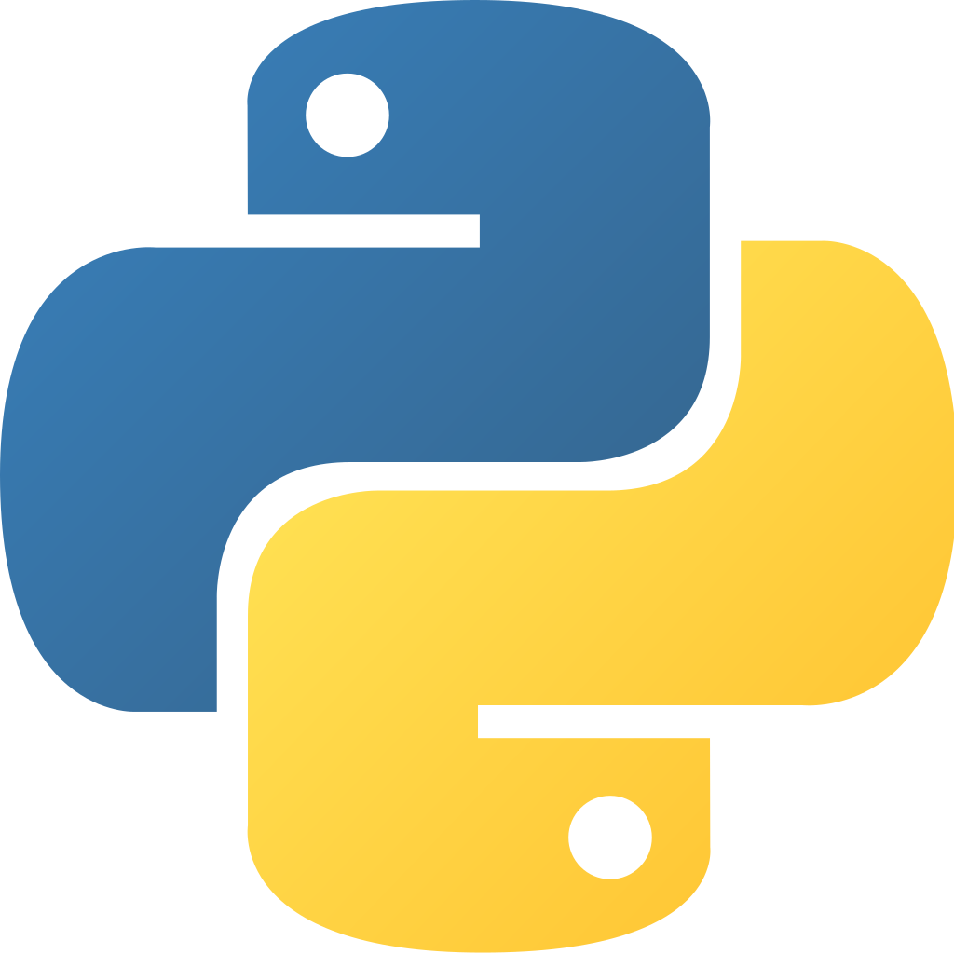
demystify Python
get you started
basics
dealing with messy data

Slide 3
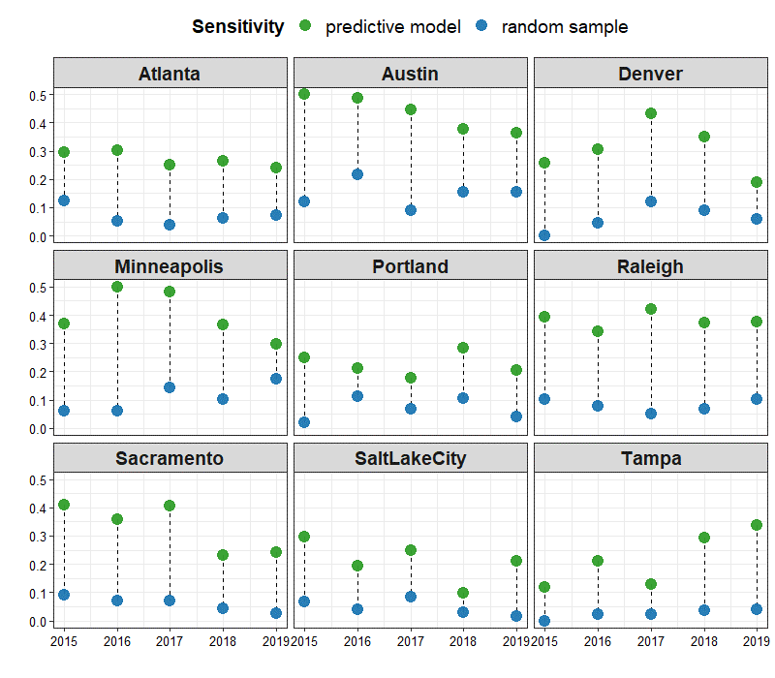
digital life/ digital trace data
large data
textual data
predictive modelling

Slide 4
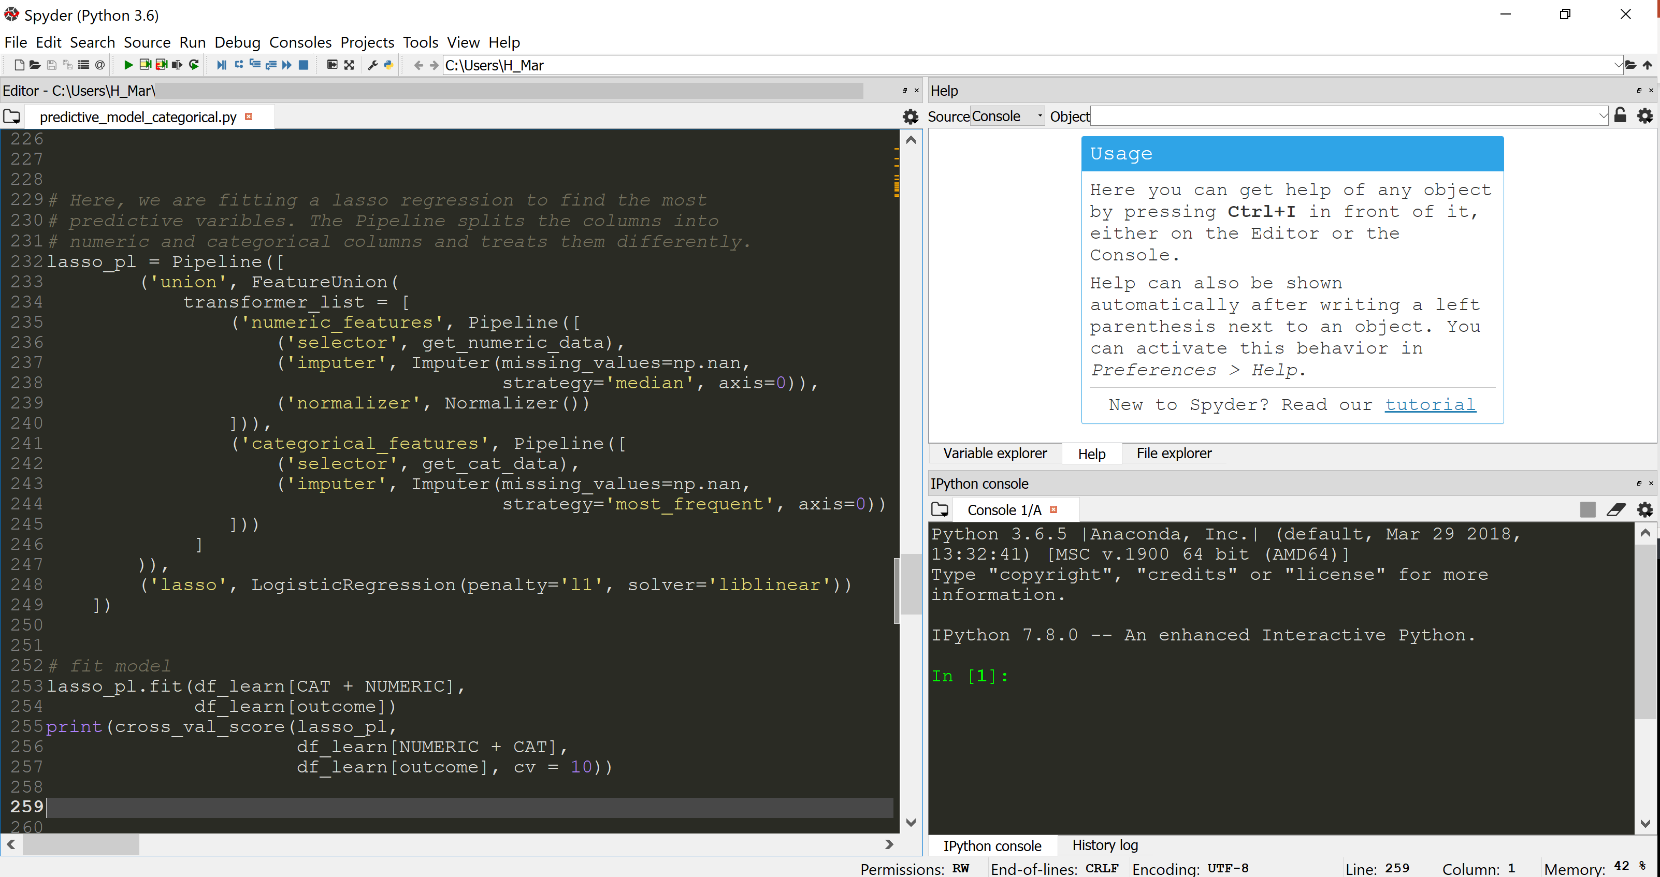
Python 3
IDE→ IDLE
Other IDE’s:
Spyder
Jupyter Notebook
…

Slide 5
data types
function vs. method
indentation is key (4 spaces)
counting begins at zero

Slide 6
Coding languages, coding as language
There are many different ways to express the same thought. For example, all of the following mean essentially the same thing:
Are we finished?
Is this over?
Has this ended?
Can I leave?
In Python, there are many different ways to do a given task

Slide 7
Part 2: Data Wrangling
ProPublica API
congress_house.xlsx
Excel spreadsheet of the current House of Representatives
ProPublica_Members-Bills.pkl
“pickle” file (Python module) of 1000 bills
How combine the two to see how many bills members of the House of Representative have passed?

