Slide 1


UNIVERSITY OF INFORMATION TECHNOLOGY AND COMMUNICATION
FINANCIAL ACCOUNTING
STUDENT:SARA ADEL
WADHAH AL-AZZAWI
SHIMAA RASHEED
HANEEN AHMED
FATIMA IHSAN
LECTURER:HASANAIN AL-SAEDI

Slide 2



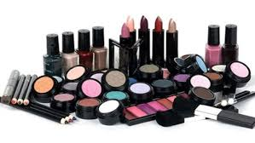

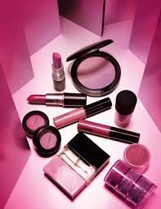
“Beauty lady company”

Slide 3
INTRODUCTION
Our project talks about the loss of the company and how
the goals and policies were changed for the purpose of success
company A category
that had not been considered
before was considered

Slide 4
The main goal
The main goal of the company and the production of beauty products is to obtain the satisfaction the young women with low income and female students, where this category was not considered before and drawing smile and happiness on their faces and the freshness of self-sufficiency that will be painted not only for profit

Slide 5
STRATEGY
For the success of any project must be a marketing plan suitable for him to succeed and achieve the goal in several ways as follows:
1 - Marketing the product for all pharmacies that sell cosmetics.
2. Visit beauty centers and women's hairdressing shops to display products on them
As well as visit the malls that have shops selling cosmetics and provide a sample of the product.
3. Do go to shops that sell wholesale and display the product on them.
4. After a period of profit, it is possible to employ delegates as product marketers to be girls or young people.
5. Conducting an advertising campaign on websites and magazines that concern women.
6. Work a page on Facebook, Twitter and Google Plus Social networking sites have become a big market to sell any product.
7. Agreement on distributors in different governorates in order to distribute products.

Slide 6
PLAN
A working group agreed and a plan was prepared for
the success of the project
Where it was going down to the street and shops
and take the views of a class of society and the young women with low income and students
Choosing the right location
Select the appropriate area:
Rent
After agreeing to rent and choose the appropriate place and company, we must obtain the operating licenses for the place and health in addition to the tax card and the commercial register to operate the place so that the place of the project does not stop at any time because of those licenses
After all these are completed, the company is supplied with the machines, the place, the raw materials, the working hand, and all that the project needs for direct work

Slide 7

Our motto is
The secret of success is in understanding the other opinion

Slide 8
Cost of production
Direct material Cost
Direct Materials
The cost of all materials that are an integral part of a finished product and that have a physical presence that is readily traced to that finished product.
the currency | Product price | Subject Name
$ | 2 | Wax
$ | 1 | oli
$ | 2 | solvents
$ | 1 | color
$ | 2 | tupe
$ | 1 | lable

Slide 9
The price of raw materials is direct to 500 piece product
Direct material price = Item price * Number of pieces
the currency | Product price | Subject Name
500unit | 10,000$ | Wax
500unit | 5,000$ | oli
500unit | 10,000$ | solvents
500unit | 5,000$ | color
500unit | 10,000$ | tupe
500unit | 5,000$ | lable

Slide 10
Manfcter Overhead
All costs of manufacturing other than direct materials and direct labora
Conversion Costs = Direct Labor + Manufacturing Overhead
.
Per month | 5,000,00$ | rent
 | 500,00$ | incurance
 | 1,000,00$ | maintaion
 | 70,00$ | electrecty

Slide 11
Direct labor cost for single worker
Consists of gross wages paid to those who physically and directly work on the goods being produced.
Per hour | 5$ | Paching worker
Per hour | 4$ | Labling worker
Per hour | 6$ | Prodection worker
Per hour | 7$ | Delivering worker
Per hour | 10$ | Worker chife

Slide 12
Indirect labor cost
Per month for single | 500$ | Accountants
Per month for single | 600$ | Supervisor
Per month for single | 300$ | Security guards
Per month for single | 400$ | Marketing emp

Slide 13
Total project cost
The direct material price is 500 pieces= 45,000$
manufacturer overhead cost=6,570$
direct labor cost=2,108$
Indirect labor cost=8,900$
Prime cost=47,108$
Converion cost=8,678$
Total Cost=53,678$

Slide 14
JOB COSTING

Slide 15
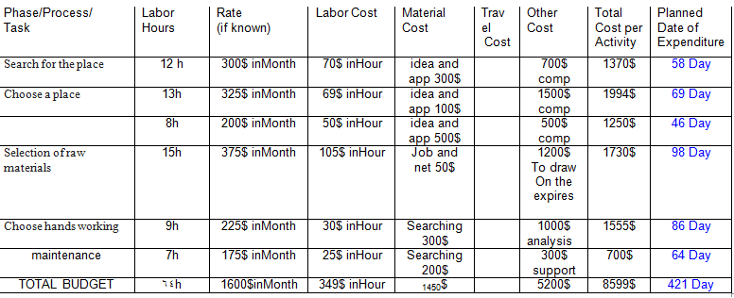
Job costing

