Slide 1
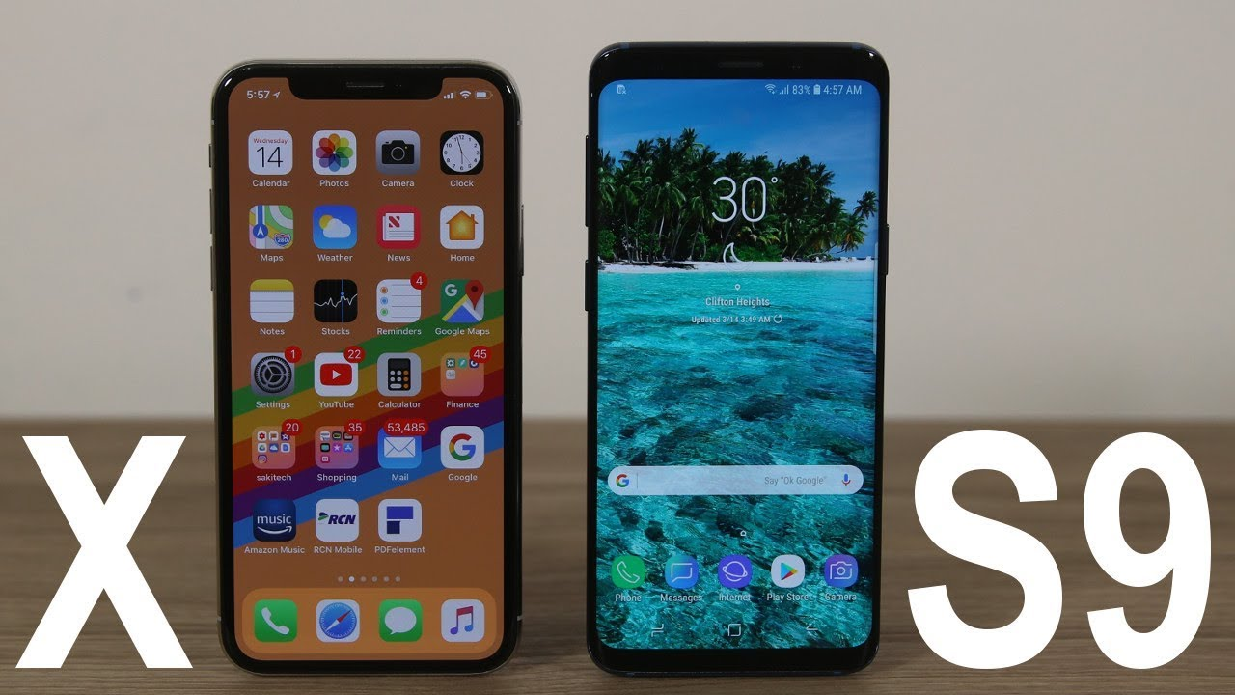
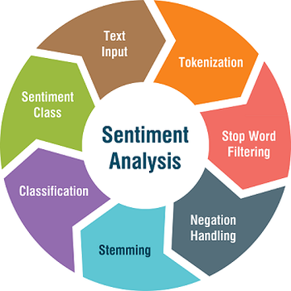

Slide 2
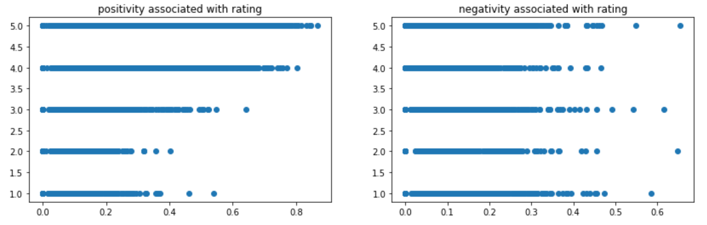
Notes:
https://www.apple.com/support/iphone-x-display-module-replacement-program/

Slide 3
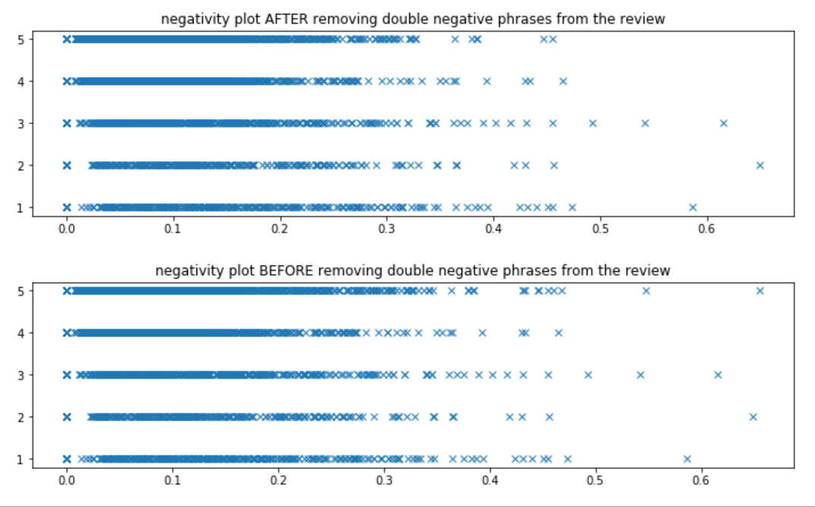

Slide 4
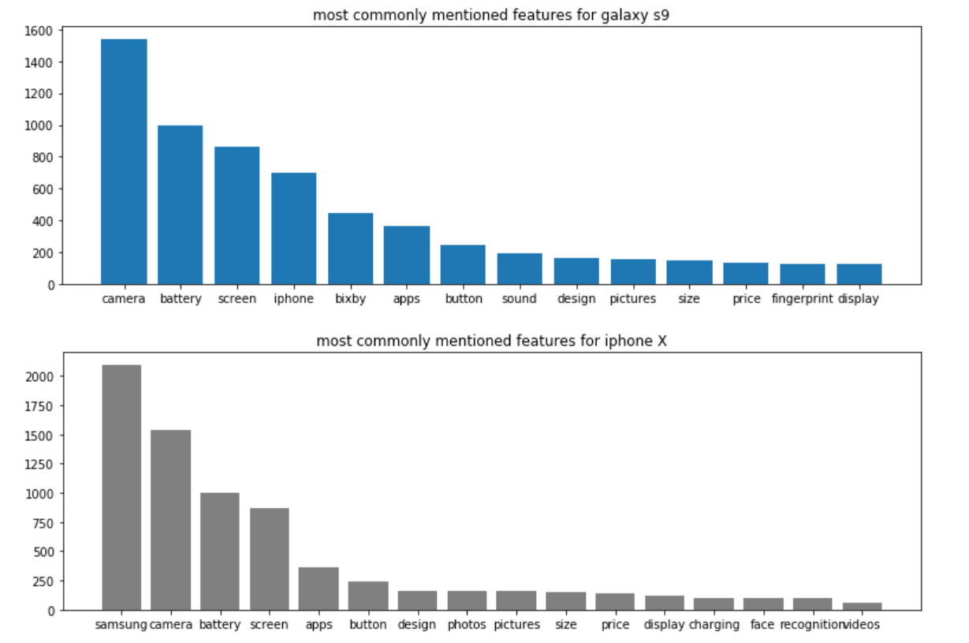
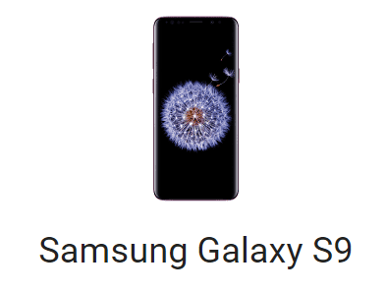
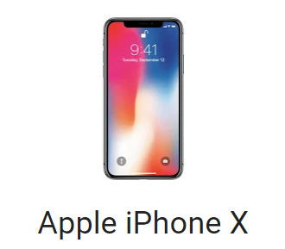

Slide 5
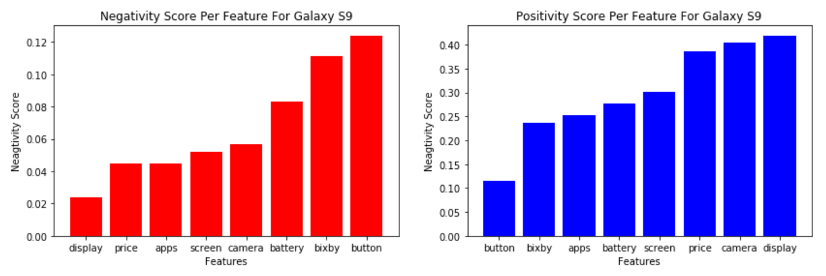
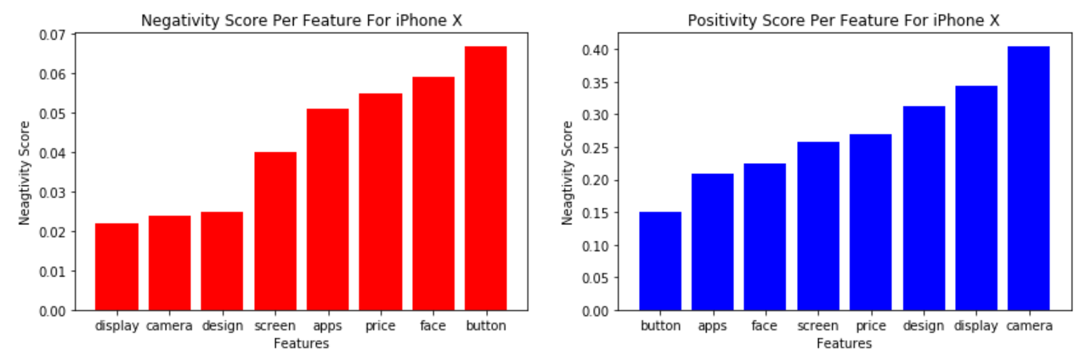
Notes:
https://www.apple.com/support/iphone-x-display-module-replacement-program/
https://www.theverge.com/circuitbreaker/2018/8/15/17683218/samsung-bixby-button-interactive-non-customizable-hardware

