Slide 1
Ontwerp, analyse en implementatie van een convolutionair neuraal netwerk voor gelijktijdige spraak en beeldherkenning

Slide 2
Overview
Problem sketch
Current research
Neural networks
Dataset: TCDTIMIT
Objectives
Lipreading
Speech (audio)
Sensor fusion
1
Notes:
1
5

Slide 3
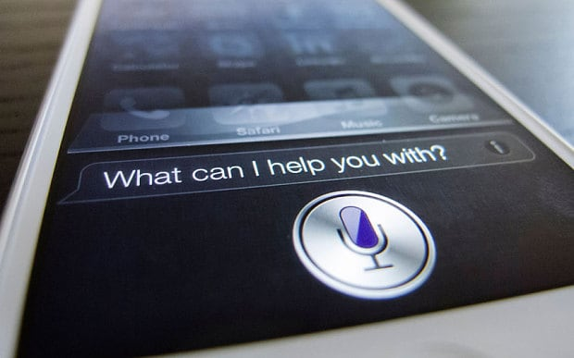
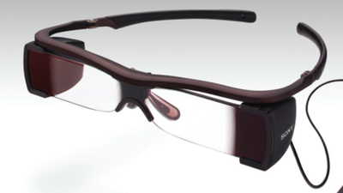
1. Problem sketch
Speech recognition applications
Automatic subtitles
Assisting hearing impaired
Human-computer interation (Siri)
International meetings (translations)
Until now: mostly audio
Use images (lipreading) → robustness, performance
Sony Entertainment
1
Notes:
1
5
Robustness:
- achtergrondgeluid, slechte kwaliteit audio,...
- performance b/c use extra information
- till now: very hard to extract this info from images (shape of mouth,...),
- but not robust against different people (mustache, gender,...)
-> CONVNETS = generalization power

Slide 4
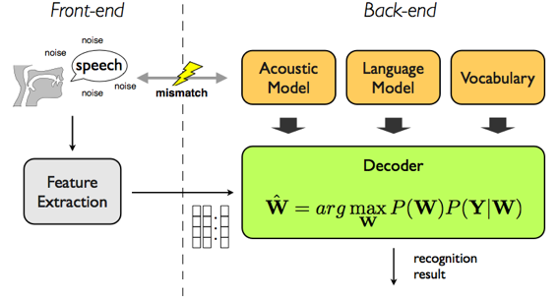
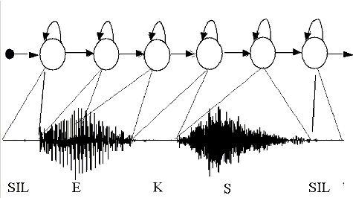
2. Research
General SR model:
In the past:
Mostly audio SR
Acoustic model: formants, fricatives,...
Record sounds, statistical correlation
→ Hidden Markov Models (HMM)
Language model on top
Often limited in scope
(eg. Phone support)
http://www.esat.kuleuven.be/psi/spraak/theses/08-09-en/MDT.php
https://www.uea.ac.uk/computing/research-at-the-uea-speech-group
1
Notes:
1
5
Past:
- pattern recognition -> HMM -> NNs
- limited scope (eg phone support: keyword spotting)
High level models:
N-gram model: statistical representation of grammar

Slide 5
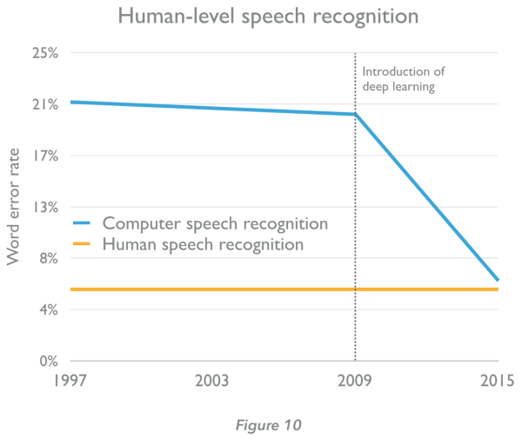
2. Research
Current: 'Deep learning'
Still mostly audio
Acoustic model: formants, fricatives,…
Record sounds, statistical correlation of spectrals
→ Convolutional Neural Networks
Language model on top (possibly DNN? ), or built-in
Much broader in scope (Siri, Cortana, SR 'in the wild')
1
Notes:
1
5
NN:
very strong abstraction, generalization power due to multilayer nonlinearity
ConvNN: NN specialized in pattern recognition
High level models:
N-gram model: statistical representation of grammar

Slide 6
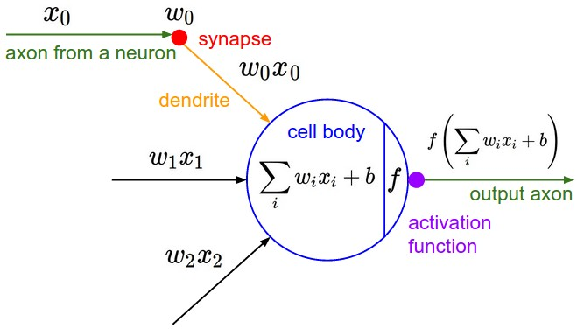
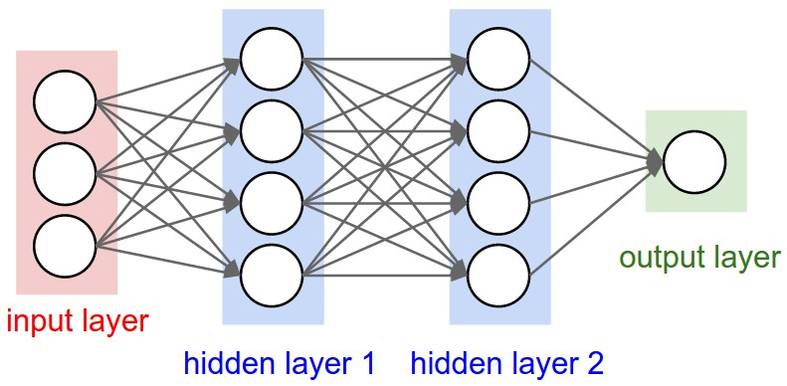
3. Neural Networks
Simple units with nonlinear output function
http://cs231n.github.io/neural-networks-1/
http://cs231n.github.io/neural-networks-1/
1
Notes:
1
5

Slide 7
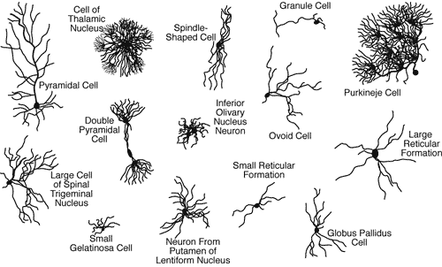
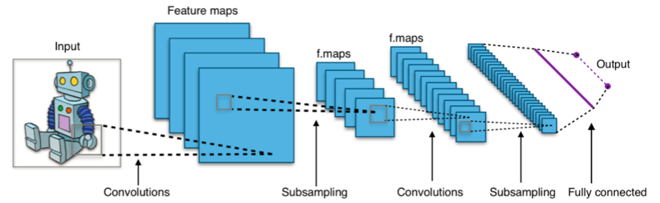


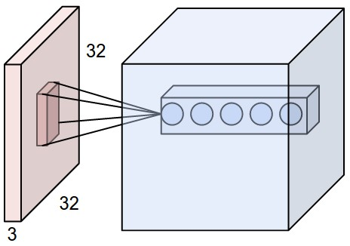

3. Neural Networks: ConvNets
Goal: Pattern Recognition → high-dimensional input data
Fully connected Nns don’t scale
We want to reduce # parameters
Brain also uses specialized neurons
→ Convolutional Neural Networks
Layers in 3D ≈ trainable filters
parameter sharing + pooling
Layer types: Conv, ReLu, Pool, FC,...
http://cs231n.github.io/convolutional-networks/
1
Notes:
1
5

Slide 8
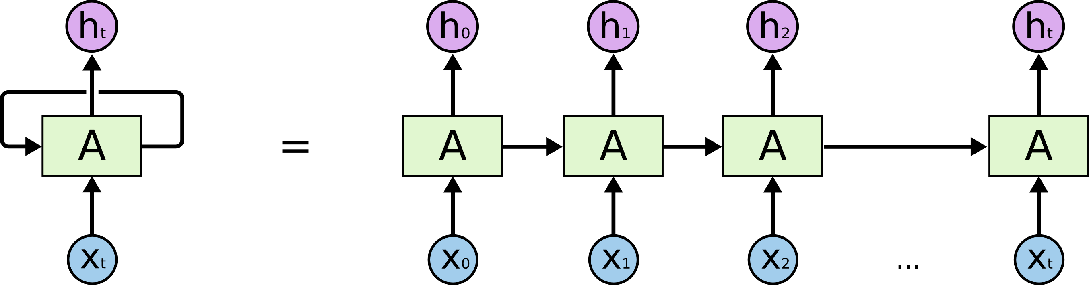
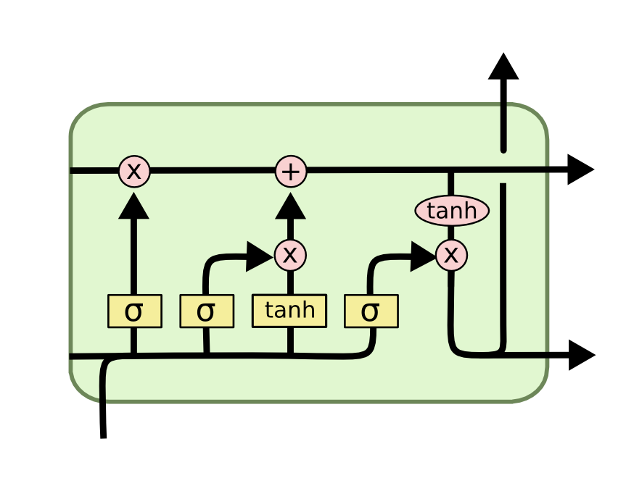
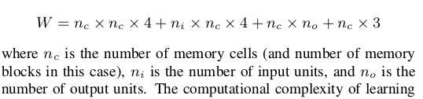
3. Neural Networks: LSTM
Goal: add time aspect → memory
Add feedback loop
→ Recurrent Neural Networks
Improved version
-> LSTM Neural Networks
1
Notes:
1
5

Slide 9

4. Dataset: TCDTIMIT
Alternatives:
GRID: large dataset, but small vocabulary
VidTIMIT: small dataset
Many non-public databases (Google etc)
TCDTIMIT:
Many speakers, high quality
Continuous speech, good coverage of phonemes and visemes. (TIMIT)
Available to other researchers.
Content:
2255 sentences from TIMIT
59 volunteers (98 sentences each)
3 professional lipspeakers (377 sentences each)
~25 phonemes/sentence
Total: 235k phoneme examples; ~ 6k each
Harte, N.; Gillen, E., "TCD-TIMIT: An Audio-Visual Corpus of Continuous Speech," Multimedia, IEEE Transactions on , vol.17, no.5, pp.603,615, May 2015 doi: 10.1109/TMM.2015.2407694
1
Notes:
1
5
TIMIT: audio database, used very much for SR (large coverage, many speakers)
Min: 800 max: 25k, median: 4.5k
Large -> no data augmentation neede
E. Gillen noted difference in Lipspeakers vs Volunteers
-> see how useful volunteer data is.

Slide 10

4. Dataset: TCDTIMIT
Issues downloading & extracting
Lacking documentation
Very little support
Files missing
After processing:
time mismatch phoneme- frame
frames missing
Other issues
→ write own software to extract data from videos
→ open source for other researchers
1
Notes:
1
5
Mismatch b/c bad frame extraction in ffmpeg
(Manually observed)

Slide 11
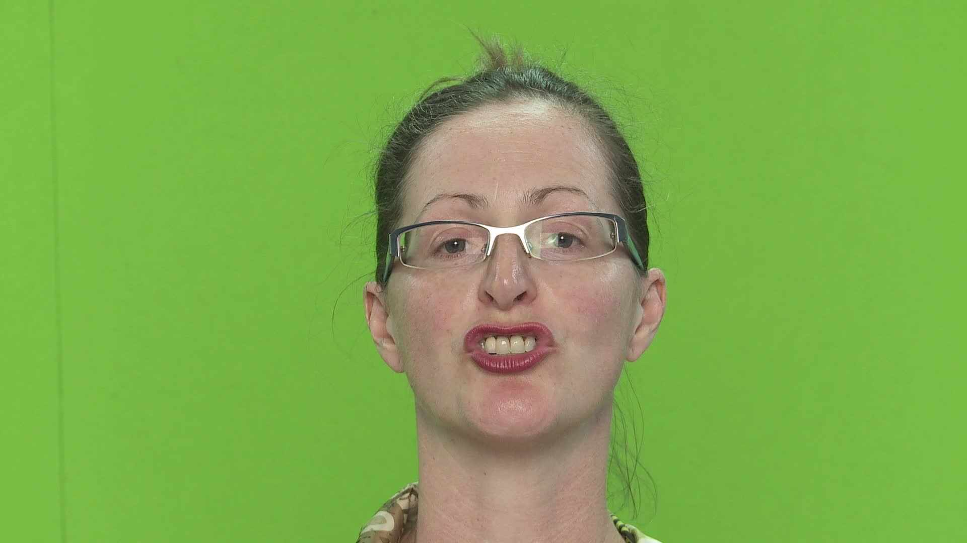
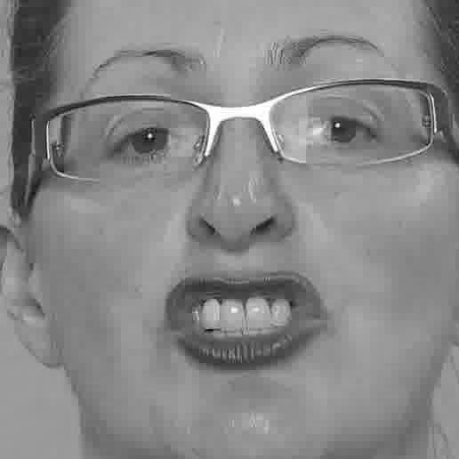
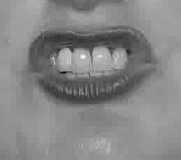
4. Dataset: TCDTIMIT
Goal: labeled frames of phoneme pronounciation
SW pipeline:
Extract phoneme time information
Extract frames
Remove invalid frames
Extract faces, mouths
Grayscale and compress
Pickle for simple loading in Python
Frame Phoneme
16 sil
34 sh
37 iy
40 hh
44 ae
45 d
47 y
49 uh
... ...
38 x
sa1_34_sh.jpg (2KB)
Sa1.mp4 (60MB)
1
Notes:
1
5

Slide 12
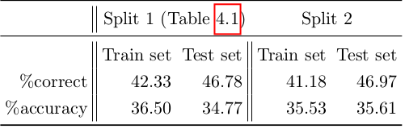
4. Dataset: TCDTIMIT
Train/test/validation set splits:
For each speaker:
80% training set
10% validation set
10% test set
Baseline results from database paper (using HMM)
Harte, N.; Gillen, E., "TCD-TIMIT: An Audio-Visual Corpus of Continuous Speech," Multimedia, IEEE Transactions on , vol.17, no.5, pp.603,615, May 2015 doi: 10.1109/TMM.2015.2407694
1
Notes:
1
5
Mismatch b/c bad frame extraction in ffmpeg
(Manually observed)

Slide 13
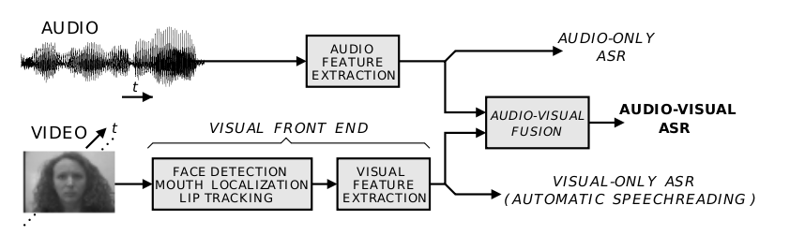
5. Objectives
Combine lipreading and audio to achieve:
Better performance (we use more information)
Better robustness (low quality recording, background noise,…)
→ use best information source available
Work on phonemes, not words or sentences
Simpler; also smaller networks needed
Language independent
Modularity
http://ml.sun.ac.za/people/helge-reikeras/
1
Notes:
1
5
Language model: eg phoneme -> word
Word -> sentence prediction (statistical models eg HMM, or other NN)

Slide 14
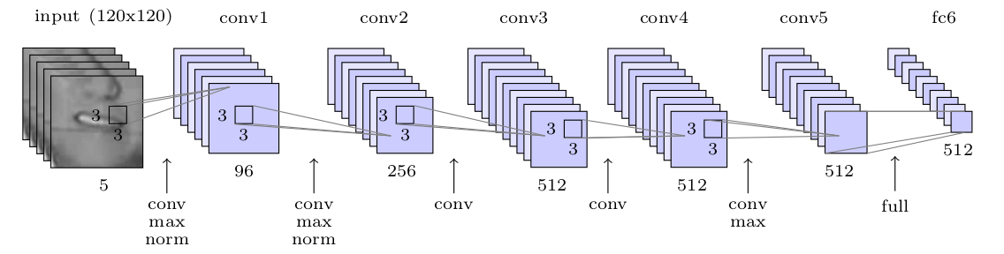
6. Lipreading
CNN for pattern recognition, then FC
Networks tested: 1) CIFAR 10, 8 layer network
2) ResNet 50 layerscifar
3) Google DeepMind network
No time-aspect (yet)
Google DeepMind network
1
Notes:
1
5
Phonemes b/c (possible information loss + solve ambiguity by language model)

Slide 15
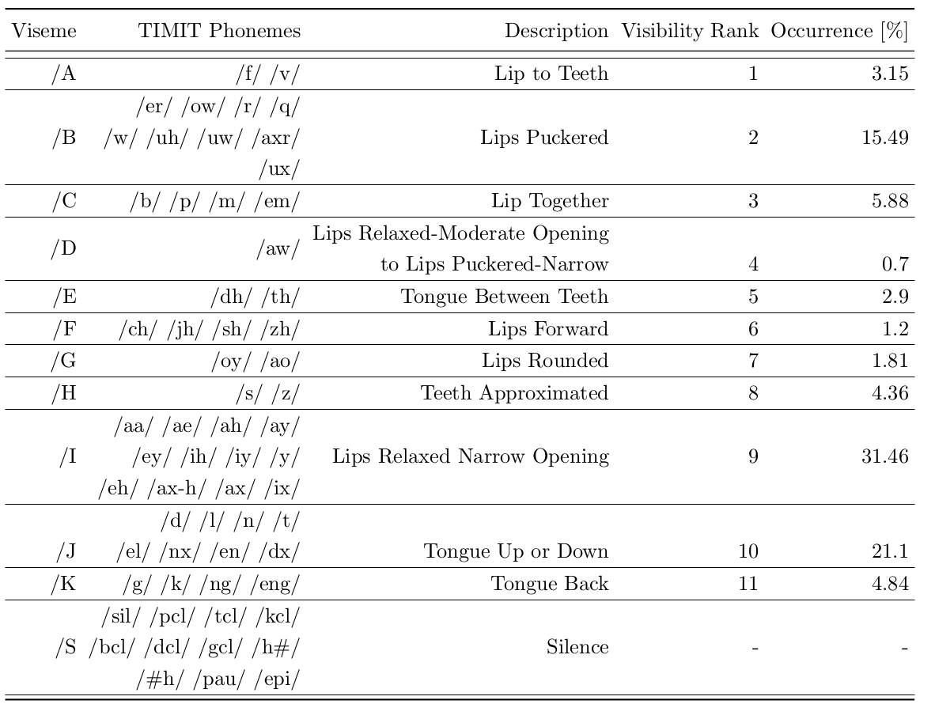
6. Lipreading: Phoneme – Viseme map
Limited correllation lips ↔ sound (aspirated or not,…) → map to visemes
-> Classification problem: 39 phonemes or 13 visemes

Slide 16
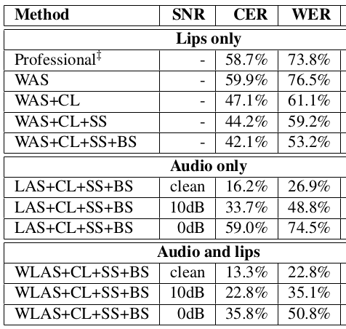
6. Lipreading: Google WLAS
Nov 2016
Goal: transcribe videos of mouth motion to characters
Beats a professional lip reader on videos from BBC television
Audio and visual parts merged with alignment mechanism
1
Notes:
1
5

Slide 17
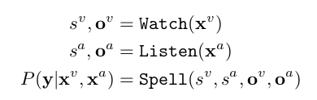
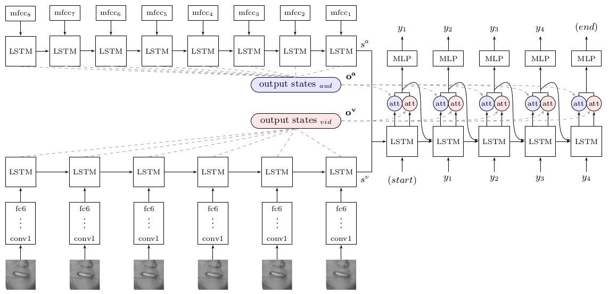
6. Lipreading: Google WLAS
1
Notes:
1
5

Slide 18
6. Lipreading: results Google network
Train and test on lipspeakers:
Trained and test on volunteers:
Train on lipspeakers, test on volunteers:
Train on volunteers, test on lipspeakers:
validation error rate: | 57.58%
test error rate: | 56.68%
validation error rate: | 64.6%
test error rate: | 91.6%
validation error rate: | 74.48%
test error rate: | 73.53%
validation error rate: | 76.58%
test error rate: | 92.68%
Conclusion similar to TCDTIMIT paper:
"Visual and audio-visual baseline results on the non-lipspeakers were low overall. Results on the lipspeakers were significantly higher."

Slide 19
6. Lipreading: results CIFAR10
Train and test on lipspeakers:
Trained and test on volunteers:
validation error rate: | 57.40%
test error rate: | 58.62%
Training takes about 2x longer than on Google network (350s/epoch)
Performance not better
Some more layers, more parameters
-> decent for lipreading
validation error rate: | 74.48%
test error rate: | 72.76%
http://www.cs.toronto.edu/~kriz/cifar.html

Slide 20
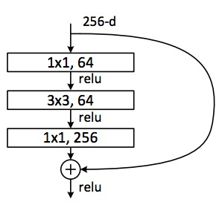
6. Lipreading: results ResNet50
Train and test on lipspeakers:
Trained and test on volunteers:
Training takes about 5x longer than on Google network (500s/epoch)
Performance not better
Many more layers, more complex architecture with more parameters
-> not well suited for lipreading
validation error rate: | 61.95%
test error rate: | 62.45%
validation error rate: | 74.48%
test error rate: | 72.76%
https://github.com/KaimingHe/deep-residual-networks

Slide 21
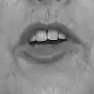
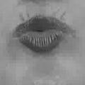
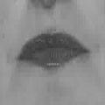
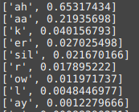
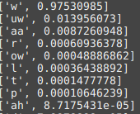
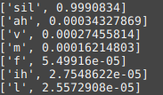
6. Lipreading: example
Take picture
Extract face, mouth, convert to grayscale and resize to 120x120x1
Reshape image for evaluation
Evaluate, print phoneme predictions (takes 0.2s on laptop)
sa1_120_aa
sa1_123_w
sa1_179_sil
1
Notes:
1
5

Slide 22
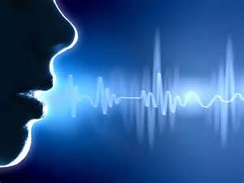
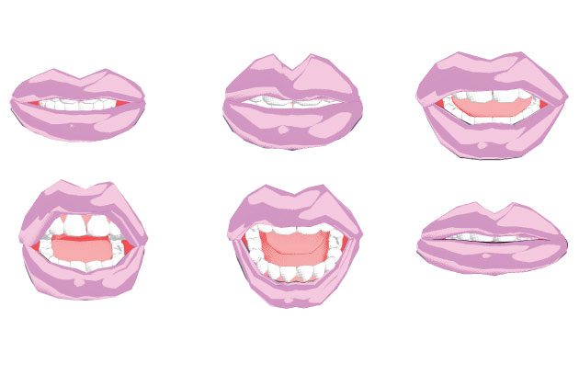
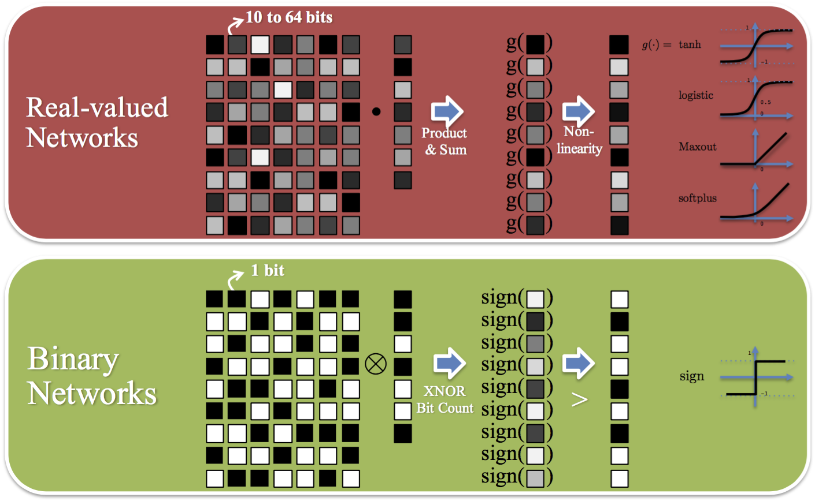
Next semester
Audio SR
Sensor fusion
Performance Analysis
Mapping to HW: train networks with:
Binary weights
Fixed- point weights
https://www.nervanasys.com/accelerating-neural-networks-binary-arithmetic/
Notes:
Binary: floating point multiplications are supplanted with bitwise XNORs and left and right bit shifts
floating point multiplications are supplanted with bitwise XNORs and left and right bit shifts

Slide 23
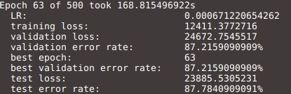
Lipreading: binaryNets
BinaryNet uses binary (+/- 1) weights
-> efficient HW implementation possible
Training has to happen with full precision for gradients
validation error rate: | 87.22%
test error rate: | 87.78%
Very high error rates -> more training needed
1
Notes:
1
5

Slide 24
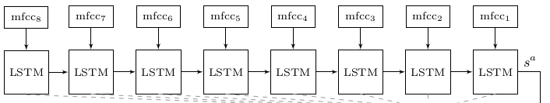
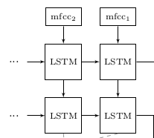
7. Audio SR
Two-layer LSTM architecture, MFCC as input
Train with noise to make more robust
Two layer LSTM
1
Notes:
1
5
Mel-frequency cepstral coefficients (MFCCs) approximate the human auditory system's response more closely than the linearly-spaced frequency bands used in the normal cepstrum. This frequency warping can allow for better representation of sound, for example, in audio compression.
MFCCs are commonly derived as follows:
Take the Fourier transform of (a windowed excerpt of) a signal.
Map the powers of the spectrum obtained above onto the mel scale, using triangular overlapping windows.
Take the logs of the powers at each of the mel frequencies.
Take the discrete cosine transform of the list of mel log powers, as if it were a signal.
The MFCCs are the amplitudes of the resulting spectrum.

Slide 25
8. Fusing audio and visual
SR: inherent time aspect
Lipreading: mostly time-independent, could benefit from limited time aspect
Audio and video synchronized thanks to labeled dataset
-> possible to combine feature vectors
-> LSTM for audio (1), LSTM for feature fusing (2)
1
2
1
Notes:
1
5
Google added NN model for alignment/synchronization -> they can do this without labeling
Their dataset much larger + larger vocabulary -> they also use LSTM for images.
TCDTIMIT: time distance between frames; not that large dataset -> little benefit

Slide 26
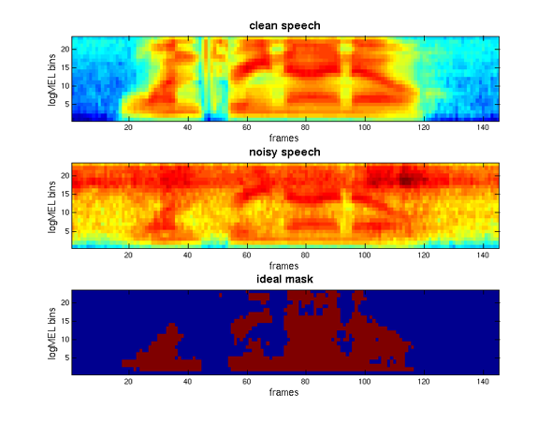
8. Fusing audio and visual
'Late fusion': combine output sequences (weighting)
Weighting determined by:
performance of seperate models
S/N of audio
Quality of video/image
...
Analyse performance:
Different amounts of audio and/or image noise
Comparison audio only/visual only/ audio-visual
http://www.esat.kuleuven.be/psi/spraak/theses/08-09-en/MDT.php
1
Notes:
<number>
5
Quality of video/image (resolution, face angle, lighting,...)

Slide 27
Questions

