Slide 1
Ontwerp, analyse en implementatie van een convolutionair neuraal netwerk voor gelijktijdige spraak en beeldherkenning

Slide 2
Overview
Problem sketch
Current research
Neural networks
Dataset: TCDTIMIT
Objectives
Lipreading
Speech (audio)
Sensor fusion
<number>
Notes:
<number>
5

Slide 3
1. Problem sketch
Speech recognition is useful:
Automatic subtitles
Assisting hearing impaired
Human-computer interation (Siri)
International meetings (translations)
Until now: mostly audio
Use images (lipreading) → robustness, performance
<number>
Notes:
<number>
5
Robustness:
- achtergrondgeluid, slechte kwaliteit audio,...
- performance b/c use extra information
- till now: very hard to extract this info from images (shape of mouth,...),
- but not robust against different people (mustache, gender,...)
-> CONVNETS = generalization power

Slide 4
2. Research
Past:
Mostly audio
Acoustic model: formants, fricatives,...
Record sounds, statistical correlation of spectrals
→ Hidden Markov Models (HMM)
Language model on top
Often limited in scope (eg. Phone support)
<number>
Notes:
<number>
5
Past:
- pattern recognition -> HMM -> NNs
- limited scope (eg phone support: keyword spotting)
High level models:
N-gram model: statistical representation of grammar

Slide 5
2. Research
Current:
Still mostly audio
Acoustic model: formants, fricatives,…
Record sounds, statistical correlation of spectrals
→ Convolutional Neural Networks
Language model on top (also NN? )
Much broader in scope (Siri, Cortana)
<number>
Notes:
<number>
5
NN:
very strong abstraction, generalization power due to multilayer nonlinearity
ConvNN: NN specialized in pattern recognition
High level models:
N-gram model: statistical representation of grammar

Slide 6
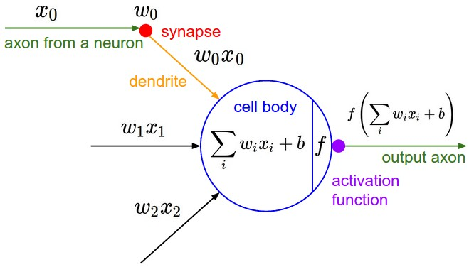
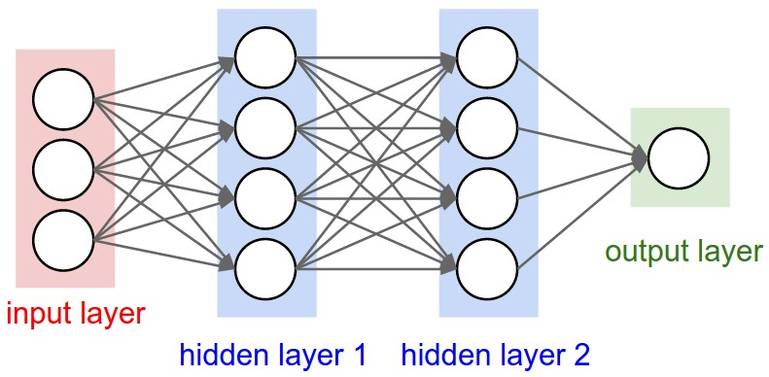
3. Neural Networks
Simple units with nonlinear output function
http://cs231n.github.io/neural-networks-1/
http://cs231n.github.io/neural-networks-1/
<number>
Notes:
<number>
5

Slide 7
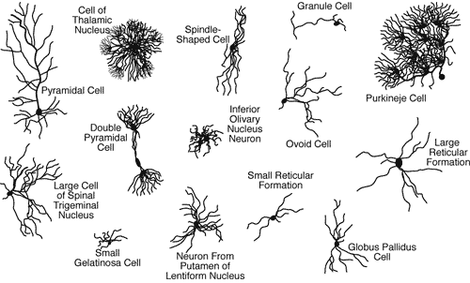
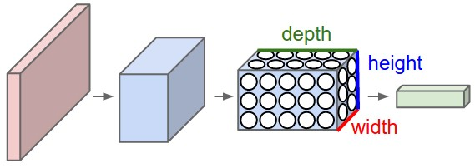
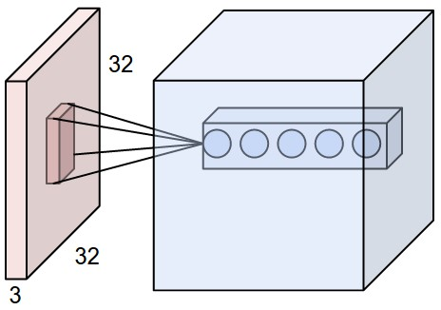
3. Neural Networks
Goal: Pattern Recognition → lots of inputs
Fully connected Nns don’t scale
Reduce # parameters
Brain also uses specialized neurons
→ Convolutional Neural Networks
Layers in 3D ≈ trainable filters
parameter sharing + pooling
Layer types: CONV, ReLu, Pool, FC
http://www.mind.ilstu.edu/curriculum/neurons_intro/neurons_intro.php
http://cs231n.github.io/convolutional-networks/
http://cs231n.github.io/convolutional-networks/
<number>
Notes:
<number>
5

Slide 8
4. Dataset: TCDTIMIT
Alternatives:
GRID: large dataset, but small vocabulary
VidTIMIT: small dataset
Many non-public databases (Google etc)
TCDTIMIT:
Many speakers, high quality
Continuous speech, good coverage of phonemes and visemes. (TIMIT)
Available to other researchers.
Content:
2255 sentences from TIMIT
59 volunteers (98 sentences each)
3 professional lipspeakers (377 sentences each)
~25 phonemes/sentence
Total: 235k phoneme examples; ~ 6k each
<number>
Notes:
<number>
5
TIMIT: audio database, used very much for SR (large coverage, many speakers)
Min: 800 max: 25k, median: 4.5k
Large -> no data augmentation neede
E. Gillen noted difference in Lipspeakers vs Volunteers
-> see how useful volunteer data is.

Slide 9
4. Dataset: TCDTIMIT
Issues downloading & extracting
Lacking documentation
Very little support
Files missing
After processing:
time mismatch phoneme- frame
frames missing
→ write own scripts to extract data from videos
<number>
Notes:
<number>
5
Mismatch b/c bad frame extraction in ffmpeg
(Manually observed)

Slide 10
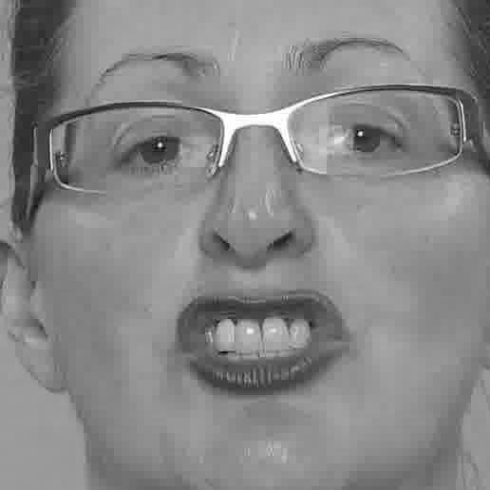
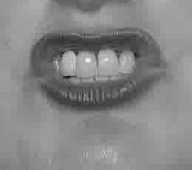
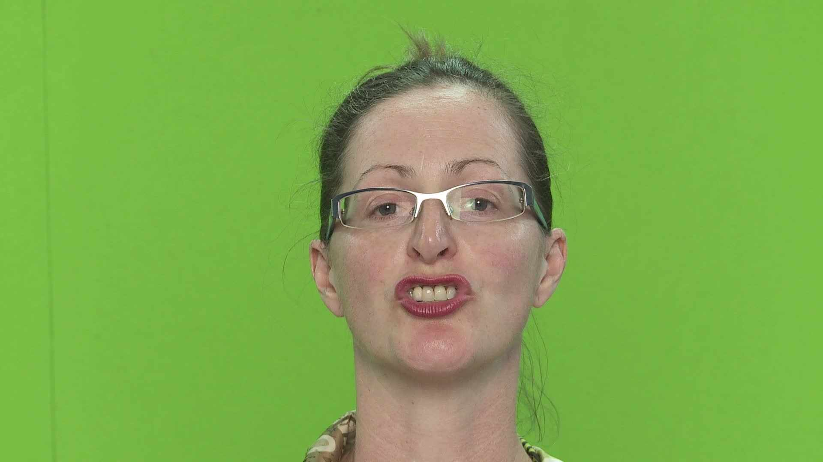
4. Dataset: TCDTIMIT
Goal: labeled frames of phoneme pronounciation
Pipeline:
Extract phoneme time information
Extract frames
Remove invalid frames
Extract faces, mouths
Grayscale and compress
Pickle for simple loading in Python
Frame Phoneme
16 sil
34 sh
37 iy
40 hh
44 ae
45 d
47 y
49 uh
... ...
38 x
sa1_34_sh.jpg (2KB)
Sa1.mp4 (60MB)
<number>
Notes:
<number>
5

Slide 11
4. Dataset: TCDTIMIT
Train/test/validation set splits:
For each speaker:
85% training set
10% validation set
5% test set
<number>
Notes:
<number>
5
Mismatch b/c bad frame extraction in ffmpeg
(Manually observed)

Slide 12
5. Objectives
Combine lipreading and audio to achieve:
Better performance (we use more information)
Better robustness (low quality recording, background noise,…)
→ use best information source available
Work on phonemes, not words or sentences
Simpler; also smaller networks needed
Language independent (dataset)
Possible to put language model on top
<number>
Notes:
<number>
5
Language model: eg phoneme -> word
Word -> sentence prediction (statistical models eg HMM, or other NN)

Slide 13
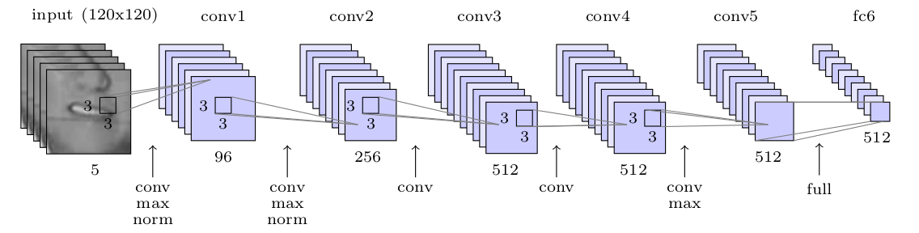
6. Lipreading
Most SR research focused on Audio (phonemes)
Limited correllation lips ↔ sound (aspirated or not,…) → map to visemes
Here, just phonemes used for lipreading (possible information loss + solve ambiguity by language model)
Classification problem: 39 phonemes
Network: based on VGG-M model (see next slide)
No time-aspect (yet )
<number>
Notes:
<number>
5

Slide 14
6. Lipreading: results
Trained only on lipspeakers, test on lipspeakers:
Trained only on volunteers, test on volunteers:
Trained on volunteers, test on lipspeakers:
validation error rate: | 57.58%
test error rate: | 56.68%
validation error rate: | 57.58%
test error rate: | 56.68%

Slide 15
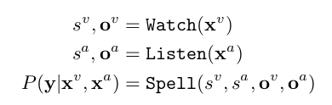
6. Lipreading: Google WLAS
Nov 2016
Goal: transcribe videos of mouth motion to characters
Beats a professional lip reader on videos from BBC television
3 parts, merged with alignment mechanism
https://www.youtube.com/watch?v=5aogzAUPilE&feature=youtu.be
<number>
Notes:
<number>
5

Slide 16
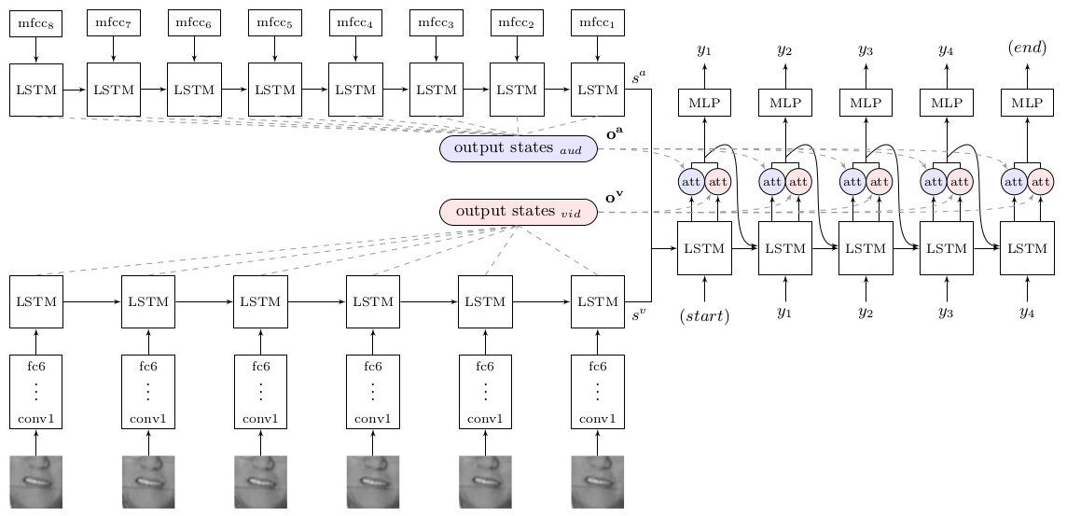
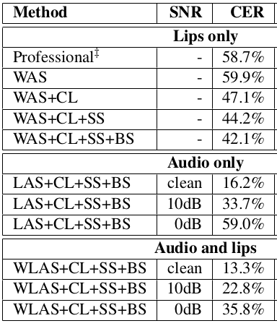
6. Lipreading: Google WLAS
<number>
Notes:
<number>
5

Slide 17
7. Audio SR
Two-layer LSTM architecture, MFCC as input
Train with noise to make more robust
Two layer LSTM
<number>
Notes:
<number>
5

Slide 18
8. Combining audio and image
SR: inherent time aspect
Lipreading: mostly time-independent, could benefit from limited time aspect
<number>
Notes:
<number>
5

