Slide 1
Ontwerp, analyse en implementatie van een convolutionair neuraal netwerk voor gelijktijdige spraak en beeldherkenning

Slide 2
Overview
Problem sketch
Current research
Neural networks
Dataset: TCDTIMIT
Objectives
Lipreading
Speech (audio)
Sensor fusion
<number>
Notes:
<number>
5

Slide 3
1. Problem sketch
Speech recognition is useful:
Automatic subtitles
Assisting hearing impaired
Human-computer interation (Siri)
International meetings (translations)
Until now: mostly audio
Use images (lipreading) → robustness, performance
<number>
Notes:
<number>
5
Robustness:
- achtergrondgeluid, slechte kwaliteit audio,...
- performance b/c use extra information
- till now: very hard to extract this info from images (shape of mouth,...),
- but not robust against different people (mustache, gender,...)
-> CONVNETS = generalization power

Slide 4
2. Research
Past:
Mostly audio
Acoustic model: formants, fricatives,...
Record sounds, statistical correlation of spectrals
→ Hidden Markov Models (HMM)
Language model on top
Often limited in scope (eg. Phone support)
<number>
Notes:
<number>
5
Past:
- pattern recognition -> HMM -> NNs
- limited scope (eg phone support: keyword spotting)
High level models:
N-gram model: statistical representation of grammar

Slide 5
2. Research
Current:
Still mostly audio
Acoustic model: formants, fricatives,…
Record sounds, statistical correlation of spectrals
→ Convolutional Neural Networks
Language model on top (also NN? )
Much broader in scope (Siri, Cortana)
<number>
Notes:
<number>
5
NN:
very strong abstraction, generalization power due to multilayer nonlinearity
ConvNN: NN specialized in pattern recognition
High level models:
N-gram model: statistical representation of grammar

Slide 6
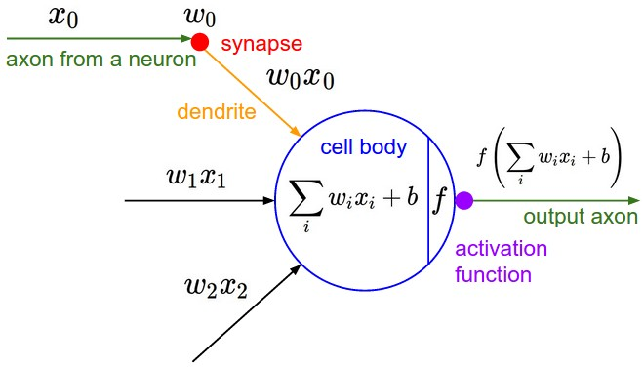
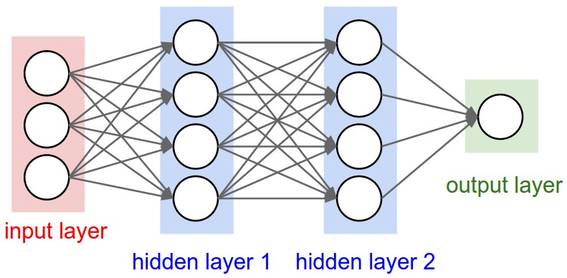
3. Neural Networks
Simple units with nonlinear output function
http://cs231n.github.io/neural-networks-1/
http://cs231n.github.io/neural-networks-1/
<number>
Notes:
<number>
5

Slide 7
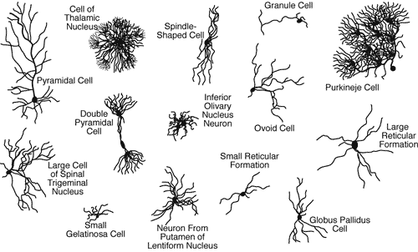
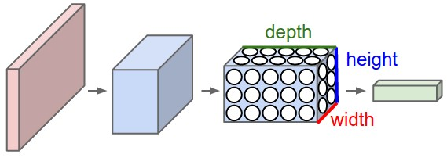
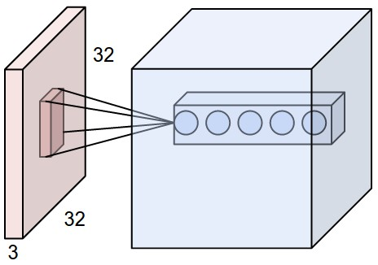
3. Neural Networks
Goal: Pattern Recognition → high-dimensional input data
Fully connected Nns don’t scale
We want to reduce # parameters
Brain also uses specialized neurons
→ Convolutional Neural Networks
Layers in 3D ≈ trainable filters
parameter sharing + pooling
Layer types: CONV, ReLu, Pool, FC,...
http://www.mind.ilstu.edu/curriculum/neurons_intro/neurons_intro.php
http://cs231n.github.io/convolutional-networks/
http://cs231n.github.io/convolutional-networks/
<number>
Notes:
<number>
5

Slide 8
4. Dataset: TCDTIMIT
Alternatives:
GRID: large dataset, but small vocabulary
VidTIMIT: small dataset
Many non-public databases (Google etc)
TCDTIMIT:
Many speakers, high quality
Continuous speech, good coverage of phonemes and visemes. (TIMIT)
Available to other researchers.
Content:
2255 sentences from TIMIT
59 volunteers (98 sentences each)
3 professional lipspeakers (377 sentences each)
~25 phonemes/sentence
Total: 235k phoneme examples; ~ 6k each
Harte, N.; Gillen, E., "TCD-TIMIT: An Audio-Visual Corpus of Continuous Speech," Multimedia, IEEE Transactions on , vol.17, no.5, pp.603,615, May 2015 doi: 10.1109/TMM.2015.2407694
<number>
Notes:
<number>
5
TIMIT: audio database, used very much for SR (large coverage, many speakers)
Min: 800 max: 25k, median: 4.5k
Large -> no data augmentation neede
E. Gillen noted difference in Lipspeakers vs Volunteers
-> see how useful volunteer data is.

Slide 9
4. Dataset: TCDTIMIT
Issues downloading & extracting
Lacking documentation
Very little support
Files missing
After processing:
time mismatch phoneme- frame
frames missing
Other issues
→ write own software to extract data from videos
→ make available for other researchers using that database
<number>
Notes:
<number>
5
Mismatch b/c bad frame extraction in ffmpeg
(Manually observed)

Slide 10
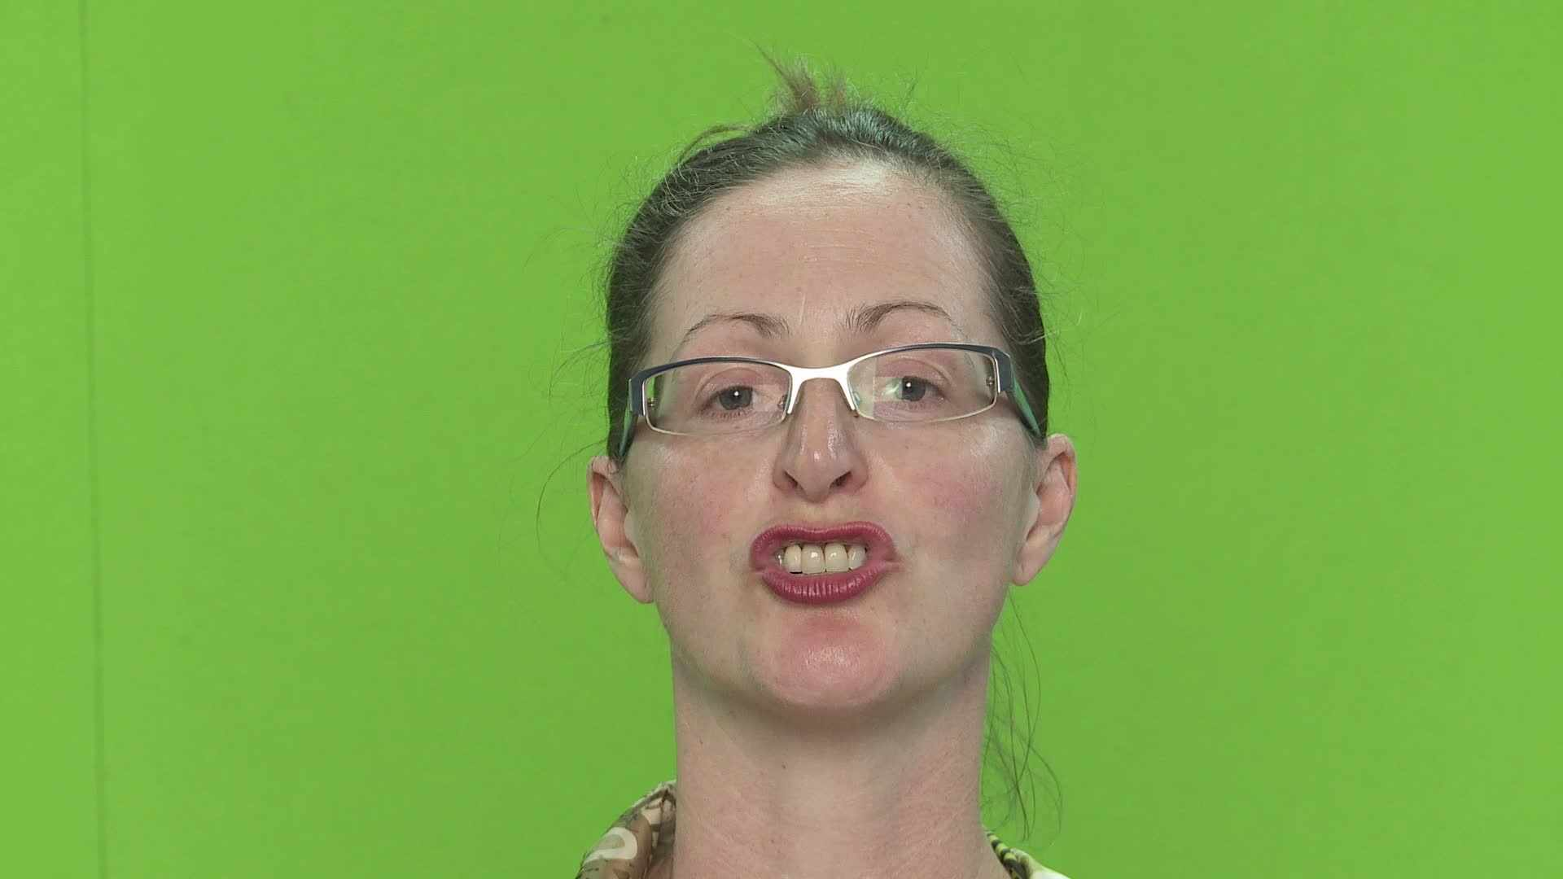
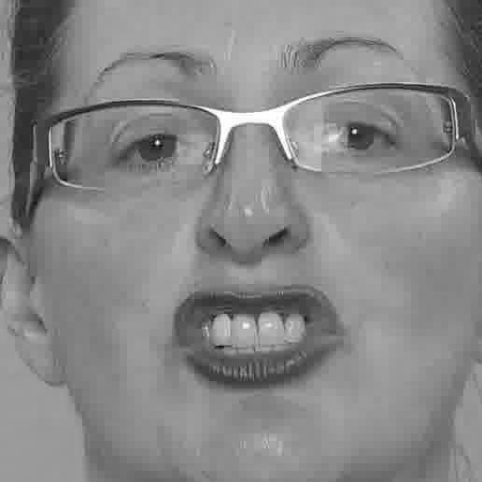
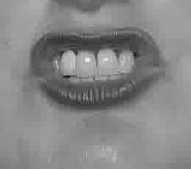
4. Dataset: TCDTIMIT
Goal: labeled frames of phoneme pronounciation
SW pipeline:
Extract phoneme time information
Extract frames
Remove invalid frames
Extract faces, mouths
Grayscale and compress
Pickle for simple loading in Python
Frame Phoneme
16 sil
34 sh
37 iy
40 hh
44 ae
45 d
47 y
49 uh
... ...
38 x
sa1_34_sh.jpg (2KB)
Sa1.mp4 (60MB)
<number>
Notes:
<number>
5

Slide 11
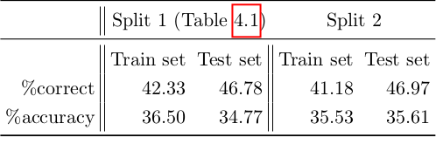
4. Dataset: TCDTIMIT
Train/test/validation set splits:
For each speaker:
80% training set
10% validation set
10% test set
Baseline results from database paper (using HMM)
Harte, N.; Gillen, E., "TCD-TIMIT: An Audio-Visual Corpus of Continuous Speech," Multimedia, IEEE Transactions on , vol.17, no.5, pp.603,615, May 2015 doi: 10.1109/TMM.2015.2407694
<number>
Notes:
<number>
5
Mismatch b/c bad frame extraction in ffmpeg
(Manually observed)

Slide 12
5. Objectives
Combine lipreading and audio to achieve:
Better performance (we use more information)
Better robustness (low quality recording, background noise,…)
→ use best information source available
Work on phonemes, not words or sentences
Simpler; also smaller networks needed
Language independent (if you have a dataset)
Possible to put language model on top
<number>
Notes:
<number>
5
Language model: eg phoneme -> word
Word -> sentence prediction (statistical models eg HMM, or other NN)

Slide 13
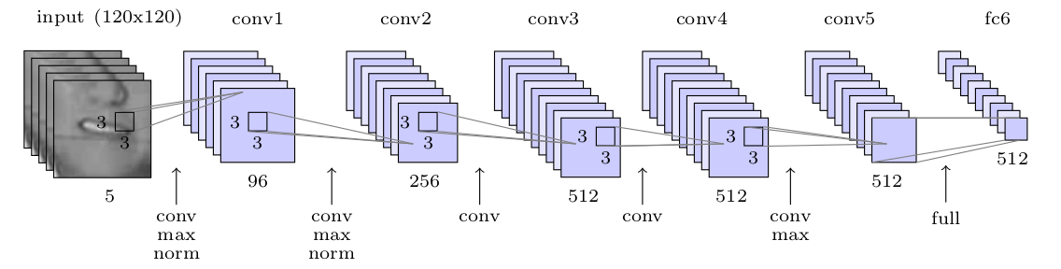
6. Lipreading
Most SR research focused on Audio (phonemes)
Limited correllation lips ↔ sound (aspirated or not,…) → map to visemes
Here, just phonemes used for lipreading (possible information loss + solve ambiguity by language model)
Classification problem: 39 phonemes
Networks tested: 1) CIFAR 10 8 layer network
2) ResNet 50 layerscifar
3) simple 6-layer ConvNet
No time-aspect (yet )
<number>
Notes:
<number>
5

Slide 14
6. Lipreading: results CIFAR10
Train and test on lipspeakers:
Trained and test on volunteers:
Training takes about 5x longer than on Google network (500s/epoch)
Performance not better
Many more layers, more complex architecture with more parameters
-> don't use for lipreading
validation error rate: | 61.30%
test error rate: | 61.11%
validation error rate: | 74.48%
test error rate: | 72.76%

Slide 15
6. Lipreading: results ResNet50
Train and test on lipspeakers:
Trained and test on volunteers:
Training takes about 5x longer than on Google network (500s/epoch)
Performance not better
Many more layers, more complex architecture with more parameters
-> don't use for lipreading
validation error rate: | 61.95%
test error rate: | 62.45%
validation error rate: | 74.48%
test error rate: | 72.76%
https://github.com/KaimingHe/deep-residual-networks

Slide 16
6. Lipreading: results Google network
Train and test on lipspeakers:
Trained and test on volunteers:
Train on lipspeakers, test on volunteers:
Train on volunteers, test on lipspeakers:
validation error rate: | 57.58%
test error rate: | 56.68%
validation error rate: | 64.6%
test error rate: | 91.6%
validation error rate: | 74.48%
test error rate: | 73.53%
validation error rate: | 57.58%
test error rate: | 56.68%
Conclusion similar to TCDTIMIT paper: "Visual and audio-visual baseline results on the non-lipspeakers were low overall. Results on the lipspeakers were significantly higher."

Slide 17
6. Lipreading: demo
Take picture
Extract face, mouth, convert to grayscale and resize to 120x120x1
Reshape image for evaluation
Evaluate, print phoneme predictions
1) python preprocessImage.py -i testImages/image.jpg
2) python evaluateImage.py -i testImages/image_mouth_gray_resized.jpg
-m results/ResNet50/allLipspeakers/allLipspeakers.npz
<number>
Notes:
<number>
5

Slide 18
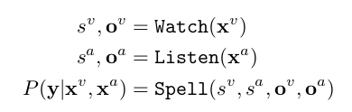
6. Lipreading: Google WLAS
Nov 2016
Goal: transcribe videos of mouth motion to characters
Beats a professional lip reader on videos from BBC television
3 parts, merged with alignment mechanism
https://www.youtube.com/watch?v=5aogzAUPilE&feature=youtu.be
<number>
Notes:
<number>
5

Slide 19
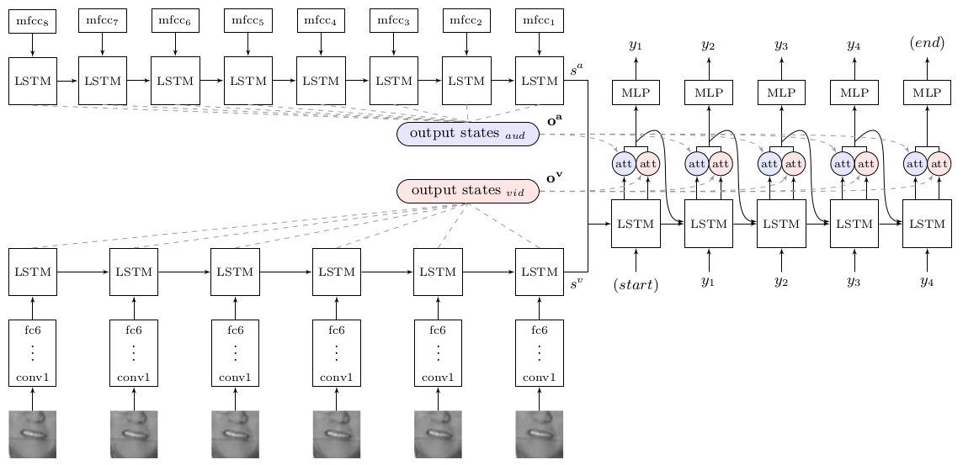
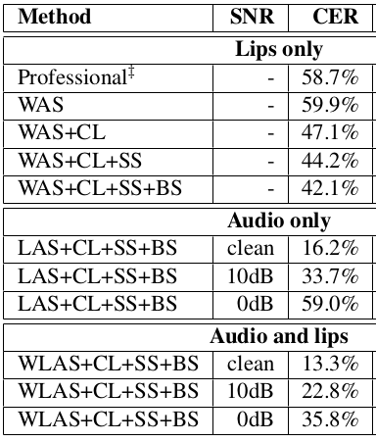
6. Lipreading: Google WLAS
<number>
Notes:
<number>
5

Slide 20
7. Audio SR
Two-layer LSTM architecture, MFCC as input
Train with noise to make more robust
Two layer LSTM
<number>
Notes:
<number>
5

Slide 21
8. Combining audio and visual
SR: inherent time aspect
Lipreading: mostly time-independent, could benefit from limited time aspect
Audio and video synchronized thanks to labeled dataset
-> possible to combine feature vectors
'Late fusion': combine output sequences (weighting)
Weighting determined by:
performance of seperate models
S/N of audio (if known)
Quality of video/image (resolution, face angle, lighting,...)
Analyse performance:
Different amounts of audio and/or image noise
Comparison audio only/visual only/ audio-visual
<number>
Notes:
<number>
5

