Slide 1
Intro to Zappa
By Brendon Lei

Slide 2
What is Zappa?
Zappa is a python “serverless” micro framework for Amazon Web Service
Server with a life cycle of 40 milisec
Without any permanent infrastructure
Based on AWS, so they handle any horizontal scaling

Slide 3
Compatible Frameworks
Works with any Web Server Gateway Interface
Django
Flask
Pyramid
Bottle
ETC.

Slide 4
AWS
$pip install awscli
$aws configure
AWS Access Key ID[None]:
AWS Secret Access Key [None]:
Default region name [None]:
Default output format [None]:

Slide 5
Virtual Enviroment
$python –m venv env
$source env/bin/activate
$pip install flask boto3 simplejson

Slide 6
Zappa
$pip install zappa
$zappa init
$zappa deploy (name of stage)

Slide 7
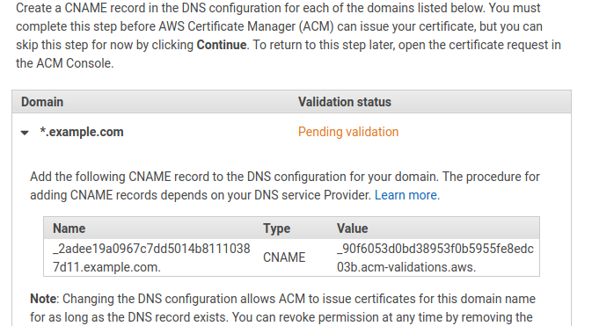
Creating Custom Domain

Slide 8
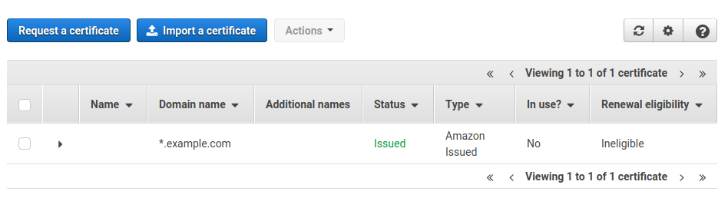

Slide 9
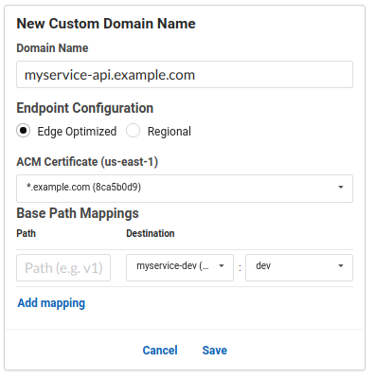
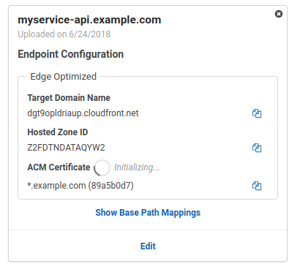

Slide 10
Readings
https://github.com/Miserlou/Zappa

