Slide 1
LOG NORMAL-KPI AND METRICS

Slide 2
Dataset
Player Details: The player details contains their id, signup date, channel, Gender, Advertiser Id and Date of Birth.
Player Activity: Contains activity month, product, subproduct, amount bet, amount won, gross amount.
First Bet: It contains datetime of first bet, first bet amount, bet product group, bet product, channel, platform.
First Deposit: First Deposit contains deposit datetime, channel, method, amount.
Bonus Cost: Contains activity month, product, bonus cost.

Slide 3
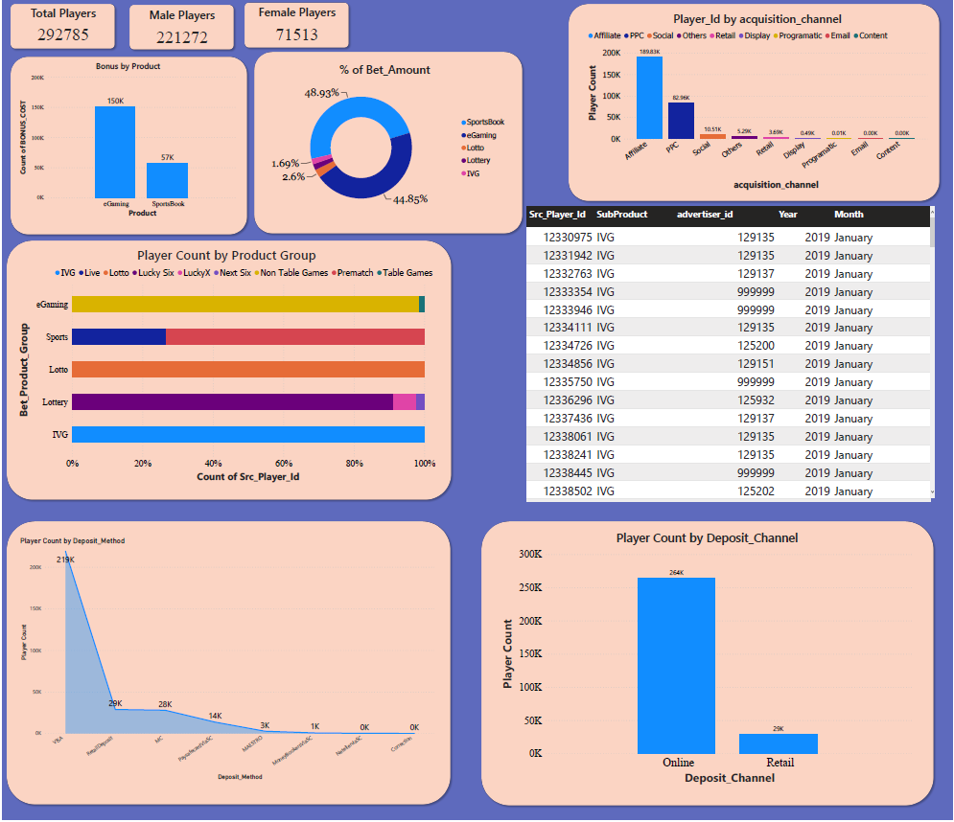

Slide 4
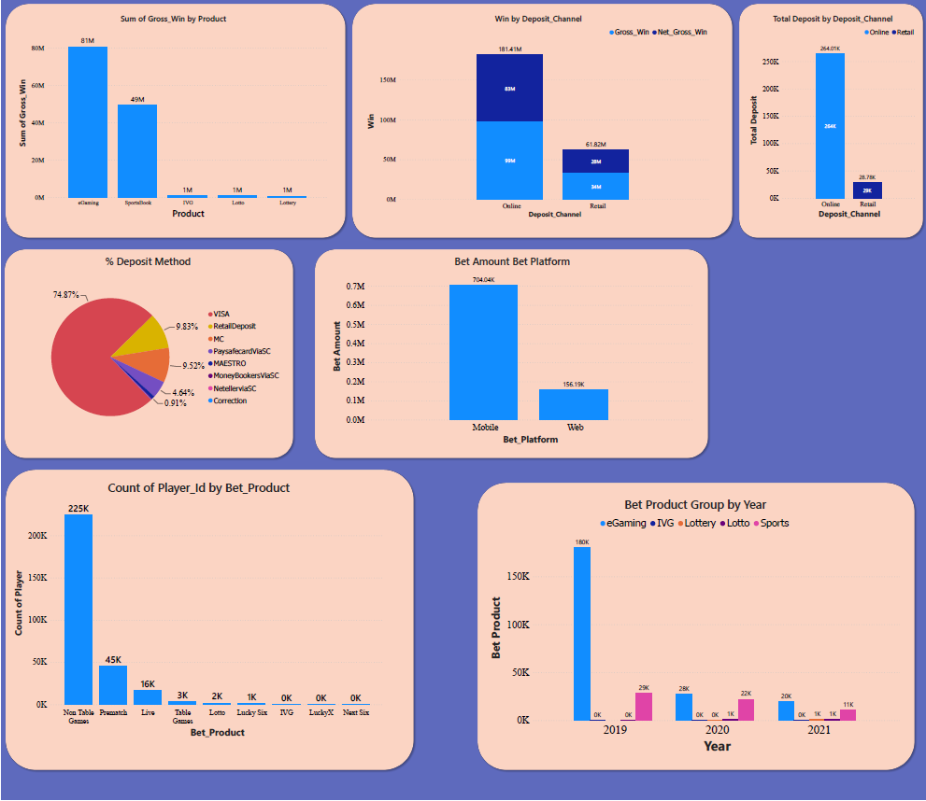

Slide 5
In this dataset total number of players are 292785.
Out of this 221272 are Male and 71513 are Female players.
There are two products eGaming and SportsBook.
Bonus cost count of eGaming is more than SportsBook. eGaming has 150k bonus count and SportsBook has 57K bonus count.
% of bet amount for SportsBook subproduct is 48.93.
Lowest % of bet amount is for Lottery subproduct with 1.93%.

Slide 6
The Affiliate channel has more number of players compare to another channels.
eGaming has more players with respect to other product group.
Subproduct of eGaming Non Table Games have highest player bet count.
Most players has placed or deposited the amount through VISA.
Players have placed more number of bets through online than retail.

Slide 7
Gross win for eGaming product is higher than other products.
The eGaming product total gross win is 81M followed by SportsBook gross win with 49M.
Online deposit channel has more gross and net gross win than retail channel.
Total deposit by deposit channel is 264K for online and for retail is 29k.
The % of deposited amount through VISA is 74.87% which is highest among other deposit method followed by RetailDeposit with 9.83%.

Slide 8
In 2019 the most number of bet are placed on eGaming with a total of 180k and it is followed by Sports with total of only 29k bets placed.
2020 and 2021 are very low compared to year 2019 in betting.
In 2020 eGaming has 28k of total bets placed and Sports have 22k of bets placed with Lotto having least number of bets placed with a total of 1k.
This is followed by 2021 but there is an increase in bets place on Lottery and Lotto product.
But eGaming has remained on top in each year.

Slide 9
KEY PERFORMANCE INDICATOR
The analysis and insights are created with PowerBI desktop platform.
All the null values are removed using python using Pandas and Numpy libraries using jupyter notebook.
After doing the analysis and creating the insights got to know that eGaming and VISA are the Key Performance Indicator.
The two are the KPIs because all others are dependent on it.

