Slide 1
How AI can generate images?
Chongxuan Li
MLSS at Tsinghua University, Introduced by Prof. Jun Zhu

Slide 2
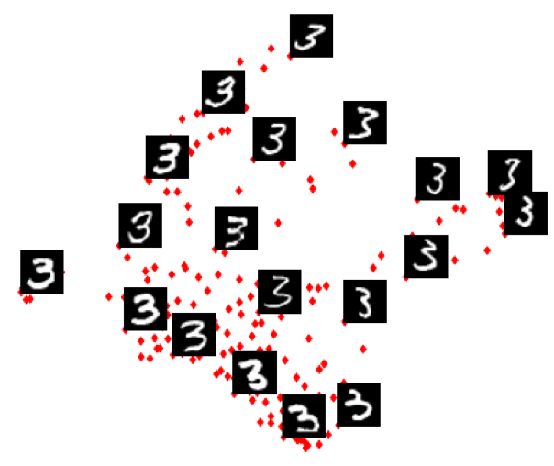
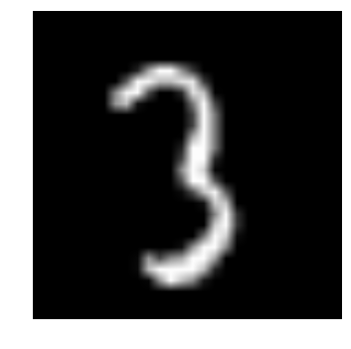
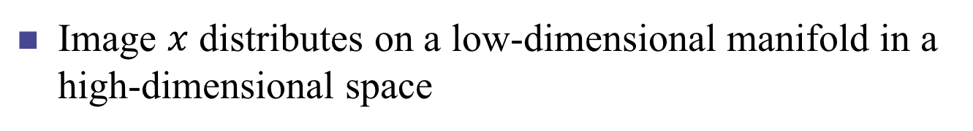
Image Manifold
Image $x$ distributes on a low-dimensional manifold in a high-dimensional space

Slide 3
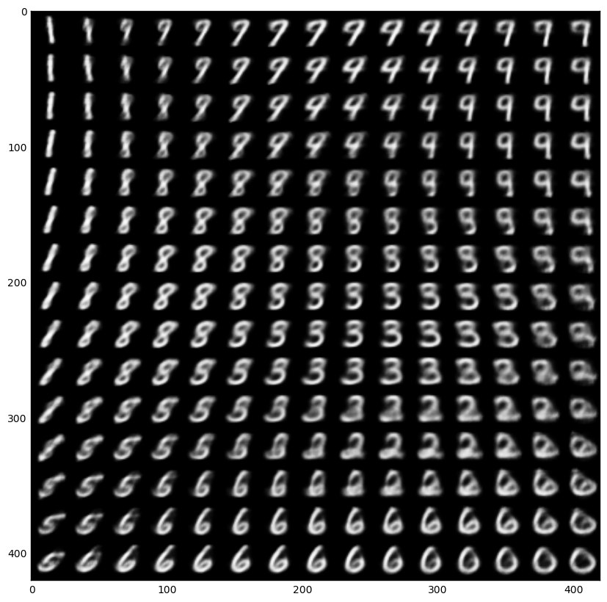
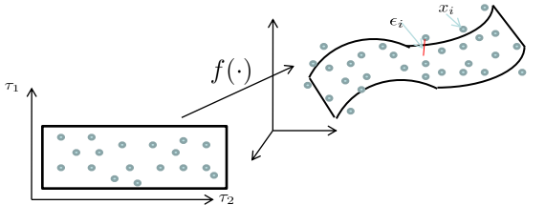
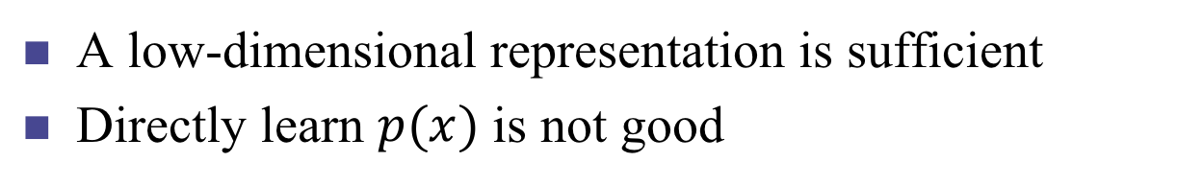
Image Manifold
A low-dimensional representation is sufficient
Directly learn $p(x)$ is not good

Slide 4
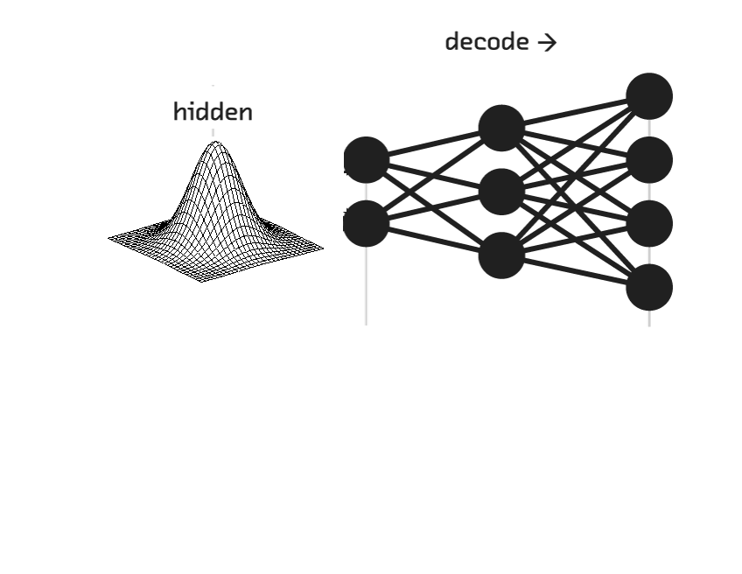
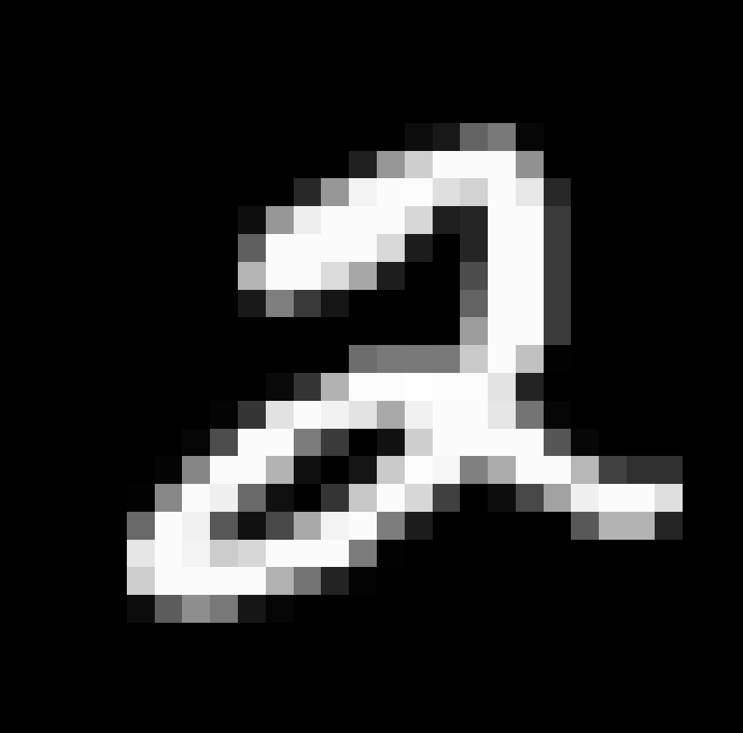
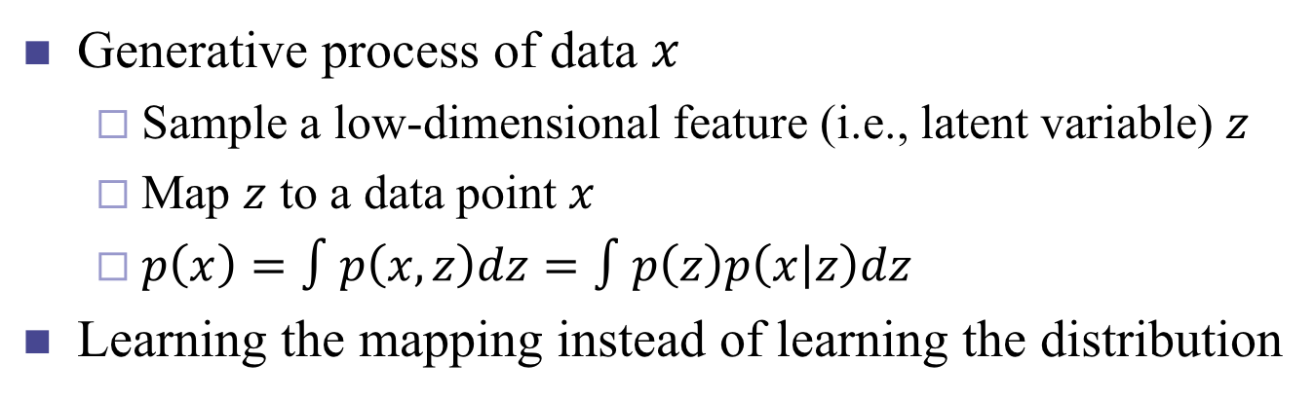
Latent Variable Model
Generative process of data $x$
Sample a low-dimensional feature (i.e., latent variable) $z$
Map $z$ to a data point $x$
$p\left(x\right)=∫p\left(x,z\right)dz=∫p\left(z\right)p\left(x | z\right)dz$
Learning the mapping instead of learning the distribution

Slide 5
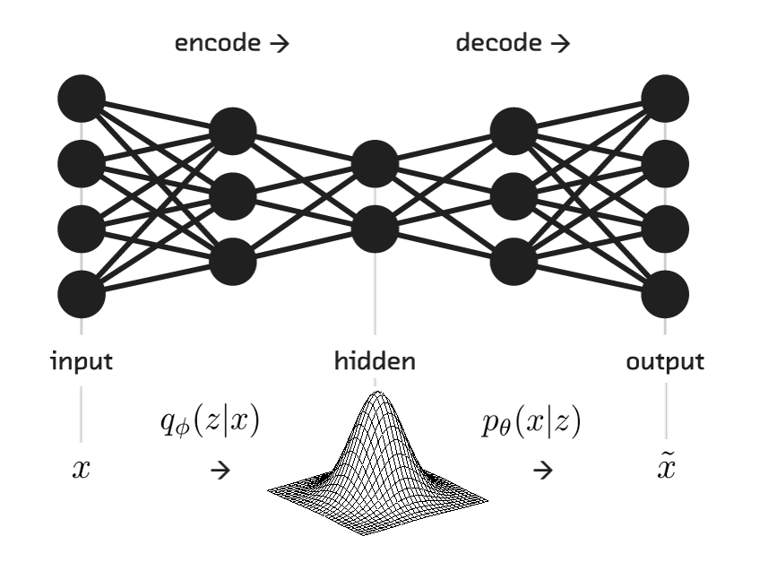
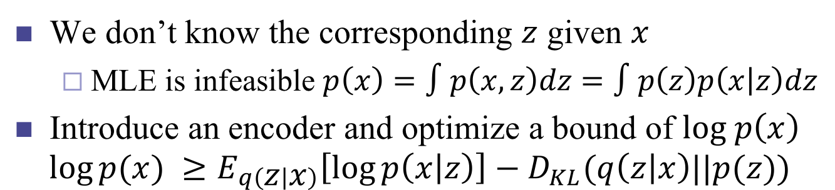
Variational Auto-Encoder (Training)
We don’t know the corresponding $z$ given $x$
MLE is infeasible $p\left(x\right)=∫p\left(x,z\right)dz=∫p\left(z\right)p\left(x | z\right)dz$
Introduce an encoder and optimize a bound of $log p\left(x\right)$
$$\log{p(x)} ≥E_{q\left(z | x\right)}\left[\log{p\left(x | z\right)}\right]−D_{KL}(q\left(z | x\right)||p(z))$$

Slide 6
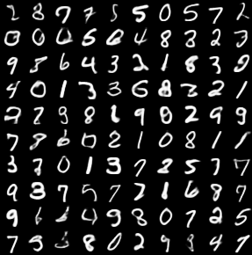
Variational Auto-Encoder (Testing)

Slide 7


ZhuSuan
Traditional DNN Platform
Layers + Gradients
Probabilistic Programming
Uncertainty + Inference

Slide 8
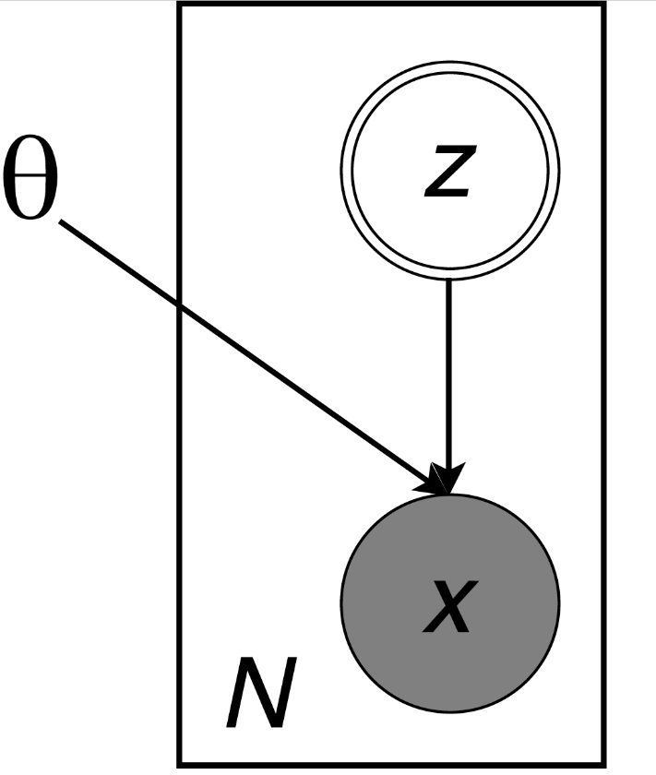
Usage of ZhuSuan
Build the model
Directed graph
Specify the nodes and edges
Automatic inference
Automatic learning

Slide 9
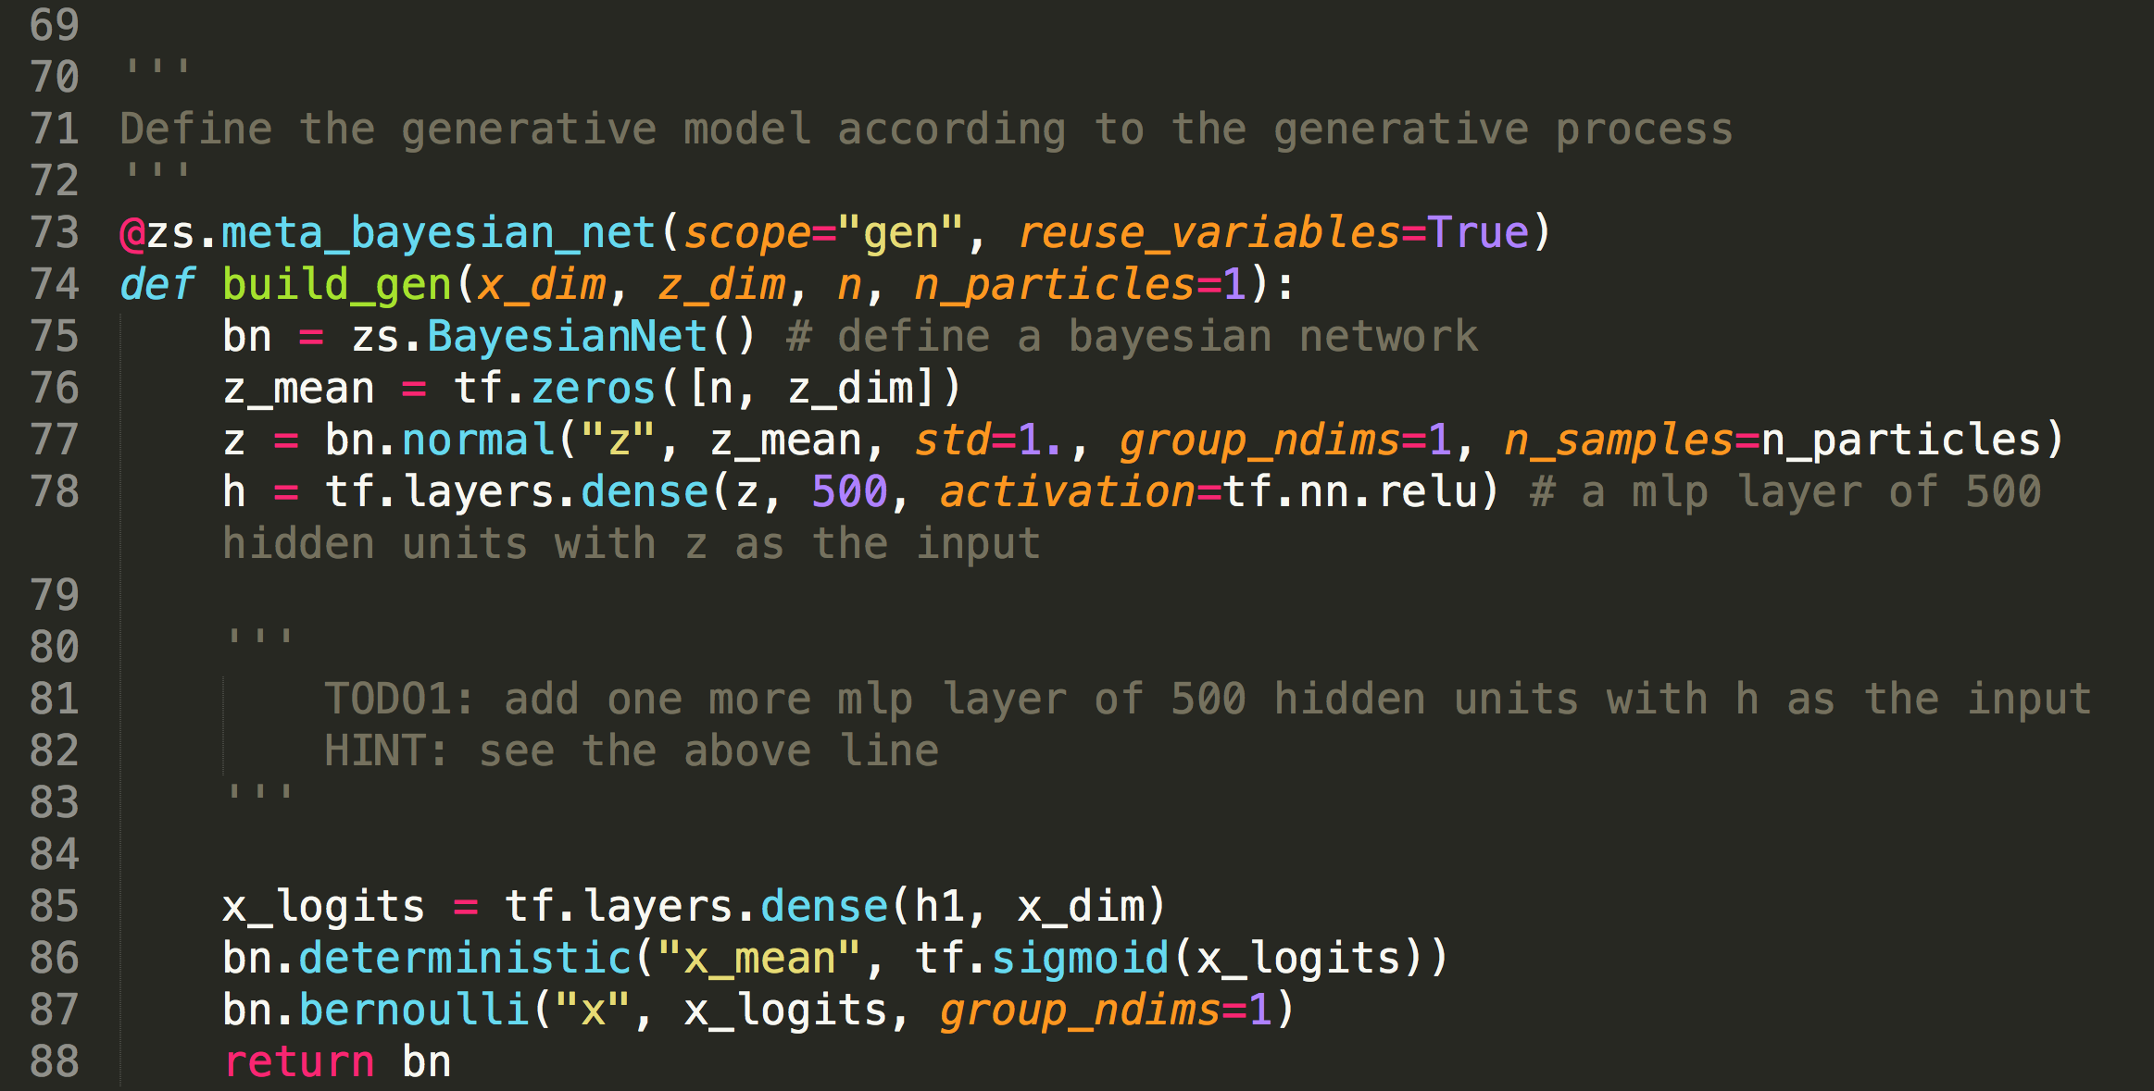
Implement VAE in ZhuSuan
Open ~/work/vae/vae.py
Fill in some code after the ‘TODO’s and run it
The bound of the log likelihood will increase
Images will be saved at ~/work/vae/results/vae for every 10 epochs

Slide 10
Thank you！

