Slide 1
Discussion with Jordana

Slide 2
Pre Processing
1,216,445
179,275
153,048
147,840
142,245
1st filter – delete organisation with no founded date, country code, category, and num_funding rounds
2nd filter – Companies after 2000
3rd filter – Delete companies with incomplete information on exit. E.g. no IPO date
4th filter – Delete companies got round c funding, IPOed, and acquired during warm-up period (0-4 years)
Status | Number of Companies with Event During Warm Up Window
Acquired | 2,765
IPO | 1,052
Round C | 1,718
TOTAL | 5,535

Slide 3
Success Definition
1,216,445
179,275
153,048
147,840
142,245
1st to 4th year as warm up period (0-4)
5th to 7th year as simulation period (4 – 7)
Any company get IPOed, Acquired, or receive another round of funding (seed, round A, round B, or round C) in simulation period is considered success. Other consider not success
STATUS | OUTCOME |  | TOTAL
STATUS | SUCCESS | NOT SUCCESS | TOTAL
ACQUIRED | 5,104 | 3,202 | 8,306 (6%)
IPO | 1,070 | 995 | 2,065 (1%)
OPERATING | 14,405 | 111,852 | 126,257 (89%)
CLOSED | 0 | 5,617 | 5,617 (4%)
TOTAL | 20,579 (15%) | 121,666 (85%) | 142,245

Slide 4
Question
Should we consider other funding in simulation window is success? Currently only consider seed, round A, round B, and round C.
Is definition of early stage correct? 7 years with 4 years warm up and 3 years simulation.
Should we consider success if company received funding in warm up window?

Slide 5
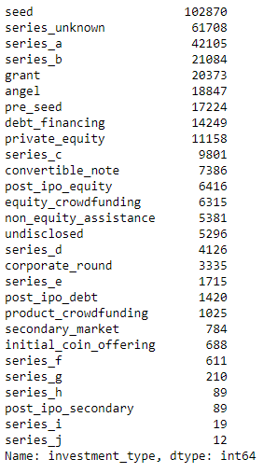
Funding Rounds Type
Total Funding Rounds: 364,336

Slide 6
Reference
Corea, F., Bertinetti, G. and Cervellati, E.M., 2021. Hacking the venture industry: An Early-stage Startups Investment framework for data-driven investors. Machine Learning with Applications, p.100062.
Arroyo, J., Corea, F., Jimenez-Diaz, G. and Recio-Garcia, J.A., 2019. Assessment of machine learning performance for decision support in venture capital investments. Ieee Access, 7, pp.124233-124243.
Retterath, A., 2020. Essays on Machine Learning and the Value of Data in Venture Capital (Doctoral dissertation, Universitätsbibliothek der TU München).

