Slide 1

Msc Project weekly progress update
Rahim

Slide 2
Week 2 update (17th June 2021)
progress
Next week plan
Blocker/issues
Read two papers on Crunchbase datasets
Starts preprocessing data – ongoing for organizations.csv
Continue pre-processing data
Unable to push to GitHub (repo forked but received error message as below when trying to push: “fatal: the remote end hung up unexpectedly”
Deciding which column in dataset are CRUCIAL and MUST HAVE for features – call for discussion

Slide 3
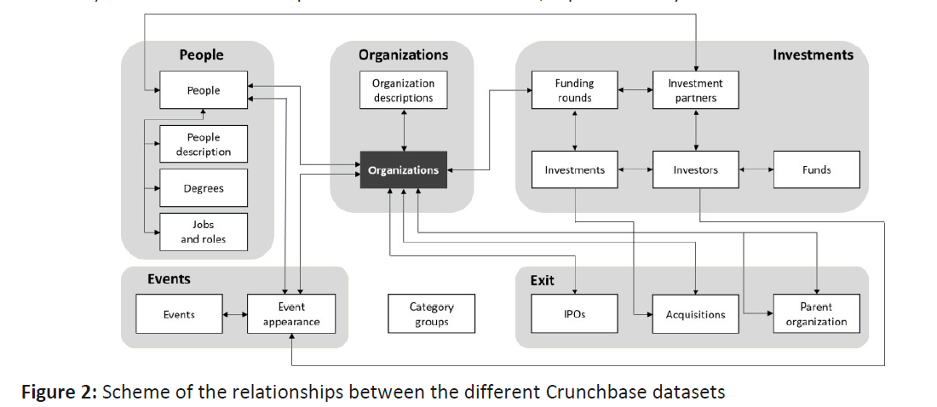
Sharing diagram from papers
Source: Ferrati, F. and Muffatto, M., 2020, June. Using Crunchbase for research in Entrepreneurship: data content and structure. In 20th European Conference on Research Methodology for Business and Management Studies: ECRM 2020 (p. 342). Academic Conferences and publishing limited

