Slide 1
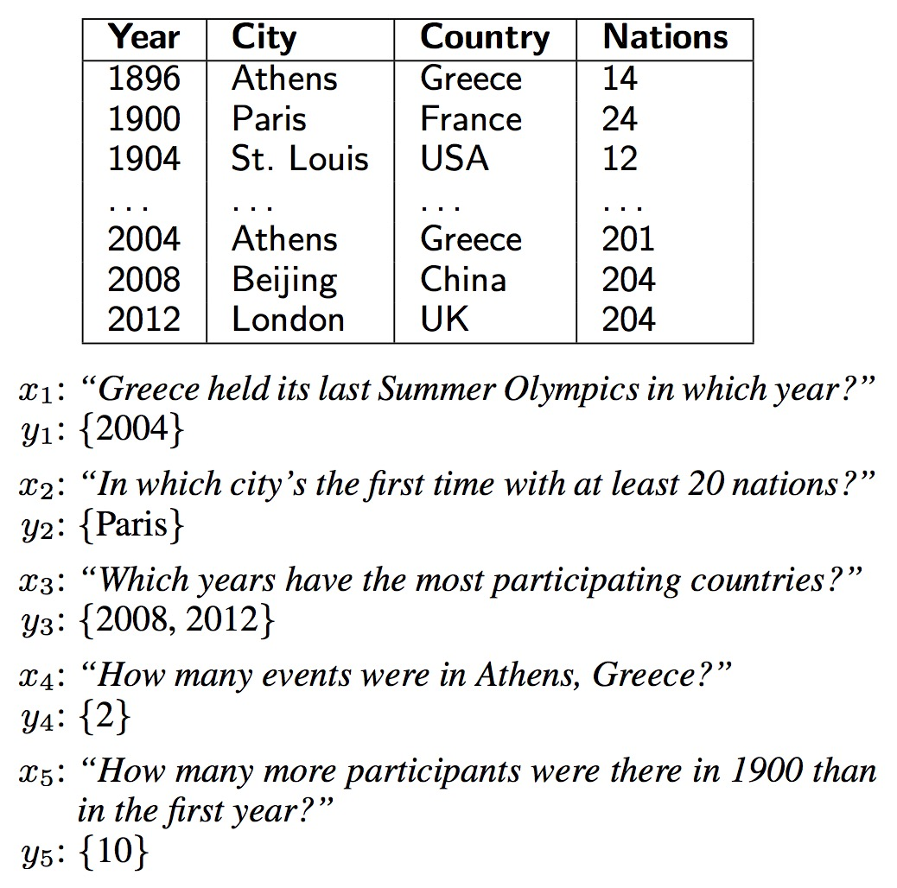
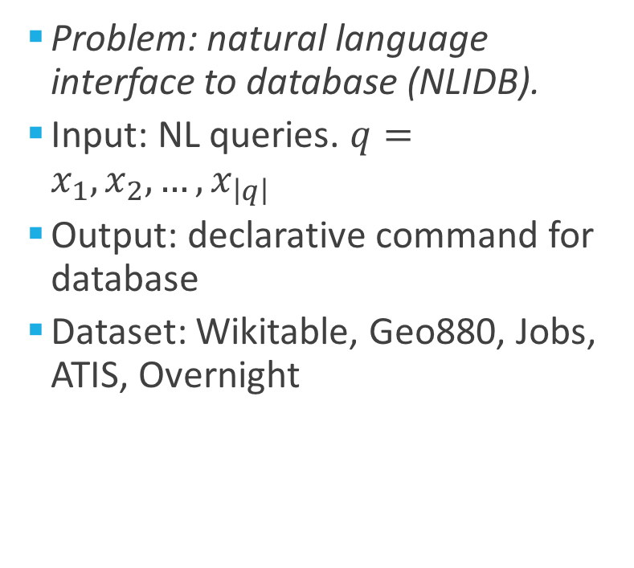
Problem Statement
Problem: natural language interface to database (NLIDB).
Input: NL queries. $q=x_{1},x_{2},…,x_{\left|q\right|}$
Output: declarative command for database
Dataset: Wikitable, Geo880, Jobs, ATIS, Overnight

Slide 2
DBMS (search engine)
Tagging
seq2seq RNN
Schema
Schema
Template
Tagged_query
where <f:1> equal <v:1> select <f: 2>
fields values
SQL to DB
Query
attention softmax
+
pointer network
how many gold medals japan won
Query Optimization (QO)
Natural Language Interface (NLI)

Slide 3
Designed feature for ‘tag’ : concatenated vector
<nan>
<f/v>
<comp>
<calc>
<arg>
<op>
id
field_template
type: {int, double, string, ordinal, category…}
 | e.g. | id | field_template | type
<nan> |  | 0 | [0, 0, …, 0] | [0, 0, 0, 0, 0]
<field> | <field:1>, <field:2> | 1,2… | embed: $People…
<value> | <value:1>, <value:2> | 1,2… | combina of fields
<comp> | <comp:eq, g, l> | 0 | embed | [0, 0, 0, 0, 0]
<calc> | <calc: sum, diff, mean> | 0 | embed | [0, 0, 0, 0, 0]
<arg> | <arg: max, min> | 0 | embed | [0, 0, 0, 0, 0]
<op> | TBD | 0 | embed | [0, 0, 0, 0, 0]
Notes:
item: (-1, 0, +1,+3,+5,+10); (or using binary?)
id: (1,2,3,…), 按出现顺序编号，除非真的确定指同一个;
field_template: nparray[] e.g.<$People><$Country>;
value type: 只有f/v非零；binary表示([0,0,1,0], [1,0,0,0],…) [int, double, string, ordinal, category];
value_embed: nparray[] e.g.

Slide 4
Designed feature for ‘tag’ : concatenated vector
<nan>
<f/v>
<comp>
<calc>
<arg>
<op>
id
field_template
type: {int, double, string, ordinal, category…}
value_embed (corresponding to the type)
To be decided
 | e.g. | id | field_template | type | value_embed
<nan> |  | 0 | [0, 0, …, 0] | [0, 0, 0, 0, 0] | [0, 0, 0, 0, 0]
<field> | <field:1>, <field:2> | 1,2… | embed: $People…
<value> | <value:1>, <value:2> | 1,2… | combina of fields
<comp> | <comp:eq, g, l> | 0 | embed | [0, 0, 0, 0, 0] | [0, 0, 0, 0, 0]
<calc> | <calc: sum, diff, mean> | 0 | embed | [0, 0, 0, 0, 0] | [0, 0, 0, 0, 0]
<arg> | <arg: max, min> | 0 | embed | [0, 0, 0, 0, 0] | [0, 0, 0, 0, 0]
<op> | TBD | 0 | embed | [0, 0, 0, 0, 0] | [0, 0, 0, 0, 0]
Notes:
item: (-1, 0, +1,+3,+5,+10); (or using binary?)
id: (1,2,3,…), 按出现顺序编号，除非真的确定指同一个;
field_template: nparray[] e.g.<$People><$Country>;
value type: 只有f/v非零；binary表示([0,0,1,0], [1,0,0,0],…) [int, double, string, ordinal, category];
value_embed: nparray[] e.g.

Slide 5
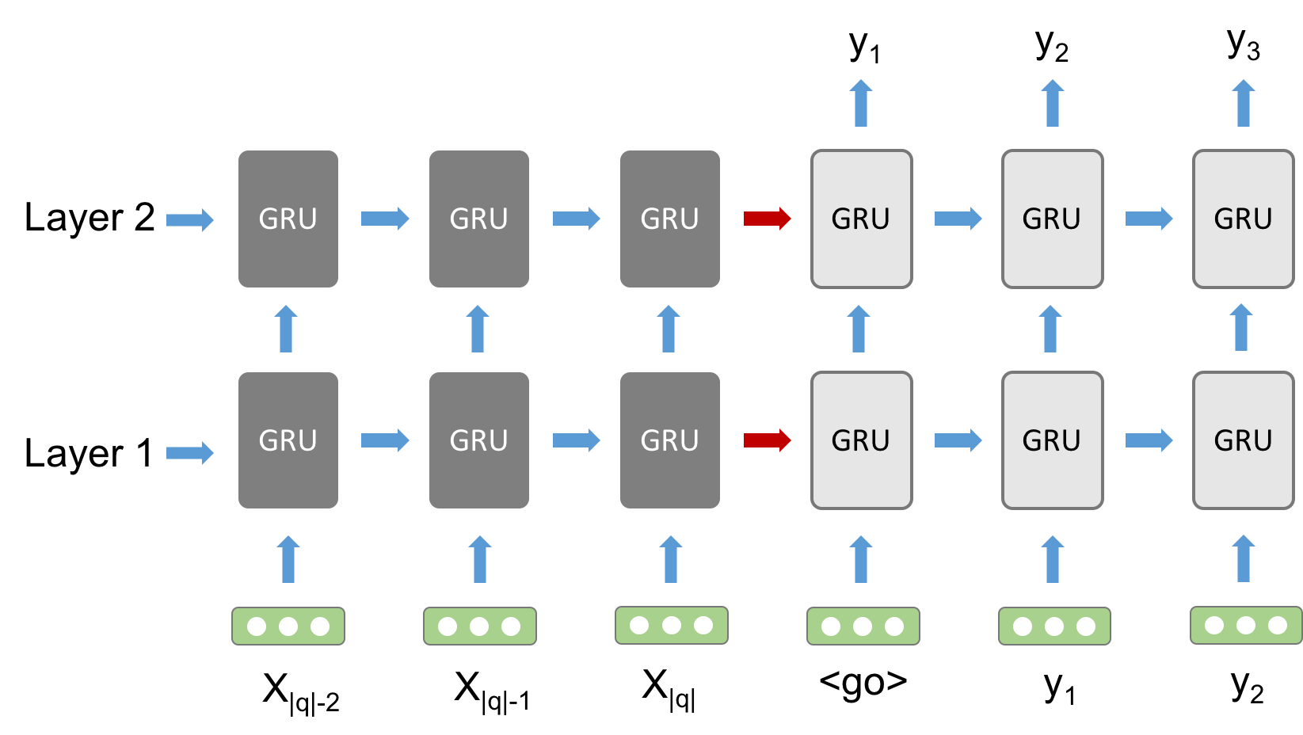


Seq2seq attention model
Encoder
Decoder
$$h_{t}^{l}=GRU(h_{t−1}^{l},h_{t}^{l−1})$$
$$p\left(y_{t} | y_{<t},q\right)=softmax{\left(W_{o}h_{t}^{L}\right)}^{T}e(y_{t})$$
Notes:
Attention-based seq2seq DNN

Slide 6
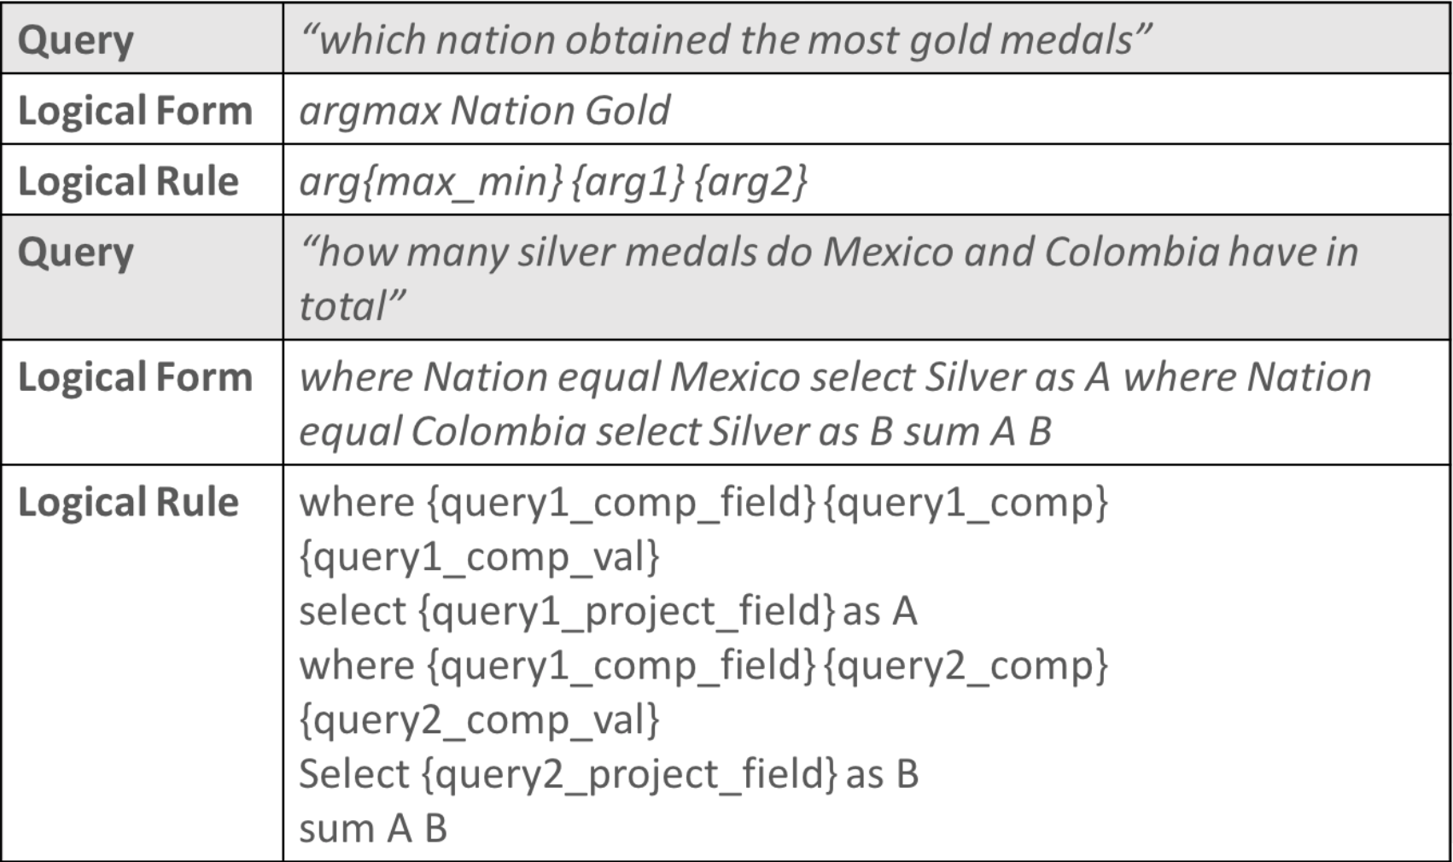
SQL-like logical forms
Notes:
Logical forms

Slide 7
Data augmentation [5,6]
Annotate ~200 queries with corresponding 16 SQL-like logical forms based on Wikitable queries; Augment to ~4000 queries and corresponding logical forms.
Field recombination (eg. argmax Nation Gold -> argmax Nation Silver)
Field value replacement (eg. where Nation equal Romania -> where Nation equal Spain)
Synonyms replacement (eg. which nation won -> which country won)
Notes:
Logical forms

Slide 8
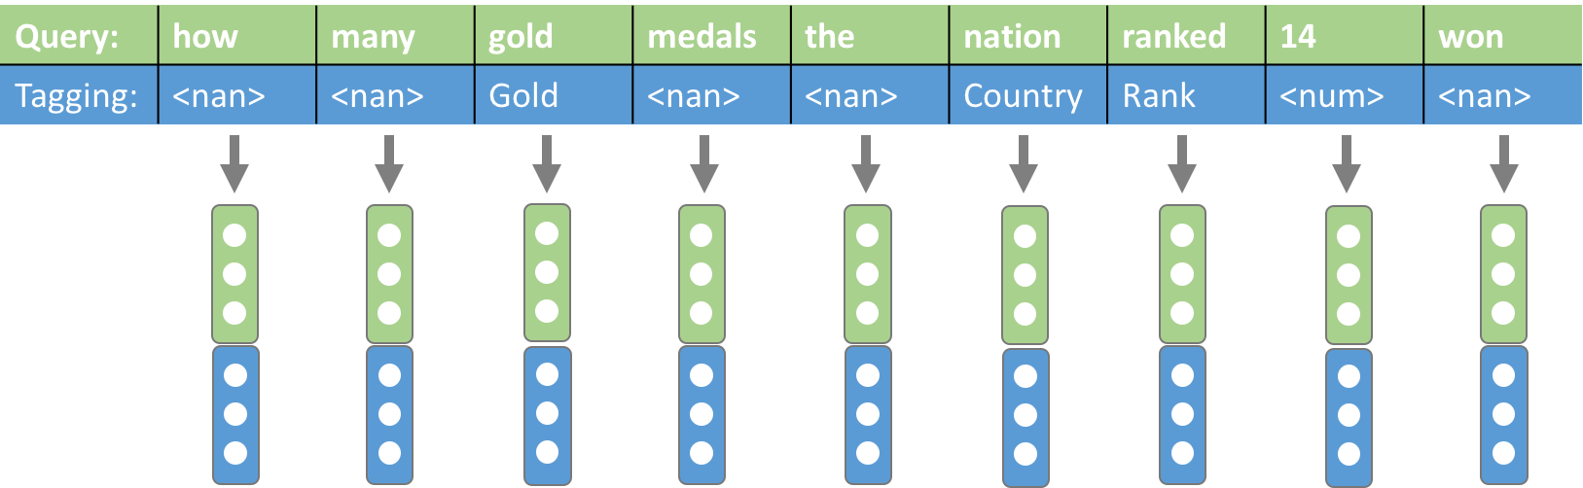
Tagging algorithm
Numerical value -> <num>
Word similarity (eg. gold ->Gold)
Semantic nearest neighbor (eg. nation -> Country)
Notes:
Input, output

Slide 9
Reference
[1] P. Pasupat and P. Liang, Compositional semantic parsing on semi-structured tables, ACL, 2015.
[2] P. Yin, Z. Lu, H. Li and B. Kao., Neural Enquirer: learning to query tables in natural language, JCA, 2016.
[3] Arvind Neelakantan, Quoc V. Le, Mart ́ın Abadi, Andrew McCallum, and Dario Amodei. Learning a natural language interface with neural programmer. CoRR, abs/1611.08945, 2016.
[4] Li Dong and Mirella Lapata. Language to logical form with neural attention. CoRR, abs/1601.01280, 2016.
[5] Robin Jia and Percy Liang. Data recombination for neural semantic parsing. CoRR, abs/1606.03622, 2016.
[6] Xiang Zhang, Junbo Jake Zhao, and Yann LeCun. Character-level convolutional networks for text classification. In NIPS, 2015.

