Slide 1
Deep Neural Parsing for Database Query
Hongyu Xiong
Stanford University
03/31/2017

Slide 2
Outline
Problem Statement
Related Work
Approach
Experiment
Conclusion & Perspectives

Slide 3
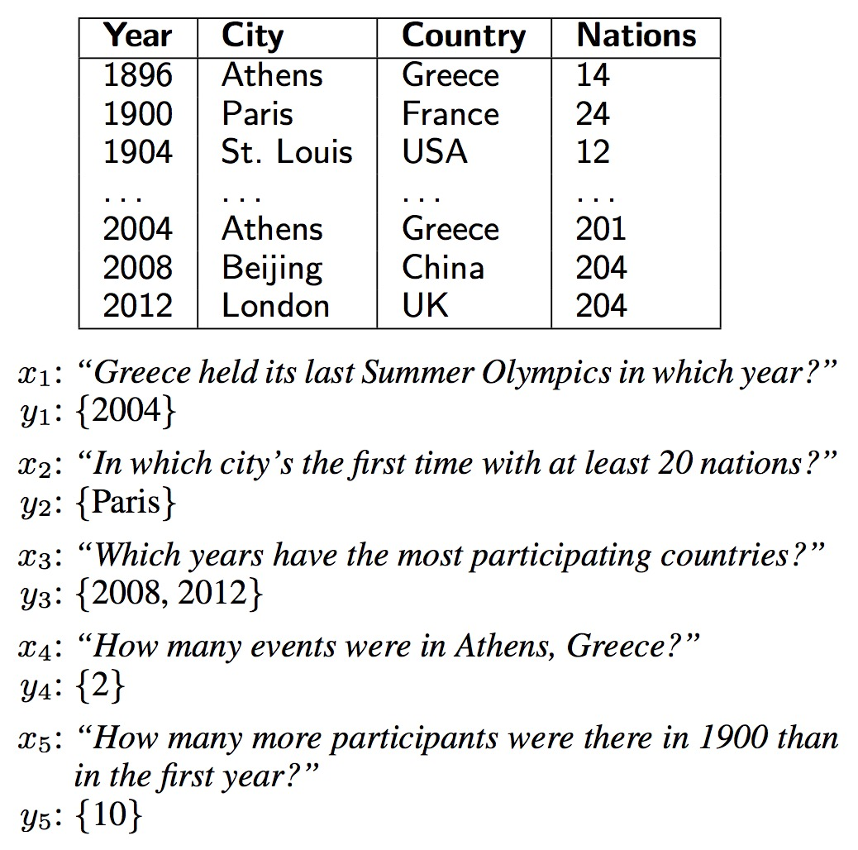
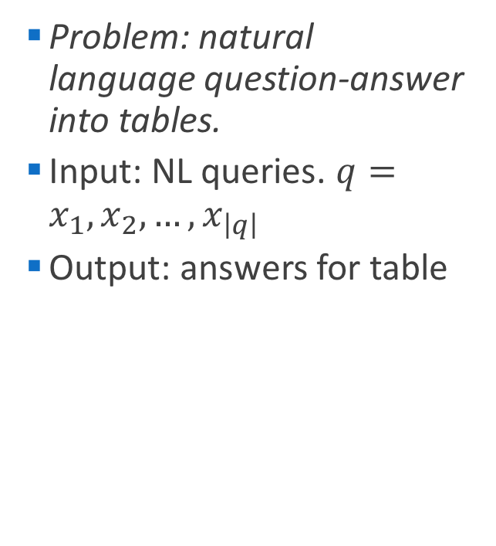
Problem Statement
Problem: natural language question-answer into tables.
Input: NL queries. $q=x_{1},x_{2},…,x_{\left|q\right|}$
Output: answers for table

Slide 4
Problem Statement
Problem: natural language question-answer into tables.
Dataset: Wikitable [1]
22033 queries on 2108 tables)

Slide 5
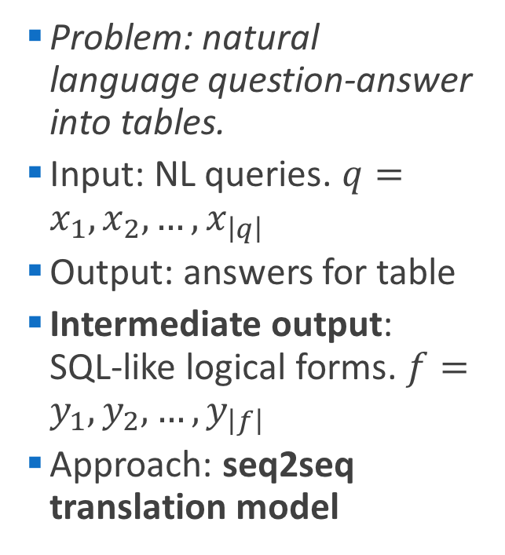
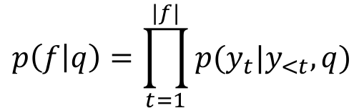
Problem Statement
Problem: natural language question-answer into tables.
Input: NL queries. $q=x_{1},x_{2},…,x_{\left|q\right|}$
Output: answers for table
Intermediate output: SQL-like logical forms. $f=y_{1},y_{2},…,y_{\left|f\right|}$
Approach: seq2seq translation model
$$p\left(f | q\right)=\prod_{t=1}^{|f|}{p(y_{t}|y_{<t},q)}$$

Slide 6
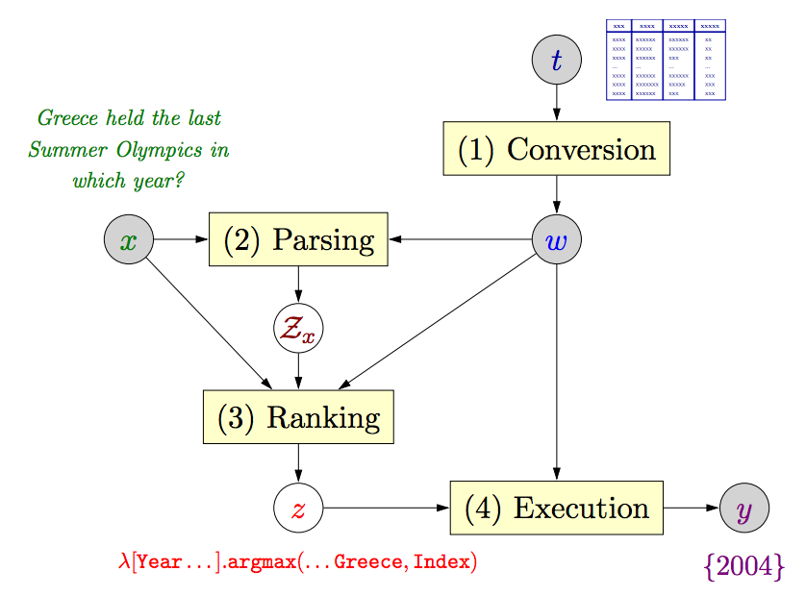

Related Work
Semantic parsing by $λ$-expression [1]
Too many grammatical analysis; hard to capture the complexity of query and similarity among words.
37.1% on Wikitable [1]
Notes:
Different grammars and composite sentences.

Slide 7
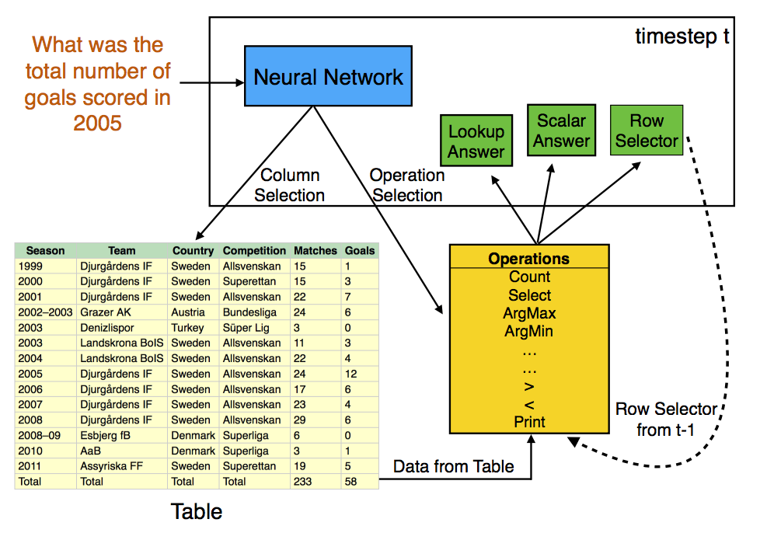
Related Work
Neural Enquirer/Neural Programmer [2,3]
Memory-based end2end neural network; hard to scale to large table and incapable to use on new tables.
37.7% on Wikitable [3]

Slide 8
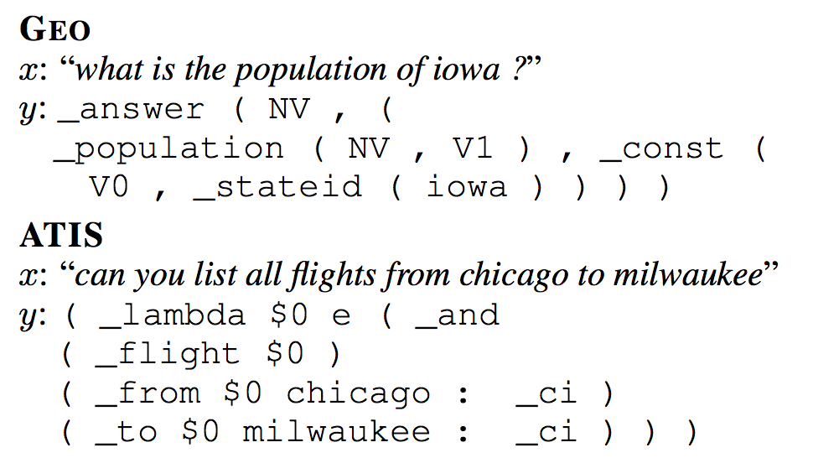
Related Work
Translating NL queries to logical forms [4,5]
Seq2seq model; data augmentation
Logical forms lack of generality; fail to incorporate table information into the model; dataset too small.
>70% on GeoQuery, ATIS [4,5]

Slide 9
Approach
Seq2seq attention model
Logical form definition
Data augmentation
Tagging

Slide 10
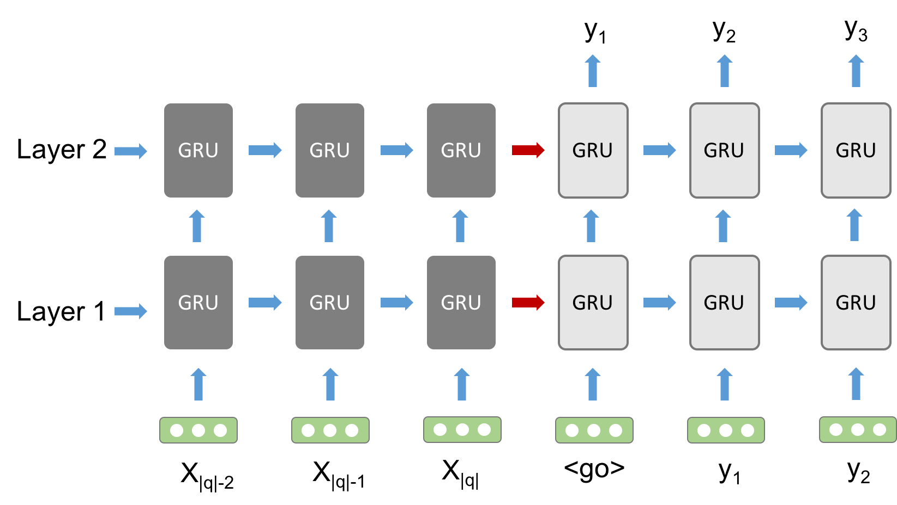


Seq2seq attention model
Encoder
Decoder
$$h_{t}^{l}=GRU(h_{t−1}^{l},h_{t}^{l−1})$$
$$p\left(y_{t} | y_{<t},q\right)=softmax{\left(W_{o}h_{t}^{L}\right)}^{T}e(y_{t})$$
Notes:
Attention-based seq2seq DNN

Slide 11
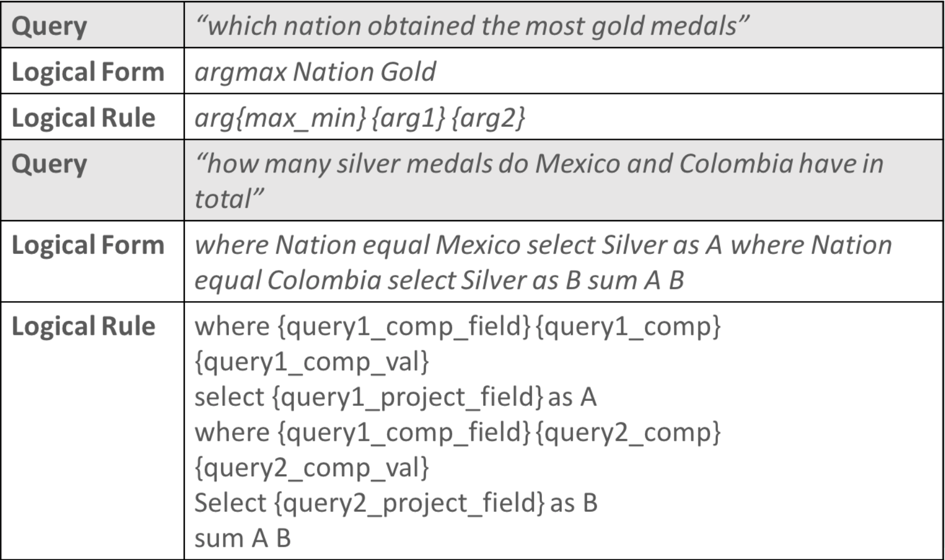
SQL-like logical forms
Notes:
Logical forms

Slide 12
Data augmentation [5,6]
Annotate ~200 queries with corresponding 16 SQL-like logical forms based on Wikitable queries; Augment to ~4000 queries and corresponding logical forms.
Field recombination (eg. argmax Nation Gold -> argmax Nation Silver)
Field value replacement (eg. where Nation equal Romania -> where Nation equal Spain)
Synonyms replacement (eg. which nation won -> which country won)
Notes:
Logical forms

Slide 13
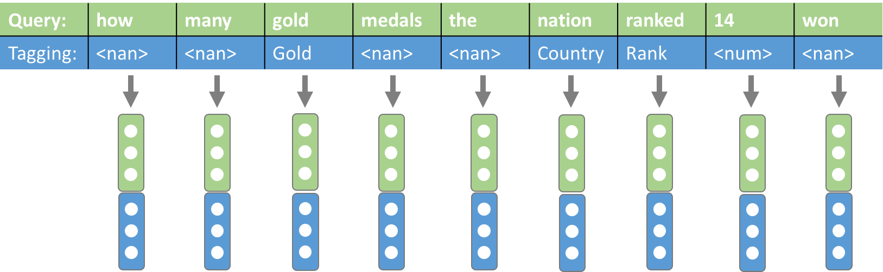
Tagging model
Glove pre-trained vectors for words in query;
Trainable embedding for tagging tokens and same for logical forms with Xavier initialization.

Slide 14
Tagging algorithm
Numerical value -> <num>
Word similarity (eg. gold ->Gold)
Semantic nearest neighbor (eg. nation -> Country)
Notes:
Input, output

Slide 15
Experiment
3,000 training set and 711 dev set.
Tensorflow framework, run on Microsoft Azure (Tesla M60 GPU)
Seq2seq attention model with different hyper-parameters

Slide 16
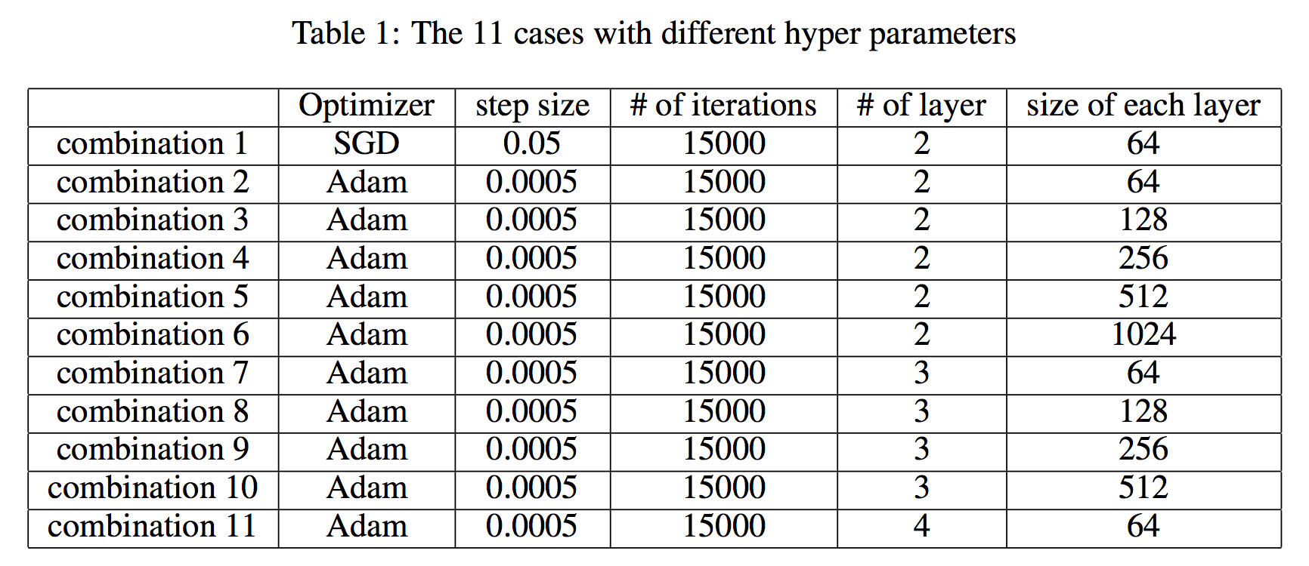
Tuning hyper-parameters

Slide 17
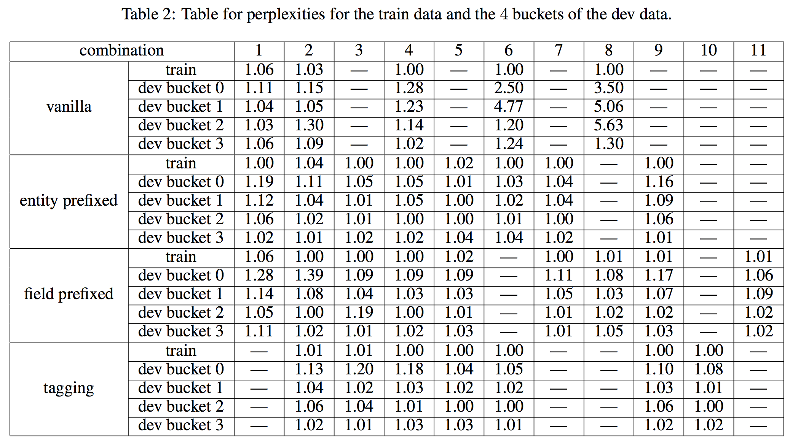
Perplexities

Slide 18
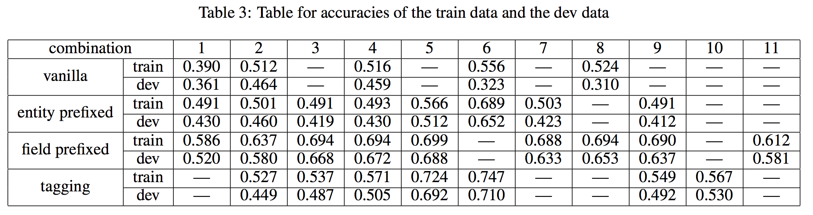
Train acc & dev acc
2-layer-1024-unit seq2seq tagging model, a new benchmark on Wikitable-related dataset.

Slide 19
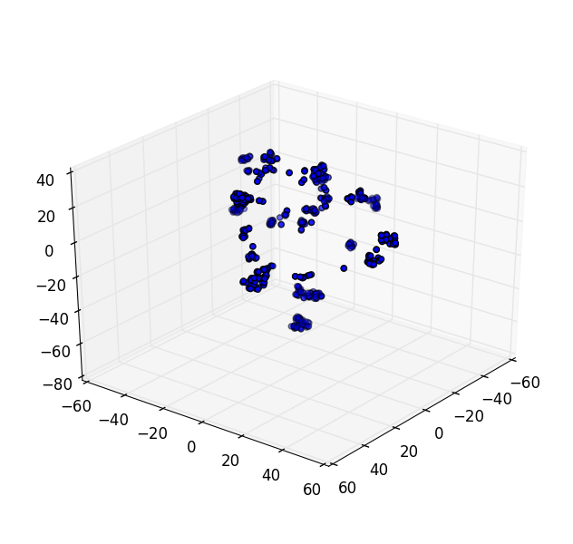
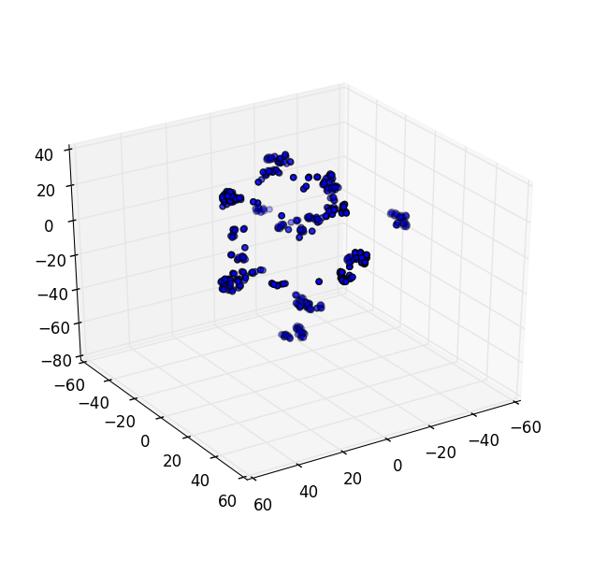
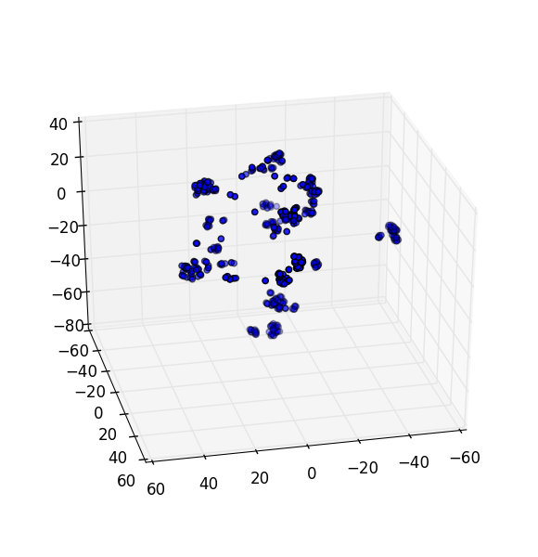
Last encoder vectors:
PCA Dimension reduction: t-sne
Clustroids represent the 16 different logical forms.

Slide 20
Conclusion
Tagging-based seq2seq model parsing NL queries to SQL-like logical forms

Slide 21
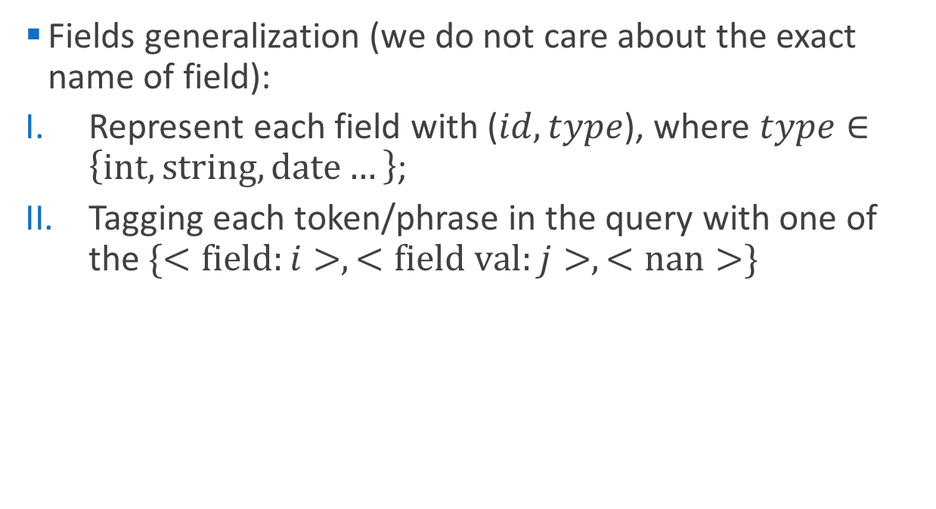
Next steps
Fields generalization (we do not care about the exact name of field):
Represent each field with ($id, type$), where $type∈\left\{int, string, date…\right\}$;
Tagging each token/phrase in the query with one of the $\{<field:i>,<field val:j>,<nan>\}$
Country Rank Gold Silver Bronze Total
how many gold medals the nation ranked 14 won
(1, string) (2, int) (3, int) (4, int) (5, int) (6, int)
<nan> <nan> <field: 1> <nan> <nan> <field: 2> <field: 3> <field val: 3> <nan>
where <field: 3> equal <field val: 3> select <field: 2> as A select <field: 1>

Slide 22
Next steps
Improve tagging algorithm to identify words that are possible values of a certain field. (e.g. ‘china’ or ‘japan’ would be related to ‘Nation’, using Bloom filter)
Greedy decoder -> beam search

Slide 23
Reference
[1] P. Pasupat and P. Liang, Compositional semantic parsing on semi-structured tables, ACL, 2015.
[2] P. Yin, Z. Lu, H. Li and B. Kao., Neural Enquirer: learning to query tables in natural language, JCA, 2016.
[3] Arvind Neelakantan, Quoc V. Le, Mart ́ın Abadi, Andrew McCallum, and Dario Amodei. Learning a natural language interface with neural programmer. CoRR, abs/1611.08945, 2016.
[4] Li Dong and Mirella Lapata. Language to logical form with neural attention. CoRR, abs/1601.01280, 2016.
[5] Robin Jia and Percy Liang. Data recombination for neural semantic parsing. CoRR, abs/1606.03622, 2016.
[6] Xiang Zhang, Junbo Jake Zhao, and Yann LeCun. Character-level convolutional networks for text classification. In NIPS, 2015.

Slide 24
SQL-like logical forms
Notes:
Logical forms

Slide 25
Designed feature for ‘tag’ : concatenated vector
shown_up id
Need to establish a correspondence
<nan>
<f/v>
field_template
type: {int, double, string, ordinal, category…}
 | e.g. | id | field_template | type
<nan> |  | 0 | [0, 0, …, 0] | [0, 0, 0, 0, 0]
<field> | <field:1>, <field:2> | 1,2… | embed: $People…
<value> | <value:1>, <value:2> | 1,2… | combina of fields
<comp> | <comp:eq, g, l> | 0 | embed/[0, 0, …, 0] | [0, 0, 0, 0, 0]
<calc> | <calc: sum, diff, mean> | 0 | embed | [0, 0, 0, 0, 0]
<arg> | <arg: max, min> | 0 | embed | [0, 0, 0, 0, 0]
<op> | TBD | 0 | embed | [0, 0, 0, 0, 0]
Notes:
后期adding新的句子和问答方式：small fields with {possible paraphrases}

Slide 26
Designed feature for ‘tag’ : concatenated vector
<nan>
<f/v>
<comp>
<calc>
<arg>
<op>
id
field_template
type: {int, double, string, ordinal, category…}
value_embed (corresponding to the type)
To be decided
 | e.g. | id | field_template | type | value_embed
<nan> |  | 0 | [0, 0, …, 0] | [0, 0, 0, 0, 0] | [0, 0, 0, 0, 0]
<field> | <field:1>, <field:2> | 1,2… | embed: $People…
<value> | <value:1>, <value:2> | 1,2… | combina of fields
<comp> | <comp:eq, g, l> | 0 | embed | [0, 0, 0, 0, 0] | [0, 0, 0, 0, 0]
<calc> | <calc: sum, diff, mean> | 0 | embed | [0, 0, 0, 0, 0] | [0, 0, 0, 0, 0]
<arg> | <arg: max, min> | 0 | embed | [0, 0, 0, 0, 0] | [0, 0, 0, 0, 0]
<op> | TBD | 0 | embed | [0, 0, 0, 0, 0] | [0, 0, 0, 0, 0]
Notes:
item: (-1, 0, +1,+3,+5,+10); (or using binary?)
id: (1,2,3,…), 按出现顺序编号，除非真的确定指同一个;
field_template: nparray[] e.g.<$People><$Country>;
value type: 只有f/v非零；binary表示([0,0,1,0], [1,0,0,0],…) [int, double, string, ordinal, category];
value_embed: nparray[] e.g.

