Slide 1
Transfer-learnable Deep Neural Natural Language Interface for Database
Hongyu Xiong
Stanford University
05/31/2017

Slide 2
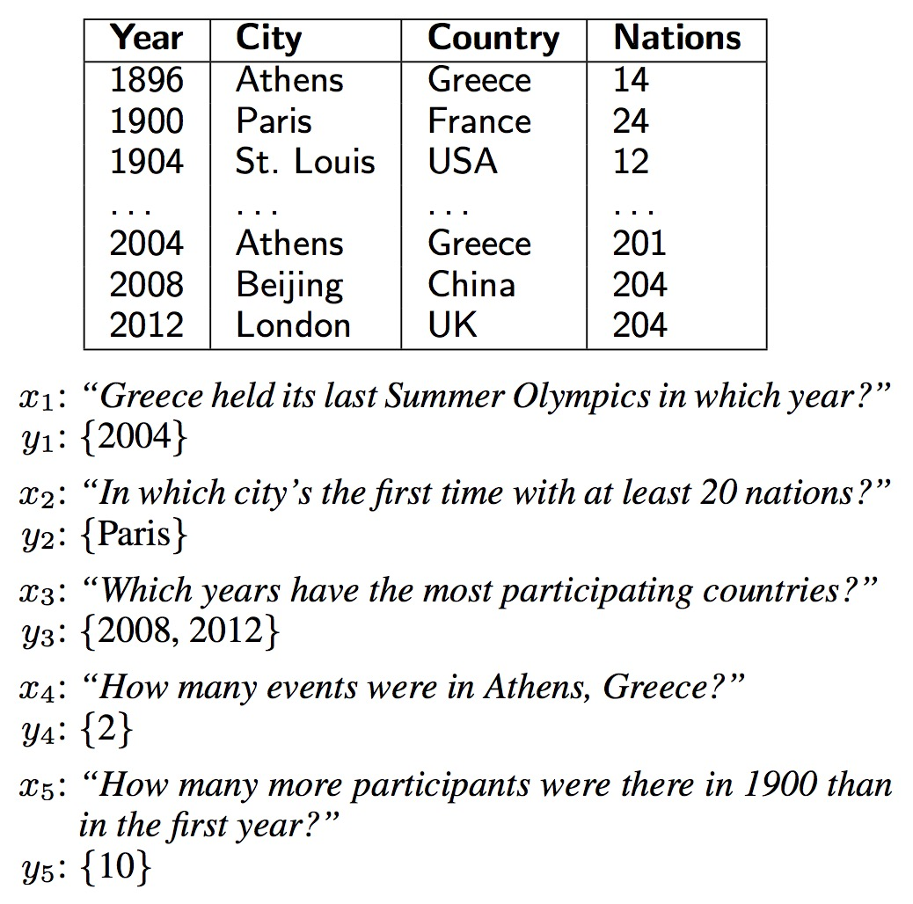
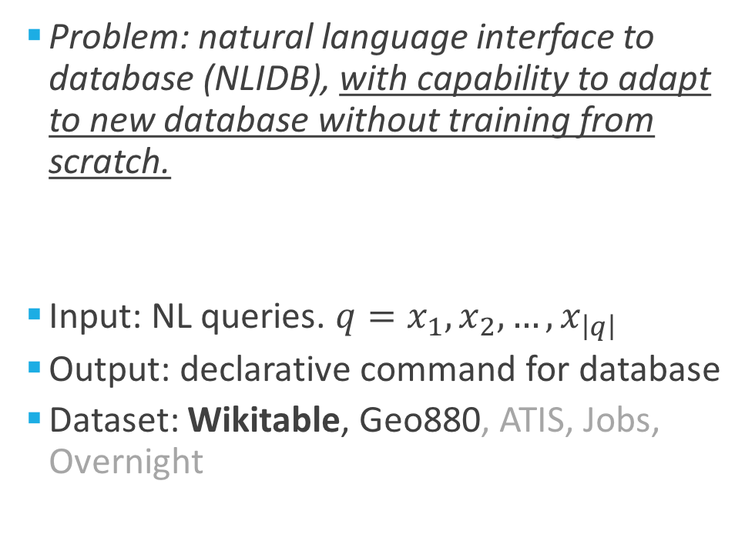
Problem Statement
Problem: natural language interface to database (NLIDB), with capability to adapt to new database without training from scratch.
Input: NL queries. $q=x_{1},x_{2},…,x_{\left|q\right|}$
Output: declarative command for database
Dataset: Wikitable, Geo880, ATIS, Jobs, Overnight

Slide 3
Recent Related Work (seq2seq)
Robin Jia and Percy Liang, 2016. Data recombination for neural semantic parsing. data augmentation
Li Dong and Mirella Lapata, 2016. Language to Logical Form with Neural Attention. Seq2seq & Seq2Tree model
Yu Su and Xifeng Yan, 2017. Cross-domain Semantic Parsing via Paraphrasing. Domain adaptation protocol, target domain fine-tuning
Jonathan Herzig and Jonathan Berant, 2017. Neural Semantic Parsing over Multiple Knowledge-bases. Trained on multiple domain and use on one specific domain with ‘special encoding’

Slide 4
Our Contribution
Transfer-learnable Deep Neural NLIDB Pipeline.
Tagging Algorithm (based on pre-trained dependency tree)
Seq2seqBridge model.
Data augmentation (recombination + paraphrase + noise).
Cross-database transfer-learning protocol.

Slide 5
Query Optimization (QO)
Natural Language Interface (NLI)
DBMS (search engine)
Tagging
Seq2seq Bridge Network
Schema
Correspondence files
where <f:1> equal <v:1> select <f:2>
fields & values
Tag_query
SQL Logical template
SQL command
look up .corr files
Query
attention network
how many gold medals japan won
0. input: natural language query
1. basic preprocessing: field name/value to one string using ‘_’; number to numerical value
2. tagging process for each word in the query, generating tagged query (parallel mode and X mode)
3. neural translation to logical template
4. convert logical template to declarative command like SQL
5 access to the database

Slide 6
Query Optimization (Tagging)
Schema
(.fi)
Nation Rank Gold Silver Bronze Total
which nation has less than 32 gold but its bronze medals are more than 4
[‘<field>:0', 'Nation']
['<field>:1', 'Gold']
['<field>:2', 'Bronze']
['<value>:1', ’32']
['<value>:2', ’4']
Nation Gold Bronze
<nan> 32 4
<nan> <field>:0 <nan> <nan> <nan> <value>:1 <field>:1 <nan> <nan> <field>:2 <nan> <nan> <nan> <nan> <value>:2
Query
(.qu)
Identifying a <value> or <field> is relatively easy. Need to establish a correspondence between a <value> and <field>, so they have the same id.
.ficorr
.vacorr
Tag
(.ta)
Notes:
还是先tag成统一的field name：[Nation, Rank…]，这样可以大致清楚都有什么fields，然后再label shown_up id
对于每一个发现的value，都要确定其对应的field

Slide 7
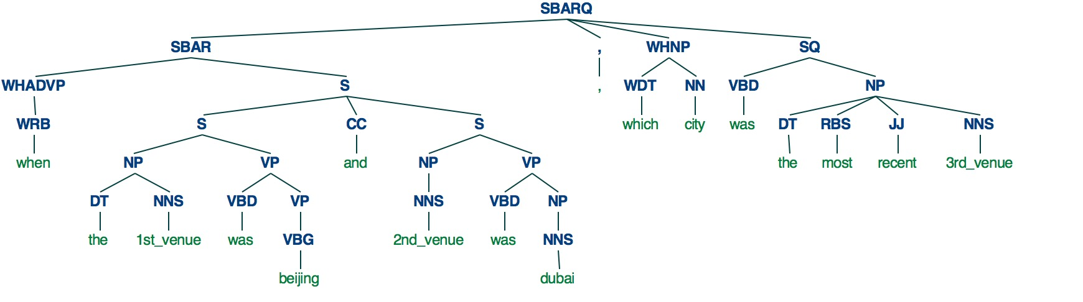
Query Optimization (Tagging) --- dealing with overlapping value domain
Query
which nation has less than 32 gold but its bronze medals are more than 4
Tag
<nan> <field>:0 <nan> <nan> <nan> <value>:? <field>:1 <nan> <nan> <field>:2 <nan> <nan> <nan> <nan> <value>:?
Method: Dependency Tree Lowest common ancestor (nltk.stanford.StanfordParser)
when the 1st_venue was beijing and 2nd_venue was dubai, which city was the most recent 3rd_venue
Notes:
还是先tag成统一的field name：[Nation, Rank…]，这样可以大致清楚都有什么fields，然后再label shown_up id
对于每一个发现的value，都要确定其对应的field

Slide 8
### example: 996 ###
Year 1st_Venue 2nd_Venue 3rd_Venue 4th_Venue 5th_Venue 6th_Venue
when the 1st_venue was beijing and 2nd_venue was dubai, which city was the most recent 3rd_venue
select 3rd_Venue argmax Year where 1st_Venue equal Beijing and 2nd_Venue equal Dubai
['<field>', 'Year']
['<field>', '1st_Venue']
['<field>', '2nd_Venue']
['<field>', '1st_Venue;2nd_Venue;3rd_Venue;4th_Venue']
['<field>', '3rd_Venue']
['<value>', '1st_Venue;2nd_Venue;3rd_Venue;4th_Venue']
['<value>', '1st_Venue;2nd_Venue;3rd_Venue;4th_Venue']
[(0, 0)]
[]
[(2, 1), (6, 2), (16, 4)]
[4, 8]
Year 1st_Venue 2nd_Venue 1st_Venue;2nd_Venue;3rd_Venue;4th_Venue 3rd_Venue
<nan> beijing dubai <nan> <nan>
<field>:0 <nan> <field>:1 <nan> <value>:1 <nan> <field>:2 <nan> <value>:2 <nan> <nan> <field>:3 <nan> <nan> <nan> <nan> <field>:4
<field>:0 the <field>:1 was <value>:1 and <field>:2 was <value>:2 , which <field>:3 was the most recent <field>:4
select <field>:4 argmax <field>:0 where <field>:1 equal <value>:1 and <field>:2 equal <value>:2

Slide 9
Schema
(.fi)
Year 1st_Venue 2nd_Venue 3rd_Venue 4th_Venue 5th_Venue 6th_Venue
when the 1st_venue was beijing and 2nd_venue was dubai, which city was the most recent 3rd_venue
select 3rd_Venue argmax Year where 1st_Venue equal Beijing and 2nd_Venue equal Dubai
Year 1st_Venue 2nd_Venue 3rd_Venue
<nan> beijing dubai <nan>
<field:0> <nan> <field:1> <nan> <value:1> <nan> <field:2> <nan> <value:2> <nan> <nan> <nan> <nan> <nan> <nan> <nan> <field:3>
<field:0> the <field:1> was <value:1> and <field:2> was <value:2> , which city was the most recent <field:3>
select <field:3> argmax <field:0> where <field:1> equal <value:1> and <field:2> equal <value:2>
Query
(.qu)
SQL comm. (.lo)
.ficorr
.vacorr
Tag
(.ta)
QueryX
(.qux)
SQL logic template
(.lox)

Slide 10
Query Optimization (Tagging)
feature vector for ‘tag’ : <field:1;int>
<nan>
<field>
<value>
id
type: {int, double, string, ordinal, category…}
Notes:
后期adding新的句子和问答方式：small fields with {possible paraphrases}

Slide 11
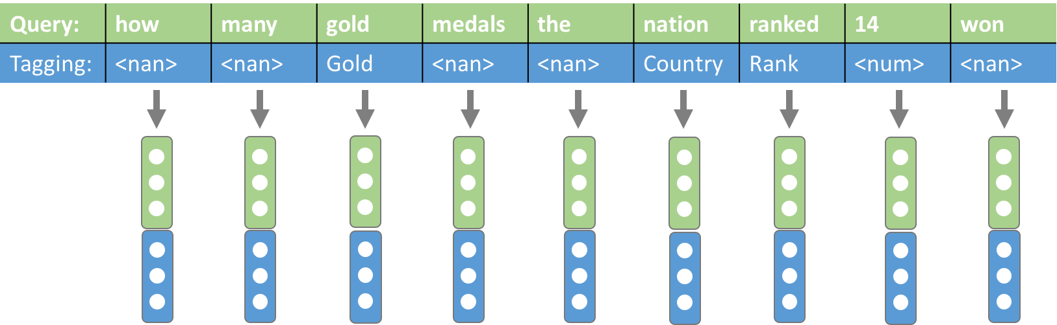
Query Optimization (Tagging)
Query
which nation has less than 32 gold but its bronze medals are more than 4
Tag
<nan> <field>:0 <nan> <nan> <nan> <value>:1 <field>:1 <nan> <nan> <field>:2 <nan> <nan> <nan> <nan> <value>:2
Tags concatenate with words in original query (Parallel model)
Meaningful tags replace the words in original query (X model)
QueryX
(.qux)
which <field>:0 has less than <value>:1 <field>:1 but its <field>:2 medals are more than <value>:2
Notes:
还是先tag成统一的field name：[Nation, Rank…]，这样可以大致清楚都有什么fields，然后再label shown_up id
对于每一个发现的value，都要确定其对应的field

Slide 12
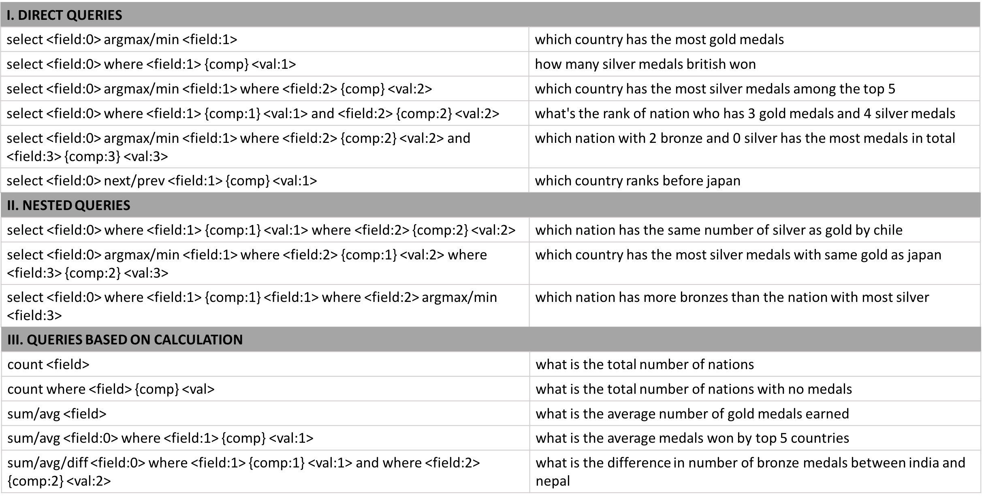
SQL-extended command

Slide 13
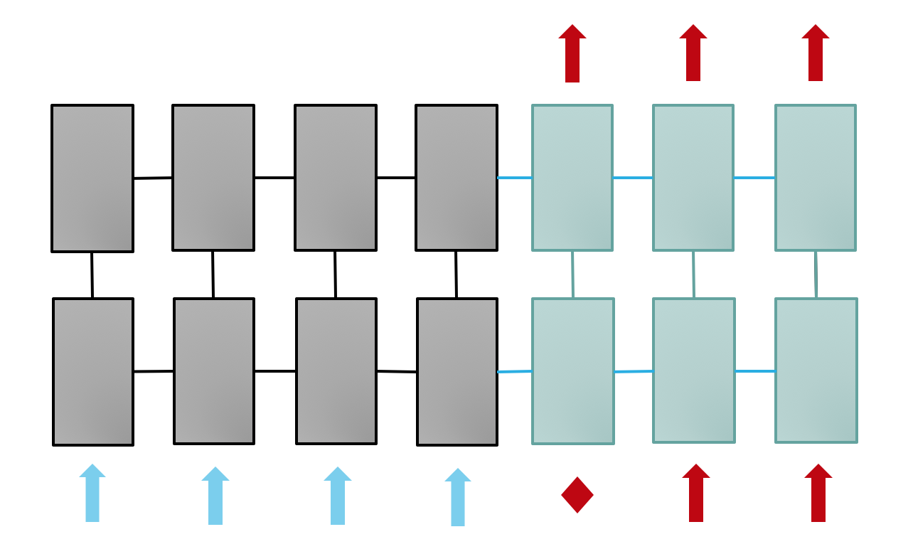
Seq2seqBridge model
Encoder
Decoder
Notes:
Attention-based seq2seq DNN,

Slide 14
Encoder
Decoder
<nan>
<field>
<value>
id
{int, string, ordinal,
…}
Notes:
Attention-based seq2seq DNN,

Slide 15
<nan>
<field>
<value>
id
type: {int, double, string, ordinal, category…}

Slide 16
Natural Language Interface (Neural Translation Machine):
Training Data: .qu, .fi, .lo files (original files); .ta, .qux, .lox files (generated through tagging process)
Logic form
(.lo)
diff Silver where Nation equal italy and where Nation equal india
Silver Nation
<nan> italy; india
diff <field>:0 where <field>:1 equal <value>:1 and where <field>:1 equal <value>:1
.ficorr
.vacorr
Logical template
(.lox)
Tagged query
(.qu+.ta / .qux)
Natural Language Interface (NLI)
Logical template
(.lox)
Notes:
Attention-based seq2seq DNN

Slide 17
Natural Language Interface (Neural Translation Machine):
Evaluation & Converting template to logical form:
Tagged query
(.qu+.ta / .qux)
Natural Language Interface (NLI)
Logical template
(.lox)
Logical template
(.lox)
diff <field>:0 where <field>:1 equal <value>:1 and where <field>:1 equal <value>:1
Silver Nation Nation
<nan> italy india
diff Silver where Nation equal italy and where Nation equal india
.ficorr
.vacorr
Logic form
(.lo)
Notes:
Attention-based seq2seq DNN

Slide 18
Data augmentation [5,6]
Annotate ~800 queries with corresponding SQL-extended command based on Wikitable queries; Augment to ~12,000 queries and corresponding logical forms.
Field recombination and value replacement (eg. argmax Nation Gold -> argmax Nation Silver, where Nation equal Romania -> where Nation equal Spain)
Paraphrase sentences recombination
Synonyms replacement (eg. which nation won -> which country won)
Noise inducing (eg. has/had, is/are, is/was, ‘the’)
Notes:
Logical forms

Slide 19
Natural Language Interface (NLI):
Tagged_query
(.qu+.ta / .qux)
Natural Language Interface (NLI)
Logical template
(.lox)
Parallel Model:
global step 3500 learning rate 0.0002 step-time 0.34 perplexity 1.00
eval: bucket 0 perplexity 1.00
eval: bucket 1 perplexity 1.00
eval: bucket 2 perplexity 1.00
train accuracy (p): 0.81925
dev accuracy (p): 0.79
test accuracy (p): 0.8167855183763757
X Model:
global step 4800 learning rate 0.0003 step-time 0.35 perplexity 1.04
eval: bucket 0 perplexity 1.09
eval: bucket 1 perplexity 1.03
eval: bucket 2 perplexity 1.01
train accuracy: 0.688571428571
dev accuracy: 0.683333333333
test accuracy: 0.696673189824
Notes:
Attention-based seq2seq DNN

Slide 20
Transfer-learning to different database
Pre-trained Natural Language Interface (NLI)
DBMS1
Schema2
fine-tune training
DBMS2
fields values
Tag and augment
Unique Queries

Slide 21
Pre-trained Natural Language Interface (NLI)
DBMS1
Schema2
fine-tune training
DBMS2
fields, values
Augmented data
Unique Queries2

Slide 22
Transfer-learning to different database
Pre-trained NLI on Wikitable-AUG 12k
Directly evaluate without fine-tune-training on GeoQuery: 49.7% accuracy
Fine-tune training on a 1k domain-specific dataset augmented by ~50 queries from GeoQuery (original set with total size 880): TO COME!

Slide 23
Conclusion
We develop a general Transfer-learnable Deep Neural NLIDB Pipeline, which processes the input queries to convert to SQL-extended commands, which could be used to access DBMS;
The tagging algorithm gives a decent query optimization, adding the schema information to the original query;
The Seq2seqBridge model enables a information communication between the tagged query and corresponding SQL-extended command, giving a higher test accuracy than normal seq2seq model;
Data augmentation boosts the volume of dataset while preserve the complexity;
We finally establish a database-adaptation protocol which transfers the formally-trained NLI on unseen different database with high accuracy.

Slide 24
Reference
[1] P. Pasupat and P. Liang, Compositional semantic parsing on semi-structured tables, ACL, 2015.
[2] P. Yin, Z. Lu, H. Li and B. Kao., Neural Enquirer: learning to query tables in natural language, JCA, 2016.
[3] Arvind Neelakantan, Quoc V. Le, Mart ́ın Abadi, Andrew McCallum, and Dario Amodei. Learning a natural language interface with neural programmer. CoRR, abs/1611.08945, 2016.
[4] Li Dong and Mirella Lapata. Language to logical form with neural attention. CoRR, abs/1601.01280, 2016.
[5] Robin Jia and Percy Liang. Data recombination for neural semantic parsing. CoRR, abs/1606.03622, 2016.
[6] Xiang Zhang, Junbo Jake Zhao, and Yann LeCun. Character-level convolutional networks for text classification. In NIPS, 2015.

Slide 25
