Slide 1
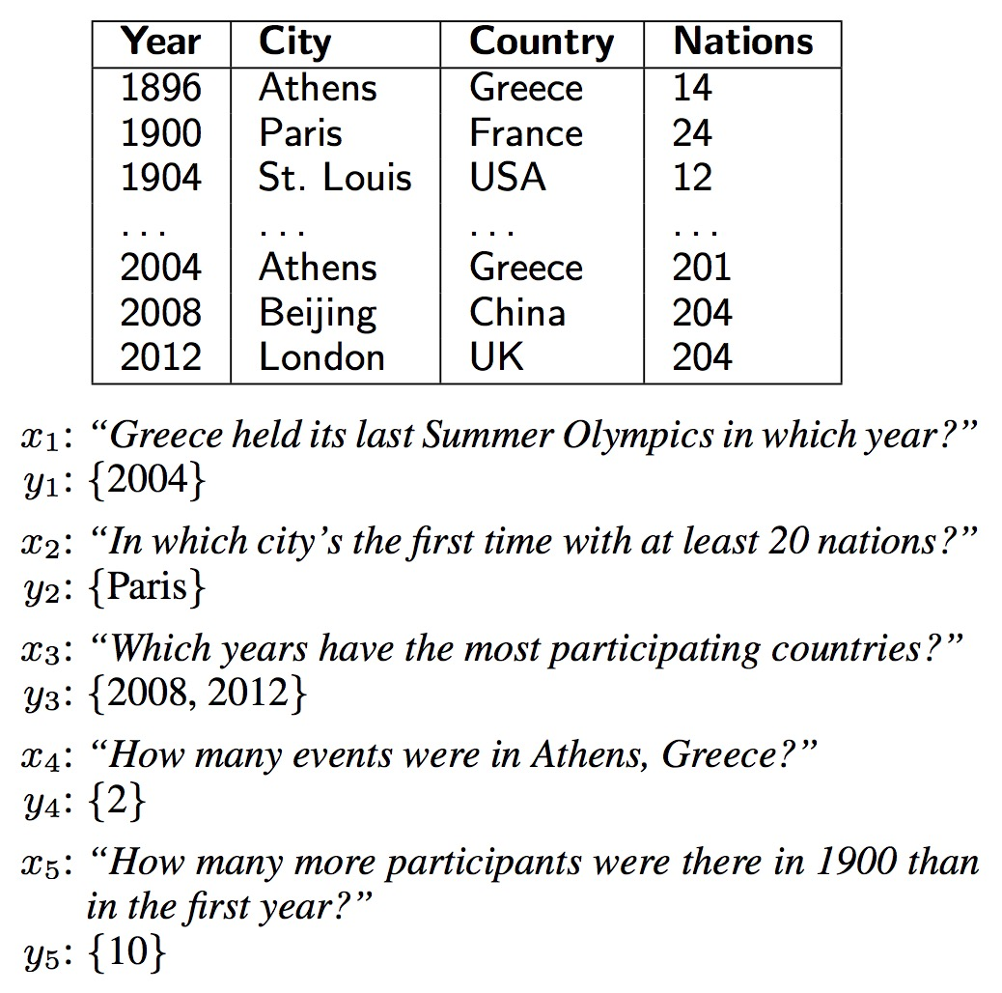
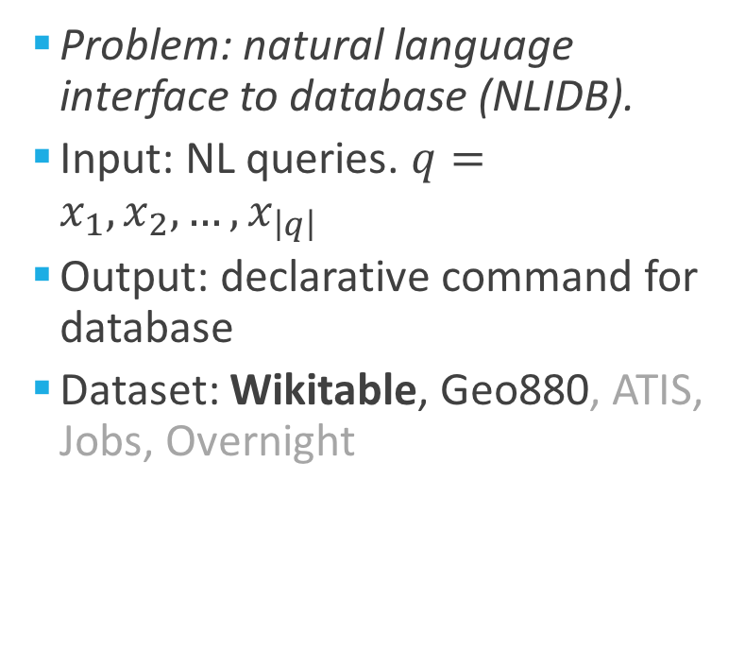
Problem Statement
Problem: natural language interface to database (NLIDB).
Input: NL queries. $q=x_{1},x_{2},…,x_{\left|q\right|}$
Output: declarative command for database
Dataset: Wikitable, Geo880, ATIS, Jobs, Overnight

Slide 2
Query Optimization (QO)
Natural Language Interface (NLI)
DBMS (search engine)
Tagging
Seq2seq Bridge Network
Schema
Correspond-ence files
where <f:1> equal <v:1> select <f:2>
Tag_query
Logical template
SQL-extended command
fields values
look up .corr files
Query
attention network
how many gold medals japan won
0. input: natural language query
1. basic preprocessing: field name/value to one string using ‘_’; number to numerical value
2. tagging process for each word in the query, generating tagged query (parallel model and X model)
3. neural translation to logical template
4. convert logical template to declarative command like SQL
5 access to the database

Slide 3
Query Optimization (Tagging)
Schema
(.fi)
Nation Rank Gold Silver Bronze Total
which nation has less than 32 gold but its bronze medals are more than 4
[‘<field>:0', 'Nation']
['<value>:1', ’32']
['<field>:1', 'Gold']
['<field>:2', 'Bronze']
['<value>:2', ’4']
Nation Gold Bronze
<nan> 32 4
<nan> <field>:0 <nan> <nan> <nan> <value>:1 <field>:1 <nan> <nan> <field>:2 <nan> <nan> <nan> <nan> <value>:2
Query
(.qu)
.ficorr
.vacorr
Tag
(.ta)
Notes:
还是先tag成统一的field name：[Nation, Rank…]，这样可以大致清楚都有什么fields，然后再label shown_up id
对于每一个发现的value，都要确定其对应的field

Slide 4
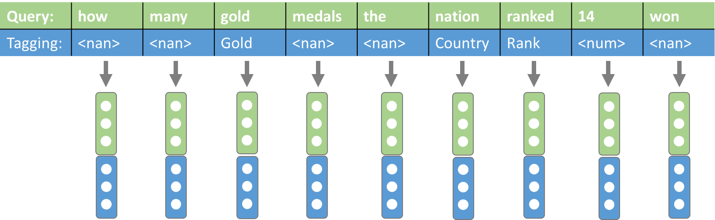
Query Optimization (Tagging)
Query
which nation has less than 32 gold but its bronze medals are more than 4
Tag
<nan> <field>:0 <nan> <nan> <nan> <value>:1 <field>:1 <nan> <nan> <field>:2 <nan> <nan> <nan> <nan> <value>:2
Tags concatenate with words in original query (Parallel model)
Meaningful tags replace the words in original query (X model)
QueryX
(.qux)
which <field>:0 has less than <value>:1 <field>:1 but its <field>:2 medals are more than <value>:2
Notes:
还是先tag成统一的field name：[Nation, Rank…]，这样可以大致清楚都有什么fields，然后再label shown_up id
对于每一个发现的value，都要确定其对应的field

Slide 5
Query Optimization (Tagging)
feature for ‘tag’ : <field:1;int>
<nan>
<field>
<value>
id
type: {int, double, string, ordinal, category…}
Identifying a <value> or <field> is relatively easy. Need to establish a correspondence between a <value> and <field>, so they have the same id.
Notes:
后期adding新的句子和问答方式：small fields with {possible paraphrases}

Slide 6
Query Optimization (Tagging)
Query
which nation has less than 32 gold but its bronze medals are more than 4
Tag
<nan> <field>:0 <nan> <nan> <nan> <value>:? <field>:1 <nan> <nan> <field>:2 <nan> <nan> <nan> <nan> <value>:?
(position, id)
[‘<field>:0', 'Nation']
['<field>:1', 'Gold']
['<field>:2', 'Bronze']
['<value>:(1/2)', ’32']
['<value>:(1/2) ', ’4']
[(6, 1), (9, 2)]
[5, 14]
Method 1: Nearest Neighbor (done, works reasonably well), HOWEVER:
when the 1st_venue was beijing and 2nd_venue was dubai, which city was the most recent 3rd_venue
Notes:
还是先tag成统一的field name：[Nation, Rank…]，这样可以大致清楚都有什么fields，然后再label shown_up id
对于每一个发现的value，都要确定其对应的field

Slide 7
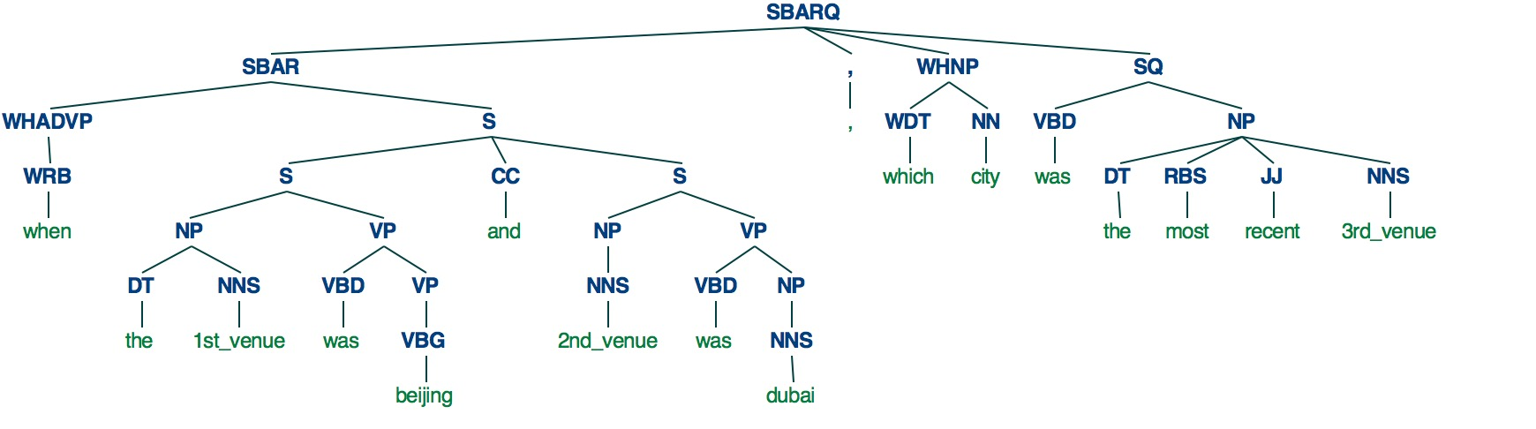
Query Optimization (Tagging)
Query
which nation has less than 32 gold but its bronze medals are more than 4
Tag
<nan> <field>:0 <nan> <nan> <nan> <value>:? <field>:1 <nan> <nan> <field>:2 <nan> <nan> <nan> <nan> <value>:?
Method 2: Dependency Tree Lowest common ancestor (nltk.stanford.StanfordParser)
when the 1st_venue was beijing and 2nd_venue was dubai, which city was the most recent 3rd_venue
Notes:
还是先tag成统一的field name：[Nation, Rank…]，这样可以大致清楚都有什么fields，然后再label shown_up id
对于每一个发现的value，都要确定其对应的field

Slide 8
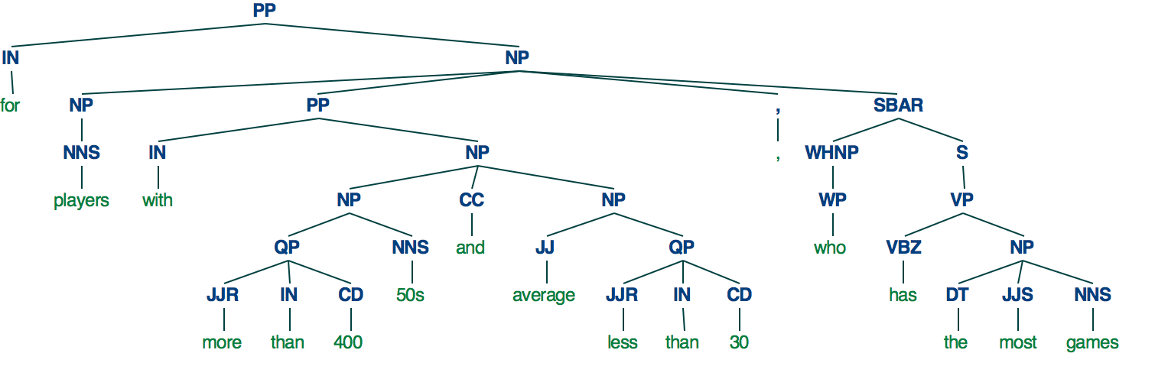
### example: 439 ###
schema: Player Matches Innings Runs Average 100s 50s Games_Played Field_Goals Free_Throws Points
query: for players with more than 400 50s and average less than 30, who has the most games
logic: argmax Player Games_Played where 50s greater 400 and Average less 30
ficorr: Player 50s Average Games_Played
vacorr: <nan> 400 30 <nan>
field position_idx: [(6, 1), (8, 2), (17, 3)]
value_position: [5, 11]
tag: <nan> <field>:0 <nan> <nan> <nan> <value>:1 <field>:1 <nan> <field>:2 <nan> <nan> <value>:2 <nan> <field>:0 <nan> <nan> <nan> <field>:3
qux: for <field>:0 with more than <value>:1 <field>:1 and <field>:2 less than <value>:2 , <field>:0 has the most <field>:3
lox: argmax <field>:0 <field>:3 where <field>:1 greater <value>:1 and <field>:2 less <value>:2

Slide 9
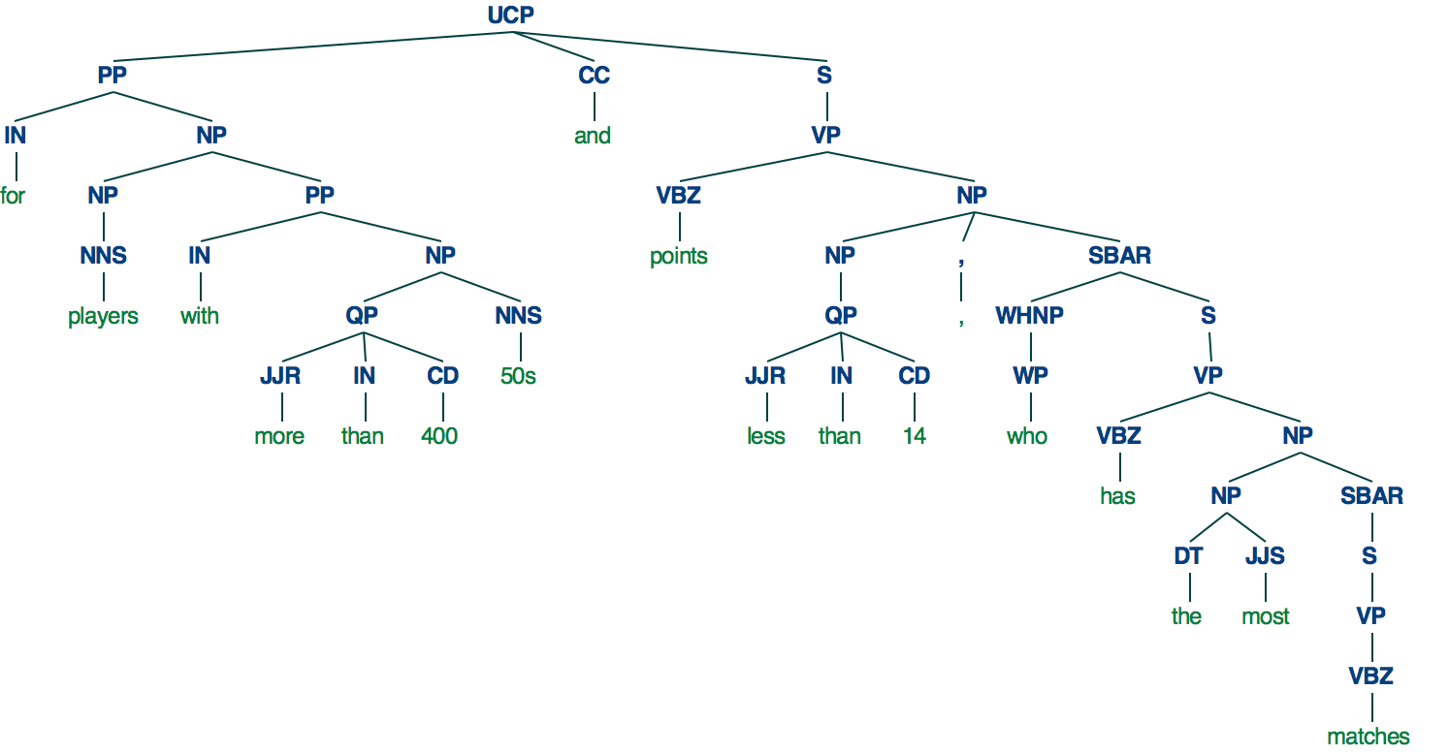
### example: 488 ###
schema: Player Matches Innings Runs Average 100s 50s Games_Played Field_Goals Free_Throws Points
query: for players with more than 400 50s and points less than 14, who has the most matches
logic: argmax Player Matches where 50s greater 400 and Points less 14
ficorr: Player 50s Points Matches
vacorr: <nan> 400 <nan> 14
field position_idx: [(6, 1), (8, 2), (17, 3)]
value_position: [5, 11]
tag: <nan> <field>:0 <nan> <nan> <nan> <value>:1 <field>:1 <nan> <field>:2 <nan> <nan> <value>:3 <nan> <field>:0 <nan> <nan> <nan> <field>:3
qux: for <field>:0 with more than <value>:1 <field>:1 and <field>:2 less than <value>:3 , <field>:0 has the most <field>:3
lox: argmax <field>:0 <field>:3 where <field>:1 greater <value>:1 and <field>:2 less <value>:3

Slide 10
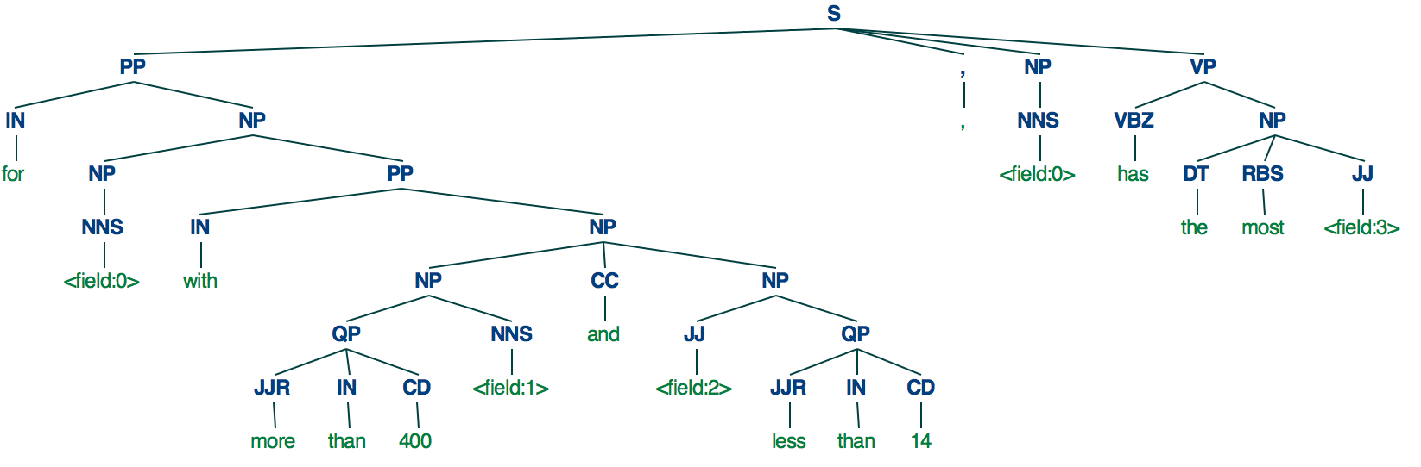
Input: for <field:0> with more than 400 <field:1> and <field:2> less than 14 , <field:0> has the most <field:3>

Slide 11
### example: 996 ###
Year 1st_Venue 2nd_Venue 3rd_Venue 4th_Venue 5th_Venue 6th_Venue
when the 1st_venue was beijing and 2nd_venue was dubai, which city was the most recent 3rd_venue
select 3rd_Venue argmax Year where 1st_Venue equal Beijing and 2nd_Venue equal Dubai
['<field>', 'Year']
['<field>', '1st_Venue']
['<field>', '2nd_Venue']
['<field>', '1st_Venue;2nd_Venue;3rd_Venue;4th_Venue']
['<field>', '3rd_Venue']
['<value>', '1st_Venue;2nd_Venue;3rd_Venue;4th_Venue']
['<value>', '1st_Venue;2nd_Venue;3rd_Venue;4th_Venue']
[(0, 0)]
[]
[(2, 1), (6, 2), (16, 4)]
[4, 8]
Year 1st_Venue 2nd_Venue 1st_Venue;2nd_Venue;3rd_Venue;4th_Venue 3rd_Venue
<nan> beijing dubai <nan> <nan>
<field>:0 <nan> <field>:1 <nan> <value>:1 <nan> <field>:2 <nan> <value>:2 <nan> <nan> <field>:3 <nan> <nan> <nan> <nan> <field>:4
<field>:0 the <field>:1 was <value>:1 and <field>:2 was <value>:2 , which <field>:3 was the most recent <field>:4
select <field>:4 argmax <field>:0 where <field>:1 equal <value>:1 and <field>:2 equal <value>:2

Slide 12
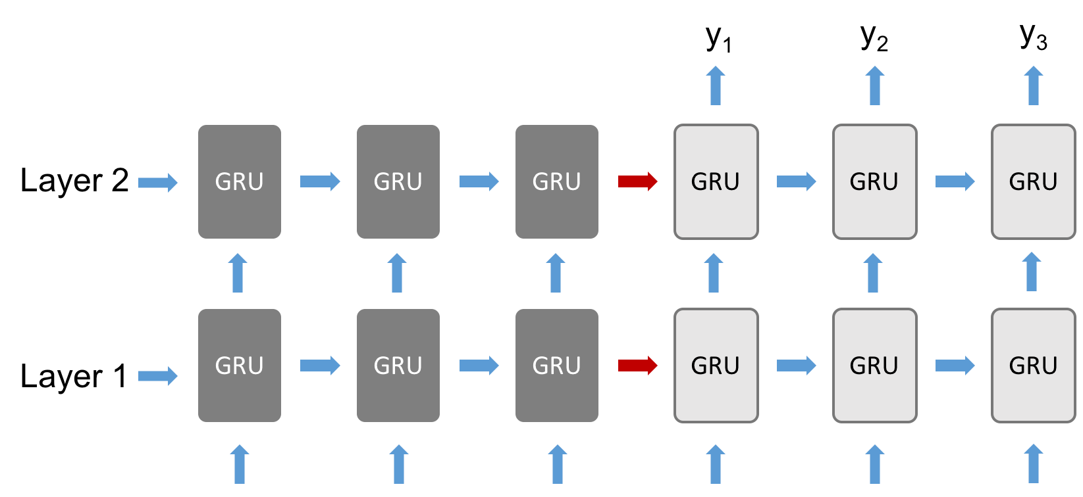


Seq2seq attention model
Natural Language Interface (Neural Translation Machine):
$$h_{t}^{l}=GRU(h_{t−1}^{l},h_{t}^{l−1})$$
$$p\left(y_{t} | y_{<t},q\right)=softmax{\left(W_{o}h_{t}^{L}\right)}^{T}e(y_{t})$$
Encoder
Decoder
Notes:
Attention-based seq2seq DNN,

Slide 13
SQL-extended command

Slide 14
Natural Language Interface (Neural Translation Machine):
Training Data: .qu, .fi, .lo files (original files); .ta, .qux, .lox files (generated through tagging process)
Logic form
(.lo)
diff A as select Silver where Nation equal italy and B as select Silver where Nation equal india
Silver Nation
<nan> italy; india
diff A as select <field>:0 where <field>:1 equal <value>:1 and B as select <field>:0 where <field>:1 equal <value>:1
.ficorr
.vacorr
Logical template
(.lox)
Tagged query
(.qu+.ta / .qux)
Natural Language Interface (NLI)
Logical template
(.lox)
Notes:
Attention-based seq2seq DNN

Slide 15
Natural Language Interface (Neural Translation Machine):
Evaluation & Converting template to logical form:
Tagged query
(.qu+.ta / .qux)
Natural Language Interface (NLI)
Logical template
(.lox)
Logical template
(.lox)
diff A as select <field>:0 where <field>:1 equal <value>:1 and B as select <field>:0 where <field>:1 equal <value>:1
Silver Nation Nation
<nan> italy india
diff A as select Silver where Nation equal italy and B as select Silver where Nation equal india
.ficorr
.vacorr
Logic form
(.lo)
Notes:
Attention-based seq2seq DNN

Slide 16
Data augmentation [5,6]
Annotate ~150 queries with corresponding 16 SQL-like logical forms based on Wikitable queries; Augment to ~4000 queries and corresponding logical forms.
Field recombination (eg. argmax Nation Gold -> argmax Nation Silver)
Field value replacement (eg. where Nation equal Romania -> where Nation equal Spain)
Synonyms replacement (eg. which nation won -> which country won)
Notes:
Logical forms

Slide 17
Natural Language Interface (Neural Translation Machine):
Tagged query
(.qu+.ta / .qux)
Natural Language Interface (NLI)
Logical template
(.lox)
Parallel Model:
global step 4400 learning rate 0.0002 step-time 0.34 perplexity 1.00
eval: bucket 0 perplexity 1.05
eval: bucket 1 perplexity 1.02
eval: bucket 2 perplexity 1.00
train accuracy: 0.773571428571
dev accuracy: 0.761666666667
test accuracy: 0.804305283757
X Model:
global step 4800 learning rate 0.0003 step-time 0.35 perplexity 1.04
eval: bucket 0 perplexity 1.09
eval: bucket 1 perplexity 1.03
eval: bucket 2 perplexity 1.01
train accuracy: 0.688571428571
dev accuracy: 0.683333333333
test accuracy: 0.696673189824
Notes:
Attention-based seq2seq DNN

Slide 18
Transfer-learning to different database

Slide 19
Reference
[1] P. Pasupat and P. Liang, Compositional semantic parsing on semi-structured tables, ACL, 2015.
[2] P. Yin, Z. Lu, H. Li and B. Kao., Neural Enquirer: learning to query tables in natural language, JCA, 2016.
[3] Arvind Neelakantan, Quoc V. Le, Mart ́ın Abadi, Andrew McCallum, and Dario Amodei. Learning a natural language interface with neural programmer. CoRR, abs/1611.08945, 2016.
[4] Li Dong and Mirella Lapata. Language to logical form with neural attention. CoRR, abs/1601.01280, 2016.
[5] Robin Jia and Percy Liang. Data recombination for neural semantic parsing. CoRR, abs/1606.03622, 2016.
[6] Xiang Zhang, Junbo Jake Zhao, and Yann LeCun. Character-level convolutional networks for text classification. In NIPS, 2015.

