Slide 1
CS551 Midterm Project Demo
Team 2
Adaptive Checkpoint in Flink

Slide 2
1.Project Overview
Motivation
Static checkpoint interval is problematic in the case of variable input rate. (Flink is configured this way which isn’t suitable for data with frequently changing input rate)
Main Goals
Implement an adaptive checkpointing mechanism. (Efficient implementation of the Flink checkpoint mechanism)
Final Expected Achievements
We would like to simulate a distributed environment on a virtual machine, in-order to compare the original Flink and our new Flink for any configuration given by the user (both stable and varying data).
We are even thinking of building a simple application which allows the user to experience the ‘Flink’ we built.

Slide 3
2.Status Update
Project Progress
Designed and a adaptive checkpointing mechanism(Done)
Implemented the basic adaptive checkpoint mechanism(Done)
Ran on the test dataset(Done)
Design and implement a new trigger mechanism of checkpoints interval changes(In Progress)
Group Task Assignment

Slide 4
3. Demonstration of working components
Dataset
We plan to develop the final job application based on Google cluster data.
We can set a serving speed factor to adjust the data generating rate at the source.
At present, we use the State Machine Example in the flink-examples directory as our test program
This test program defines several events and randomly generate these events for state changing in Flink streaming processing.
So the source data generating rate tends to be a constant, the adaptive checkpoint strategy will set the checkpoint period based on that rate.

Slide 5
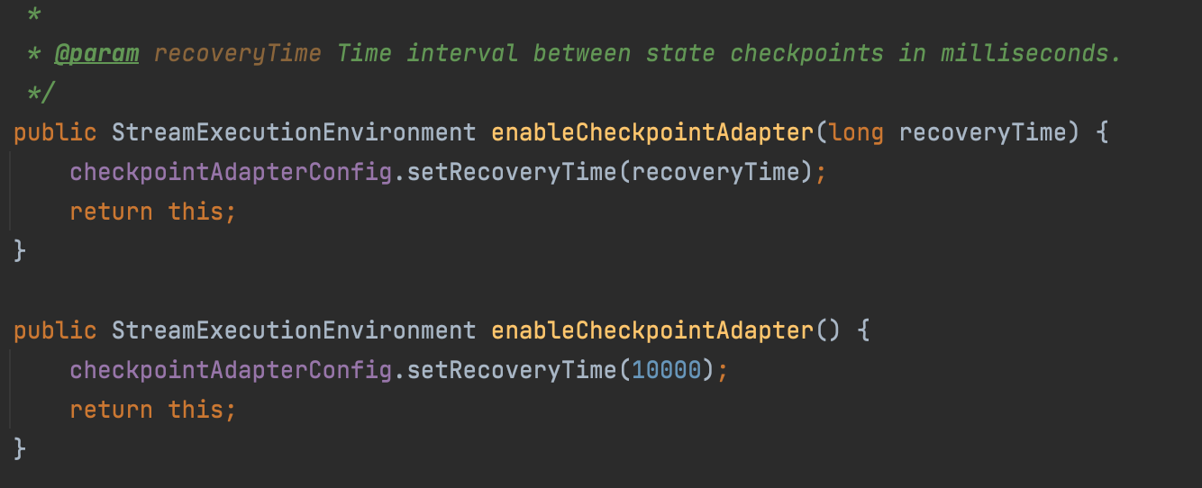
2. system components
org/apache/flink/streaming/api/environment/StreamExecutionEnvironment.java

Slide 6
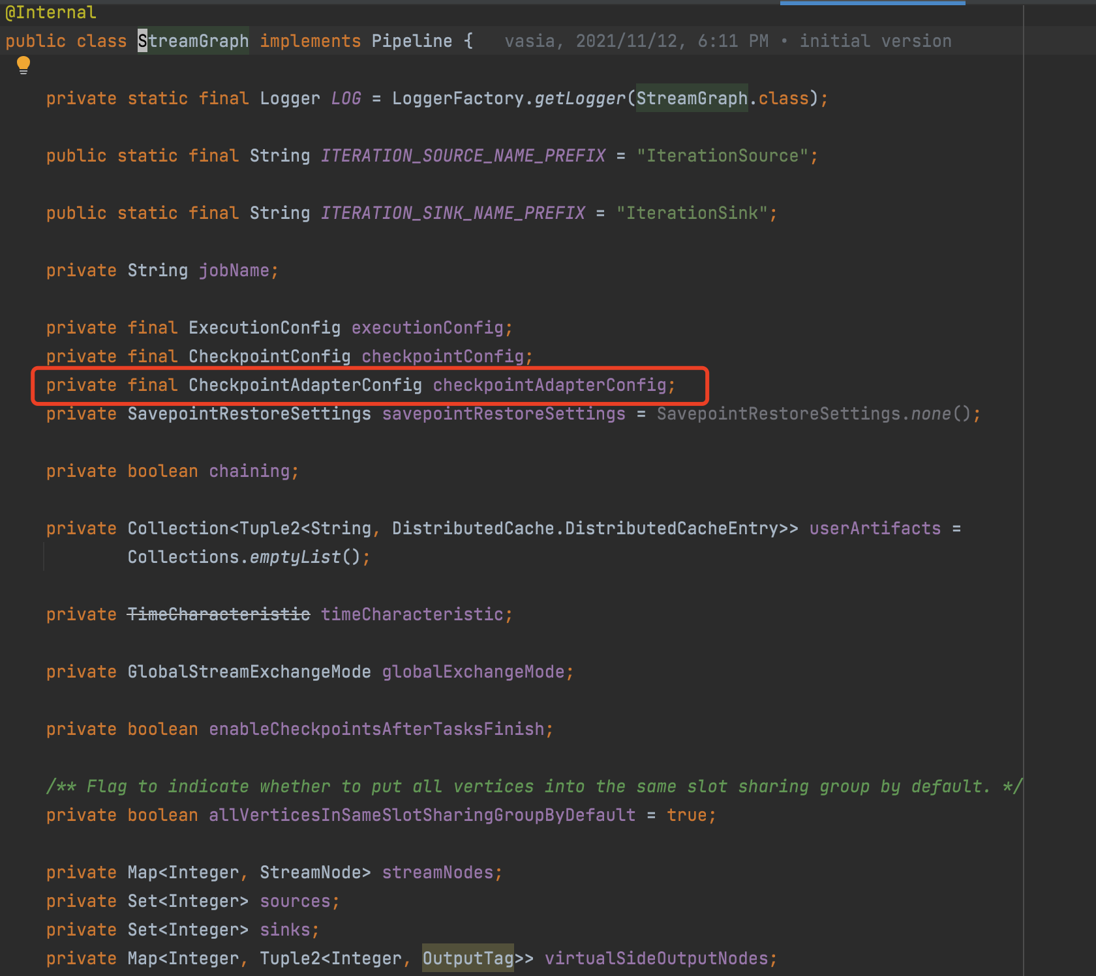
org/apache/flink/streaming/api/graph/StreamGraph.java

Slide 7
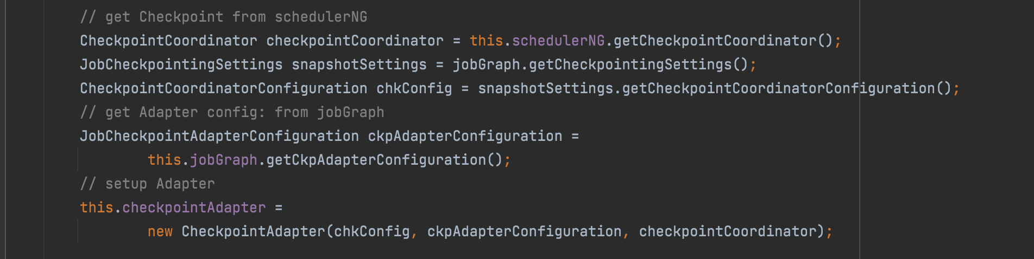
org/apache/flink/runtime/jobmaster/JobMaster.java

Slide 8
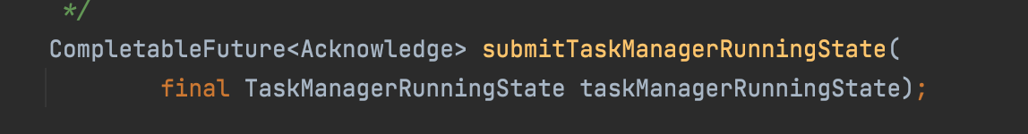
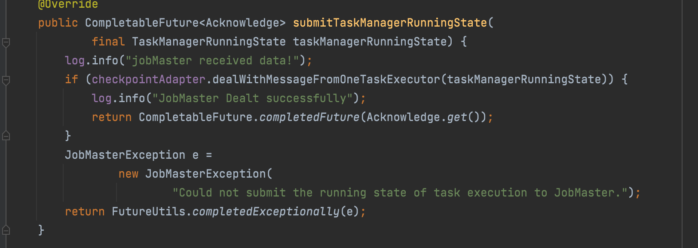
org/apache/flink/runtime/jobmaster/JobMasterGateway.java
org/apache/flink/runtime/jobmaster/JobMaster.java

Slide 9
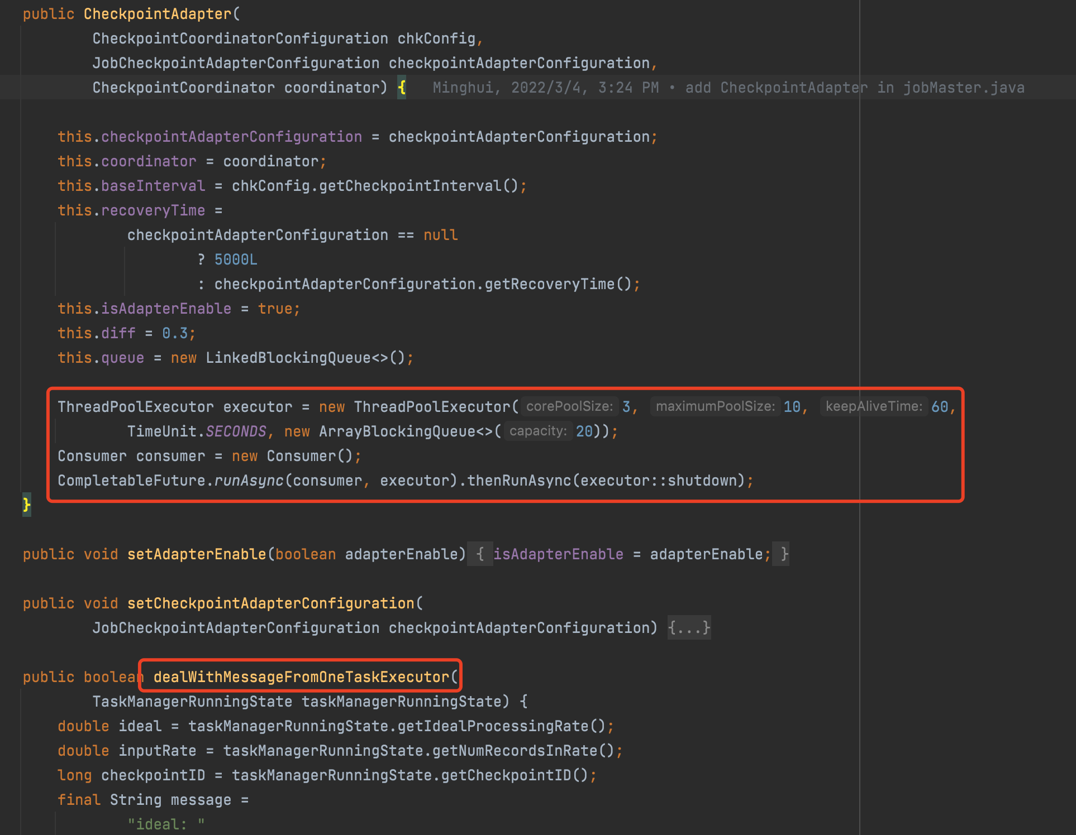
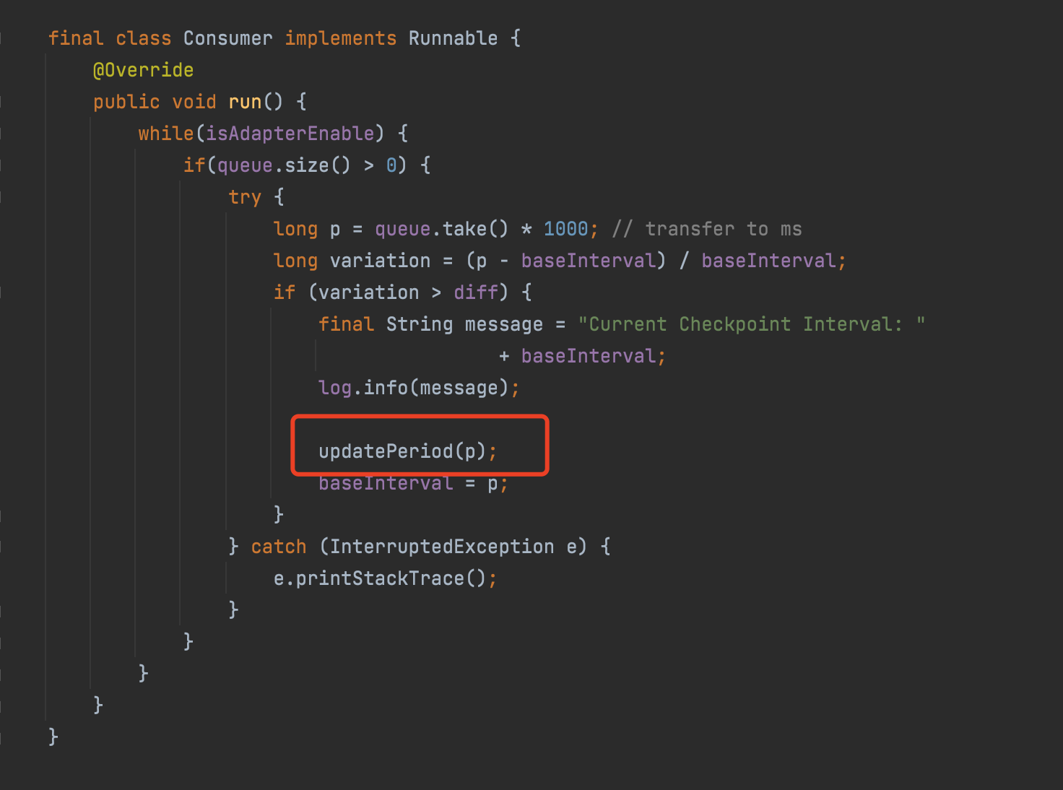
org/apache/flink/runtime/jobmaster/CheckpointAdapter.java
org/apache/flink/runtime/jobmaster/CheckpointAdapter.java

Slide 10
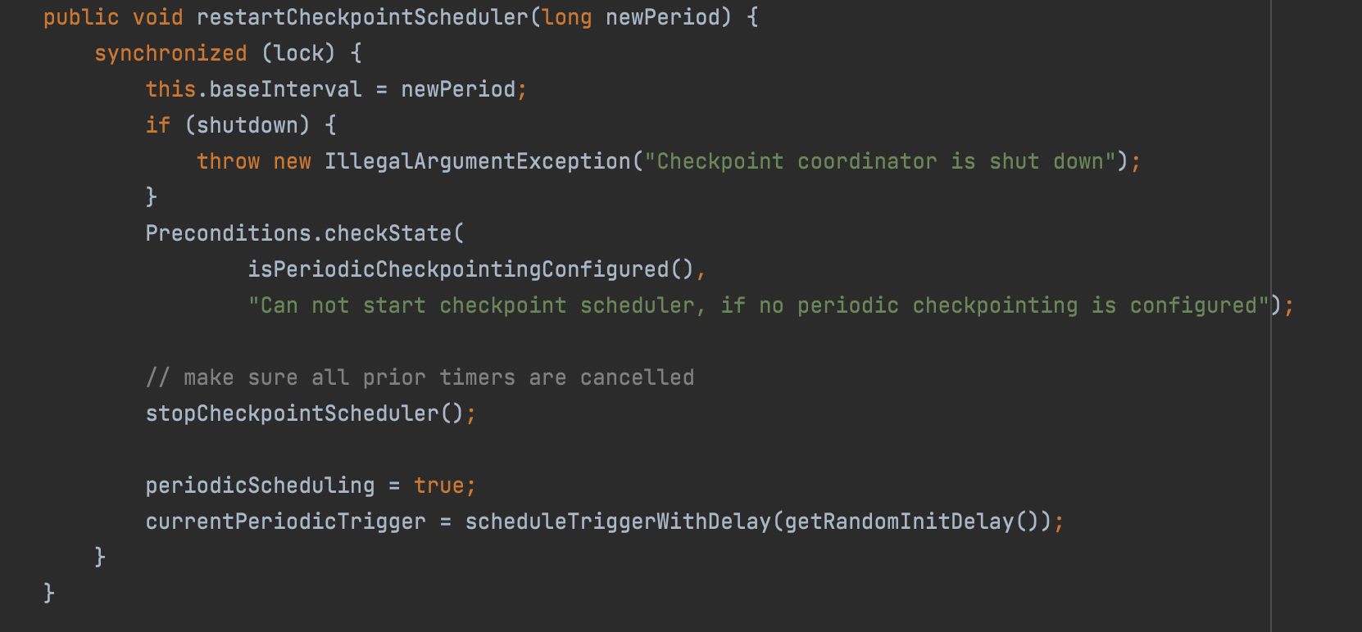
org/apache/flink/runtime/checkpoint/CheckpointCoordinator.java

Slide 11
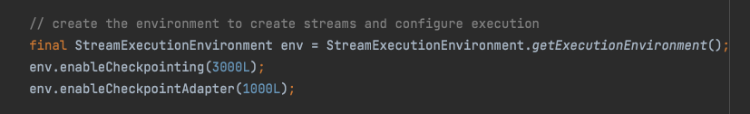
3. experiment & test
set the initial checkpoint interval
set the tolerant time as 1000ms

Slide 12
4. Challenges
Job application runs on custom Flink
- create a independent project, edit .pom file to modify the <dependencies>, set <scope> as 'system', set <SystemPath> as the local .jar file path after running Flink building command. And then build the .jar file for this job application and runs it. (didn't work)
- directly modifies the code in flink-examples directory, and after running the Flink building command, the job jar file will be automatically created in the build-target/examples/streaming directory. If we want to add new project, modify the .pom file in flink-examples-streaming by creating new xml <execution> and <plugin> for compilation.

Slide 13
5. Future Work
Experimented to get a more accurate threshold ex. For now the threshold is set to be 30%, which means if the new period is in this range, the checkpoint will not be restarted. We do more experiments to figure out a more reasonable threshold in the future.
The timing of collecting metrics.
Deployed with Hadoop Distributed File System. Extend the policy to further take into account the end-to-end recovery time.

