Slide 1

MisAmplifiers: A public tool to identify hidden super-amplifiers of misinformation
Filippo Menczer, Matt DeVerna, Rachith Aiyappa, John Bryden

Slide 2
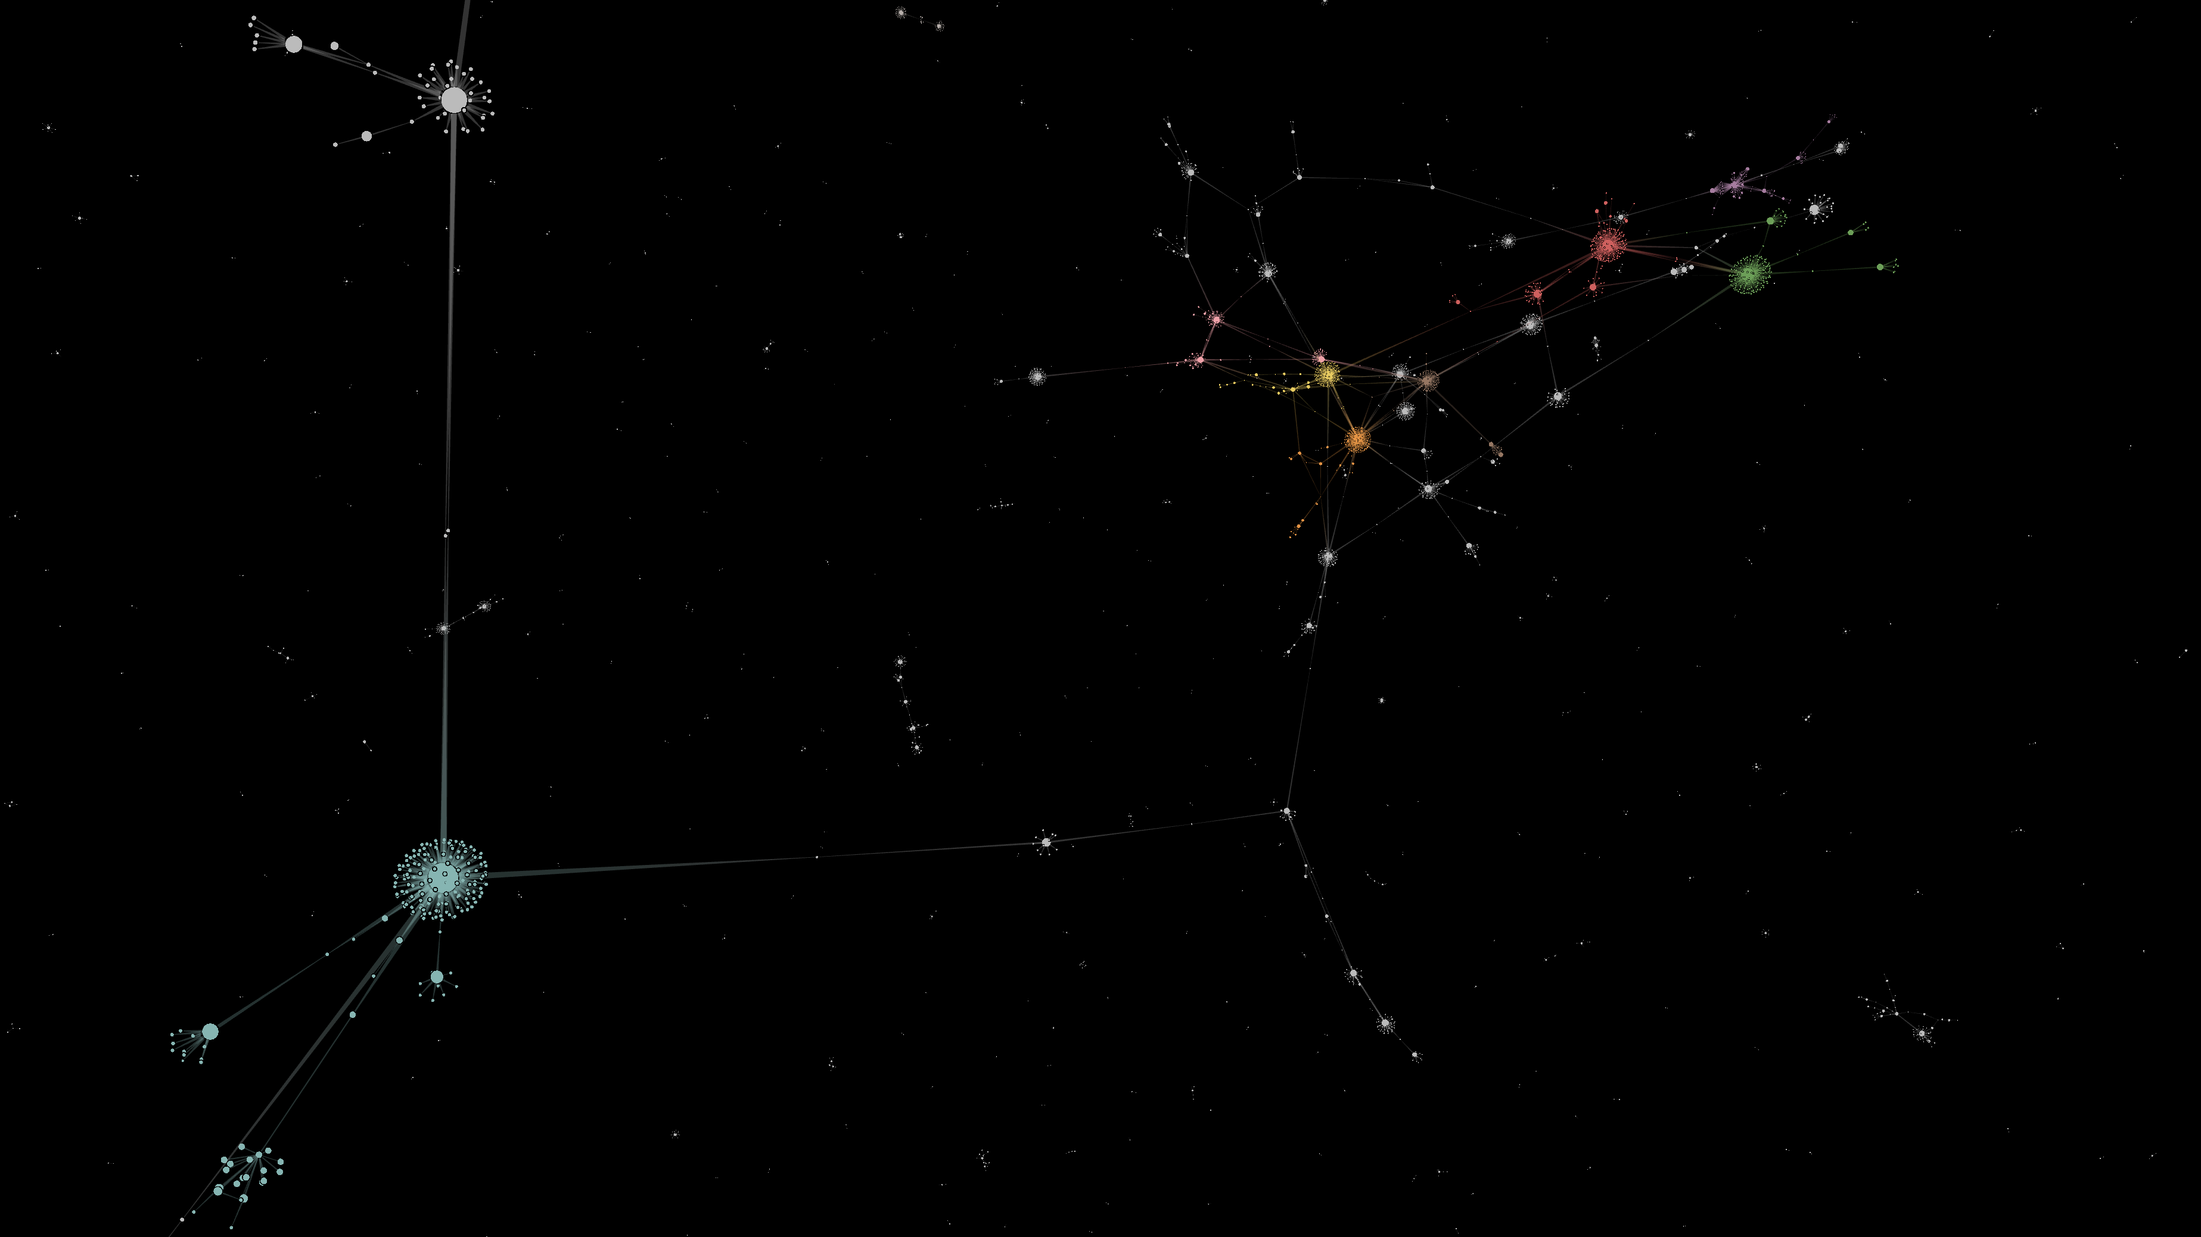




Time

Slide 3



Time

Slide 4
Demo

Slide 5
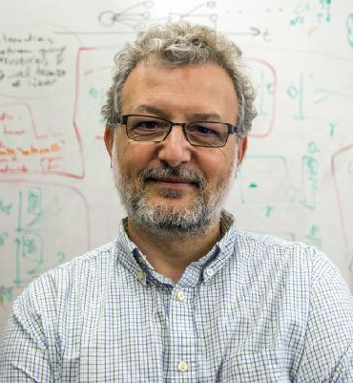



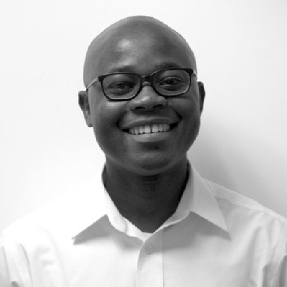
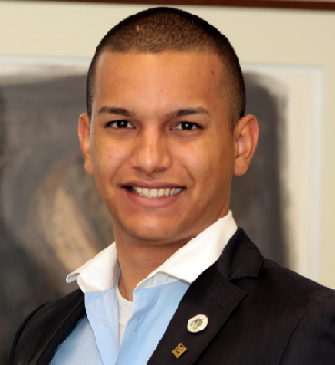


Thank you
Questions?

