Slide 1
PyShip Easily Ship your Python Apps to End Users
James Abel
Oct 8, 2020
j@abel.co @jamesabel www.abel.co

Slide 2

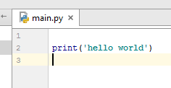
Project Goals
Easily provide Python desktop apps to end users
Works with virtually any modern Python application (and required libraries)
No assumption of pre-installed Python interpreter or environments
Application can update itself in the background (no user intervention required)
Native application (e.g. .exe for Windows)
Supports Windows. Architecture extensible to other populator OSs (e.g. MacOS, Linux)
http://manicallydepressedmoderatelyfunny.blogspot.com/2015/01/halo-5-beta-livedierepeat.html

Slide 3
PyShip High Level Architecture
Your Python Application
package with setup.py, flit, etc.
runnable as “main module” with python –m <module>
Create your Python application
Package your application as a wheel
Run pyship to create installer
Release installer to users
Update as desired
Distribution wheel (.whl file)
PyShip
clip (Complete Location Independent Python)
(Embedded) Python Interpreter +
Your App (main module) +
Required Packages
Installer Tool
NSIS (Windows)
Installer
Native Launcher

Slide 4
Application development
Develop Python app as usual
GUI or CLI
End user apps are usually GUIs, but can be CLIs
Executable as “main module” (python –m <module>)
Normal development and debug
Packaged as a wheel (i.e. installable via pip)
Defines requirements
Pyship Works With Normal Python Application Development

Slide 5
clip (Complete Location Independent Python)
Key architectural aspect of PyShip
Full Python environment in a separate relocatable directory
Uses “Embedded” Python (available since Python 3.5)
Some “fixups” required
Install and upgrade pip
Install tkinter
Patch zipimporter
Your application (as a wheel) is installed into the lip
pyship also installs its dependencies
Result is a self-contained application that executes from a location independent directory
Modular development aids testing

Slide 6
Launcher
Native OS application (.exe for Windows)
Small application that executes the target application from the clip
clip can also be installed into the OS “data” area for updates
Facilitates autonomous application updates
Written in Python
Frozen with pyinstaller to create an .exe and associated files
Notes:
pyinstaller learning: “single binary” startup time is long

Slide 7
Installer
clip + launcher → desktop app
Uses the NSIS installer utility
PyShip writes an “nsis” file for the target application
PyShip runs NSIS to create a Windows installer

Slide 8
Application Updates (optional)
clip is versioned (e.g. directory is <app>_<version>)
Launcher looks for and runs the highest version (using semantic versioning)
pyship creates new clip versions and uploads to the cloud (e.g. AWS)
Updating is under application control
Poll cloud for all available versions
If new version available, download to user data area
App exits with a “restart” code and is rerun to use the updated clip

Slide 9
Example application
pyshipexample
https://github.com/jamesabel/pyshipexample
Learn to use pyship by example

Slide 10
PyShip release
Open Source at https://github.com/jamesabel/pyship
Released to PyPI
pip install pyship

Slide 11
Status/Next Steps
Status
PyShip v0.0.9 recently released
Successfully used on 2 applications
Next Steps
Release autonomous update capability
Documentation
Beta testing
Windows application signing
Increase code coverage
MacOS support
Populate https://www.pyship.org/

Slide 12
BACKUP

Slide 13
Thank You
Thomas Kluyver ( pynsist )
Glyph (presentations, discussions)

Slide 14
Related Tools
cx_freeze
py2exe
py2app
briefcase
pyinstaller
pynsist

Slide 15
OSNAP is simplistic …
Leverages embedded Python builds for Windows and OSX
Python is “embedded” into the launcher
Not too complex
Native Launchers – 82 lines of Python (not C) code
Both Windows and Mac
osnapy (independent Python interpreter w/packages) – 80 lines of code
Installers - ~300 total lines of code (both Windows and Mac)
Installer (what’s shipped) is kind of big. Test case:
87 MB on Windows
132 MB on Mac
(Note: I’m not trying to replace the existing freezing/app creation tools. They are mature and often work quite well. I’m merely offering an alternative for cases that have additional requirements.)

Slide 16
Why is it “overly simplistic”?
The installer (what you ship to users) is kind of big – even for the small test case:
132 MB for OS X
87 MB for Windows
Just for reference, iTunes installers are:
242 MB for OS X (our example app is 55% of that)
122 MB for Windows (our example app is 71% of that)
With care our installer size should be able to be reduced
Also it’s simplistic since our launcher is also written in Python
Created with py2exe and py2app
Is a simple native program that just executes main

Slide 17
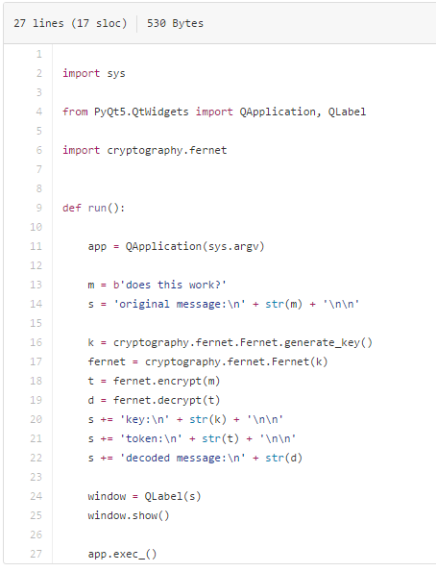
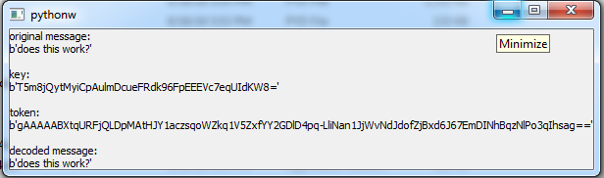
Minimal But Effective Test Case

Slide 18

c:\temp>testcase.exe
Traceback (most recent call last):
File "testcase.py", line 26, in <module>
File “c:\James\Projects\cryptographybugtestcase\core\crypto.py", line 17, in encrypt
File "c:\python34\lib\site-packages\cryptography\fernet.py", line 51, in encrypt
File "c:\python34\lib\site-packages\cryptography\fernet.py", line 61, in _encrypt_from_parts
File "c:\python34\lib\site-packages\cryptography\hazmat\primitives\ciphers\base.py", line 43, in encryptor
File "c:\python34\lib\site-packages\cryptography\hazmat\backends\multibackend.py", line 57, in create_symmetric_encryption_ctx
cryptography.exceptions.UnsupportedAlgorithm: cipher AES in CBC mode is not supported by this backend.
https://memegenerator.net/instance/58809918

Slide 19
The launcher
Written in Python (to keep it easy to write)
Use py2exe (Windows) and py2app (Mac) to create the native apps
Just does a osnapy/bin/python main.py
See test_example

Slide 20
PyShip Architecture
complete native application
Your Python Application
lip (Location Independent Python)
Installer Tool
(NSIS for Windows)
Native Installer (Windows .exe)
Complete (Embedded) Python Interpreter
+
Required Packages
Create a normal venv
Install osnap package into that venv
Create osnapy (embedded Python interpreter)
Add required packages into osnapy
Develop your application
Create and deploy installer
Native Launcher

