Slide 2
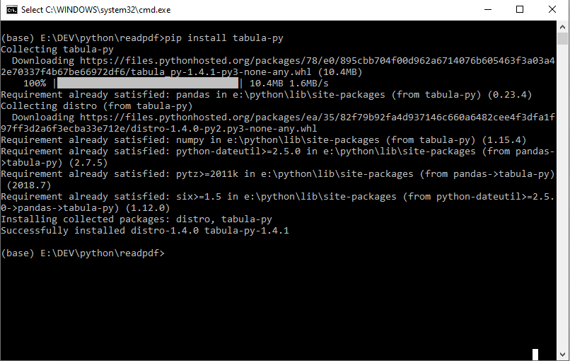
GitHub - chezou/tabula-py: Simple wrapper of tabula-java: extract table from PDF into pandas DataFrame

