Slide 1


Regression
Presented By: Lokesh Kumar

Slide 2

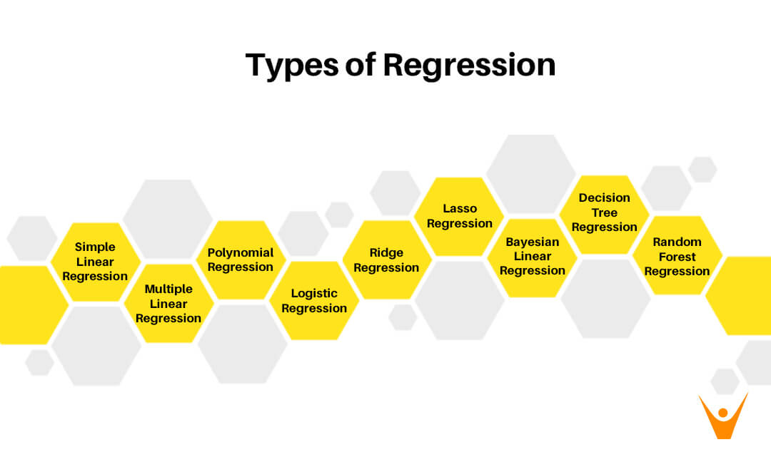
Our Agenda
Regression and

Slide 3
Introduction
Regression is a statistical method used in finance, investing, and other disciplines that attempts to determine the strength and character of the relationship between one dependent variable (usually denoted by Y) and a series of other variables (known as independent variables)
Regression" comes from "regress" which in turn comes from latin "regressus" - to go back (to something). In that sense, regression is the technique that allows "to go back" from messy, hard to interpret data, to a clearer and more meaningful model.

Slide 4
Terminologies Related to the Regression Analysis:
Dependent Variable: The main factor in Regression analysis which we want to predict or understand is called the dependent variable. It is also called target variable.
Independent Variable: The factors which affect the dependent variables or which are used to predict the values of the dependent variables are called independent variable, also called as a predictor.
Outliers: Outlier is an observation which contains either very low value or very high value in comparison to other observed values. An outlier may hamper the result, so it should be avoided.
Multicollinearity: If the independent variables are highly correlated with each other than other variables, then such condition is called Multicollinearity. It should not be present in the dataset, because it creates problem while ranking the most affecting variable.
Underfitting and Overfitting: If our algorithm works well with the training dataset but not well with test dataset, then such problem is called Overfitting. And if our algorithm does not perform well even with training dataset, then such problem is called underfitting.

Slide 5
Why to use ?
Regression analysis helps in the prediction of a continuous variable. There are various scenarios in the real world where we need some future predictions such as weather condition, sales prediction, marketing trends, etc., for such case we need some technology which can make predictions more accurately. So for such case we need Regression analysis which is a statistical method and used in machine learning and data science. Below are some other reasons for using Regression analysis:
Regression estimates the relationship between the target and the independent variable.
It is used to find the trends in data.
It helps to predict real/continuous values.
By performing the regression, we can confidently determine the most important factor, the least important factor, and how each factor is affecting the other factors.

Slide 6
Types of Regression

Slide 7
Linear Regression
Linear regression is a statistical regression method which is used for predictive analysis.
It is one of the very simple and easy algorithms which works on regression and shows the relationship between the continuous variables.
Linear regression shows the linear relationship between the independent variable (X-axis) and the dependent variable (Y-axis), hence called linear regression.
If there is only one input variable (x), then such linear regression is called simple linear regression. And if there is more than one input variable, then such linear regression is called multiple linear regression.
The relationship between variables in the linear regression model can be explained using the below image. Here we are predicting the salary of an employee on the basis of the year of experience.

Slide 8
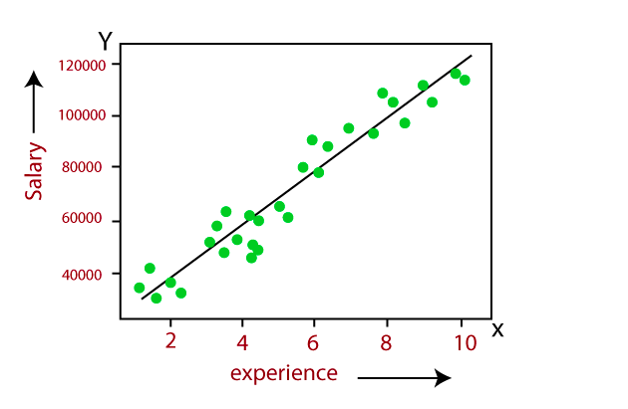

Slide 9
Expression
Y= aX+b
Here, Y = dependent variables (target variables),
X= Independent variables (predictor variables),
a and b are the linear coefficients

Slide 10
Points to keep in mind:
Note that a simple linear regression model is more susceptible to outliers hence; it should not be used in the case of big-size data.
There should be a linear relationship between independent and dependent variables.
There is only one independent and dependent variable.
The type of regression line: a best fit straight line.

Slide 11
Multiple linear regression
Simple linear regression allows a data scientist or data analyst to make predictions about only one variable by training the model and predicting another variable. In a similar way, a multiple regression model extends to several more than one variable.

Slide 12
expression
​
yi=β0 +β1​xi1​+β2 x i2 ​+...+βp x ip​+ϵ
where, for i=n observations:
y=dependent variable
x=explanatory variables
β0=y-intercept (constant term)
βp=slope coefficients for each explanatory variable
ϵ=the model’s error term (also known as the residuals)
​

Slide 13
Points to keep in mind:
Multiple regression shows these features multicollinearity, autocorrelation, heteroscedasticity.
Multicollinearity increases the variance of the coefficient estimates and makes the estimates very sensitive to minor changes in the model. As a result, the coefficient estimates are unstable.
In the case of multiple independent variables, we can go with a forward selection, backward elimination, and stepwise approach for feature selection.

Slide 14
Polynomial Regression
Polynomial Regression is a type of regression which models the non-linear dataset using a linear model.
It is similar to multiple linear regression, but it fits a non-linear curve between the value of x and corresponding conditional values of y.
Suppose there is a dataset which consists of datapoints which are present in a non-linear fashion, so for such case, linear regression will not best fit to those datapoints. To cover such datapoints, we need Polynomial regression.
In Polynomial regression, the original features are transformed into polynomial features of given degree and then modeled using a linear model. Which means the datapoints are best fitted using a polynomial line.

Slide 15
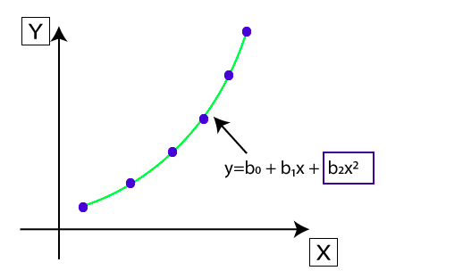

Slide 16
Points to keep in mind:
In order to fit a higher degree polynomial to get a lower error, can result in overfitting. To plot the relationships to see the fit and focus to make sure that the curve fits according to the nature of the problem.

Slide 17
Logistic Regression
Logistic regression is another supervised learning algorithm which is used to solve the classification problems. In classification problems, we have dependent variables in a binary or discrete format such as 0 or 1.
Logistic regression algorithm works with the categorical variable such as 0 or 1, Yes or No, True or False, Spam or not spam, etc.
It is a predictive analysis algorithm which works on the concept of probability.
Logistic regression is a type of regression, but it is different from the linear regression algorithm in the term how they are used.
Logistic regression uses sigmoid function or logistic function which is a complex cost function. This sigmoid function is used to model the data in logistic regression. The function can be represented as:

Slide 18
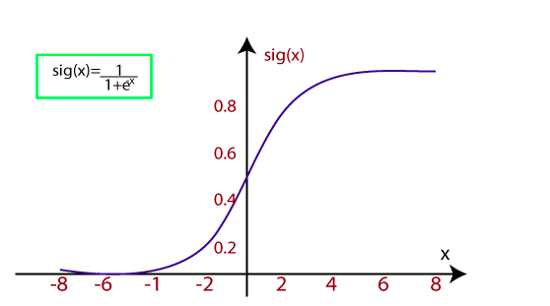
f(x)= 1/ (1+e^-x)
f(x)= Output between the 0 and 1 value.
x= input to the function
e= base of natural logarithm.
When we provide the input values (data) to the function, it gives the S-curve as follows:
It uses the concept of threshold levels, values above the threshold level are rounded up to 1, and values below the threshold level are rounded up to 0.

Slide 19
Ridge Regression
Ridge regression is one of the most robust versions of linear regression in which a small amount of bias is introduced so that we can get better long term predictions.
The amount of bias added to the model is known as Ridge Regression penalty. We can compute this penalty term by multiplying with the lambda to the squared weight of each individual features.
A general linear or polynomial regression will fail if there is high collinearity between the independent variables, so to solve such problems, Ridge regression can be used.
Ridge regression is a regularization technique, which is used to reduce the complexity of the model. It is also called as L2 regularization.
It helps to solve the problems if we have more parameters than samples.

Slide 20
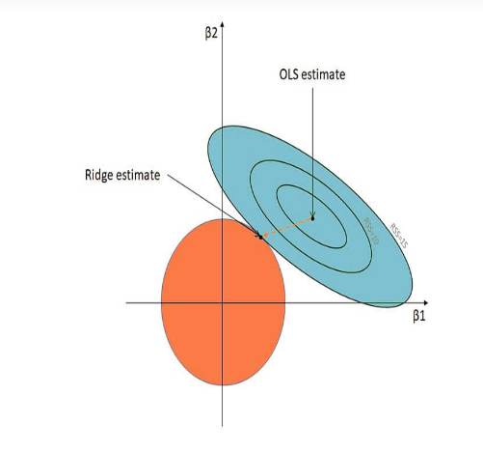
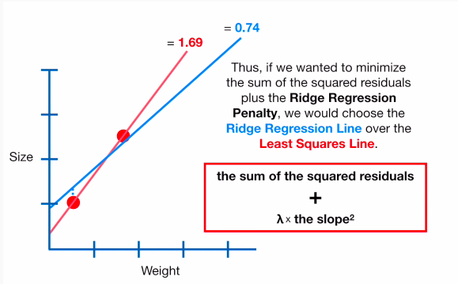
Below is the equation used to denote the Ridge Regression, λ (lambda) resolves the multicollinearity issue:
β = (X′X+λI)^−1 (X′Y)

Slide 21
Lasso Regression
The full form of LASSO is the Least Absolute Shrinkage and Selection Operation. As the name suggests, LASSO uses the “shrinkage” technique in which coefficients are determined, which get shrunk towards the central point as the mean.
The LASSO regression in regularization is based on simple models that posses fewer parameters. We get a better interpretation of the models due to the shrinkage process. The shrinkage process also enables the identification of variables strongly associated with variables corresponding to the target.

Slide 22

Lasso regression is another regularization technique to reduce the complexity of the model.
It is similar to the Ridge Regression except that penalty term contains only the absolute weights instead of a square of weights.
Since it takes absolute values, hence, it can shrink the slope to 0, whereas Ridge Regression can only shrink it near to 0.
It is also called as L1 regularization. The equation for Lasso regression will be:

Slide 23
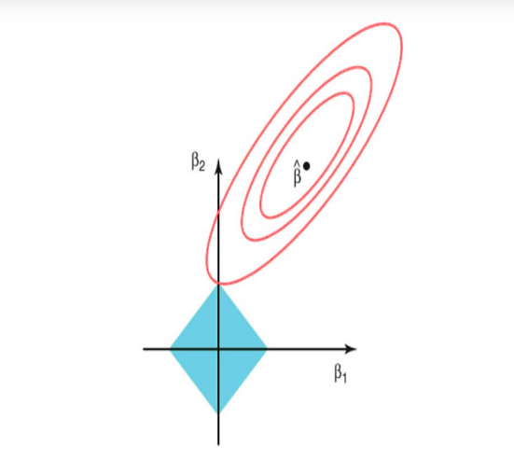
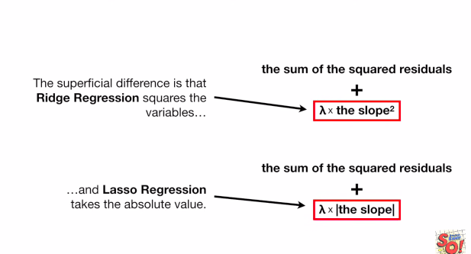

Slide 24
Bayesian Linear Regression
Bayesian Regression is used to find out the value of regression coefficients. In Bayesian linear regression, the posterior distribution of the features is determined instead of finding the least-squares. Bayesian Linear Regression is a combination of Linear Regression and Ridge Regression but is more stable than simple Linear Regression.

Slide 25
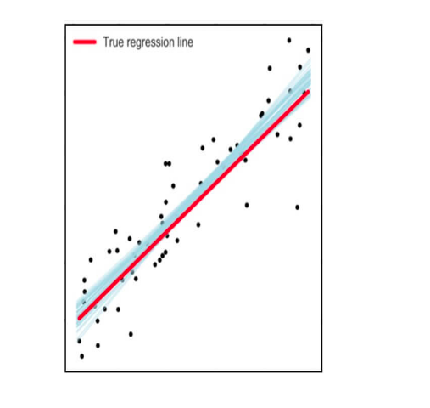

Slide 26
Decision Tree Regression
The decision tree as the name suggests works on the principle of conditions. It is efficient and has strong algorithms used for predictive analysis. It has mainly attributed that include internal nodes, branches, and a terminal node.
Every internal node holds a “test” on an attribute, branches hold the conclusion of the test and every leaf node means the class label. It is used for both classifications as well as regression which are both supervised learning algorithms. Decisions trees are extremely delicate to the information they are prepared on — little changes to the preparation set can bring about fundamentally different tree structures.

Slide 27
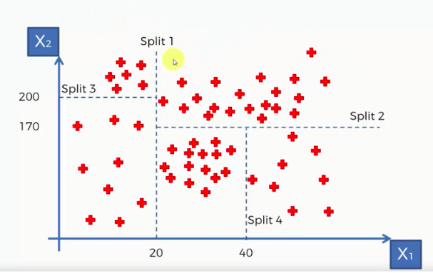

Slide 28
Random Forest Regression
Random forest, as its name suggests, comprises an enormous amount of individual decision trees that work as a group or as they say, an ensemble. Every individual decision tree in the random forest lets out a class prediction and the class with the most votes is considered as the model's prediction.
Random forest uses this by permitting every individual tree to randomly sample from the dataset with replacement, bringing about various trees. This is known as bagging.

Slide 29
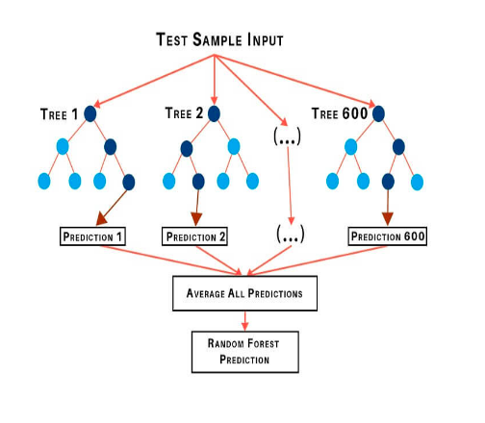

Slide 30
How to select the right regression model?
Each type of regression model performs differently and the model efficiency depends on the data structure. Different types of algorithms help determine which parameters are necessary for creating predictions. There are a few methods to perform model selection.
Adjusted R-squared and predicted R-square: The models with larger adjusted and predicted R-squared values are more efficient. These statistics can help you avoid the fundamental problem with regular R-squared—it always increases when you add an independent variable. This property can lead to more complex models, which can sometimes produce misleading results.
Adjusted R-squared increases when a new parameter improves the model. Low-quality parameters can decrease model efficiency.
Predicted R-squared is a cross-validation method that can also decrease the model accuracy. Cross-validation partitions the data to determine whether the model is a generic model for the dataset.

Slide 31
2. P-values for the independent variables: In regression, smaller p-values than significance level indicate that the hypothesis is statistically significant. “Reducing the model” is the process of including all the parameters in the model, and then repeatedly removing the term with the highest non-significant p-value until the model contains only significant weighted terms.
3. Stepwise regression and Best subsets regression: The two algorithms that we discussed for automated model selection that pick the independent variables to include in the regression equation. When we have a huge amount of independent variables and require a variable selection process, these automated methods can be very helpful.

Slide 32
Conclusion
The different types of regression analysis in data science and machine learning discussed in this presentation can be used to build the model depending upon the structure of the training data in order to achieve optimum model accuracy.

Slide 33
Thank You !
Get in touch with us:
Lorem Studio, Lord Building
D4456, LA, USA

