Slide 1






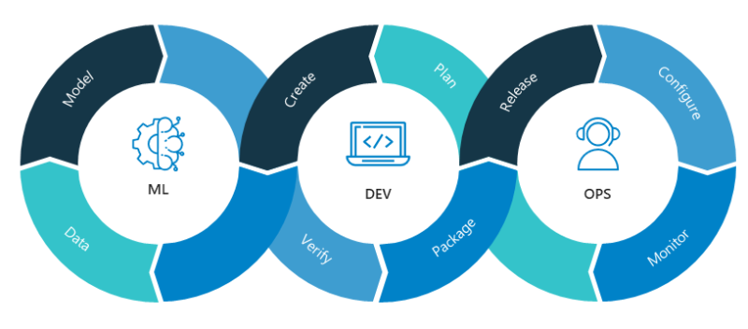
Infrastructure Provisioning
Model Development
Model Training
Model Deployment
Model Serving

