Slide 1
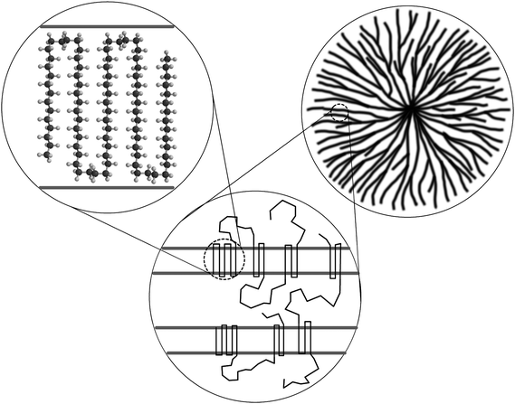
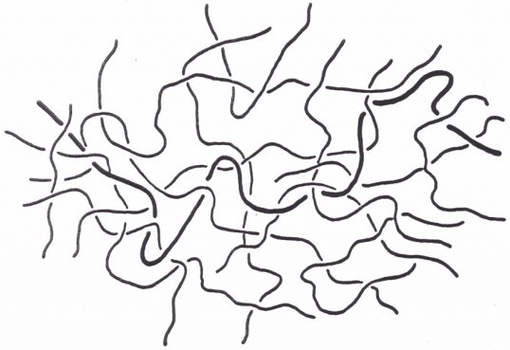
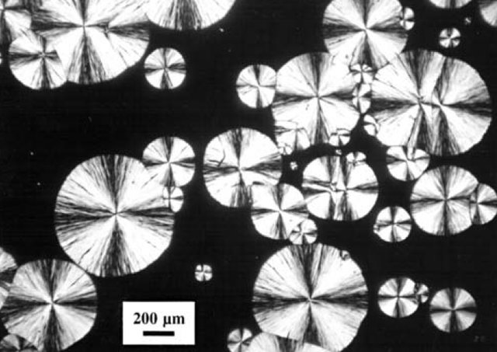
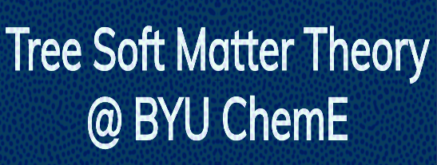

Pierre Kawak
Brigham Young University
Primary Nucleation
Secondary Nucleation
Coarsening
Amorphous Melt
Lamellar Crystal
Spherulite
Semicrystalline Materials
Winkler, Anders & Kloosterman, Gertjan. (2015). A critical review of fracture mechanics as a tool for multiaxial fatigue life prediction of plastics. Frattura ed Integrita Strutturale. 9.
https://polymerinnovationblog.com/polymers-electronic-packaging-types-polymers-used/
S. T. Milner, “Polymer crystal-melt interfaces and nucleation in polyethylene,” Soft Matter, vol. 7, no. 6, pp. 2909–2917, 2011.
Notes:
Crystallization is a multistep process
Two activated processes:
Nucleation of crystal nucleus
Growth by adding more segments
Polymers fold into lamella
Spherulites intermixed with amorphous regions

Slide 2
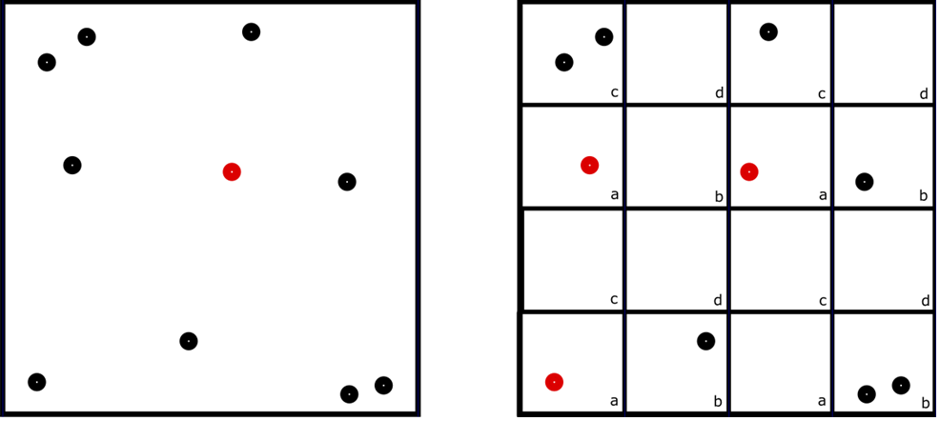
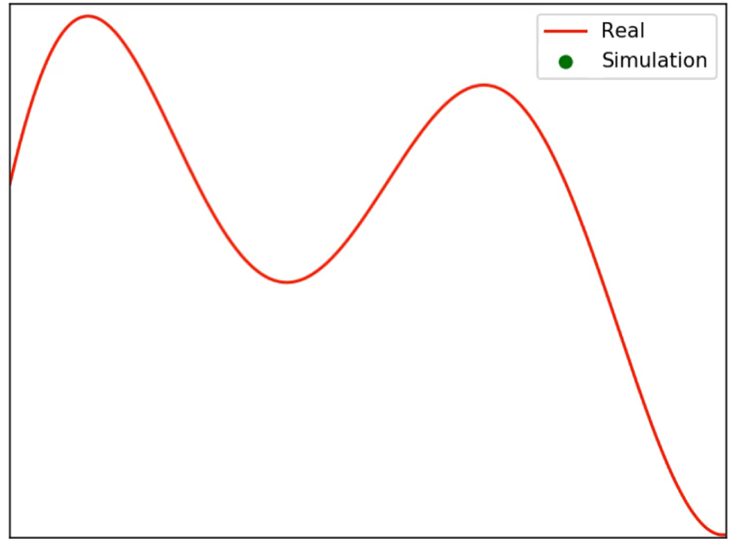

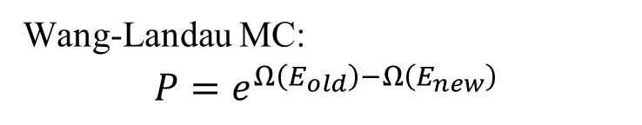
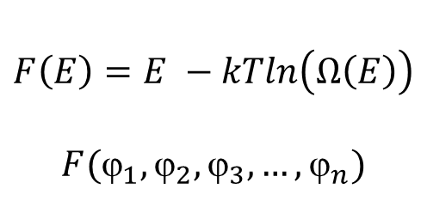
Pierre Kawak
Brigham Young University
Gibbs
Free Energy
Energy

Slide 3
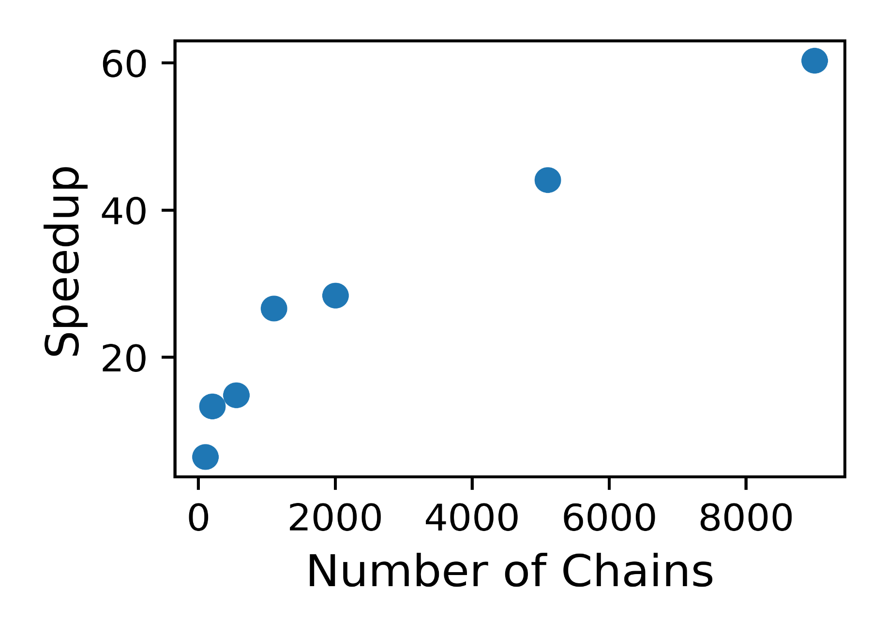
Pierre Kawak
Brigham Young University
Wang-Landau sampling
Less wallclock time
More computational complexity
Polymers are difficult to simulate because of kinetic constraints
Memory and function optimization are important

