Slide 1
Well- architecture framework

Slide 2
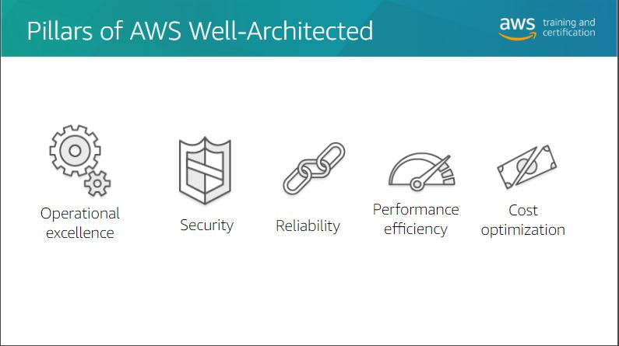
`

Slide 3
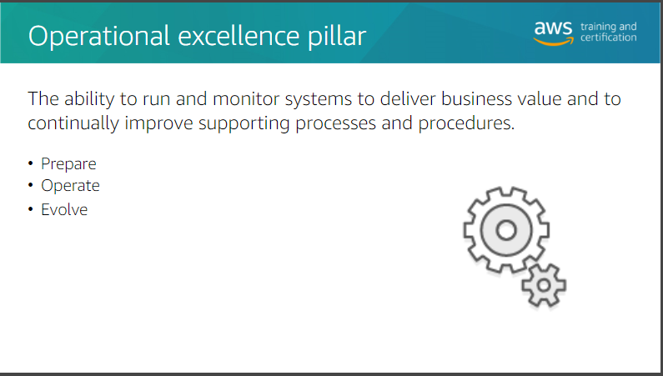

Slide 4


Slide 5
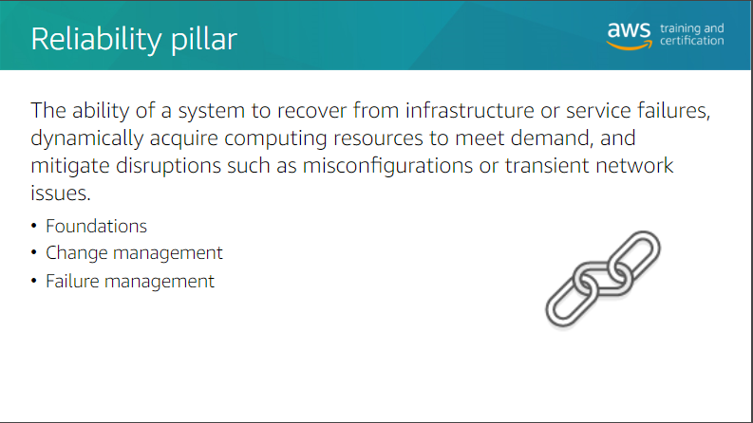

Slide 6
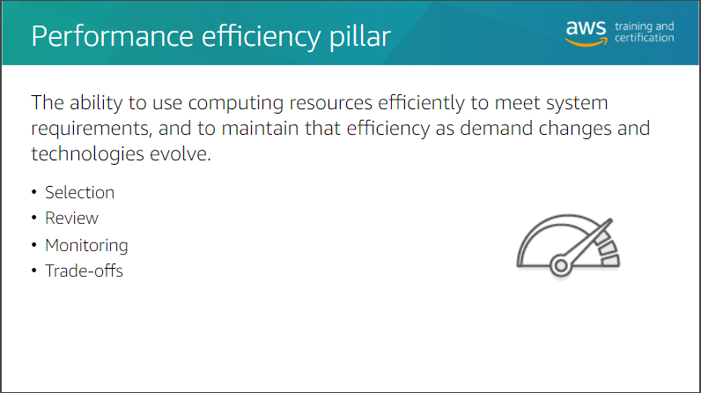
Notes:
Performance efficiency is about the ability to use IT or computing resources efficiently.
The focus areas include selecting the right resource types for computing; storage, databases and networking.
Reviewing your selection as AWS continues to innovate with new resource types and features. Being aware of how your resources are performing through monitoring and, making architectural trade-offs to maximise performance efficiency.

Slide 7
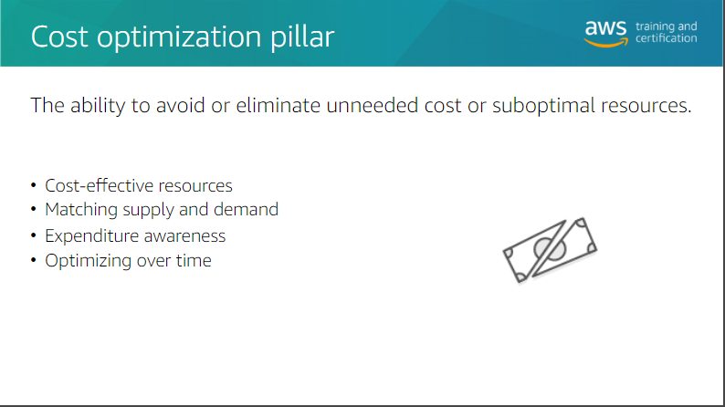

Slide 8
