Slide 1
FLAVA
A Foundational Language And Vision Alignment Model

Slide 2
Outline
Introduction
Flava Model Architecture
Other Vision and Language models
Pre-Training tasks
Results
Conclusion
References

Slide 3

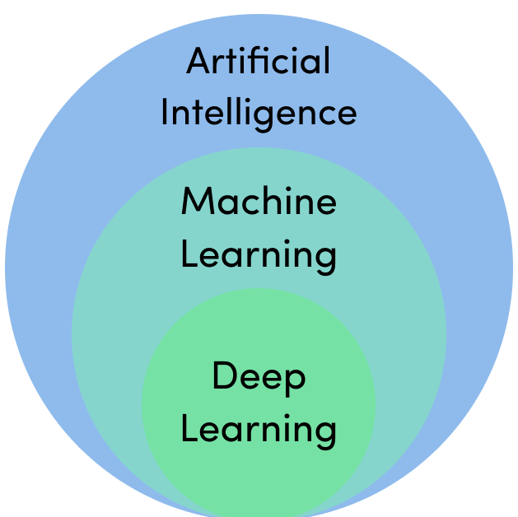
Introduction
Foundational Language And Vision Alignment Model (FLAVA)
Released in 2021 by Facebook AI Research Team
Language vision alignment model that learns strong representations from multimodal data (image-text pairs) and unimodal data (unpaired images and text

Slide 4
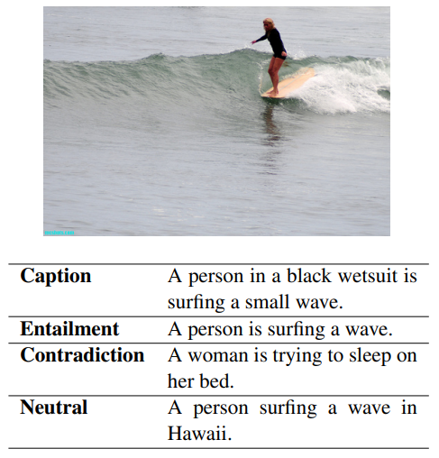
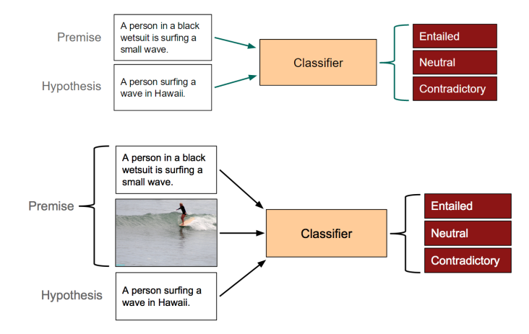
Introduction - Tasks
There are several categories of tasks which span across modalities:
Unimodal Vision Tasks ( Image)
Object Identification/Facial Recognition
Image Segmentation
Image Classification
Unimodal Language Tasks (Tex)
Natural Language Inference
Sentiment Analysis
Named Entity Recognition
Multimodal Tasks (Image + Text)
Image-Text retrieval
Visual Question Answering (VQA)
Multimodal Natural Language Inference (MNLI)
Figure: An example of the data given in the SNLI dataset, with the associated image from the Flickr30k dataset

Slide 5
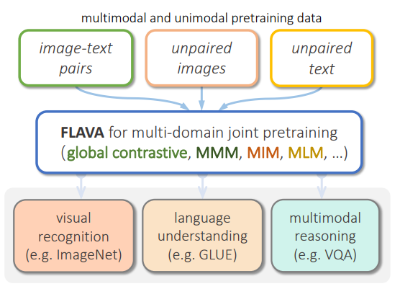
Introduction - FLAVA
State-of-the-art models are often either cross-modal (contrastive) or multi-modal (with earlier fusion) but not both; and they often only target specific modalities or tasks.
FLAVA targets all modalities at once – a true vision and language foundation model good at vision tasks, language tasks, and cross- and multi-modal vision and language tasks.
FLAVA demonstrates impressive performance on a wide range of 35 tasks spanning these target modalities (visual recognition, language understanding, and multimodal reasoning).
FLAVA uses a Transformer Architecture

Slide 6
Flava Model
The FLAVA model core is composed by:
an image encoder transformer to capture unimodal image representations
a text encoder transformer to process unimodal text information
a multimodal encoder transformer that takes as input the encoded unimodal image and text and integrates their representations for multimodal reasoning
For downstream tasks:
classification heads are applied on the outputs from the image, text, and multimodal encoders respectively for visual recognition, language understanding, and multimodal reasoning tasks.

Slide 7
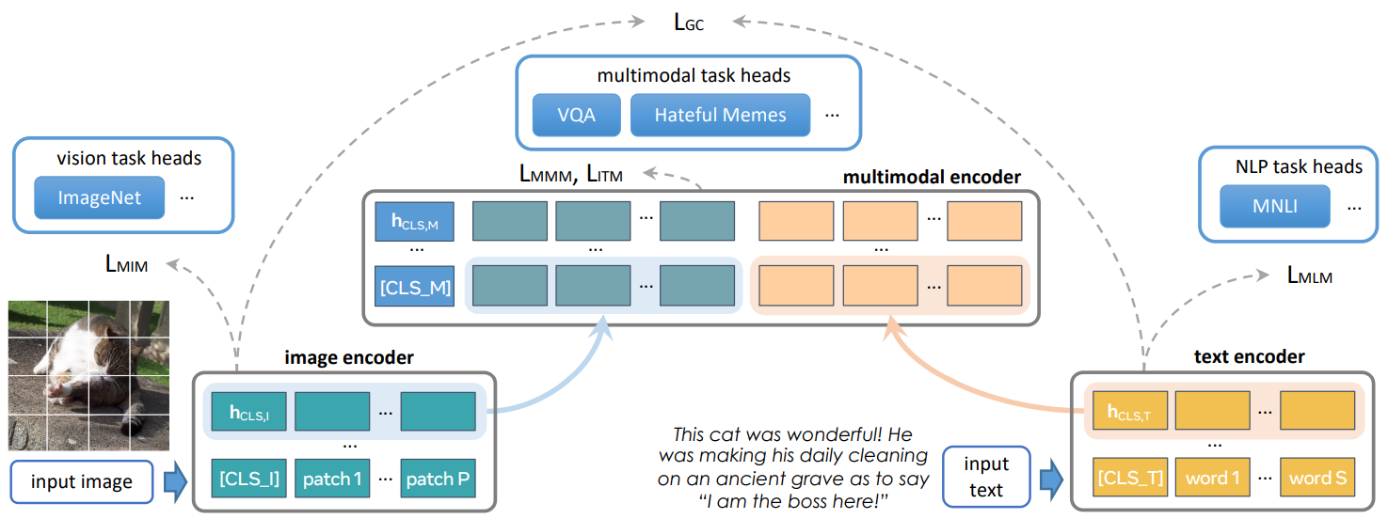
Flava Model
Figure: Overview of the FLAVA model

Slide 8
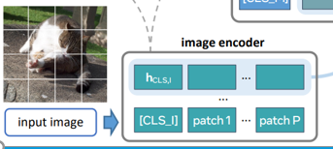

Flava Model - Image Encoder
Thee ViT-B/16 architecture is adopted for the image encoder.
Given an input image:
the image is resized to a fixed size
the image is split into patches
The patches are linearly embedded and fed into a transformer model (along with positional embeddings and an extra image classification token$\left[CLS_I\right]$).
The image encoder output is a list of image hidden state vectors ${\{h}_{I}\}$, each corresponding to an image patch, plus an additional $h_{CLS,I}$ for $\left[CLS_I\right]$.

Slide 9
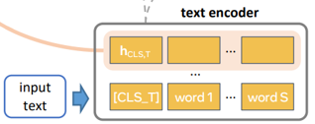

FLAVA Model - Text Encoder
Given an input piece of text (e.g., a sentence or a pair of sentences):
The sentence is first tokenized
The sentence is embedded it into a list of word vectors.
Then, a transformer model is applied over the word vectors to encode them into a list of hidden state vectors $\{h_{t}\}$, including $h_{CLS,T}$ for the text classification $[CLS_T]$ token.
Importantly, different from prior work, the text encoder has exactly the same architecture as the visual encoder). The same ViT architecture is used (but with different parameters) for both the visual and textual encoder i.e. ViT-B/16.

Slide 10
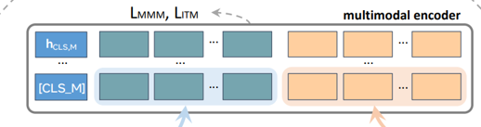

Flava Model - Multimodal Encoder
A separate transformer is used to fuse the image and text hidden states:
Two learned linear projections are applied over each hidden state vector in $\{h_{I}\}$ and $\left\{h_{T}\right\}.$
These projections are concatenated into a single list with an additional $[CLS_M]$ token added.
This concatenated list is fed into the multimodal encoder transformer (also based on the ViT architecture), allowing cross-attention between the projected unimodal image and text representations and fusing the two modalities.
The output from the multimodal encoder is a list of hidden states $\left\{h_{M}\right\}$, each corresponding to a unimodal vector from $\{h_{I}\}$ or $\{h_{T}\}$ (and a vector $h_{CLS,M}$ for $[CLS_M]$).

Slide 11

Attention
The transformer building blocks are scaled dot-product attention units.
When a sentence is passed into a transformer model, attention weights are calculated between every token simultaneously.
The attention unit produces embeddings for every token in context that contain information about the token itself along with a weighted combination of other relevant tokens each weighted by its attention weight.
$$Attention\left(Q,K,V\right)=softmax\left(\frac{QK^{T}}{\sqrt{d_{k}}}\right)V$$

Slide 12

Multi-head Attention
One set of $\left(W_{Q},W_{K},W_{V}\right)$ matrices is called an attention head, and each layer in a transformer model has multiple attention heads.
While each attention head attends to the tokens that are relevant to each token, with multiple attention heads the model can do this for different definitions of "relevance". In addition the influence field representing relevance can become progressively dilated in successive layers.

Slide 13
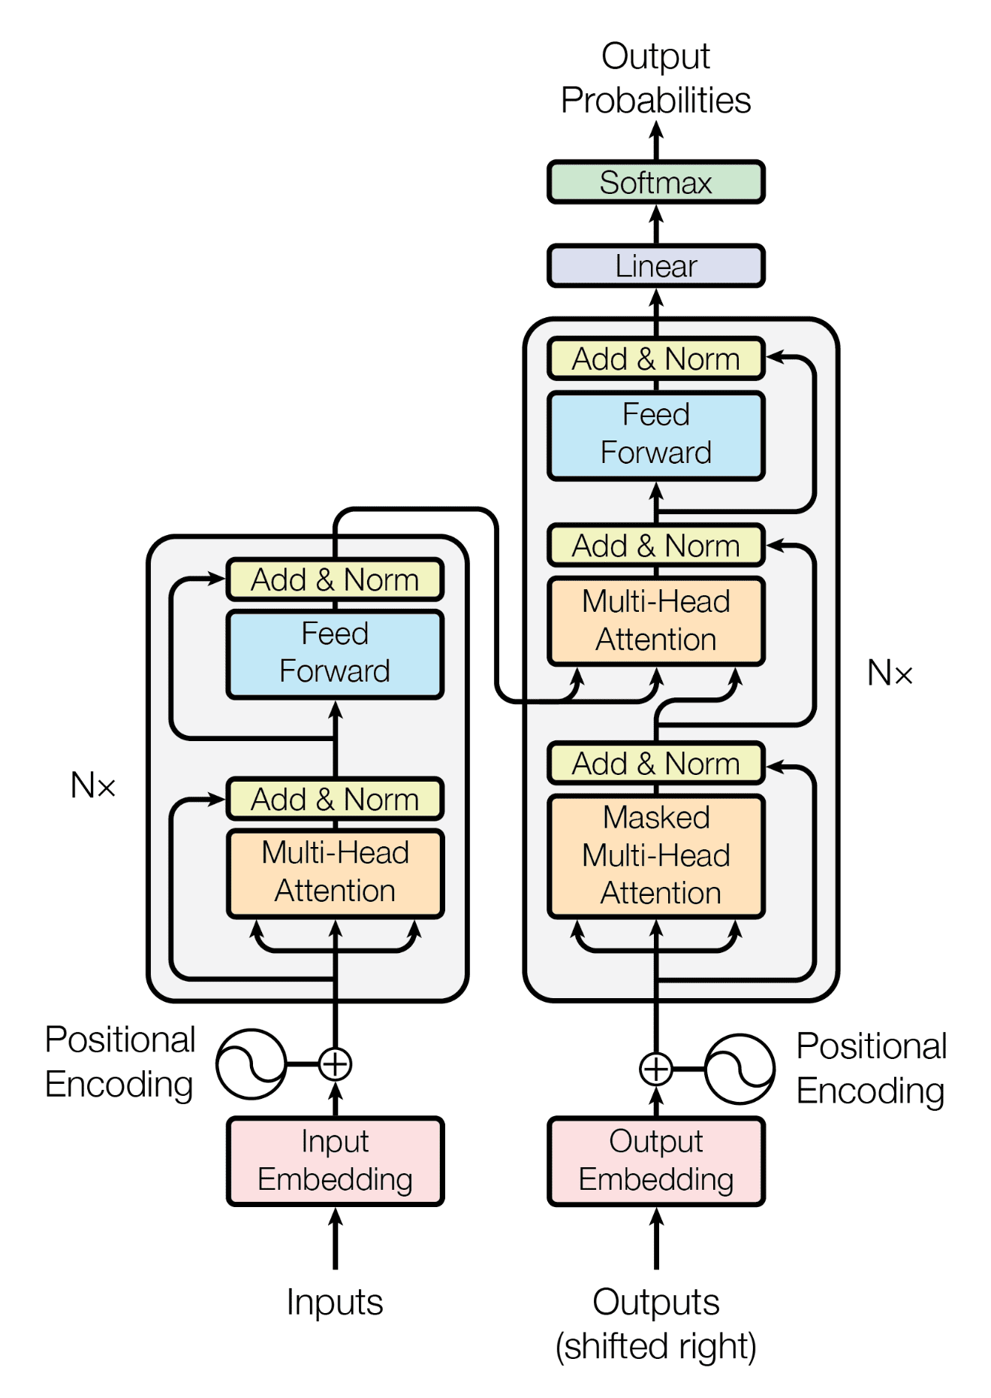
Transformer
Like earlier seq2seq models, the original Transformer model used an encoder-decoder architecture.
The encoder consists of encoding layers that process the input iteratively one layer after another
The decoder consists of decoding layers that process the hidden state iteratively
The function of each encoder layer is to generate encodings that contain information about which parts of the inputs are relevant to each other. It passes its encodings to the next encoder layer as inputs.
Each decoder layer does the opposite, taking all the encodings and using their incorporated contextual information to generate an output sequence. To achieve this, each encoder and decoder layer makes use of an attention mechanism.

Slide 14
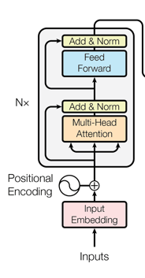
Encoder
Each encoder consists of two major components:
a self-attention mechanism, which accepts input encodings from the previous encoder and weighs their relevance to each other to generate output encodings.
a feed-forward neural network, which further processes each output encoding individually, which are then passed to the next encoder as its input, as well as to the decoders.
The first encoder takes positional information and embeddings of the input sequence as its input, rather than encodings. The positional information is necessary for the transformer to make use of the order of the sequence, because no other part of the transformer makes use of this.

Slide 15
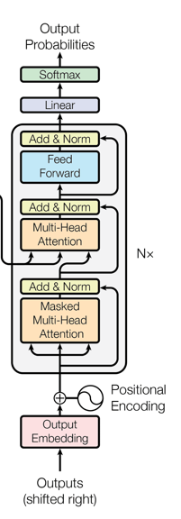
Decoder
Each decoder consists of three major components: a
self-attention mechanism
an attention mechanism over the encodings
and a feed-forward neural network.
The decoder functions in a similar fashion to the encoder, but an additional attention mechanism is inserted which instead draws relevant information from the encodings generated by the encoders.
Like the first encoder, the first decoder takes positional information and embeddings of the output sequence as its input, rather than encodings.
The transformer must not use the current or future output to predict an output, so the output sequence must be partially masked to prevent this reverse information flow. The last decoder is followed by a final linear transformation and softmax layer, to produce the output probabilities over the vocabulary.

Slide 16
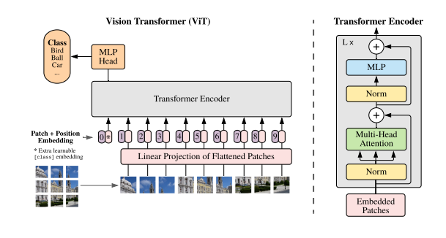
Vision TransfoRmer
Model overview:
Split an image into fixed-size patches, linearly embed each of them and add position embeddings
feed the resulting sequence of vectors to a standard Transformer encoder
In order to perform classification, the standard approach of adding an extra learnable “classification token”
to the sequence is used

Slide 17
Transformer vs CNN
Inductive bias

Slide 18
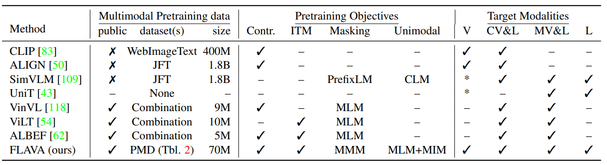
Other Models
Figure: Comparing FLAVA with previous models on multimodal tasks, language tasks, and ImageNet linear evaluation

Slide 19
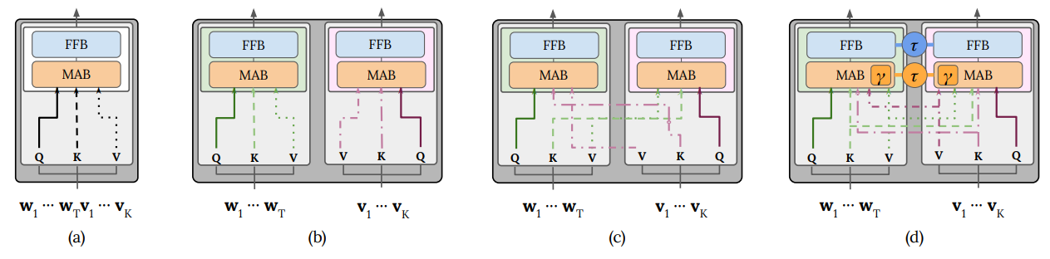
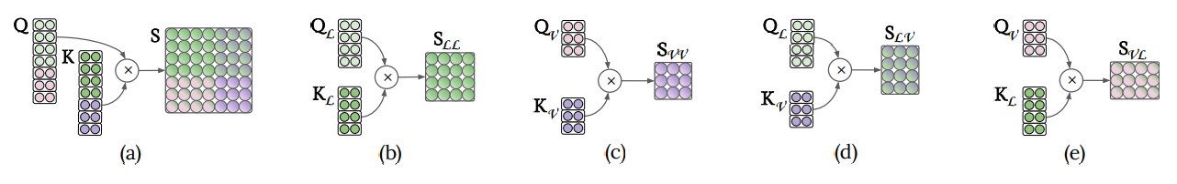
Meta-Analysis and a Unified Framework of Vision-and-Language BERTs
Figure: Visualisation of the (a) single-stream, (b) dual-stream intra-modal and (c) dual-stream intermodal
Transformer layers. (d) shows our gated bimodal layer. The inter-modal layer attends across modalities, while the intra-model layer attends within each modality. Gated bimodal can attend to either or both.
Figure : Visualisation of the score matrix for (a) single-stream, (b) text–text, (c) vision–vision, (d) text–vision, and (e) vision–text interactions. Shades of green denote the text modality, while purple ones denote the vision modality. Dual-stream scores are sub-matrices of the single-stream scores matrix.

Slide 20
Background – Pretraining/Fine Tuning
Pretraining/Fine-tuning work as follows:
You have a machine learning model m
Pre-training: You have a dataset A on which you train m
You have a dataset B. Before you start training the model, you initialize some of the parameters of m with the model which is trained on A.
Fine-tuning: You train m on B.
This is one form of transfer learning, so you can transfer some of the knowledge obtained on dataset A to dataset B.

Slide 21
FLAVA MODEL PRETRAINING
During pretraining:
masked image modeling (MIM) and mask language modeling (MLM) losses are applied onto the image and text encoders over a single image or a text piece, respectively
contrastive, masked multimodal modeling (MMM), and image-text matching (ITM) loss are used over paired image-text data.

Slide 22
Pretraining Objectives
Pretraining obejectives aim to obtain strong representations through pretraining on both multimodal data (paired image and text) as well as unimodal data (unpaired images or text).
Unimodal pretraining objectives:
Masked Image Modeling (MIM)
Masked Language Modeling (MLM)
Encoder initialization from unimodal pretraining
2. Multimodal pretraining objectives:
Global Contrastive Loss (GC Loss)
Masked multimodal modeling (MMM)
Image-texto matching (ITM)
3. Joint unimodal and multimodal training

Slide 23

Unimodal Objectives - Masked Image Modeling (MIM)
“On unimodal image datasets, we mask a set of image patches following the rectangular block-wise masking in BEiT and reconstruct them from other image patches.
The input image is first tokenized using a pretrained dVAE tokenizer and then a classifier is applied on the image encoder outputs $\{h_{I}\}$ to predict the dVAE tokens of the masked patches.”

Slide 24

Unimodal Objectives - Masked Language Modeling (MLM)
“We apply a masked language modeling loss on top of the text encoder to pretrain on stand-alone text datasets. A fraction (15%) of the text tokens are masked in the input, and reconstructed from the other tokens using a classifier over the unimodal text hidden states output $\{h_{T}\}$.”

Slide 25
Unimodal Objectives - Encoder initialization from unimodal pretraining
“We use three sources of data for pretraining: unimodal image data (ImageNet-1K), unimodal text data (CCNews and BookCorpus ), and multimodal image-text paired data. We first pretrain the text encoder with the MLM objective on the unimodal text dataset. We experiment with different ways for pretraining the image encoder:
We pretrain the image encoder on unpaired image datasets with either MIM or the DINO objective, before joint training on both unimodal and multimodal datasets.
We empirically found the latter to work quite well, despite the switch to an MIM objective on images post-initialization (more details in supplemental).
Then, we initialize the whole FLAVA model with the two respective unimodally-pretrained encoders, or when we train from scratch, we initialize randomly. We always initialize the multimodal encoder randomly for pretraining. “

Slide 26

Multimodal Objectives - Global contrastive (GC) loss
“Our image-text contrastive loss resembles that of CLIP.
Given a batch of images and text, we maximize the cosine similarities between matched image and text pairs and minimize those for the unmatched pairs. This is accomplished by linearly projecting each $h_{CLS,I}$ and $h_{CLS,T}$into an embedding space, followed by L2-normalization, dot-product, and a softmax loss scaled by temperature.
Large models are often trained using multiple GPUs data parallelism, where the samples in a batch are split across GPUs. When gathering embeddings for the image and text contrastive objective, the open-source CLIP implementation only back-propagates the gradients of the contrastive loss to the embeddings from the local GPU where the dot-product is performed.
In contrast, through experiments that can be found in the supplemental, we observe a noticeable performance gain by performing full backpropagation across GPUs compared to only doing backpropagation locally. We call our loss “global contrastive” LGC to distinguish it from “local contrastive” approaches.”

Slide 27
Multimodal Objectives - Masked multimodal modeling (MMM)
“While a number of previous vision-and-language pretraining approaches (e.g. [63]) have focused on masked modeling of the text modality by reconstructing masked tokens from the multimodal input, most of them do not involve masked learning on image modality directly at the image pixel level in an end-to-end manner.
Here, we introduce a novel masked multimodal modeling (MMM) pretraining objective LMMM that masks both the image patches and the text tokens and jointly works on both modalities.
Specifically, given an image and text input, we first tokenize the input image patches using a pretrained dVAE tokenizer, which maps each image patch into an index in a visual codebook similar to a word dictionary
Then, we replace a subset of image patches based on rectangular block image regions following BEiT and 15% of text tokens following BERT with a special [MASK] token.
Then, from the multimodal encoder’s output {hM}, we apply a multilayer perceptron to predict the visual codebook index of the masked image patches, or the word vocabulary index of the masked text tokens. “

Slide 28

Multimodal Objectives - Image-text matching (ITM)
“Finally, we add an image-text matching loss LITM following prior vision-and-language pretraining literature. During pretraining, we feed a batch of samples including both matched and unmatched image-text pairs. Then, on top of $h_{CLS,M}$ from the multimodal encoder, we apply a classifier to decide if an input image and text match each other.”

Slide 29
Joint unimodal and multimodal training
“After unimodal pretraining of the image and text encoders, we continue training the entire FLAVA model jointly on the three types of datasets with round-robin sampling. In each training iteration, we choose one of the datasets according to a sampling ratio that we determine empirically and obtain a batch of samples. Then, depending on the dataset type, we apply unimodal MIM on image data, unimodal MLM on text data, or the multimodal losses (contrastive, MMM, and ITM) on image-text pairs.”

Slide 30
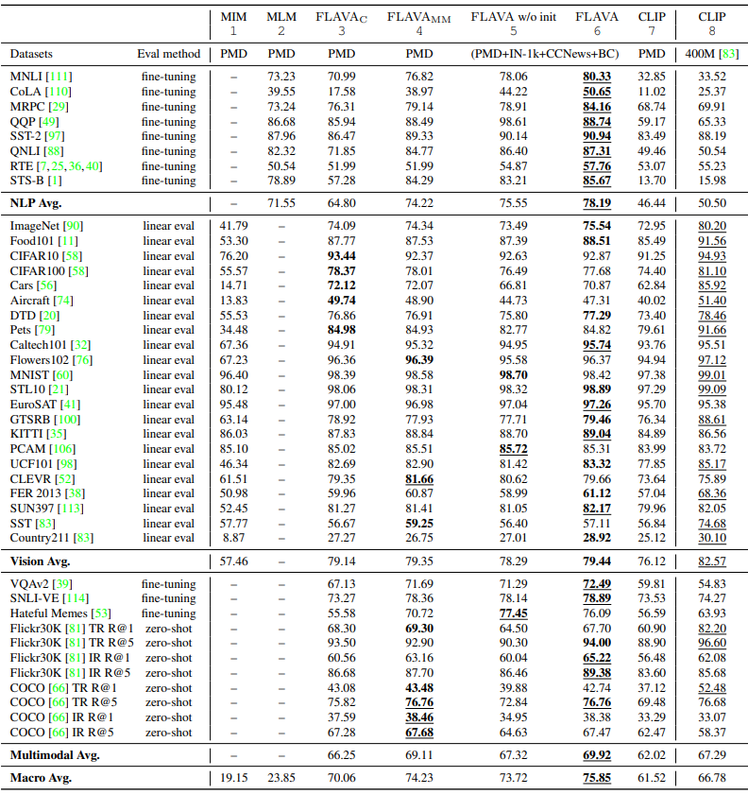
FLAVA Results
Table: Comparing full FLAVA pretraining with other settings, where FLAVA gets the highest macro average score.

Slide 31
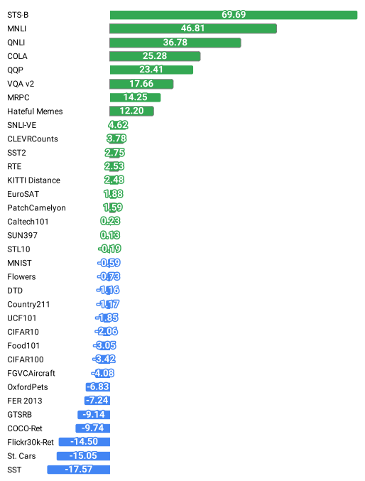
FLAVA Results
Figure: The performance difference between FLAVA and CLIP-ViT-B/16 (400M) on vision, language
and multimodal tasks (positive means FLAVA is better).

Slide 32
Conclusion
FLAVA is a new model
Perhaps

Slide 33
References
Singh, Amanpreet, et al. "FLAVA: A Foundational Language And Vision Alignment Model." arXiv preprint arXiv:2112.04482 (2021).

