Slide 1
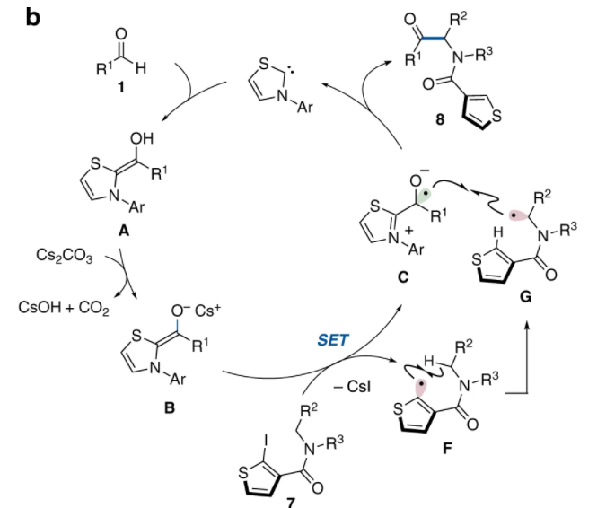
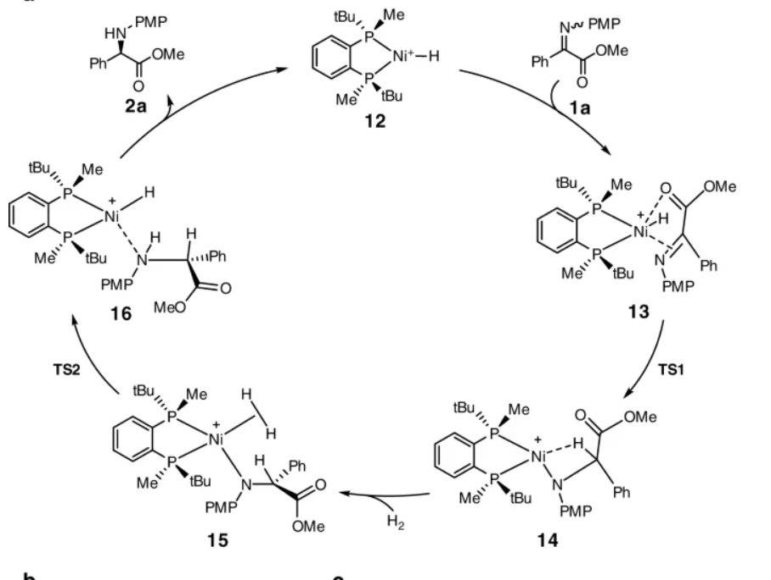
Crazy arrows
Radical arrows
Addition of molecules

Slide 2
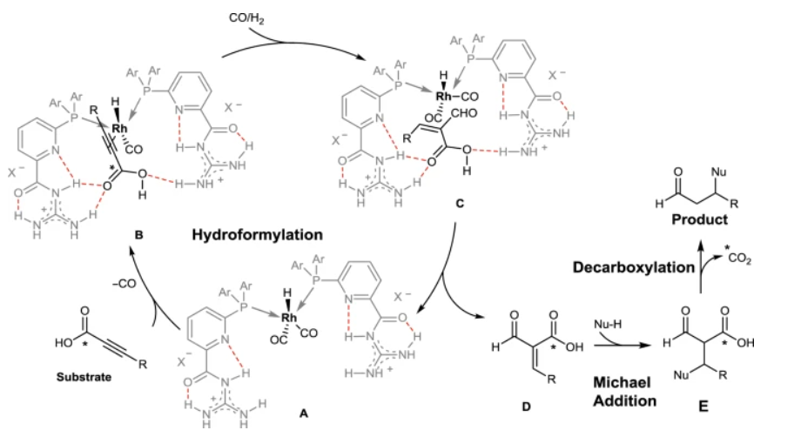
- Minus reagent

Slide 3
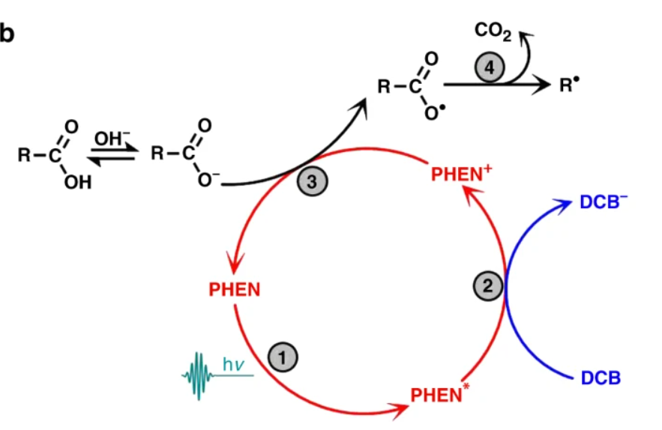
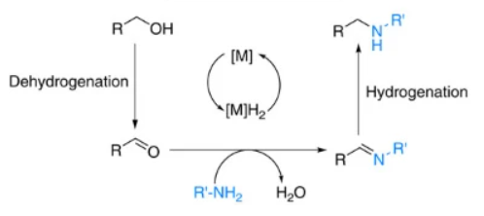
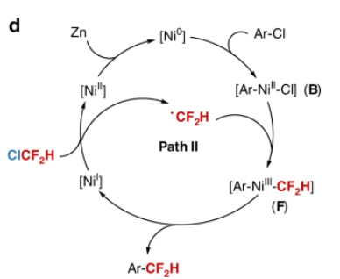
Light drawing
Metal (as general M)
[M0]

Slide 4
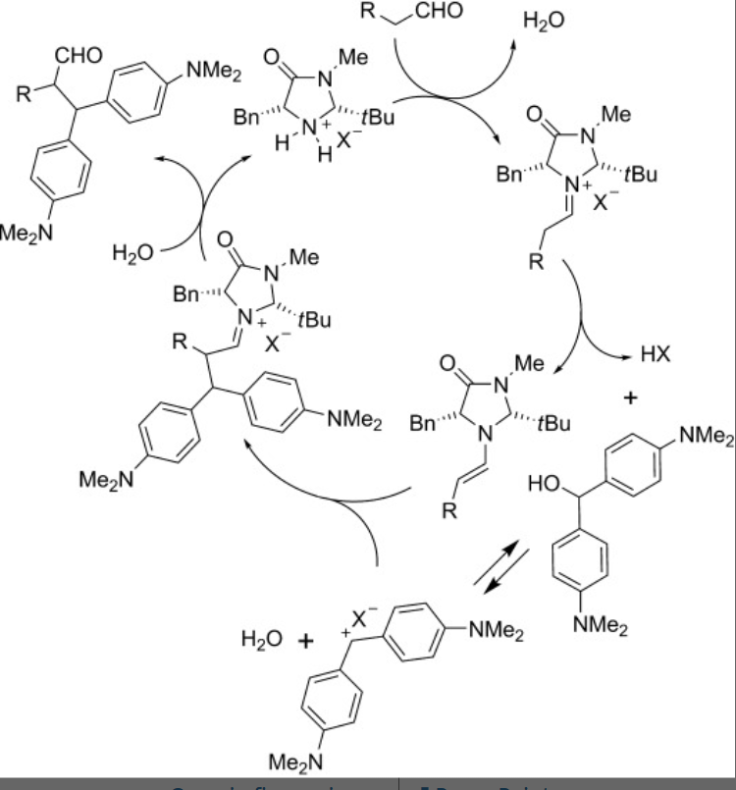
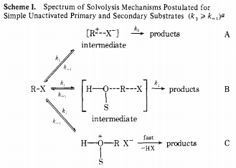
Dotted line
Square brackets
- Arrows splitting or uniting

Slide 5
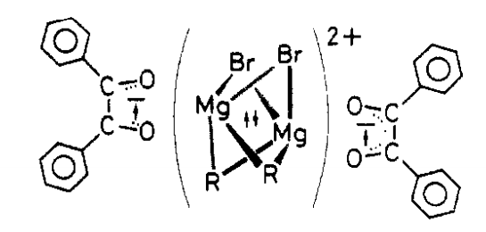
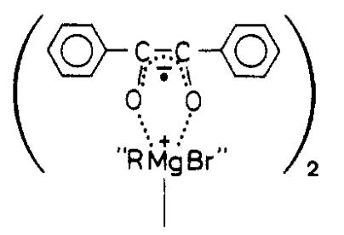

Dotted lines
Parenthesis
Radical
Dotted line
180 degrees round arrows (?)

Slide 6
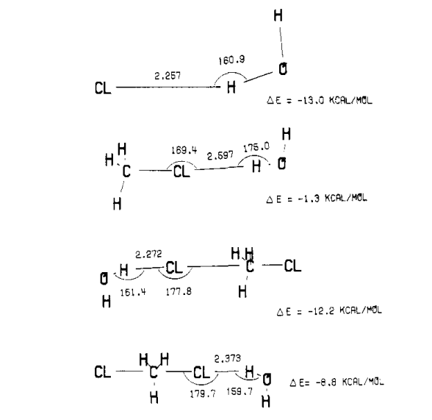
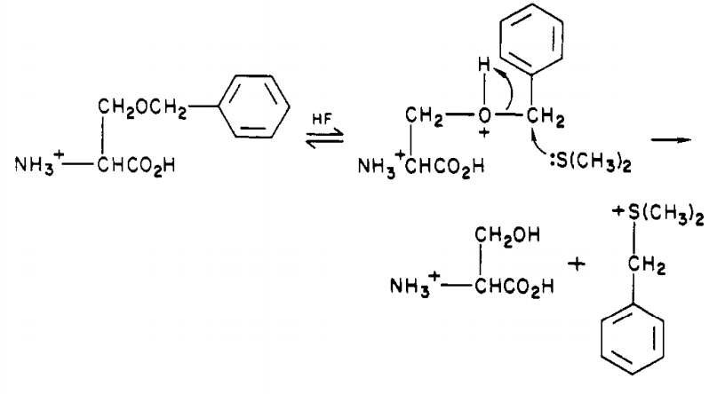
- Electrons on neutral compound
Sign for angle size

Slide 7
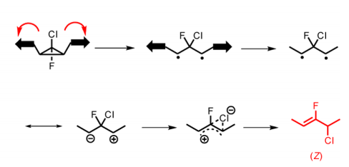

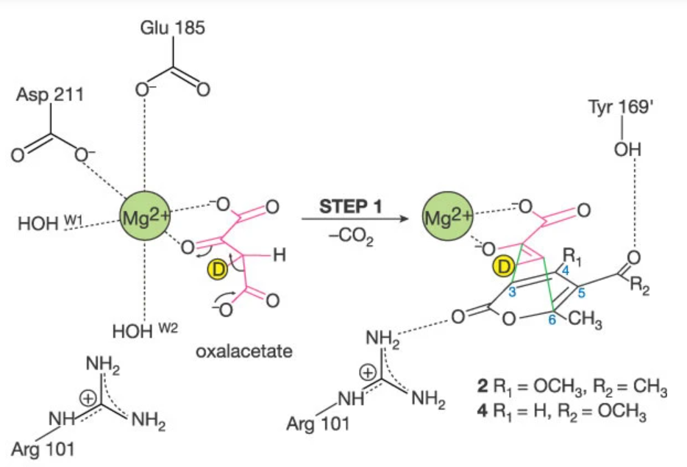
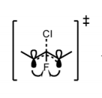
Coloring on non molecular objects
* Coloring Might be potentially problematic since
it used for scope depiction
Numbering
Orbitals

Slide 8



Electron specifically pointed out
Transition state sign
“to be continued” arrows

Slide 9
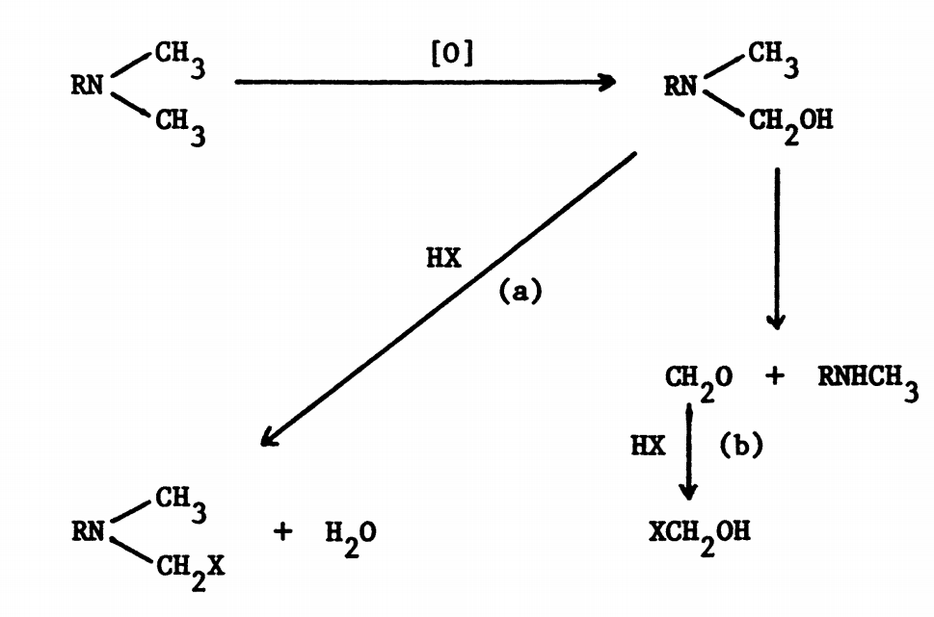
Square brackets on reagents

Slide 10
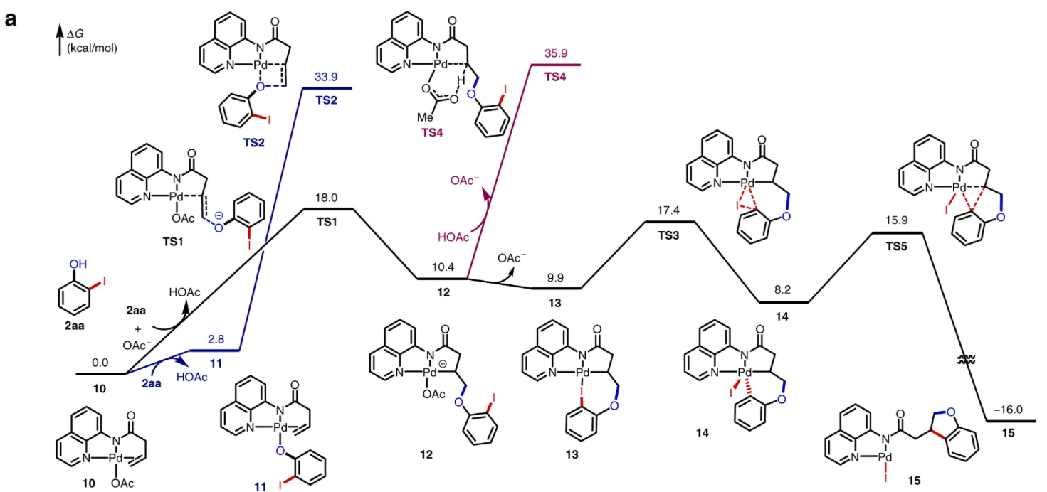
?
Why not follow the computations?

Slide 11
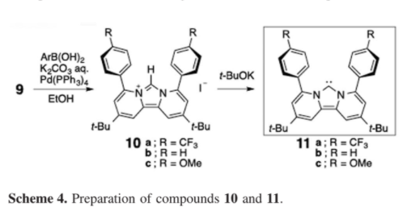
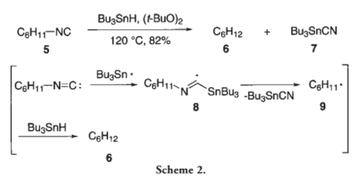
Electrons drawn on picture

Slide 12
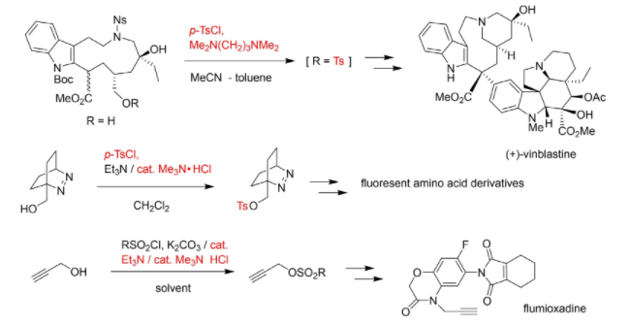
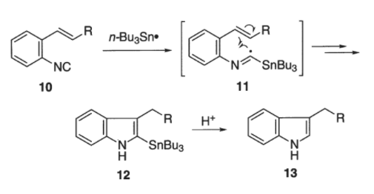
Double arrows

Slide 13
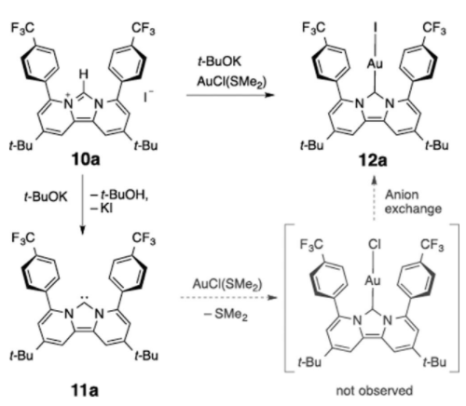
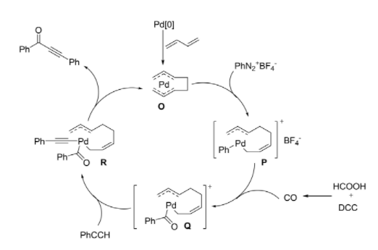
Dotted line

Slide 14
Dotted line

Slide 15
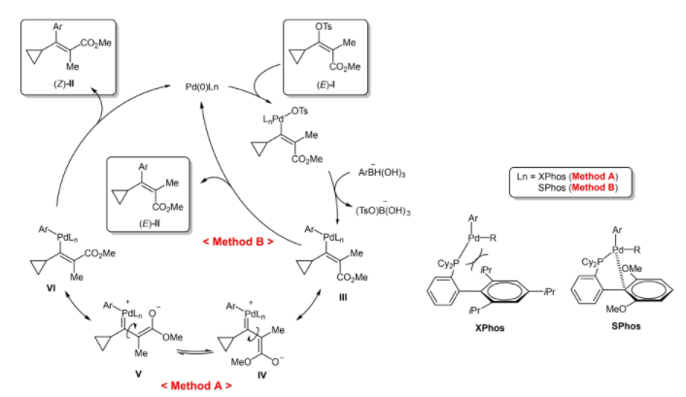
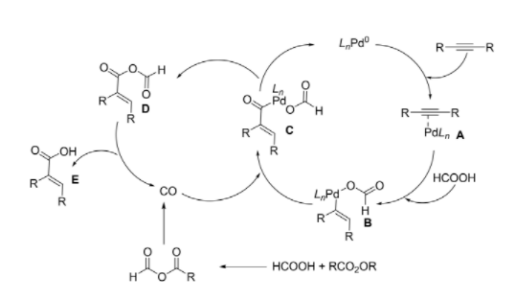
cycles

Slide 16


Brackets

Slide 17
Round arrows

Slide 18

Key words
Mechanism
Base / Acid
EWG / EDG

Slide 19
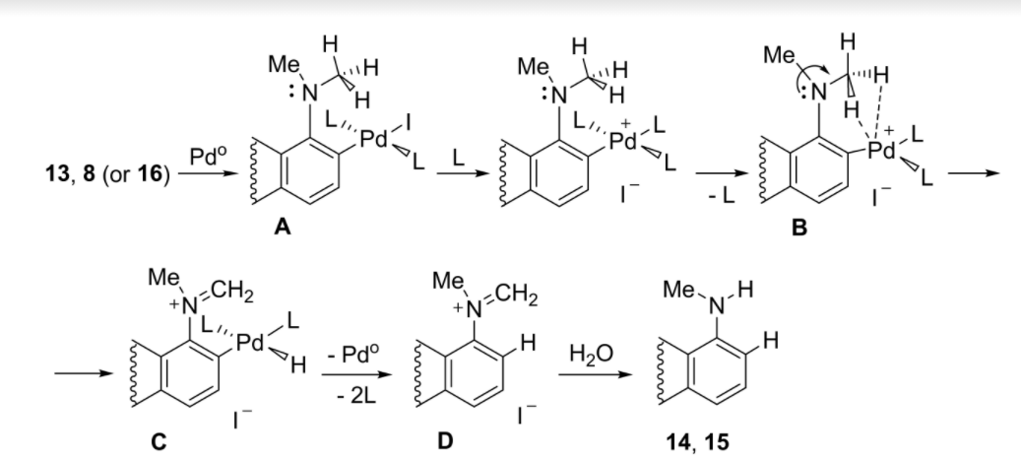
Dotted lines, electrons and arrows

