Slide 1
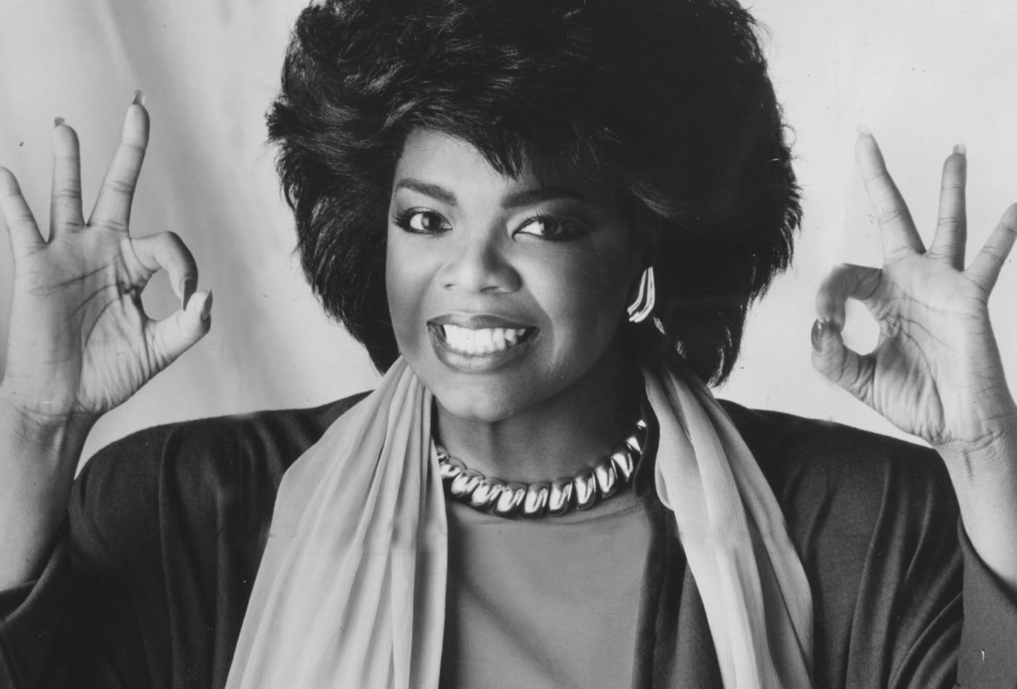
WabiSabi: A Smart chatbot
Beatriz Borges
Lilia Ellouz
Andre Ghattas

Slide 2
Table of contents
The motivation behind our idea and its evolution
The tools that we used
Fine-tuning the model
The utility of the result

Slide 3
The motivation behind our idea and its evolution
An NLP project
A project that is useful but that is also fun
A project that has not really been well done before
A project that can be used for the good of society
A project that requires user interaction as opposed to a generic generator

Slide 4
The motivation behind our idea and its evolution
Pep talk generator? Sarcasm detector? Sarcastic pep talk generator?
Inspirational chatbot
Chatbot which takes the personality requested by the user

Slide 5
The tools that we used
State-of-the-art conversational AI with Transfer Learning
Pre-train a language model on a large corpus of text for it to be able to generate long coherent text (GPT-2)
Fine-tune the model to adapt it to dialog
persona sentences
history of the dialog
tokens of output sequence i.e. the words that have been generated
Add embeddings for words, sequences and position in order for the model to understand the difference between the inputs

Slide 6
Fine-tuning the model
Tweaking the personality by replacing it with Oprah Winfrey quotes
Randomly sampling from a big list of quotes
Limitations of memory
Selecting the quotes from the best models
Making a proper user interface for chatting
Adding the feature that lets users select other famous people to talk to
Wikiquotes

Slide 7
The utility of the result
Functional but not perfect
If given enough memory, could work better
People do struggle with stress, anxiety, depression and need an encouraging voice
Bigger scale application could be deployed and would have an impact

