Slide 1

What’s
cooking?
Predicting cuisine
by provided ingredients
& market basket analysis
Gabriela Dvořáková, Michal Lehončák
[image source]

Slide 2
Data mining agenda
Part 01: Goal definition
Part 02: Dataset
Part 03: Preprocessing
Part 04: Prediction
Part 05: Results discussion
Part 06: Market Basket Analysis

Slide 3

What’s the goal?
Predict the category of a dish's cuisine given a list of its ingredients.
Part 01
INGREDIENTS
romaine lettuce
black olives
grape tomatoes
garlic
pepper
purple onion
seasoning
garbanzo beans
feta cheese crumbles
greek
cuisine
[image source]

Slide 4
Dataset
Part 02
Kaggle competition free dataset with 3 features: cuisine, recipe id, ingredients
cuisine | id | ingredients
greek | 10259 | ['romaine lettuce', 'black olives', 'grape tomatoes', 'garlic', 'pepper', 'purple onion', 'seasoning', 'garbanzo beans', 'feta cheese crumbles']
southern_us | 25693 | ['plain flour', 'ground pepper', 'salt', 'tomatoes', 'ground black pepper', 'thyme', 'eggs', 'green tomatoes', 'yellow corn meal', 'milk', 'vegetable oil']
filipino | 20130 | ['eggs', 'pepper', 'salt', 'mayonaise', 'cooking oil', 'green chilies', 'grilled chicken breasts', 'garlic powder', 'yellow onion', 'soy sauce', 'butter', 'chicken livers']
indian | 22213 | ['water', 'vegetable oil', 'wheat', 'salt']
TRAINING SET
39774
recipes
TESTING SET
9944
recipes

Slide 5
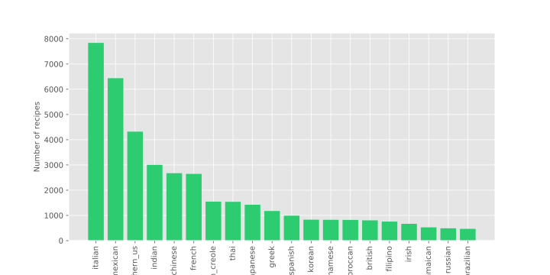
Dataset
Part 02
- number of dishes per cuisine:
Classes
20
cuisines

Slide 6
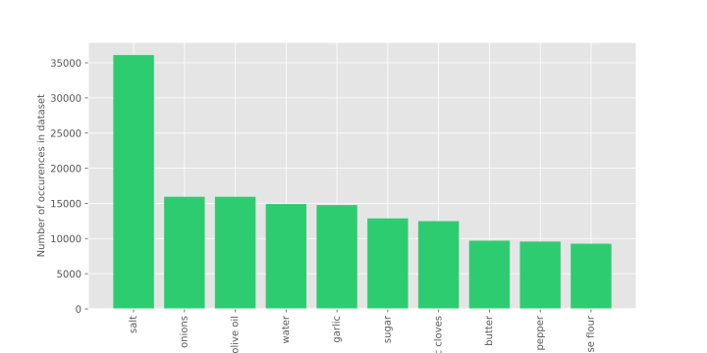
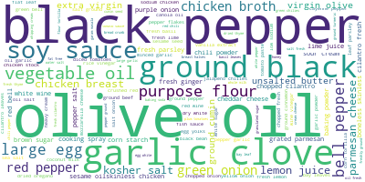
Dataset
Part 02
- most frequent ingredients:

Slide 7
Preprocessing
Part 03
Ingredient concatenation
2. Normalizing Case
- many ingredients have multiple names: ’finely chopped onion’ & ‘diced onions’ & ‘onions’
- computer views them as two distinct ingredients
to solve this problem, ingredients are:
concatenated to form a single string
tokenized
- all words are converted to lowercase
example:
‘KRAFT Zesty Italian Dressing’
‘kraft zesty italian dressing'
example:
['water', 'vegetable oil', 'wheat', ‘salt’]
[‘water vegetable oil wheat salt']

Slide 8
Preprocessing
Part 03
3. Punctation removal
4. Digits removal
- removing any redundant symbols from the set:
- numbers do not hold much informational value for cuisine prediction
example:
‘1% low-fat milk’ ’40% less sodium taco seasoning’
'!"#$%&'()*+,-./:;<=>?@[]^_`{|}~™®'

Slide 9
Preprocessing
Part 03
5. Porter Stemming
6. Rare words removal
- ’tomatoes’ & ‘tomato’ are the same ingredient
- to achieve that, we use stemming`: process of reducing words to their word stem, base or root form by removing characters from the word endings
- words that appear less then 3 times are removed from the ingredients, as their occurence does not provide enough prove to tell it discriminates one dish from another
example:
['tomatoes', 'sweetened, 'onions']
[‘tomato’, ‘sweeten’, ‘onion’]
examples of rare words (after stemming):
['poupon', 'krachai', 'nusalt', 'bluefish', 'rapini', 'rouget', 'shanghaistyl', 'moscato', 'dasti', 'hors', 'delux', 'silk', 'cupcak', 'surimi', 'dream', ‘hint’…]

Slide 10
Preprocessing
Part 03
Features encoding: Binary representation
id | ‘olive’ | ‘garlic’ | ‘pepper’ | ‘milk’ | ‘broccoli’ | …
10259 | 1 | 1 | 1 | 0 | 0 | …
25693 | 0 | 0 | 1 | 0 | 0 | …
20130 | 0 | 0 | 0 | 0 | 0 | …
22213 | 0 | 0 | 0 | 1 | 0 | …
each dish is represented by a vector of length of the number of unique ingredients
feature vector at i-th term may be 1 or 0
1: i-th ingredient appears in the example
0: otherwise
ingredient cannot appear more than once

Slide 11
Prediction
- we compared 5 different predictive models
- models are evaluated on the test-train 20%-80% split of the training dataset
Part 04
Neural
Network
5
1
Logistic
Regression
Random
Forest
classifier
2
Gaussian
Bayes
classifier
3
4
KNN
classifier

Slide 12
1. Logistic Regression
Part 04
Train accuracy
84.11%
TEST accuracy
78.66%

Slide 13
2. Gaussian Bayes classifier
Part 04
Assumption: conditional independence assumption
Train accuracy
29.61%
we assume the probability of one ingredient does not depend on the presence of different ingredient in a dish
TEST accuracy
23.77%
$$p(ingr_{i}∣ingr_{i+1},…,ingr_{n},Dish_{k})=p(ingr_{i}∣Dish_{k})$$

Slide 14
3. Random Forest classifier
Part 04
Train accuracy
99.97%
TEST accuracy
75.80%

Slide 15
4. K nearest neighbors
Part 04
Optimal K: 15
Train accuracy
70.13%
number of nearest neighbors ‘K’ found using Grid Search
Metric: minkowski
TEST accuracy
65.48%

Slide 16
5. Neural Network
Part 04
- we acquired the best results with the following architecture:
epochs
Layer (type) | Output shape | Param #
Dense | (None, 1024) | 2749440
Batch Normalization | (None, 1024) | 4096
Dropout | (None, 1024) | 0
Dense | (None, 512) | 524800
Dropout | (None, 512) | 0
Dense | (None, 256) | 131328
Dropout | (None, 256) | 0
Dense | (None, 20) | 5140
Train accuracy
100
99.93%
batch size
TEST accuracy
64
80.38%

Slide 17
Results discussion
Part 05
using the 5 classification algorithms discussed, the best performance observed is from the NN model
we created a final model by training NN on the whole training dataset
submittion to kaggle we achieved the following accuracy:
final score on kaggle
80.03%

Slide 18
Results discussion
Part 05
we compared our results with the kernel cuisine-classification, which achieved the best accuracy of 78.88% using the OVA SVM algorithm
different feature encoding method - TF-IDF
less thorough preprocessing steps (no sparse words removal)
our model performed better by almost 2 % using the deep neural network

Slide 19

Thank you for your
attention.
References:
[0] https://www.kaggle.com/c/whats-cooking
[image source]

