Slide 1
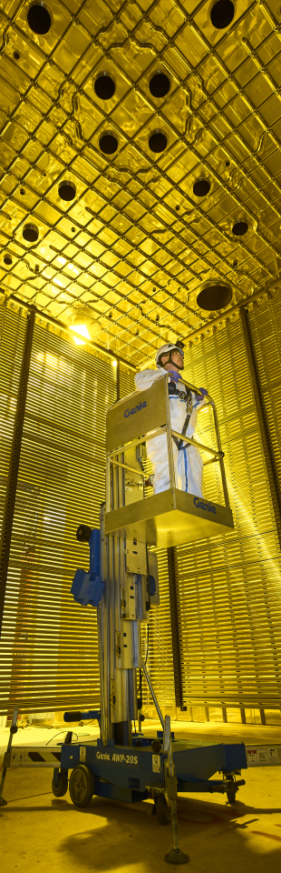

L2G :
EARLY performance analysis
Authors: Federico Battisti

Slide 2
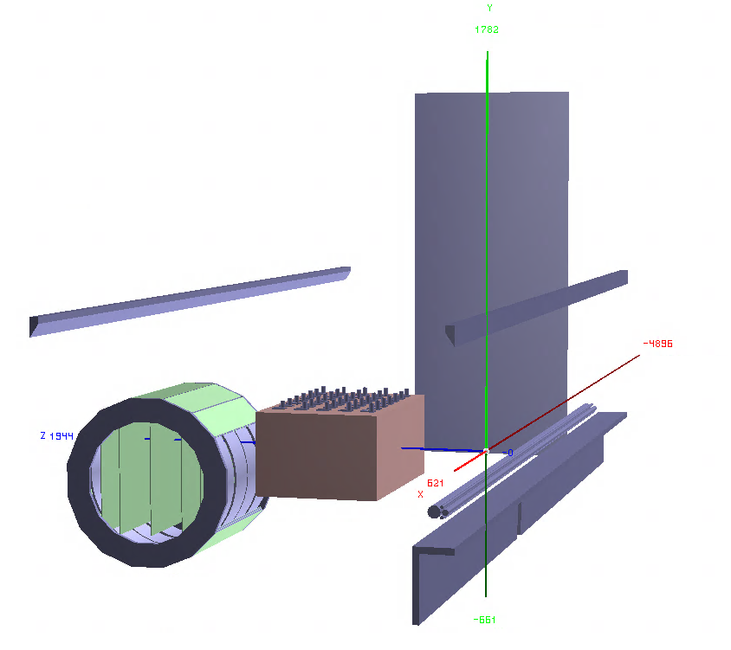
Generated sample: neutrino interactions in lar
Sample generated with GENIE v2
  Gsimple flux in ND-Hall (from Tanaz)
  1M single interaction events in ND-LAr (volArgonCubeActive)
Geometry used:
  Baseline ND-LAr from dunendggd (apparently some updates are needed but not pushed yet...)
  ND-GAr-Lite detector with SPY magnet (not the latest one acting as PV)
    5 Scintillator planes (Minerva-like) of 6mx5mx4cm at (-240, -150, 0, 150, 240) //Not Optimized yet!
    Segmented with triangular shapes strips in X/Y (2 cm triangle base)
    Includes a muon detector (3 planes of Sc of 2 cm around the magnet yoke of the ND-GAr) with 2x7.5cm iron for mu/pi separation over 500 MeV/c
Coordinate sytem: z roughly the flux direction, y is the vertical direction and x is the drift direction (i.e. the magnetic field direction)
y
z
x

Slide 3
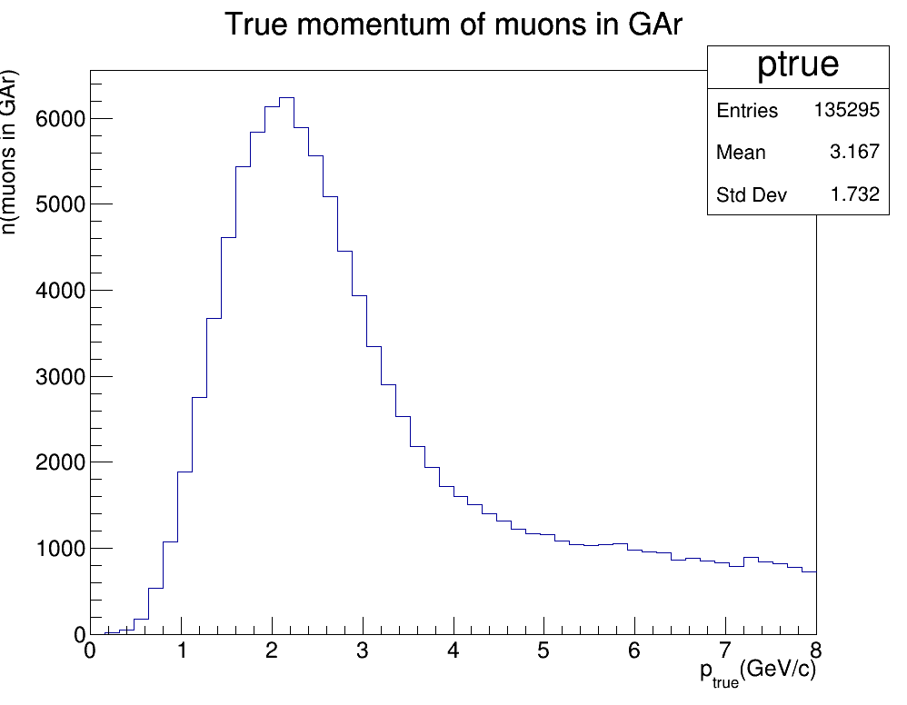
TRACK MATCHING AND MOMENTUM SPECTRUM IN GAR
Track matching (using Leo's original technique):
Event by event get all muon tracks that have at least one MC trajectory point in the GAr TPC volume, defined as:
  GArCenter(0,-68.287,1486)cm;
  GAr_radius = 349.9cm;
  GAr_Length = 669.6cm;
For each muon thus found, cycle over all the ND-GAr reconstructed tracks for the event and evaluate the angle between the reco track momentum and the MC momentum taken at the first MC trajectory point in the GArTPC. Save the the track with the smallest angle θ
Calculate the distance between the saved track and trajectory in the plane transverse to the direction of the MC momentum ΔX
Impose the cuts: cosθ>0.997 && ΔX<3cm . If these are passed the track was matched and we had a successfull reconstruction

Slide 4
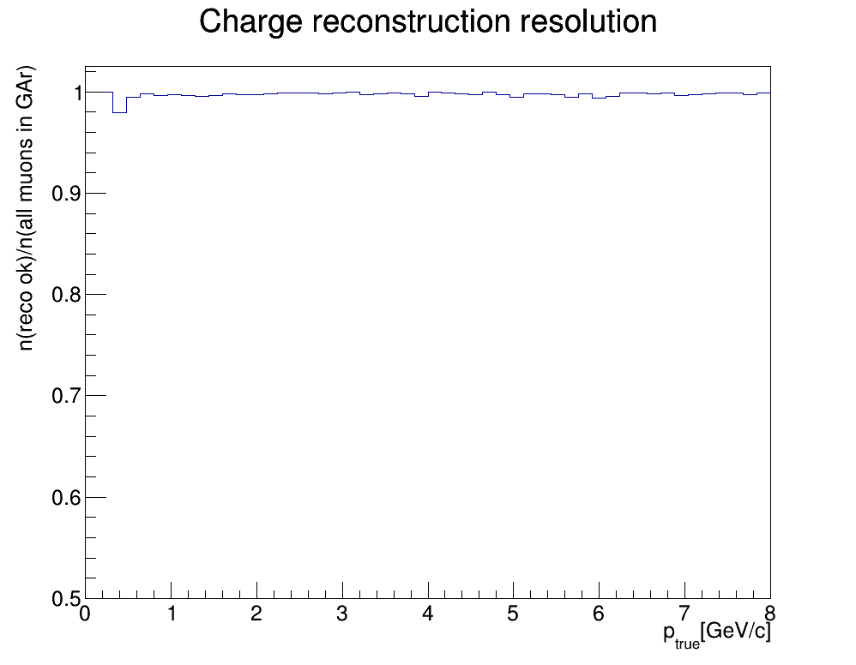
CHARGE reconstruction EFFICIENCY
n(all muons in GAr) = all MC muons that have been matched to a reconstructed track in GAr
n(reco ok) = all MC muons that have been matched to a reconstructed track in GAr whose reco charge matches the MC truth charge
p_{true}= muon momentum as it’s entering the GAr TPC

Slide 5
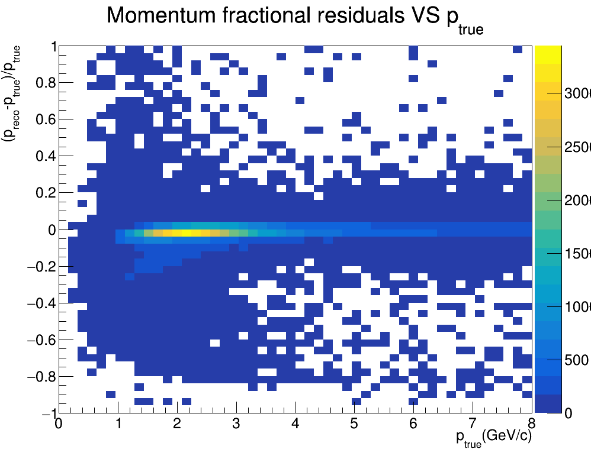
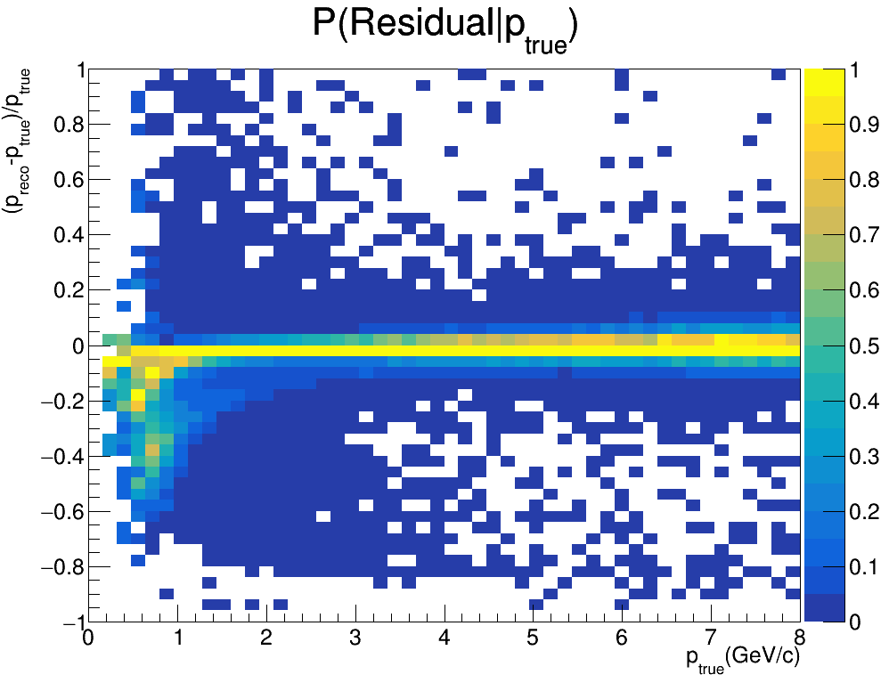
RESIDUALS FITTED WITH CAUCHY AND GAUSS
Note: The conditional probability plot is normalized so that for each column the maximum has the value 1 (i.e. these are not proper PDF’s)

Slide 6
RESIDUALS FITTED WITH CAUCHY AND GAUSS
Note: The conditional probability plot is normalized so that for each column the maximum has the value 1 (i.e. these are not proper PDF’s)
There are some noticible structures in the low true momentum region

Slide 7
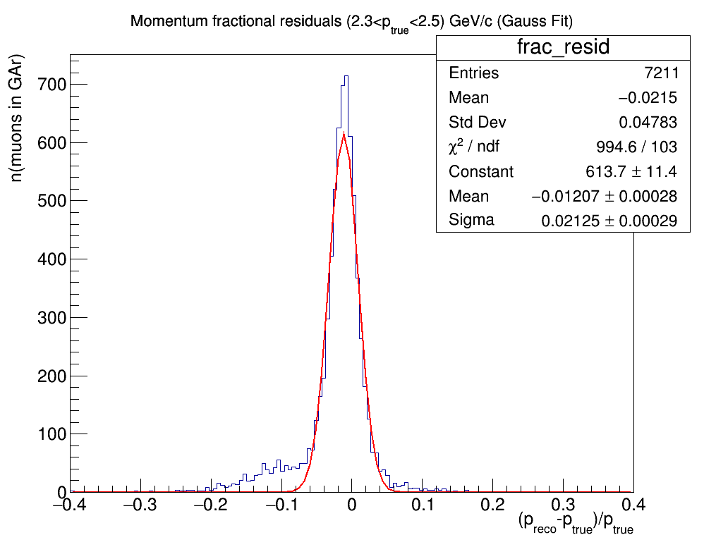
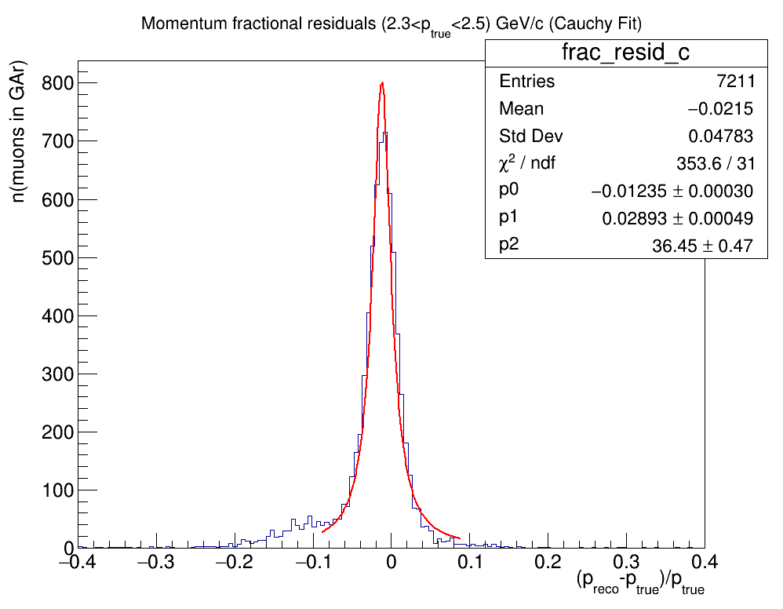
RESIDUALS FITTED WITH CAUCHY AND GAUSS
p_{true}= MC true momentum of muon entering the TPC
p_{reco}= reconstructed momentum of the matched track
n(muons in GAr)= number of matched tracks
Checked a limited range: (2.3<p_{true}<2.5)GeV

Slide 8
RESIDUALS FITTED WITH CAUCHY AND GAUSS
Need to investigate what is causing the residuals tail that is visible between -0.2 and -0.1

Slide 9
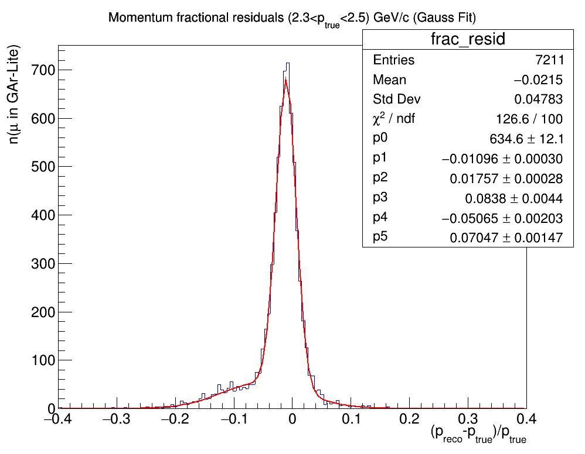

RESIDUALS FITTED WITH 2-Gaussian
We fit with a double Gaussian
The tail seem to be about 10%

Slide 10
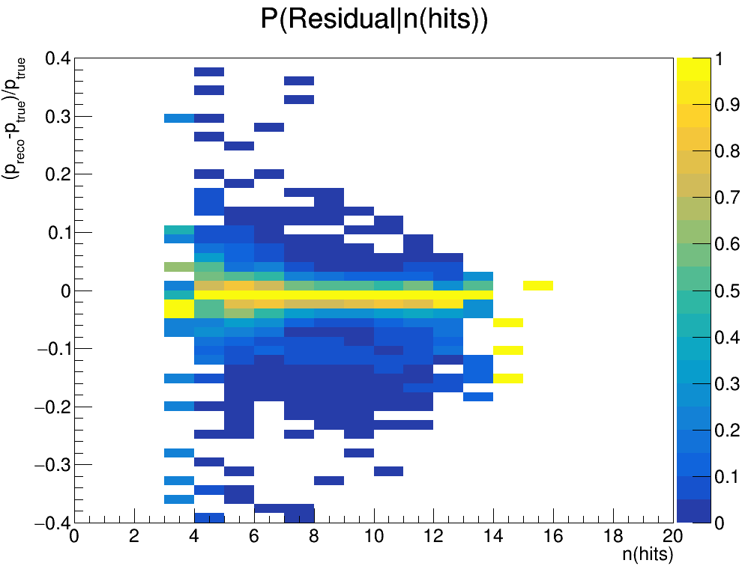
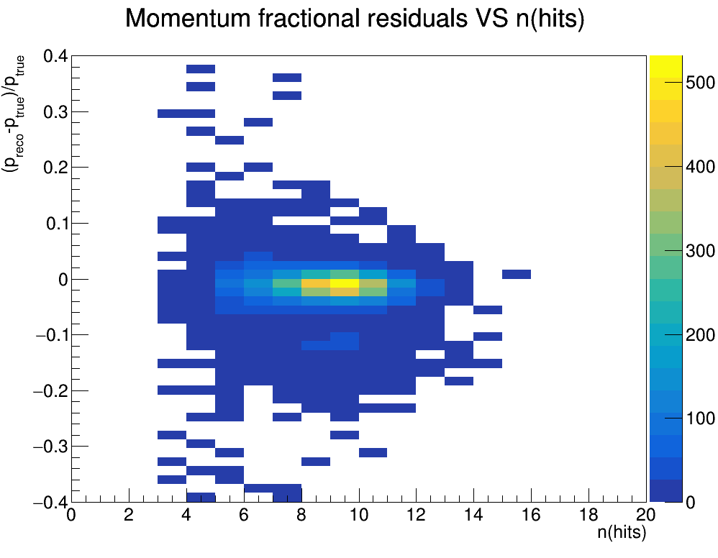
RESIDUALS vs n hits
First thing we checked was to look at Residuals VS nhits in the track to see if there was a correlation between the two quantities

Slide 11
Residuals vs nhits
First thing we checked was to look at Residuals VS nhits in the track to see if there was a correlation between the two quantities
The tail somewhat surprisingly seems to be constituted mostly of tracks with a large number of hits, especially 9 or 10

Slide 12
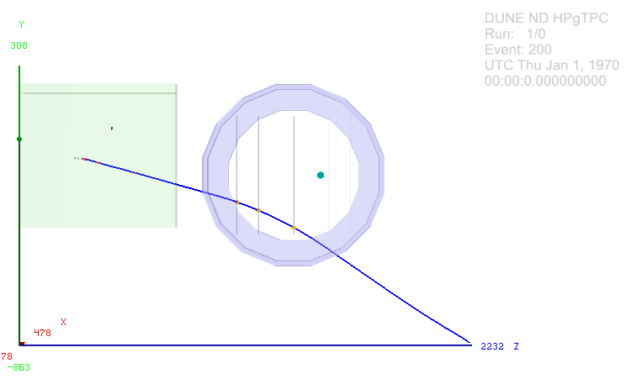
EVENT VIEWER
Looked at event viewers for events in a sample of 1000 that had Residuals < -0.1
Unfortunately these events seem to be fairly unremarkable at first glance

Slide 13
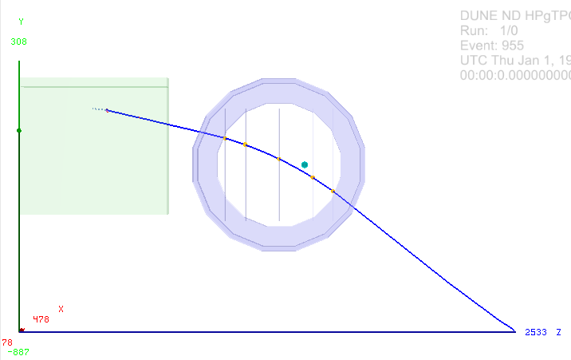
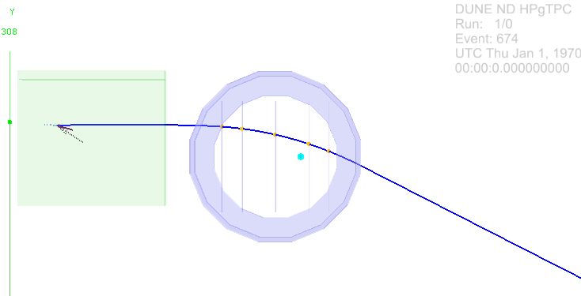
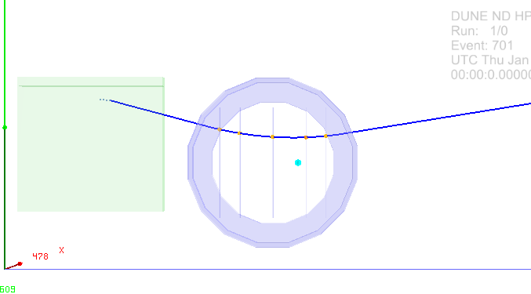
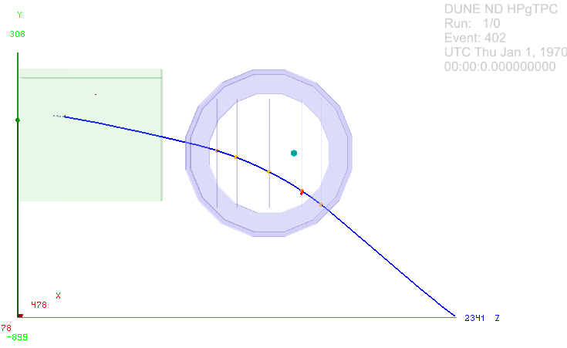
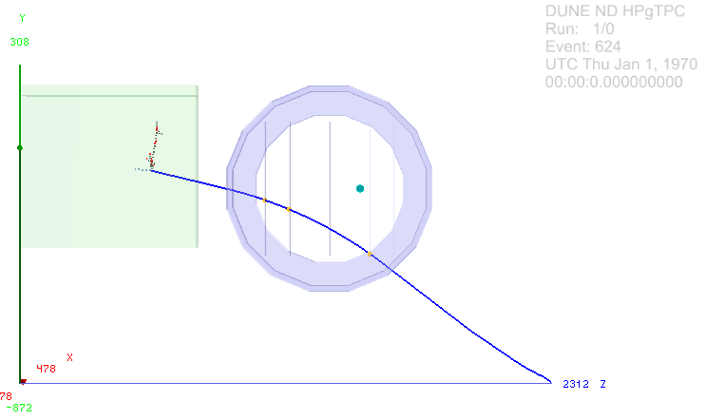
EVENT VIEWER

Slide 14
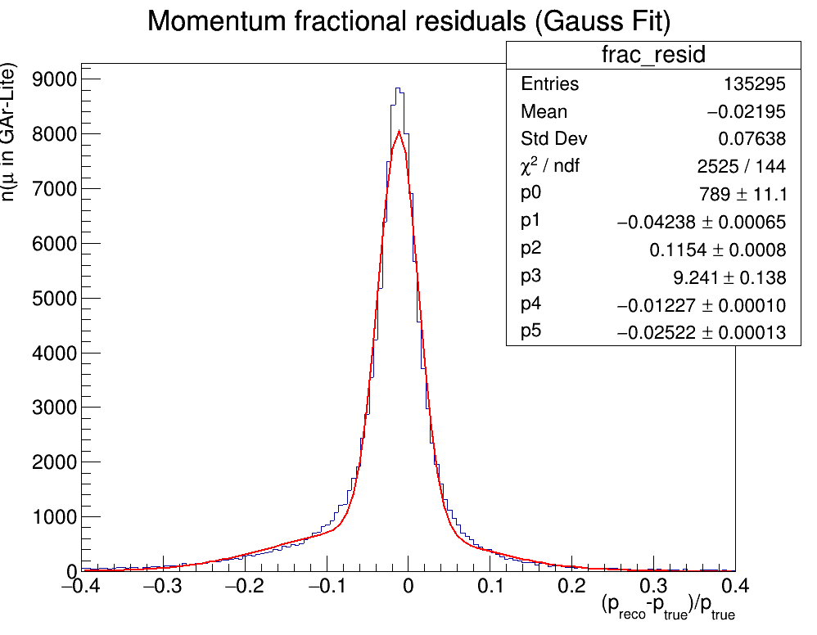
RESIDUALS FITTED WITH 2-Gaussian
We fit with a double Gaussian also to the full momentum spectrum
The tail seem to be about 10%

Slide 15
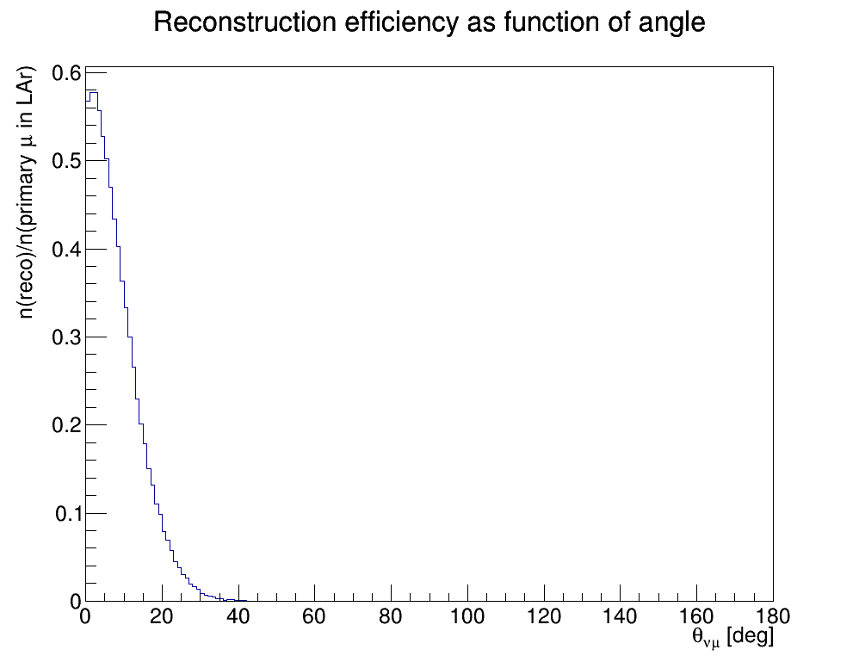
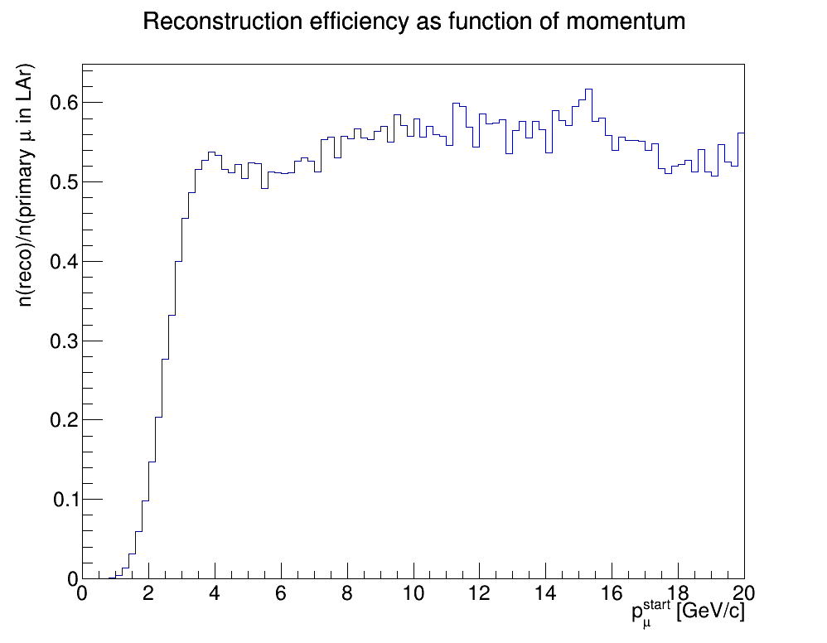
RECONSTRUCTION EFFICIENCY PRIM MUONS IN LAR
n(primary mu in LAr): primary muons produced in LAr
n(reco): matched track in the event
p_{μ}^{start}: true momentum at creation
θ_{νμ}: angle between μ and ν at creation

Slide 16
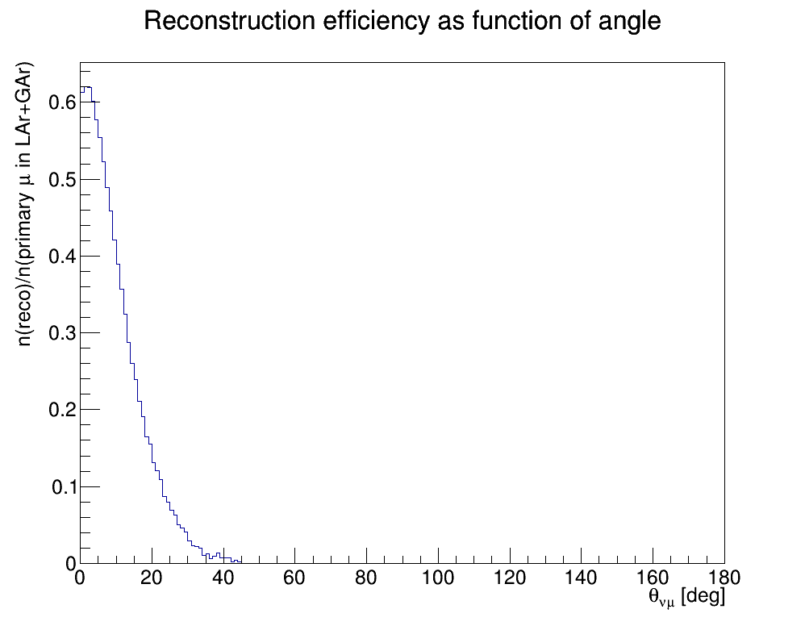
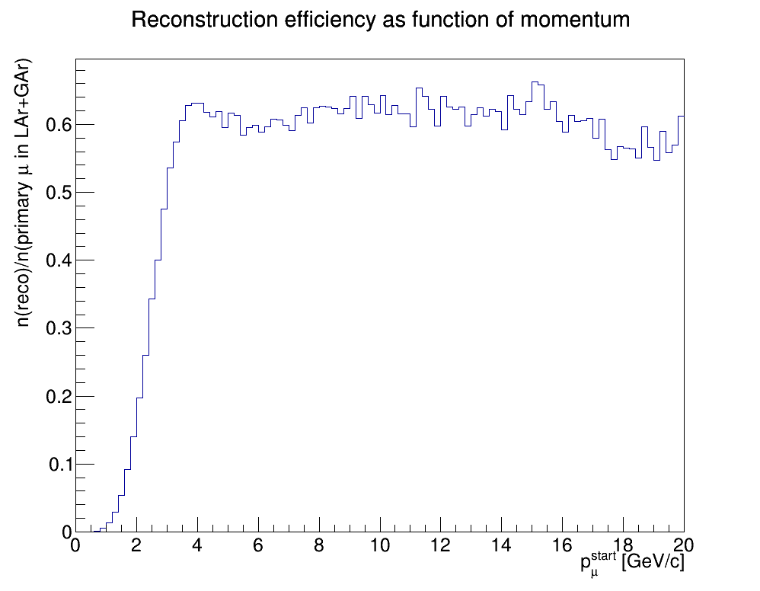
RECONSTRUCTION EFFICIENCY PRIM MUONS IN LAR+GAR
n(primary mu in LAr+GAr): primary muons produced in LAr having at least one traj point Gar
n(reco): matched track in the event
p_{μ}^{start}: true momentum of muon at creation
θ_{νμ}: angle between μ and ν at creation

Slide 17
Summary and future prospects
My new track matching algorithm, based on Leo Bellantoni’s, allowed me to start studying the performace of NDGAr-Lite in terms of:
Charge Resolution as a function of MC momentum (Very good over all the spectrum)
Momentum residuals VS True momentum distribution (Interesting features found in low momentum region)
Momentum residual distribution over the entire momentum range and in (2.3<p<2.5)GeV/c (Found a tale which needs to be investigated)
Find a preliminary efficiency distribution as function of angle and initial momentum at vertex (Possibly low due to inefficiencies in track matching)
Immidiate future steps:
Try to produce Reconstructed files which contain hit by hit information
Improve track matching
Add chi² to track fit
Possibly use a simple Kalman Filter in track fit

